Slide 1
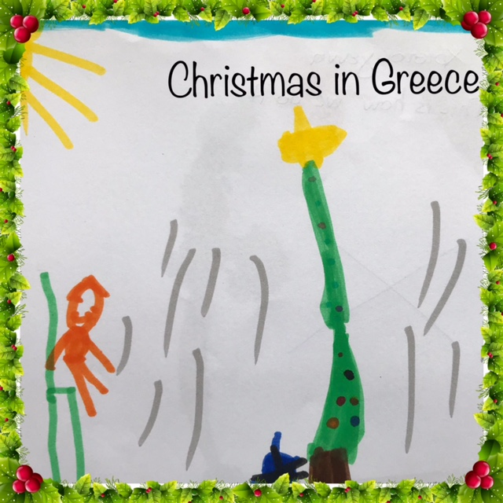
This is how we do it…

Slide 2
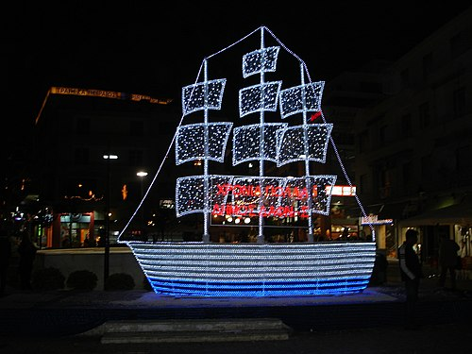
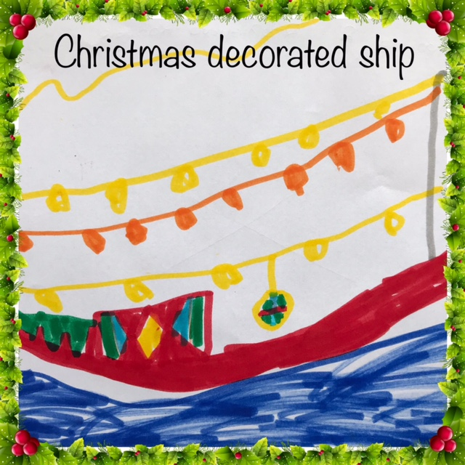
Once upon a time in Greece, during Christmas we used to decorate ships because we are a country surrounded by sea.

Slide 3
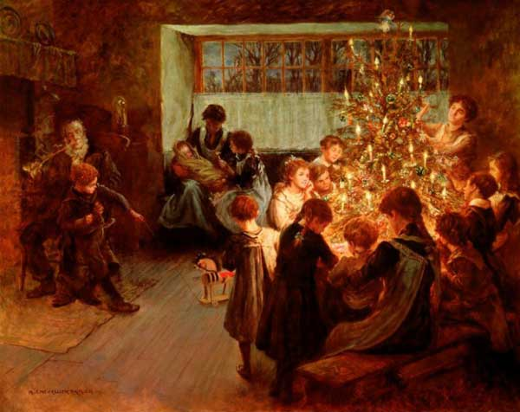
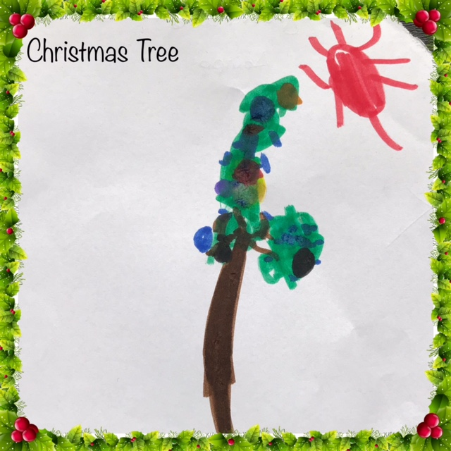
Later, we adopted the European custom of decorating the Christmas tree.

Slide 4
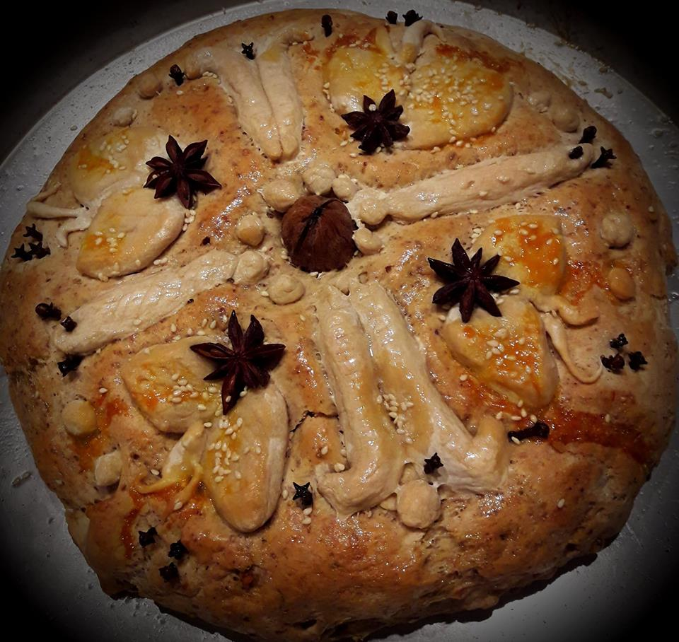
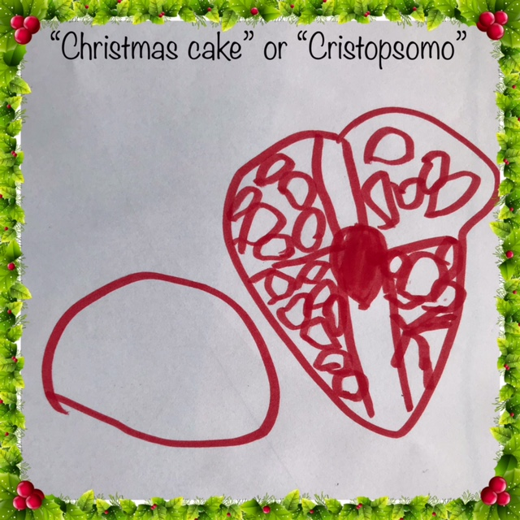
On Christmas Eve the housewife of the household makes some special bread called “Christmas cake” or “christipsomo” in Greek. On the bread there is a carved cross, a walnut in the middle and it is decorated with different kinds of designs or nuts.

Slide 5
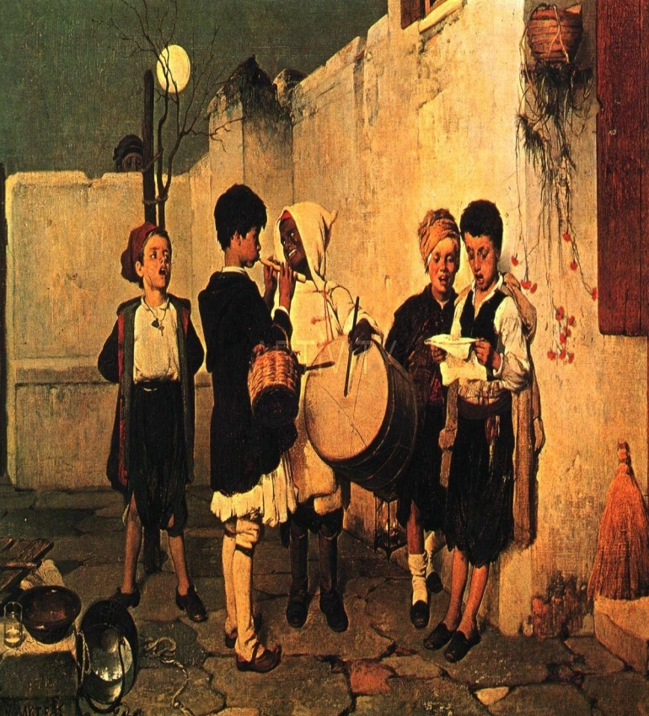
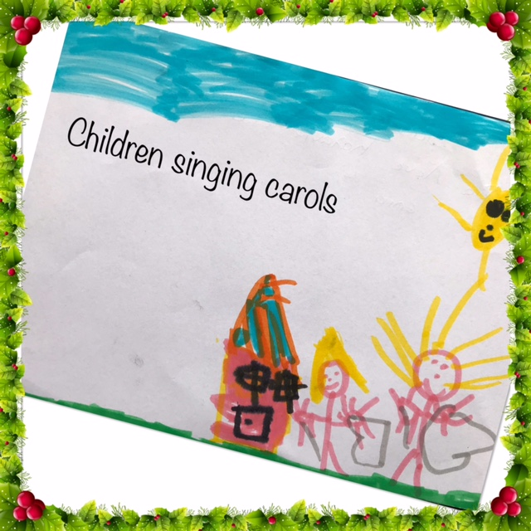
On Christmas and New Year’s Eve the Children travel from house to house and sing carols. In the past, the landlord of the house used to give them sweets as a treat but nowadays the children get money instead.

Slide 6
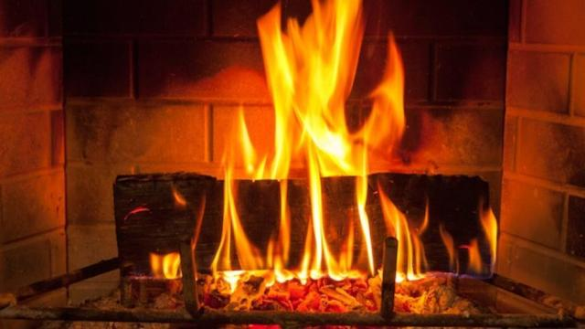
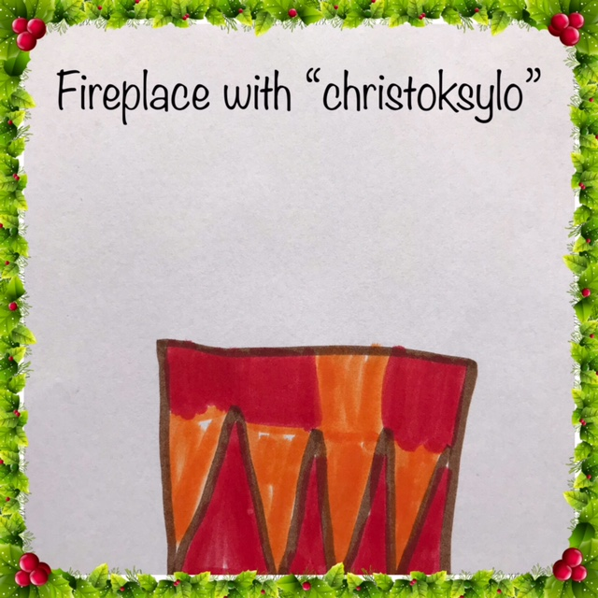
On Christmas Day, we light a piece of strong, thick wood from pine or olive, which is called “Cristoksylo” in greek…

Slide 7
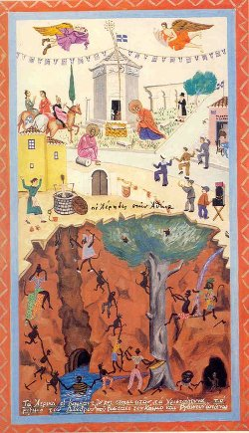
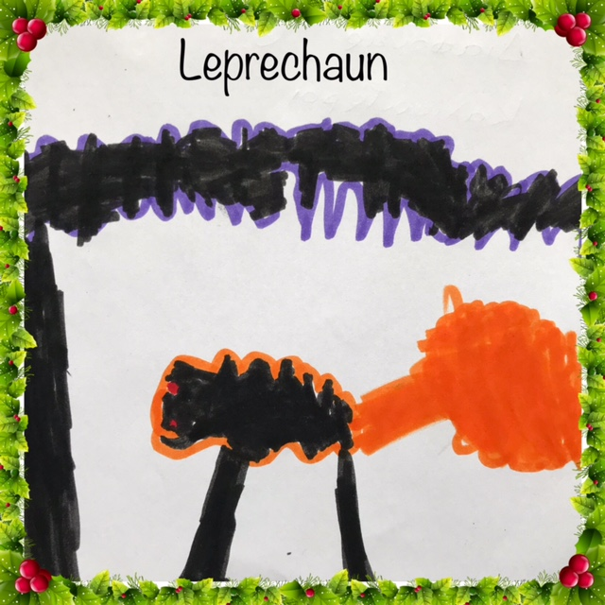
…It remains lit until Epiphany to keep leprechauns away.

Slide 8
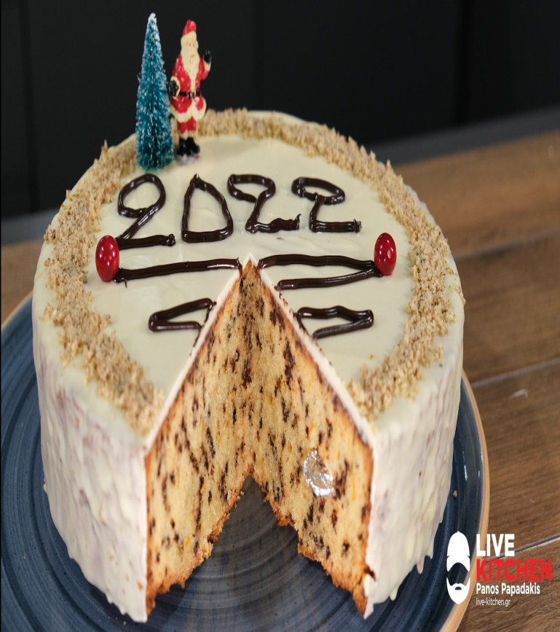
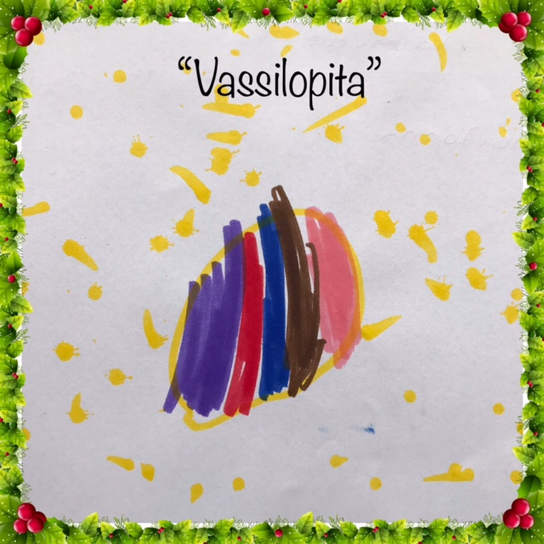
On New Years Eve we eat “Vasilopita”. ..

Slide 9
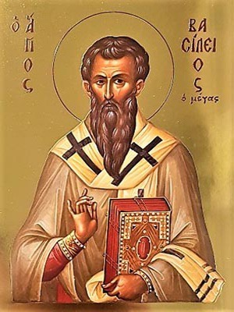
It is a custom that is connected to the celebration of “Saint Vasilios” from Caesarea in Cappadocia.

Slide 10
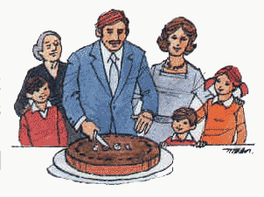
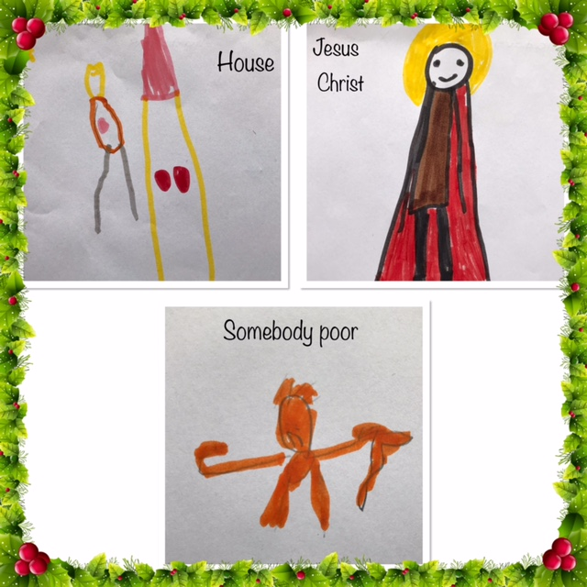
Before we cut it, we cross it. The first three pieces are for Jesus Christ, one for somebody poor and one for the house. After that we cut one piece for each member of the family.

Slide 11
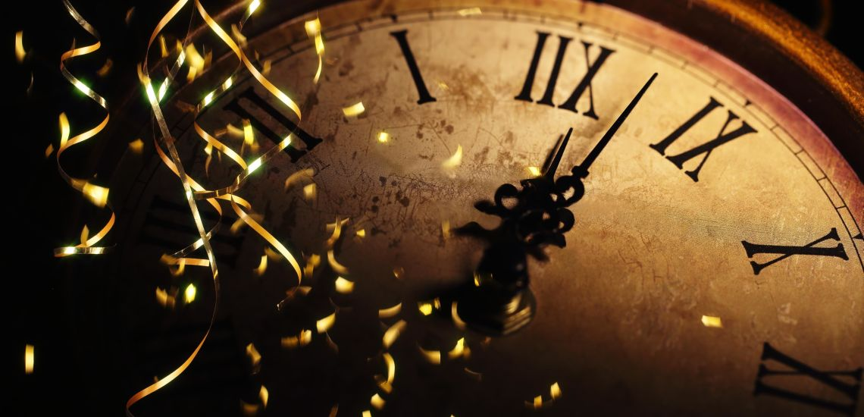
When the year is about to change, we turn off the lights 10 seconds before the coming of the New Year and we count down…

Slide 12
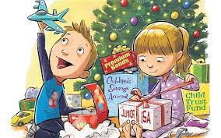
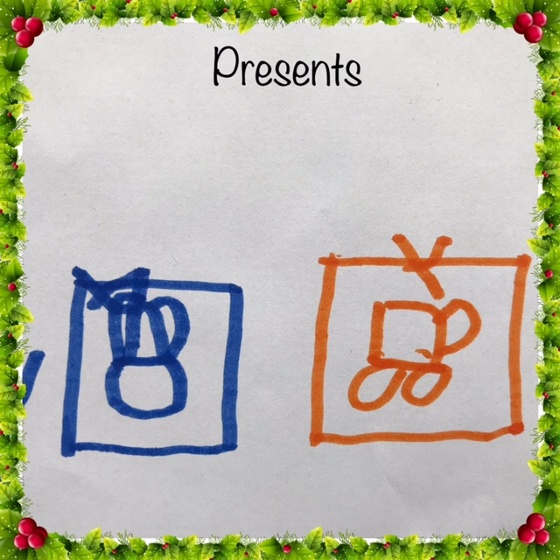
…After wishing “Happy New Year” we open our presents.

Slide 13
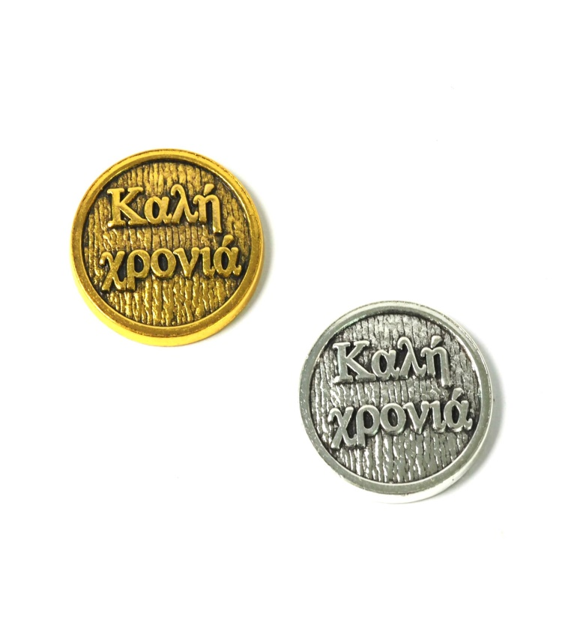
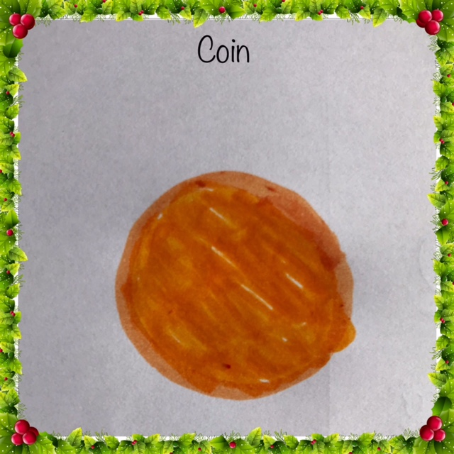
In “Vasilopita”, a coin is hidden. Those who will find it, he/she will have good fortune throughout the coming year.

Slide 14
In the morning of New Year, we go to the church and when we come back, the one who gets in first, he/she must enter with the right foot for good luck holding a pomegranate. He/she drops the pomegranate which breaks into pieces and at the same time he/she wishes “health, happiness, and joy for the new year and may you have as many pennies as the pieces of the pomegranate”…

Slide 15
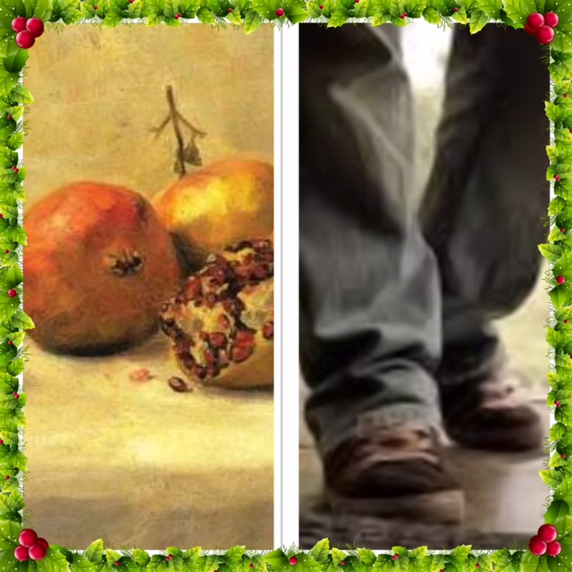
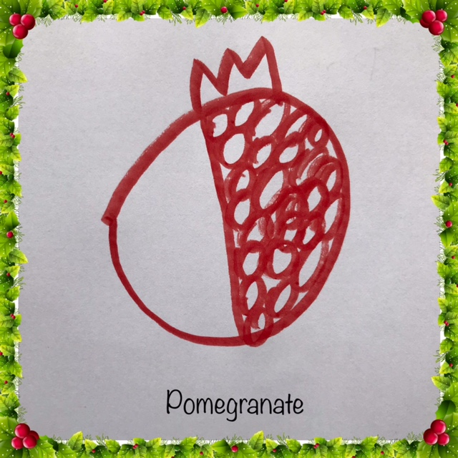
…

Slide 16
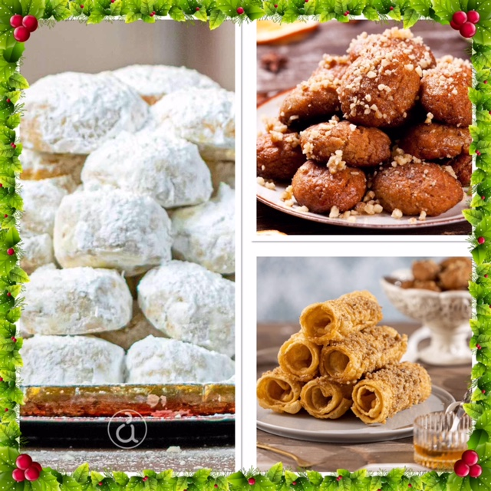
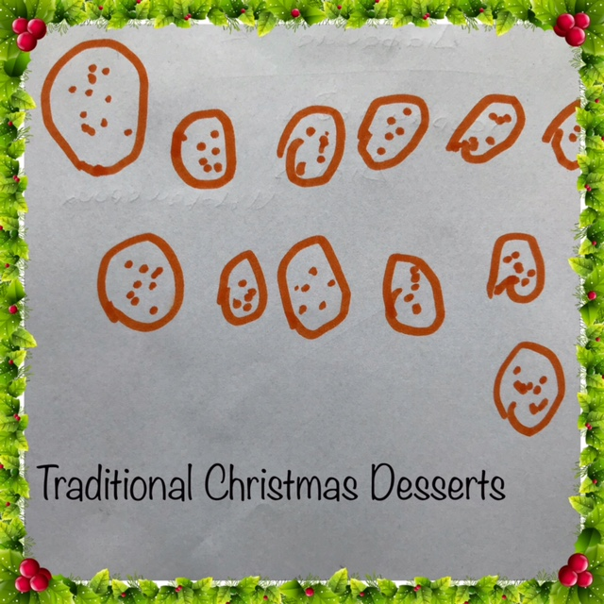
The sweets we eat during the festivities are greek such as “kourabiedes”, “diples” and “melomakarona”

Slide 17

Some information about our country…

Slide 18
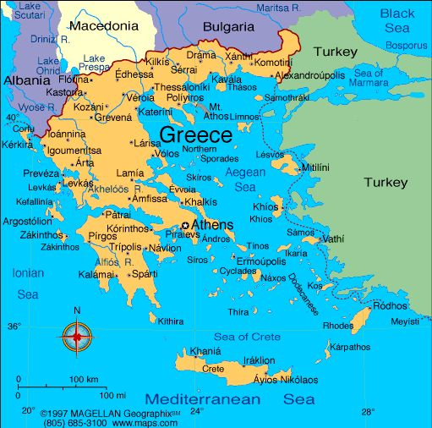
Greece is situated in the South of Europe.

Slide 19
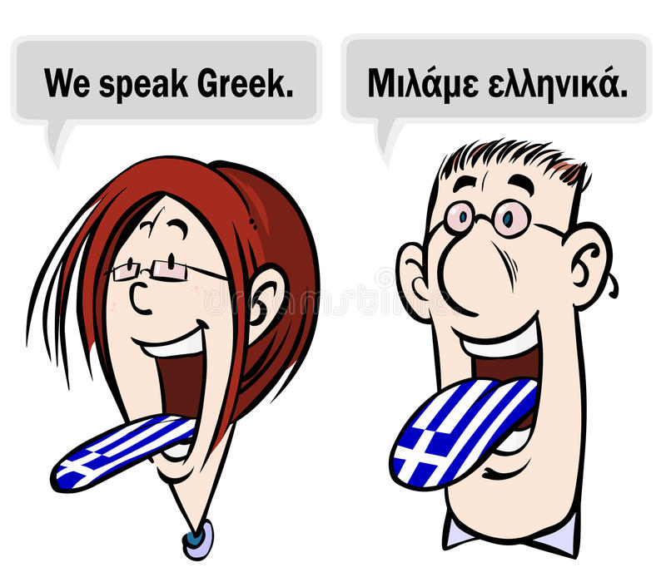
We all speak greek.

Slide 20
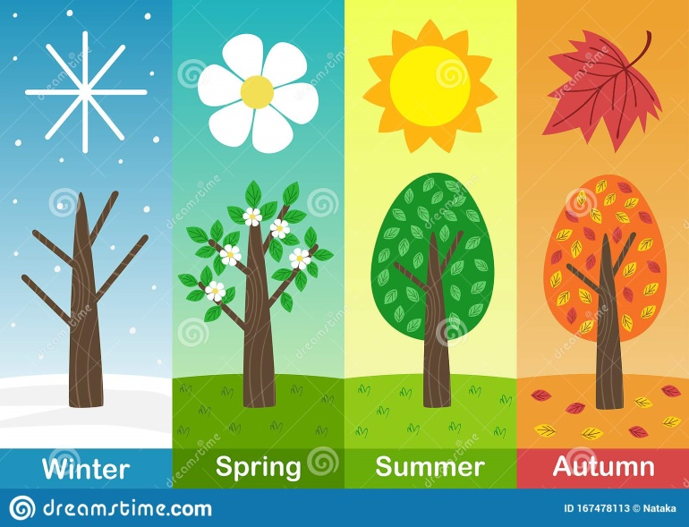
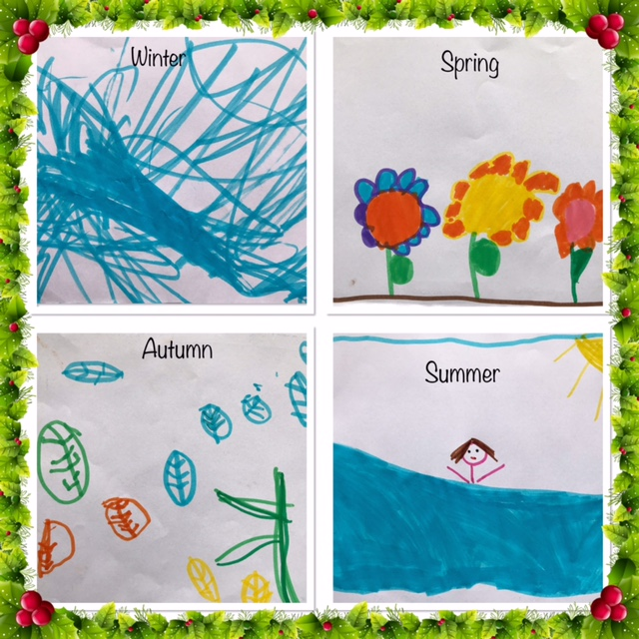
In spring and summer ,the weather is really hot since we are a country with sunshine. In autumn and winter it’s cold.

Slide 21
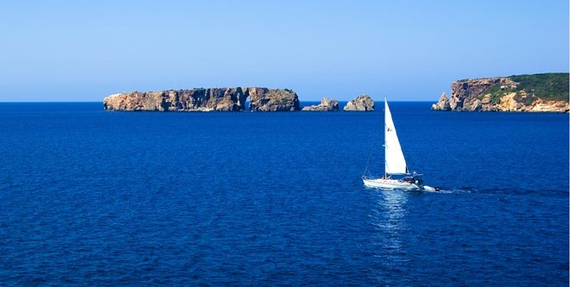
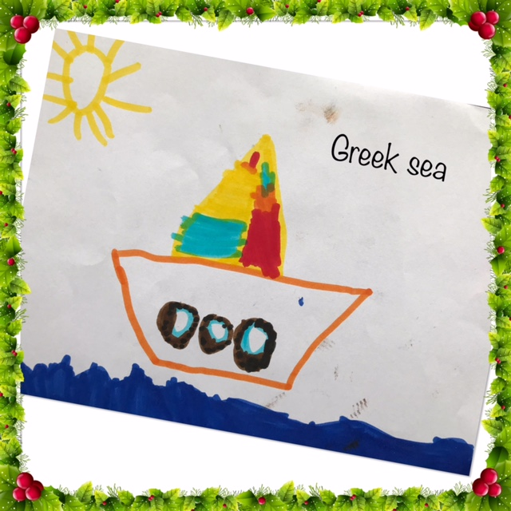
We are well known for the sea which surrounds our country…

Slide 22
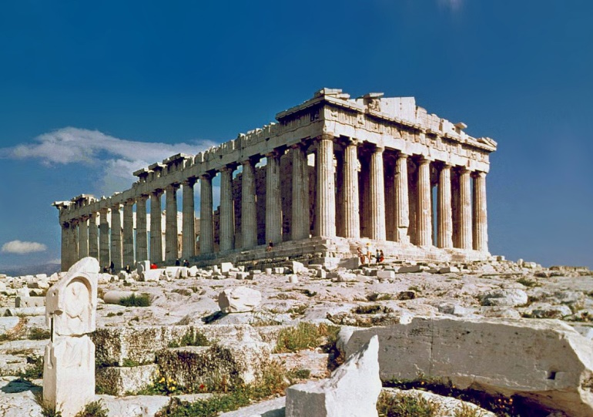
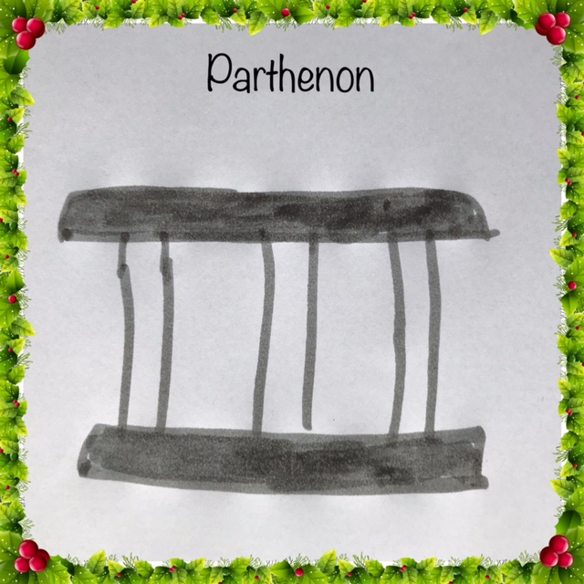
…and for our ancient greek civilization.

Slide 23
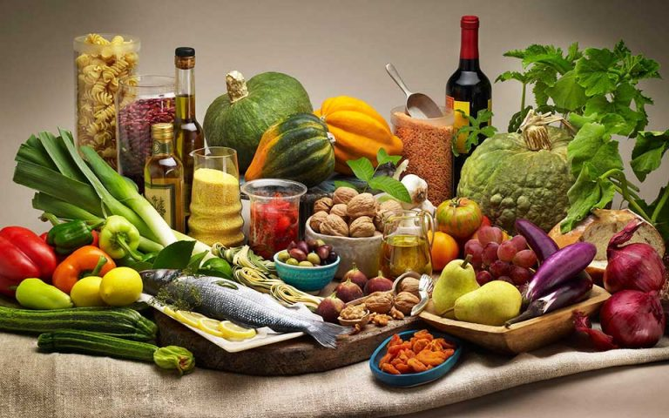
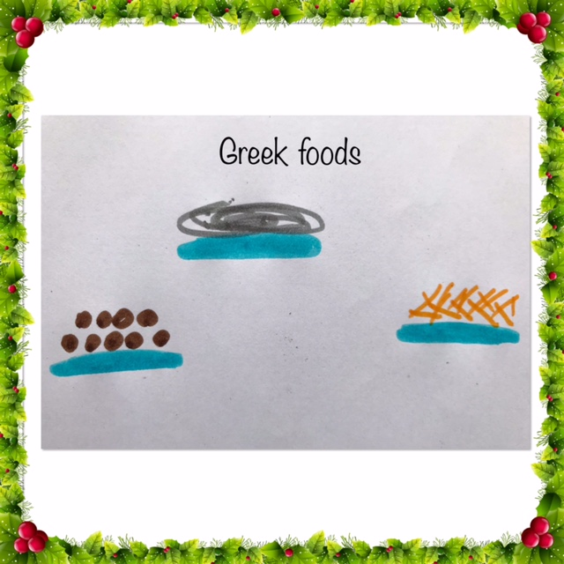
Our diet is the Mediterranean Diet…

Slide 24
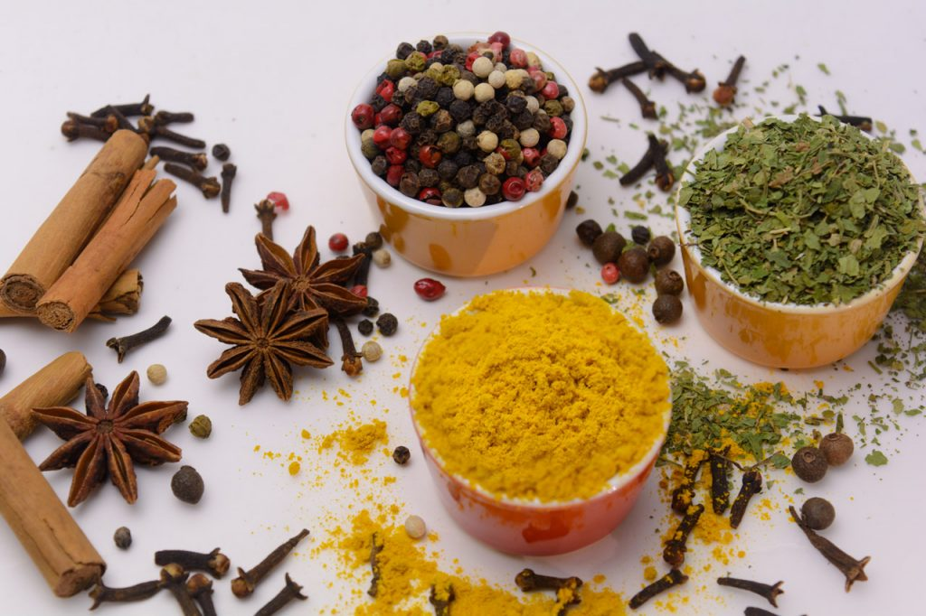
…and we use a lot of spices.

Slide 25
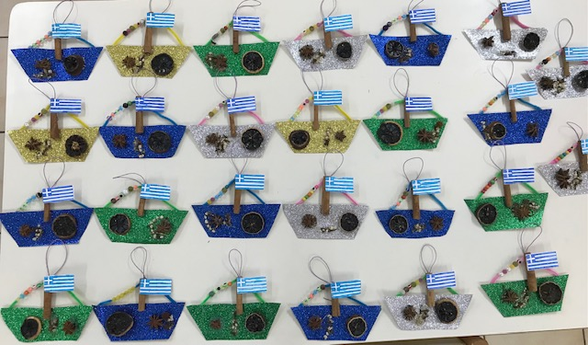
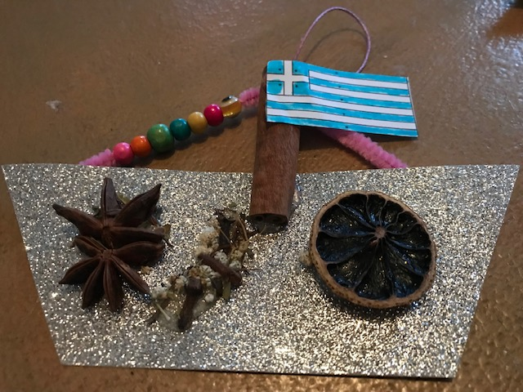
That’s why, as Christmas ornaments, we chose to make and sent you small Greek ships made of spices we use in our diet.

Slide 26
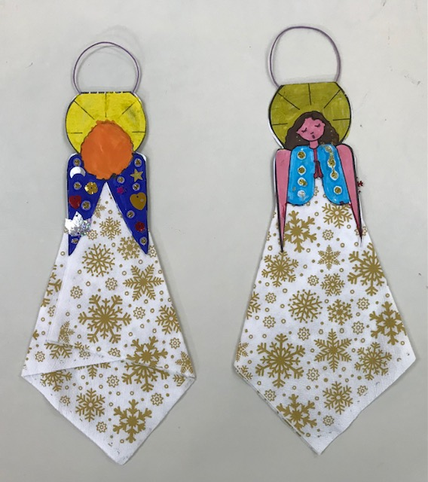
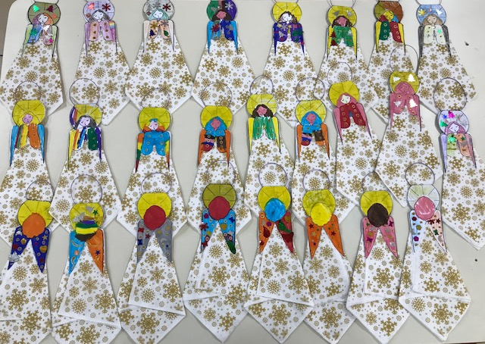
We are also sending you an angel to protect all the students in your school.

Slide 27
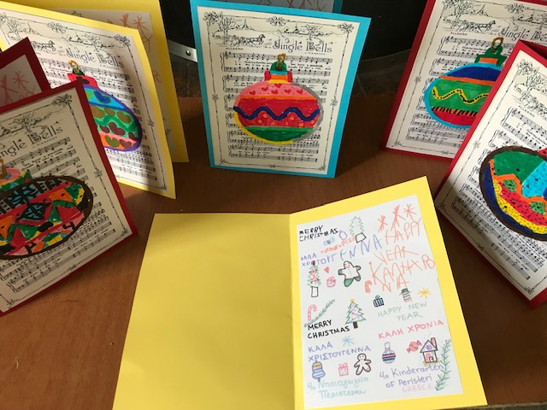
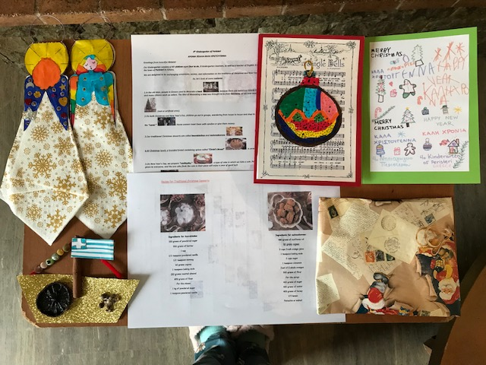
Even though we are little ones and we are now learning the greek alphabet, we have tried to write some wishes to the Christmas card we’ve sent you.

Slide 28
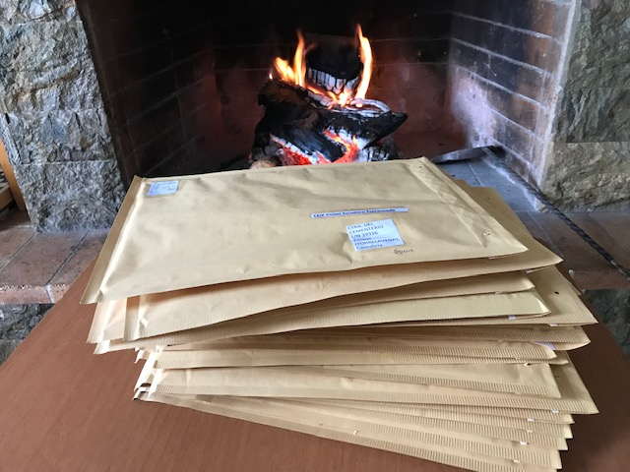
We hope that you’ll like our creations. We made them with love and enthusiasm.

Slide 29
Greek Carols
Christmas Carols
https://www.youtube.com/watch?v=rTrUJh7Wy7w
New Years Eve Carols
https://www.youtube.com/watch?v=ru02M_Nm_jk

Slide 30
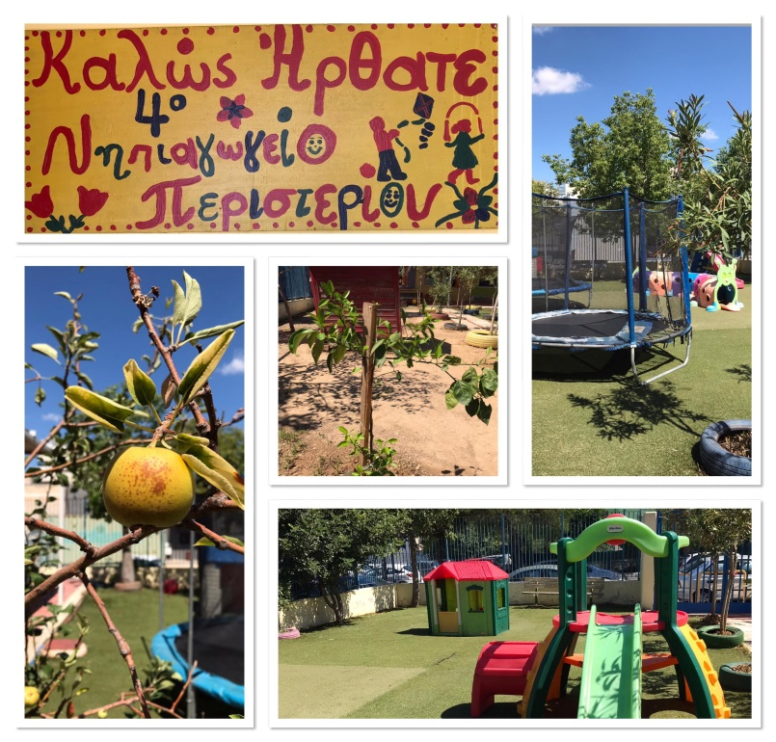
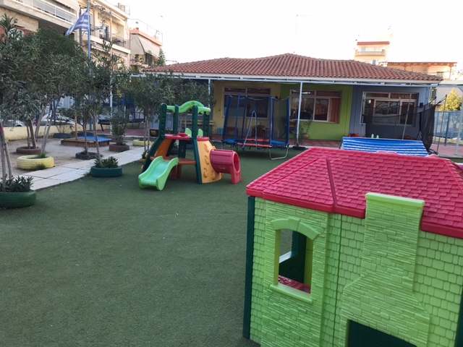
Merry Christmas and a Happy New Year full of joy for every child in the world!
With love, the students and teachers of 4th Kindergarten Of Peristeri (Greece)

