Slide 1
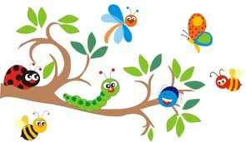
WELCOME TO BUGS WORLD
Who’s this? This is…

Slide 2
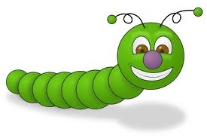
Who’s this?
This is Colin.
Colin is a caterpillar

Slide 3

Who’s this?
This is Ann.
Ann is a ladybug.

Slide 4

Who’s this?
This is Pat.
Pat is a bee.

Slide 5
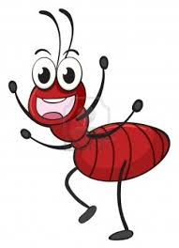
Who’s this?
This is Buu.
Buu is an ant.

Slide 6
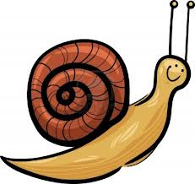
Who’s this?
This is JJ .
JJ is a snail.

Slide 7

Who’s this?
This is Sam.
Sam is a beetle.

Slide 8
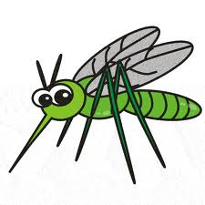
Who’s this?
This is Tony.
Tony is a mosquito.

Slide 9
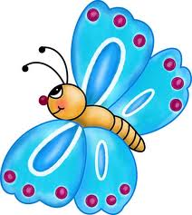
Who’s this?
This is Fifi.
Fifi is a butterfly.

Slide 10
What’s this? speaking

Slide 11
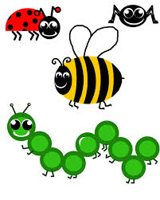
Goodbye
copyright @ Małgorzata Szewczyk-Walczak hometeaching 2013

