Slide 1
Teacher’s final survey
Little hands
Mega structures

Slide 2
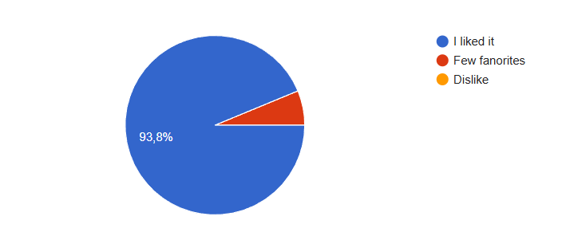
How much you liked the program?

Slide 3
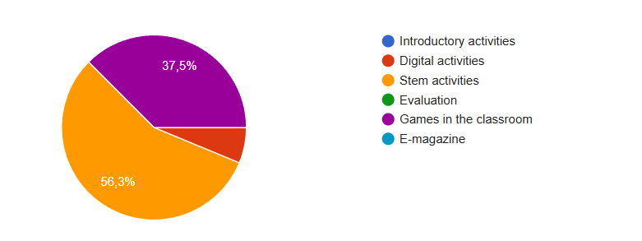
Which part did you like most?

Slide 4
If you could, what would you change about the program?
The duration and the deadlines (1 month per block)
Nothing, everything was perfect.
Make it easier for students. (Children's participation was low at the structure)
Increasing the diversity in the preparation of digital games

Slide 5
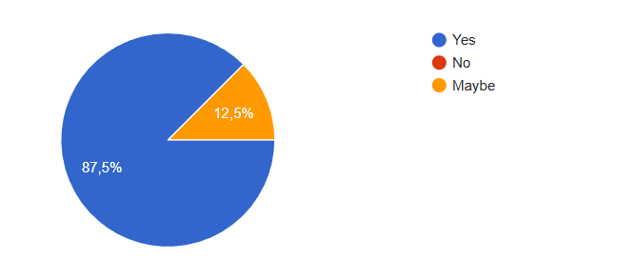
Was the program suitable for the children in your class?

Slide 6
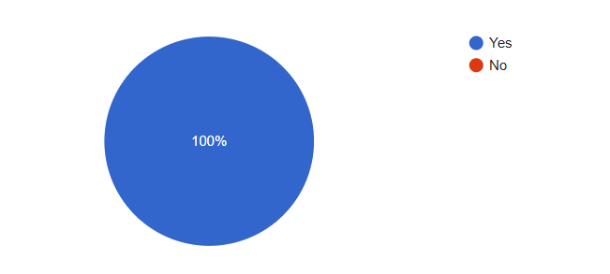
Have you had the opportunity to exchange good practice with other teachers?

Slide 7
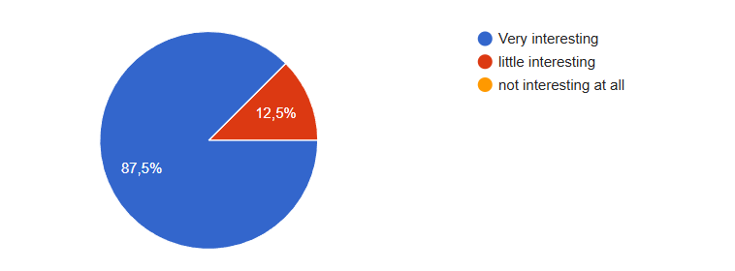
How interesting and high quality was the educational material used in the program?

Slide 8
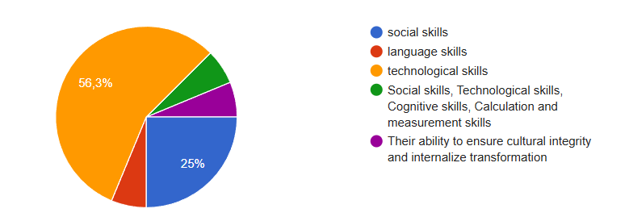
What skills or knowledge did your students develop during the program?

