Slide 1
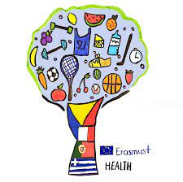
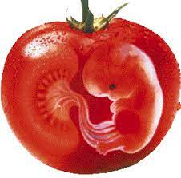
genetically modified food
4th Primary School of Sykies
By Apostolos Rafael

Slide 2
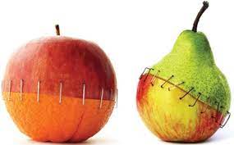
SOME USEFUL INFO
GMO foods, known as genetically modified foods or biologically processed foods, are foods produced by organisms that have undergone changes in their DNA using genetic engineering methods. Genetic engineering techniques allow the introduction of new traits as well as greater control of traits by previous methods such as selective crossbreeding and mutagenesis, where an organism is exposed to radioactivity or chemicals to create a non-specific but permanent change.
The commercial sale of genetically modified foods began in 1994, when Calgene first promoted the unsuccessful Flavr Savr tomato with slow ripening.

Slide 3
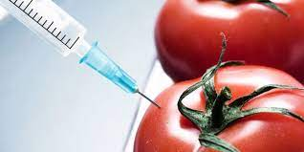
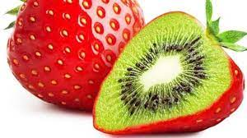
Products that usually being modified
Most food modifications focused mainly on high-demand crops such as soybeans, corn, canola and cotton. Genetically modified crops are designed for resistance to pathogens and herbicides and for better nutrient profiles.

Slide 4
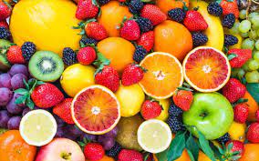
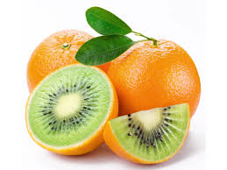
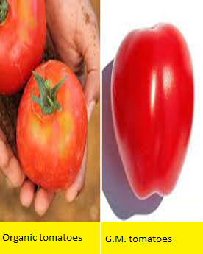
BASIC DIFFERENCES
Organic products are the result of cultivating the land without chemical fertilizers, toxic pesticides and pesticides, while the control of plant diseases, as well as soil fertilization are done by natural methods.
The cultivation of organic products is based on the knowledge of the traditional farmer and the search of science for healthy solutions. Organic products contain 20% -30% less water in their composition, higher percentages of proteins, minerals, enzymes and vitamins.
Genetically modified foods are spreading more and more, without seeming to harm our health. The methods of genetic engineering today allow the modification of the genetic code found in the DNA of cells.
These modifications are achieved by gene transfer and can be made in plant and animal organisms, fish and bacteria.

Slide 5
GMO foods VS Organic foods
healthy
the most healthy
Modified products while tastier than organic are more unhealthy. Also in the modified products we have the ability to introduce specific changes and so we can mix one product with another.
Organic products of plant origin are divided into two categories, organic products in transition and organic products. The difference is that the former are produced in "converted" fields, as they are called, where the principles of organic farming are applied for a period of at least one year and ensure that pesticides or their residues are absent from the final products.

Slide 6
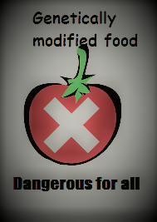
The result …

