Slide 1
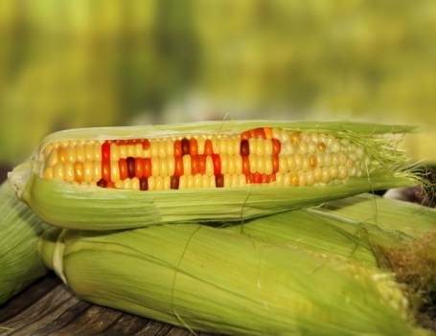
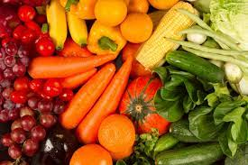
GMO FOODS VS ORGANIC FOODS
from the 4th elementary school of Sykies
HEALTHY PLATE
By Danai Papadopoulou

Slide 2
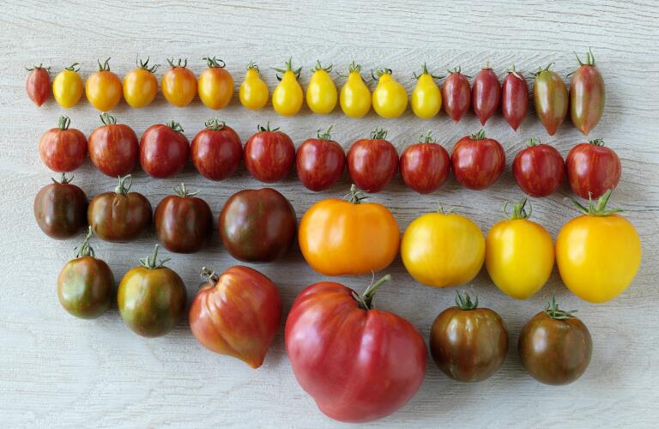
GMO FOODS
Genetically modified foods, known as genetically modified foods or biologically processed foods, are foods produced by organisms that have undergone changes in their DNA using the methods of genetic engineering.

Slide 3
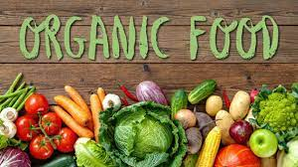
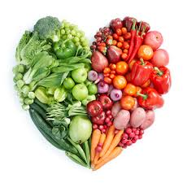
ORGANIC FOODS
Organic food is food produced by methods complying with the standards of organic farming. Standards vary worldwide, but organic farming features practices that cycle resources, promote ecological balance, and conserve biodiversity. Organizations regulating organic products may restrict the use of certain pesticides and fertilizers in the farming methods used to produce such products. Organic foods typically are not processed using irradiation, industrial solvents, or synthetic food additives.

Slide 4
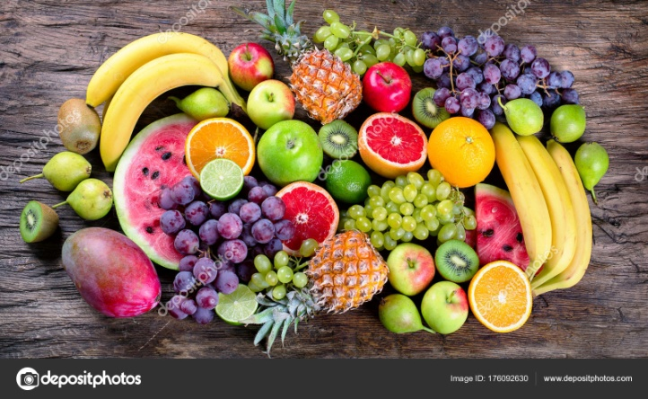
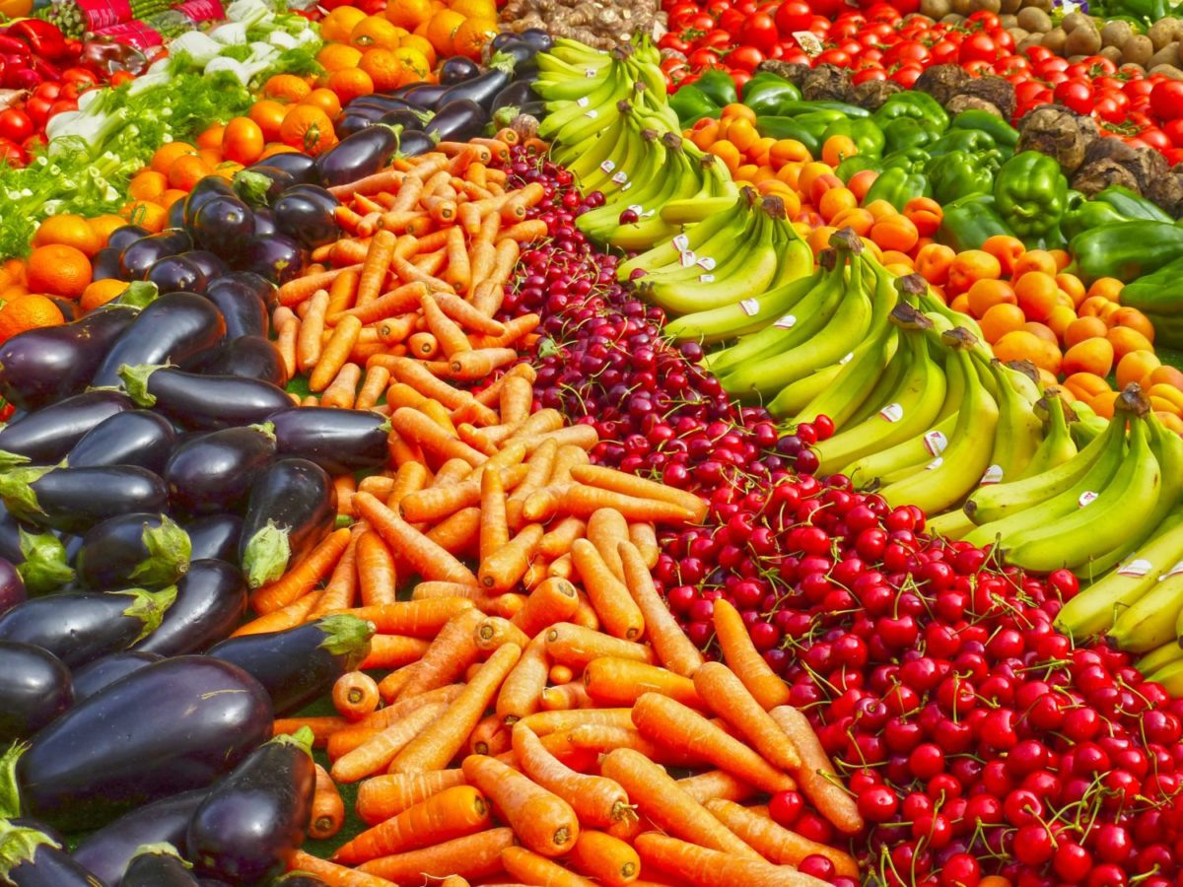
Comparison
In my opinion as we all prefer organic fruits because they grow and grow with nature while the others do not.

