Slide 1
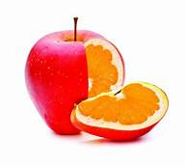
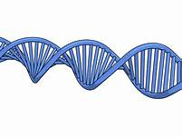
GENETICALY MODIFIED FOODS MYTHS AND TRUTHS
THIS IS A PRESENTATION OF OUR TEAM WORK AND RESEARCH ABOUT GENETICALLY MODIFIED FOOD
ST’1 CLASS
4TH PRIMARY SCHOOL OF SYKIES
THESSALONIKI, GREECE

Slide 2
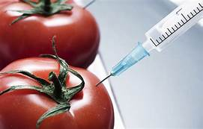
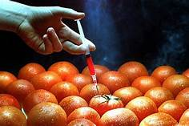
OUR RESEARCH
Our first step was to get informed about the definition of the term “Genetically Modified Foods”. After that, we watched a video, we discussed in the classroom and we tried to collect information about this term
Secondly, we discussed about the term “ORGANIC FOOD” and after a long research, we tried to found the differences between GM Food and OF
Then, we drew some paintings that present some Genetically Modified fruits and vegetables in comparison with some Organic fruits and vegetables
After that, we tried to find which products are mostly GM
In the end, we worked in teams and tried to find the PROS and CONS about GM Foods

Slide 3
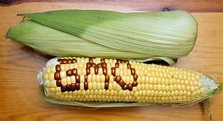
DEFINITION OF GENETICALLY MODIFIED FOODS
Genetically modified foods (GM foods), also known as genetically engineered foods (GE foods), or bioengineered foods are foods produced from organisms that have had changes introduced into their DNA using the methods of genetic engineering. Genetic engineering techniques allow for the introduction of new traits as well as greater control over traits when compared to previous methods, such as selective breeding and mutation breeding.

Slide 4
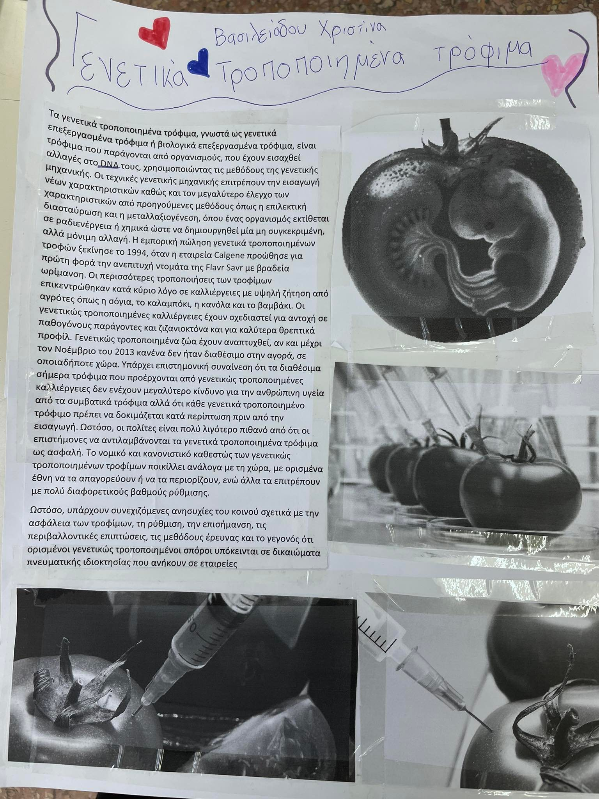
DEFINITION OF GENETICALLY MODIFIED FOODS

Slide 5
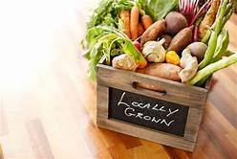
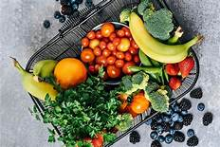
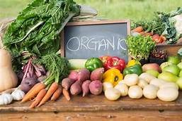
DEFINITION OF ORGANIC FOOD
Organic food is food produced by methods complying with the standards of organic farming. Standards vary worldwide, but organic farming features practices that cycle resources, promote ecological balance, and conserve biodiversity. Organizations regulating organic products may restrict the use of certain pesticides and fertilizers in the farming methods used to produce such products. Organic foods typically are not processed using irradiation, industrial solvents, or synthetic food additives.

Slide 6
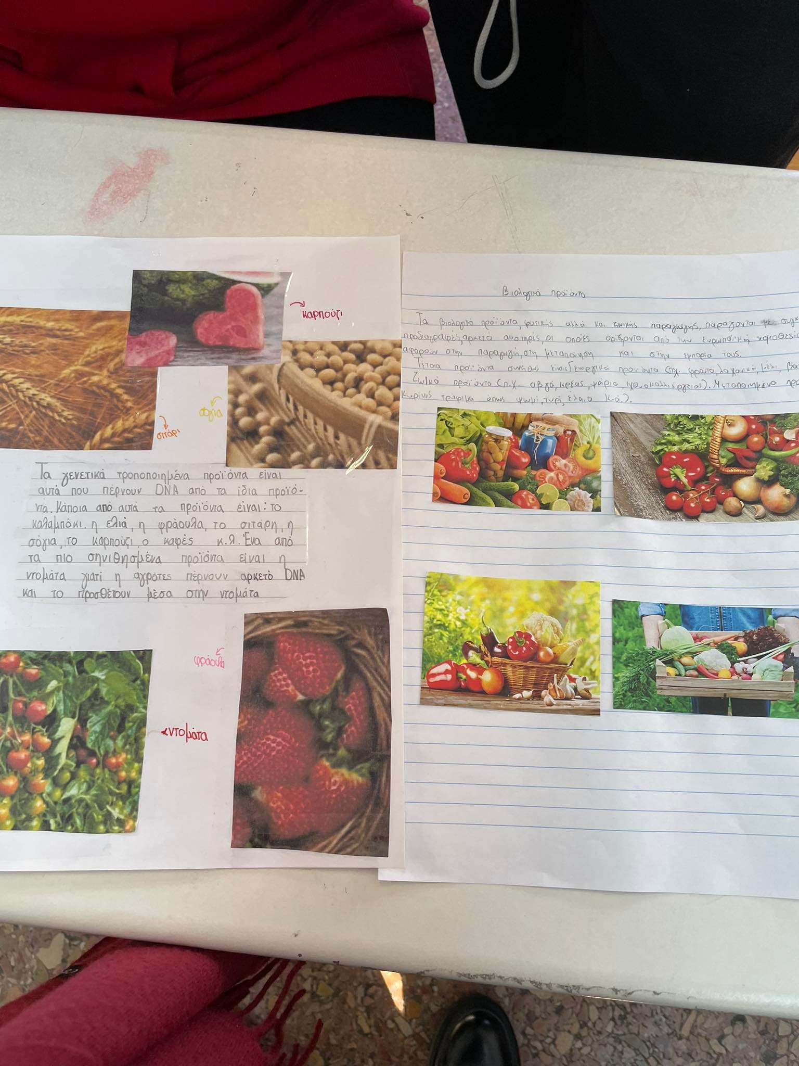
DEFINITION OF ORGANIC FOOD

Slide 7
DIFFERENCES BETWEEN GM FOODS AND ORGANIC FOOD (DRAWINGS)

Slide 8
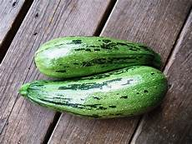
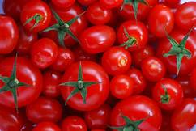
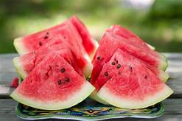
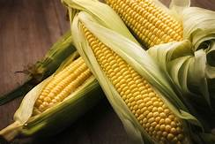
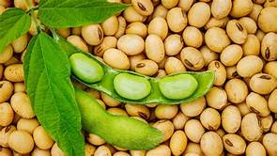
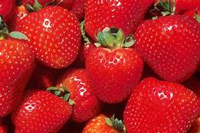
PRODUCTS THAT ARE MOSTLY GENETICALLY MODIFIED
Strawberries
Corn
Soy
Zucchini
Canola
Apples
Watermelon
Coffee

Slide 9
PRODUCTS THAT ARE MOSTLY GENETICALLY MODIFIED

Slide 10
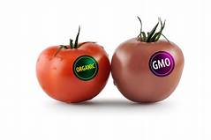
PROS ABOUT GENETICALLY MODIFIED FOODS
They offer better overall quality and taste. By modifying food, its flavors can be enhanced. For instance, corn can become sweeter and pepper can become spicier. In fact, it can make difficult flavors become more palatable.
They come with lowered the risk of crop failure. Seeds are being genetically altered for many reasons, including improved resistance to insects and better crop health. Genetically modified crops can also better resist extreme weather conditions. All these things mean lower risk of crop failure.
They are more resistant to disease. Plants and animals that have been genetically modified for food can have better resistance to unexpected diseases. Like a vaccine, genetic enhancements are encoded into them to strengthen their immune system.
They have longer shelf life. Typically, genetically modified foods have a longer shelf life than their traditional counterparts, which means that they can be safely transported to far-away regions that have no to nutritious food without the worry of them getting spoiled.

Slide 11
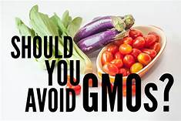
CONS ABOUT GENETICALLY MODIFIED FOODS
They can pose significant allergy risks. Genetic enhancements would often combine proteins that are not originally there in the organism, which can cause allergic reactions for people. In fact, GMOs were found to have caused an increase in allergic reactions in the general population.
They have lowered resistance to antibiotics. Some genetically modified foods have built-in antibiotic qualities that boost immunity, but when they are consumed, the effectiveness would be lessened, unlike actual antibiotics.

Slide 13
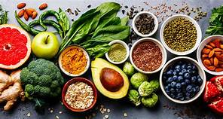
THANK YOU FOR WATCHING

