Slide 1
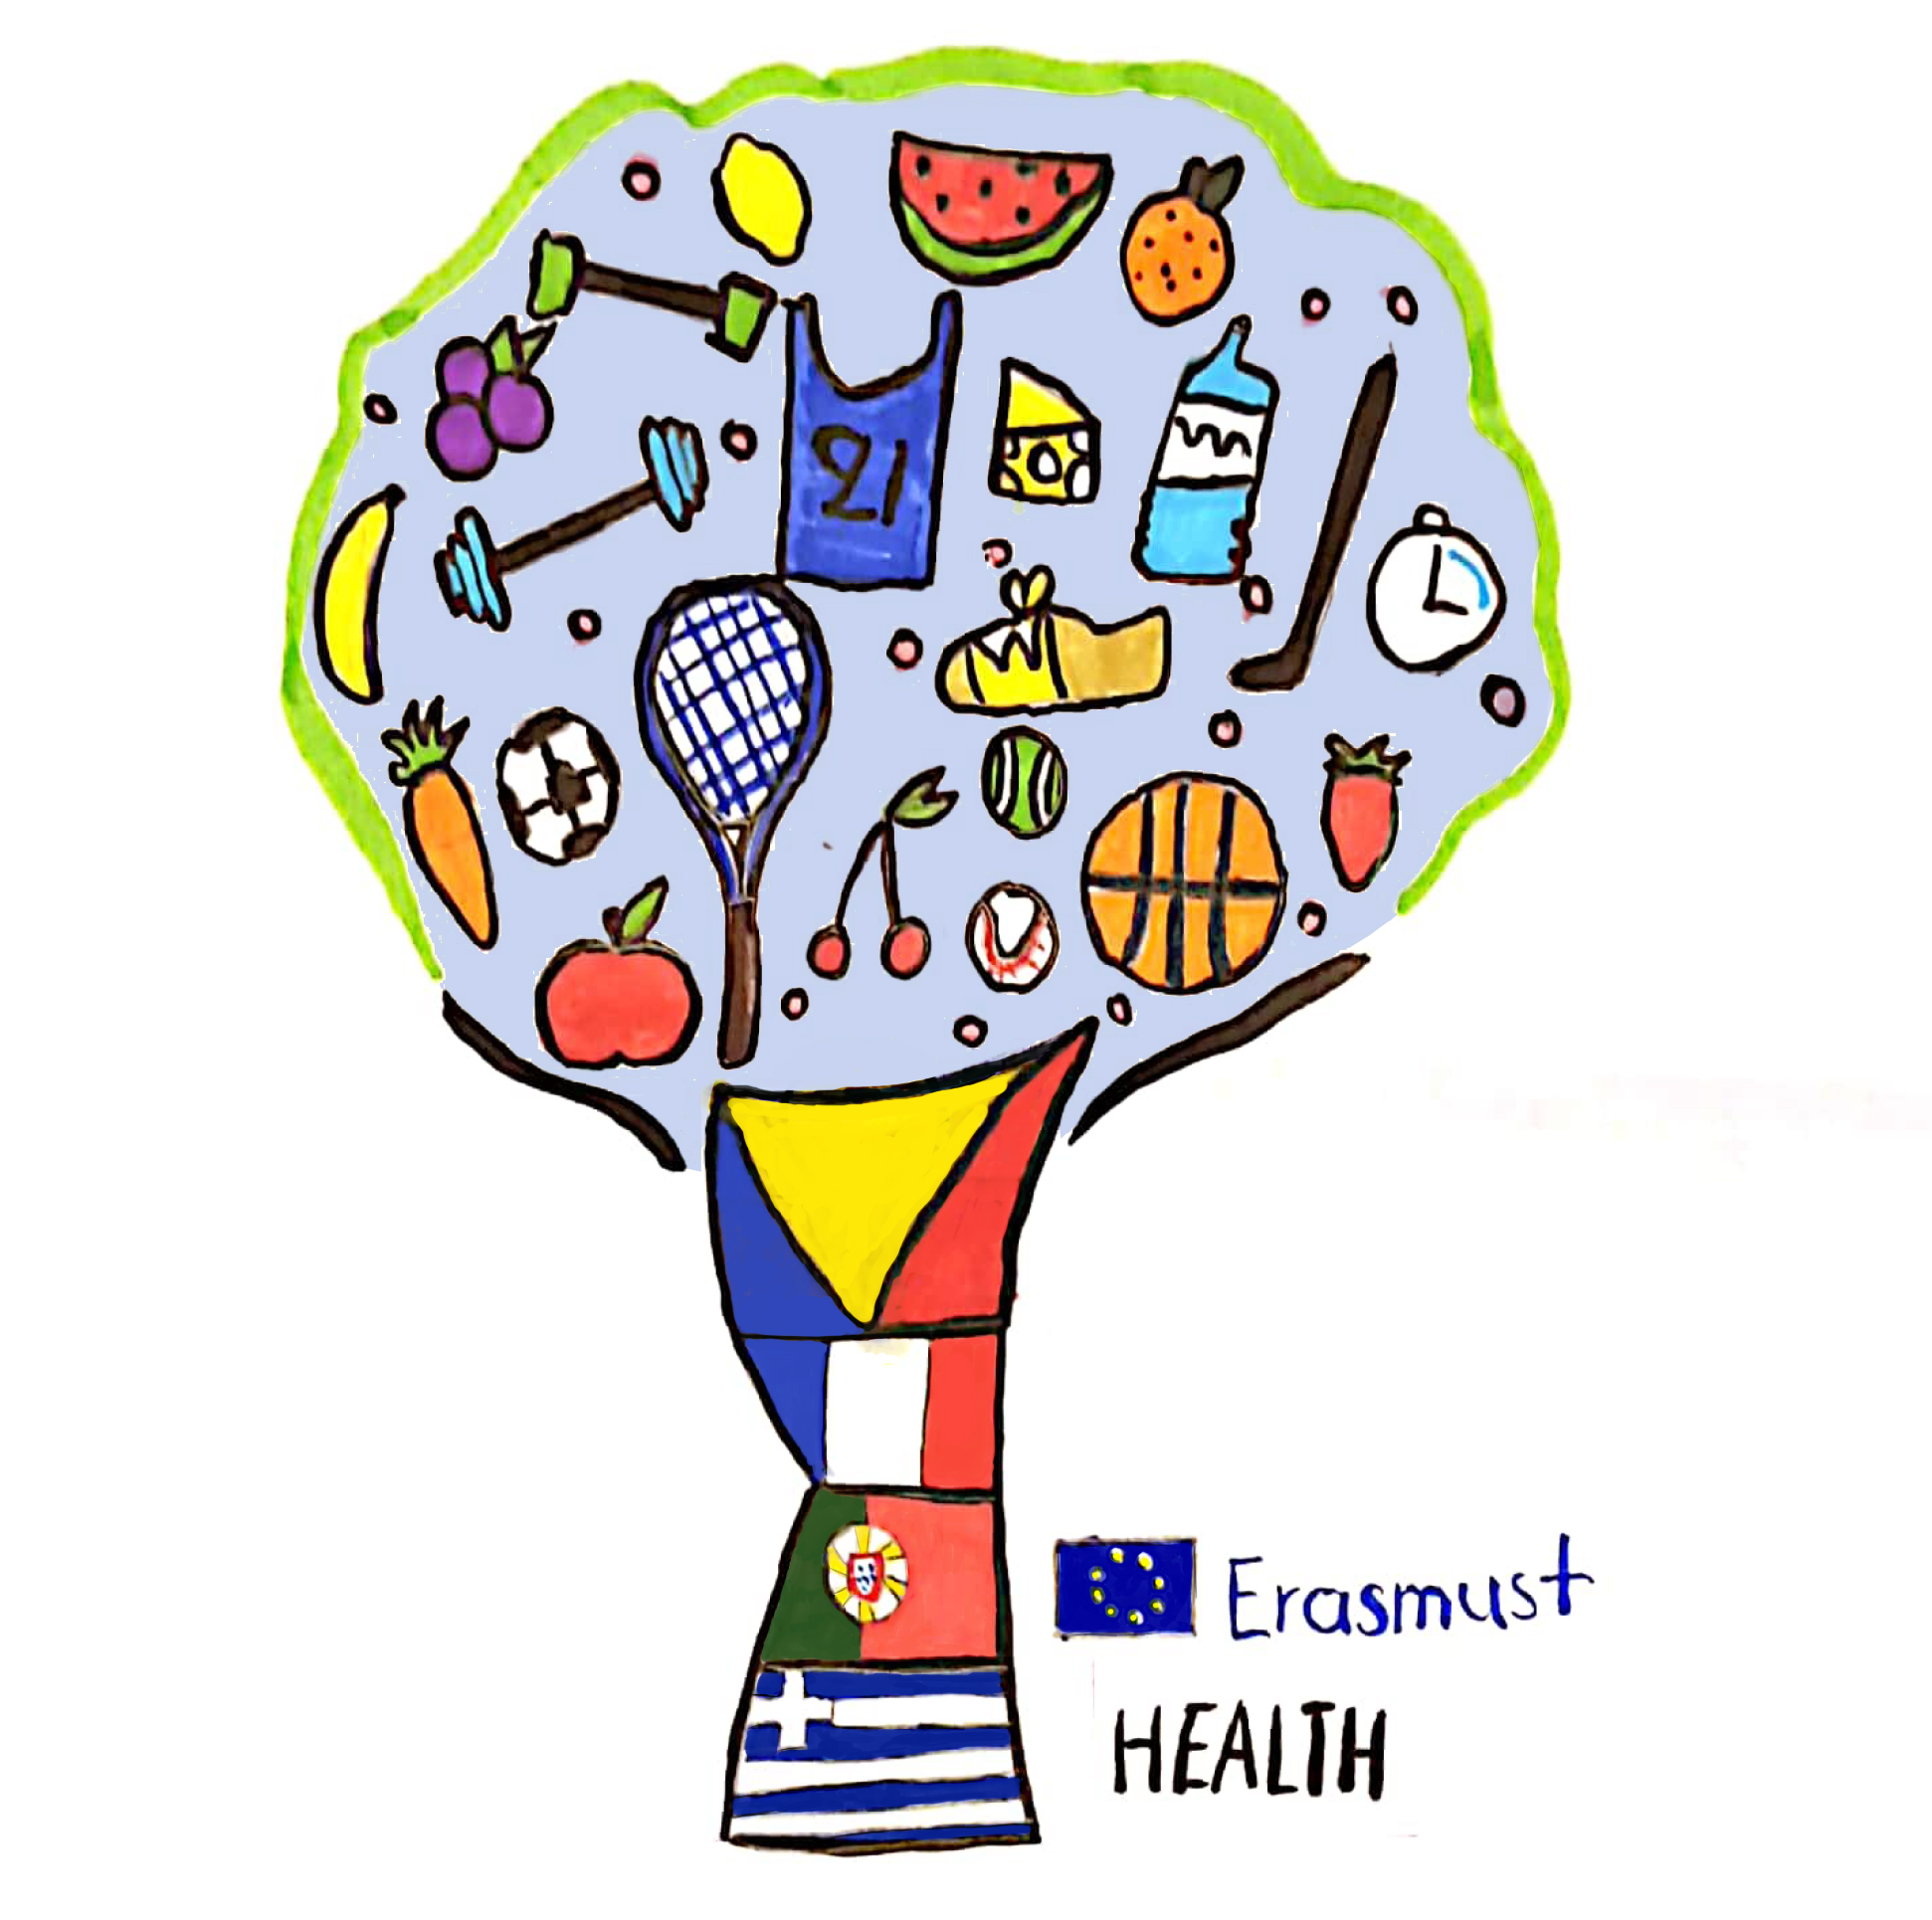

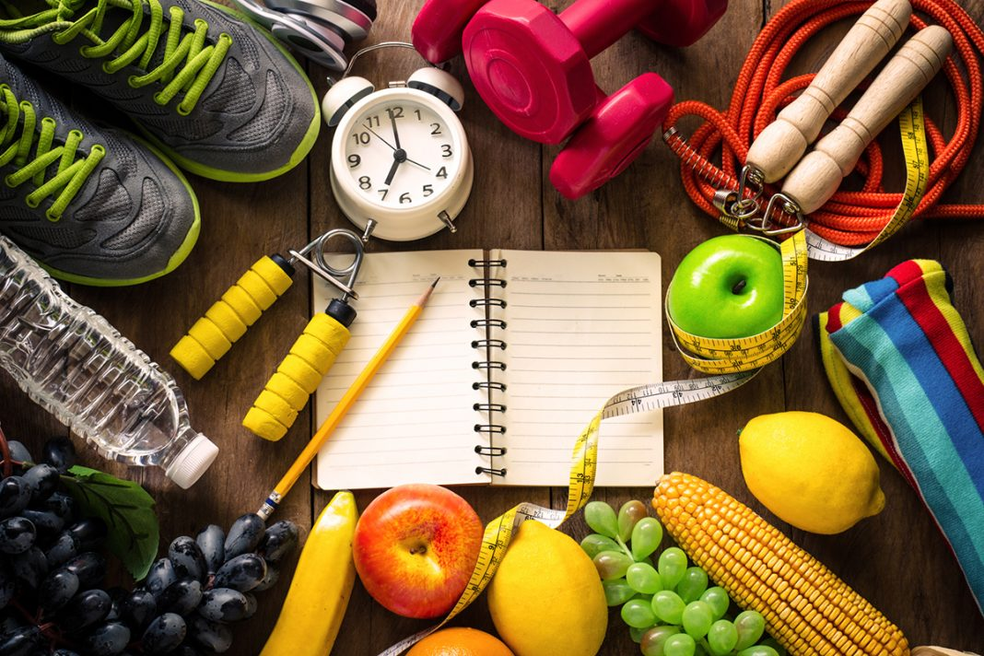


Healthy Education and Active Lifestyle turn in to Happinness
4th Primary school of Sykies - Thessaloniki
January 2021

Slide 2
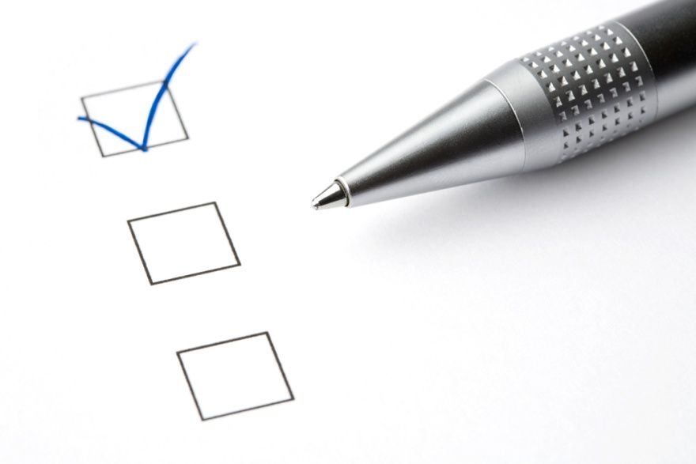
Initial Questionnaire
Findings΄ Presentation
Greek students’ views
January 2021

Slide 3
Question 1
Do you eat brekfast before going to school?
11%
54%
28%
Every day
Sometimes
Rarely
Never

Slide 4
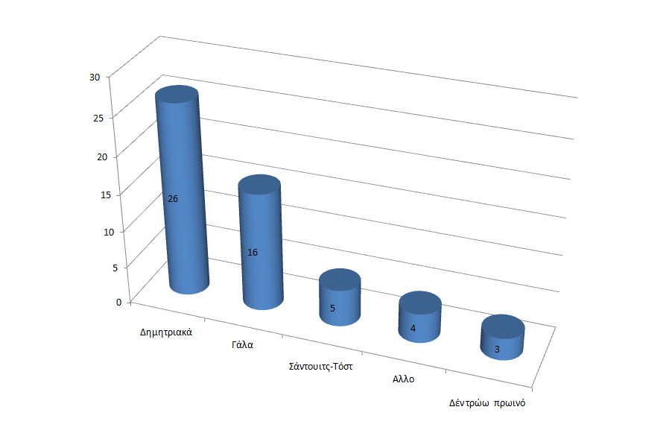
Question 2
What do you usually eat for brekfast?
Cereals
Milk
Sandwich-toast
Other
I don’t eat breakfast

Slide 5
Question 3
Do you eat salad with lunch?
44%
Every day
Sometimes
Rarely

Slide 6
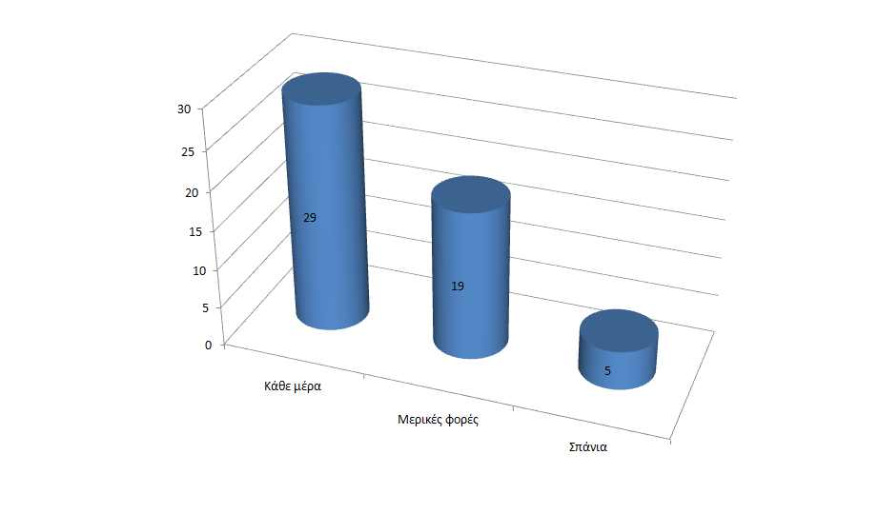
Question 4
How many times a week do you eat vegetables?
Every day
Sometimes
Rarely

Slide 7
Question 10
How many times a week do you eat meat?
More than two

Slide 8
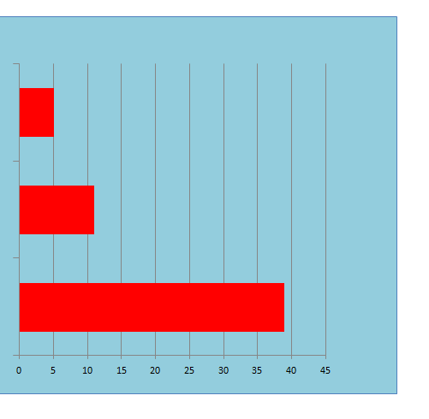
Question 5
How often do you eat fruit?
Less than twice a week
2-3 times per week
Every day

Slide 9
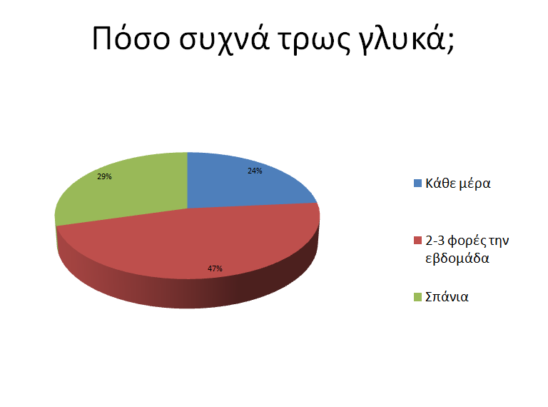
Question 6
How often do you eat sweets?
Every day
2-3 times per week
Rarely

Slide 10
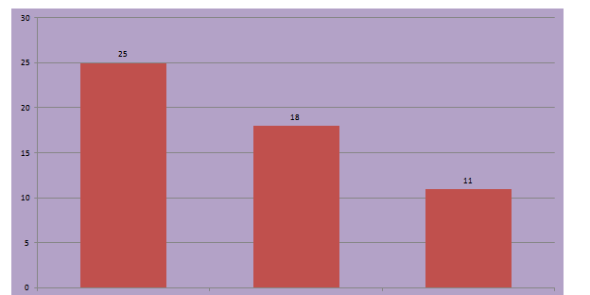
Question 7
How often do you exercise?
Every day 2-3 times per week Less than twice a week

Slide 11
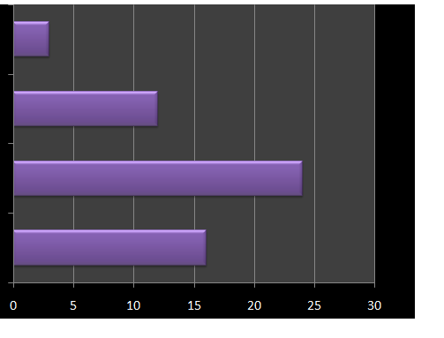
Question 8
Why do you exercise?
Other
Fun
Health
Nice body

Slide 12
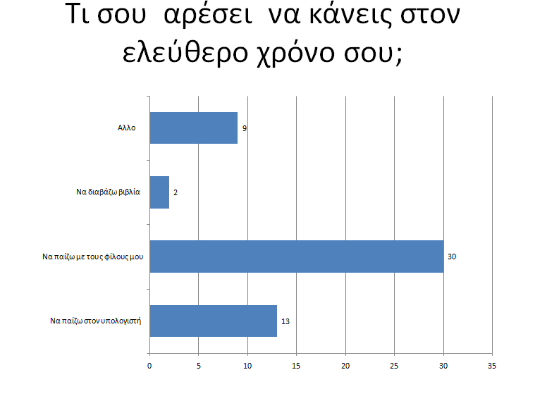
Question 9
What do you like doing in your free
time?
Other
Read books
Play with friends
Play computer games

