Slide 1


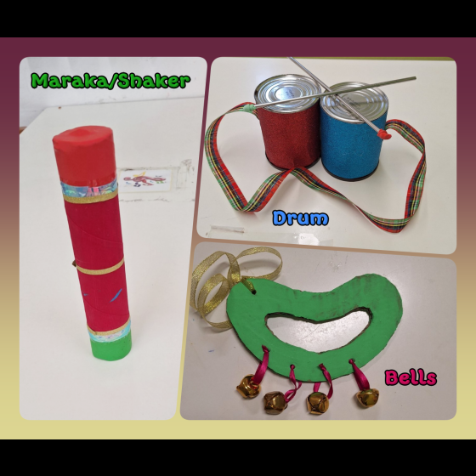

Little Music Travellers
Welcome to our little musical museum!
Here, you will discover wonderful musical instruments made by children using recyclable materials and lots of imagination.
While creating these instruments, the children had fun exploring, crafting, and learning how to use simple tools like scissors, glue, and rulers. At the same time, they expressed their creativity and developed their artistic skills.
As you explore the rooms, you will find wind, percussion, string, and many other unique instruments, all made with care, excitement, and teamwork between children and their teachers.
Enjoy the music, the creativity, and the joy behind every creation!

Slide 2
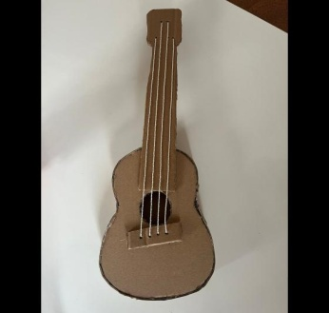
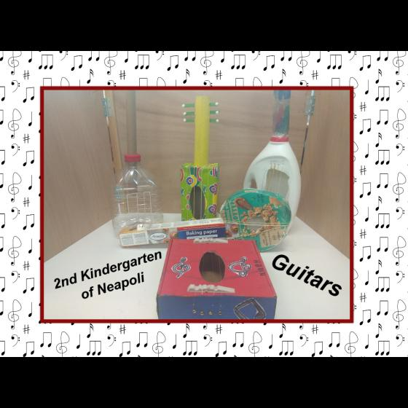
Little Music Travellers
String instruments are musical instruments that make sound when their strings vibrate.
In this section, the children created their own guitars using recyclable materials such as cardboard, plastic bottles, and boxes.
With imagination and creativity, they turned simple everyday objects into beautiful musical instruments!
String instruments

Slide 3
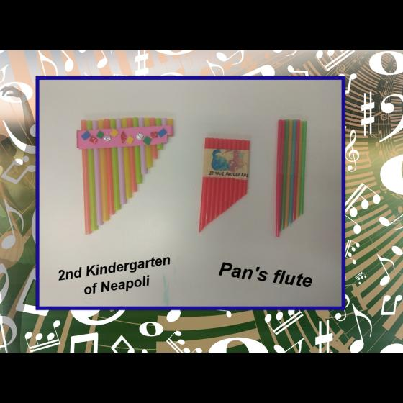
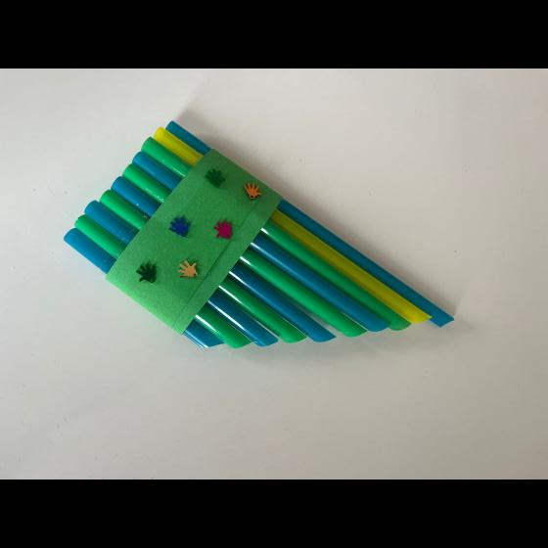
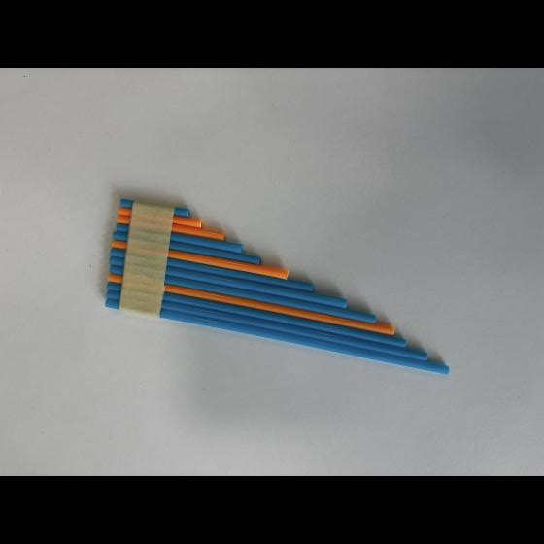
Little Music Travellers
Wind instruments
are musical instruments that make sound when we blow air into them.
In this section, the children created their own Pan flutes using straws cut into different lengths. Through this fun activity, they discovered how changing the size of the tubes can create different sounds, turning simple materials into music!
Wind instruments

Slide 4
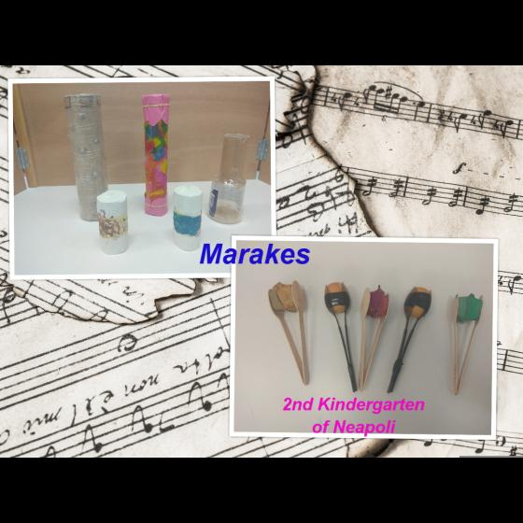
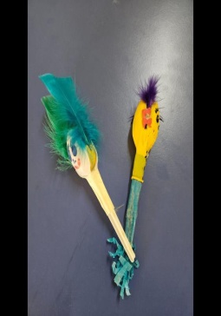
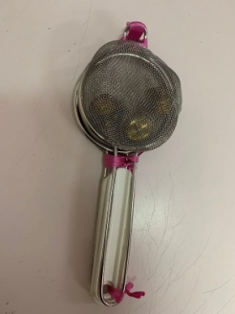
Little Music Travellers
Percussion instruments are musical instruments that make sound when we tap, shake, or hit them.
In this section, the children created their own handmade percussion instruments using a variety of materials such as strainers, spoons, and empty chips cans. With creativity and imagination, they turned everyday objects into fun musical tools, exploring rhythm and sound in a playful way!
Percussion instruments

Slide 5
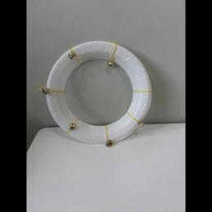
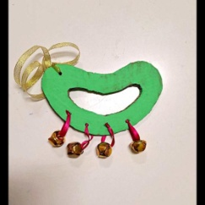
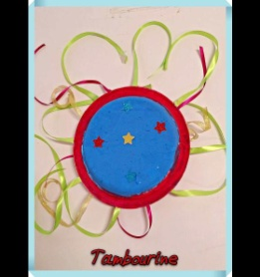
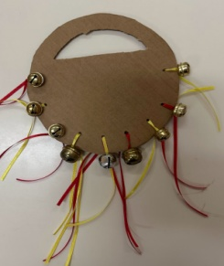
Little Music Travellers
Percussion instruments
In this section, the children created their own handmade tambourines using materials such as cardboard, plastic plates, and little bells. With imagination and joy, they explored rhythm and created fun sounds, turning simple materials into musical instruments!
Percussion instruments are musical instruments that make sound when we tap, shake, or hit them.
tambourines

Slide 6
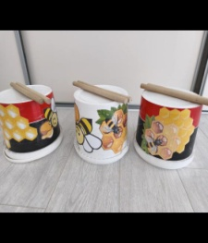
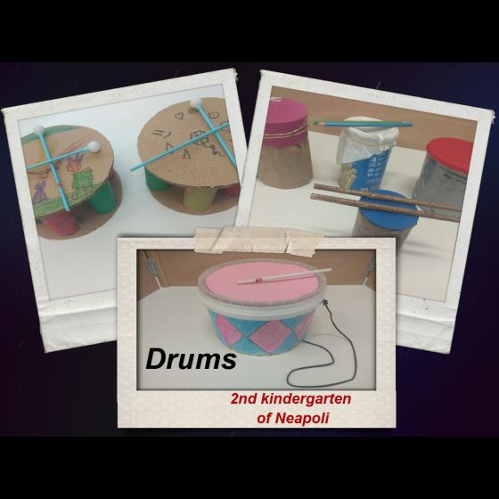
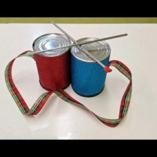
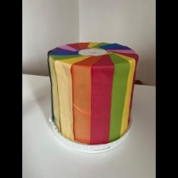
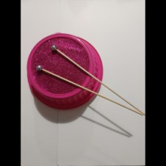
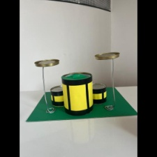
Little Music Travellers
Percussion instruments are musical instruments that make sound when we tap, shake, or hit them.
In this section, the children created their own handmade drums using empty containers, covered with plastic materials such as balloons or plastic lids. They also used wooden sticks to play them and explore different sounds.
Percussion instruments
DRUMS

Slide 7
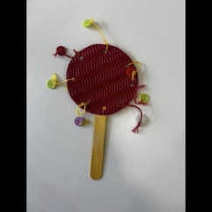
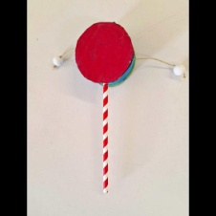
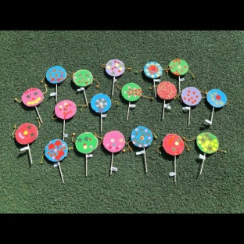
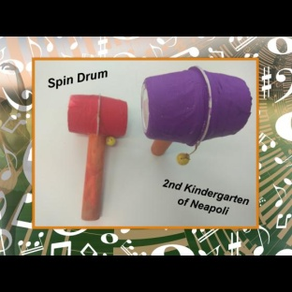
Little Music Travellers
Percussion instruments
In this section, the children created their own handmade spins using materials such as cardboard,
popsicle sticks, straws, and empty yogurt cups.
With imagination and creativity, they explored movement and rhythm, discovering how simple materials can spin, dance, and become part of their musical play!
SPIN
Spin toys are fun creations that move and spin, bringing joy and movement into our music and play

Slide 8
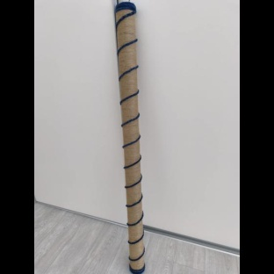
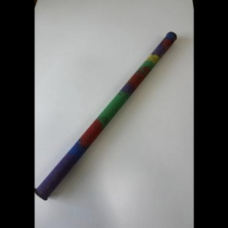
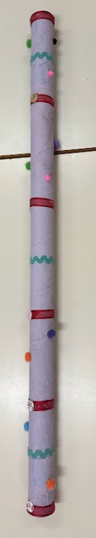
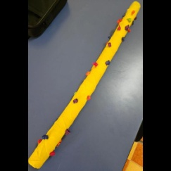
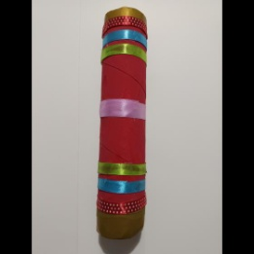
Little Music Travellers
In this section, the children made their own rain sticks using simple materials. By gently turning them, they discovered how the sound can remind us of raindrops, the wind, and even the waves of the sea.
RAINMAKERS
Rainmakers are special musical instruments that create the soft, calming sound of falling rain
Through this creative activity, children explored sounds from nature and learned how music can bring the feeling of rain and ocean into the classroom!

Slide 9
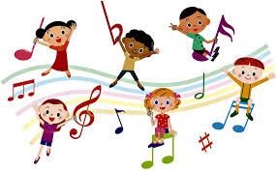
Little Music Travellers
Thank you for visiting our musical museum!
We are so happy you explored the wonderful handmade instruments created by our children with love, imagination, and creativity.
Your presence means a lot to us and encourages our little artists to keep creating, learning, and sharing their joy through music.
We hope you enjoyed this special journey into the world of sounds! 🎵✨

