Slide 1
THOMAS EDISON
T & A F

Slide 2
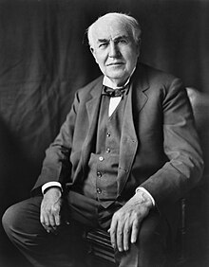
Thomas edison
Thomas Alva Edison was an American inventor and businessman. He developed many devices in fields such as electric power generation, mass communication, sound recording, and motion pictures.

Slide 3
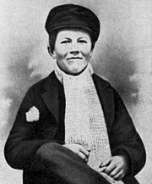
Thomas edison early in his life
Thomas Edison was born in 1847 in Milan, Ohio, but grew up in Port Huron, Michigan, after the family moved there in 1854.^{[8]} He was the seventh and last child of Samuel Ogden Edison Jr.

Slide 4
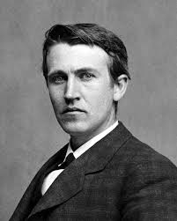
Early career
Thomas Edison began his career as a news butcher, selling newspapers, candy, and vegetables on trains running from Port Huron to Detroit. He turned a $50-a-week profit by age 13, most of which went to buying equipment for electrical and chemical experiments.

Slide 5
Thank you for watching!!

