Slide 1
PosterMyWall

Slide 2

What is PosterMyWall?
The PosterMyWall tool allows us to create posters in a very simple way without installing any program on our computer.
We can create a poster starting with one of the ready-made templates it offers, or we can start using a background image, choosing from an extensive collection. If none of the above covers us, we can upload our own photos.
The tool is free with the limitation that a watermark will appear at the bottom of the poster. Of course, by paying a small fee, it gives you the opportunity to download your poster in super high resolution so that you can print it in large dimensions.

Slide 3

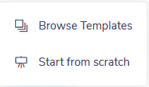
PosterMyWall Presentation
Go to the address http://www.postermywall.com/
Step 1: To start creating a poster, click on "CREATE A DESIGN".

Slide 4
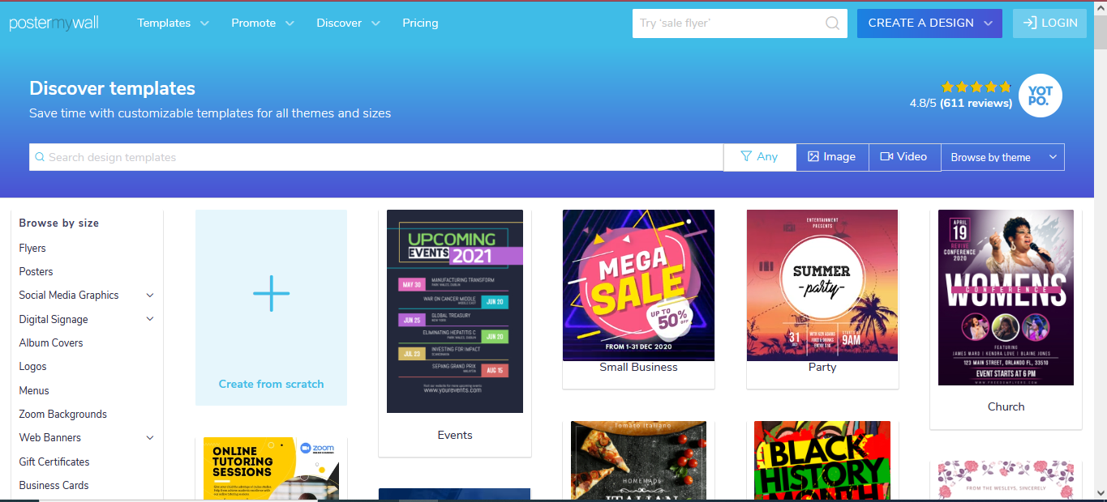
PosterMyWall Presentation
Step 2: The next step is to choose the background for your Poster. You can search for a template by categorizing it by size (by clicking All Sizes), create a blank one using "Create from Scratch" or select a category from the ones below. If you select a category, a new window will open with the ready-made templates of that specific category.

Slide 5


PosterMyWall Presentation
Step 3a: After choosing a ready-made template, you will then need to click to edit your poster.

Slide 6
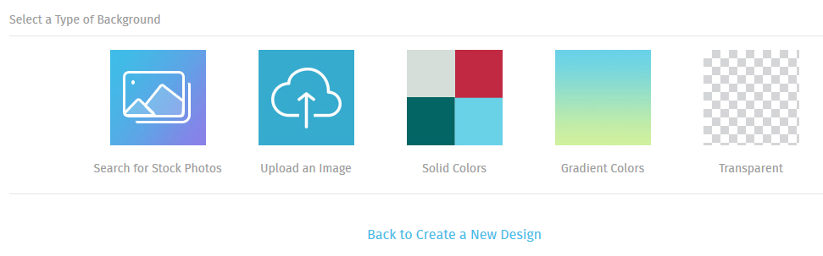
PosterMyWall Presentation
Step 3b: If you select "Create from Scratch" then on the next screen you will need to select
the type of design e.g. poster, tabloid, flyer, instagram post etc.
its orientation and
finally one of the 5 options below.

Slide 7

Toolbox
After making your selections, select Apply and the main design screen appears, which has the following sections:
Toolbox: Located on the left side of the screen. This is where you start. You can add photos, elements, text, multimedia and design to your poster. Of course, you can modify the background of your poster.

Slide 8
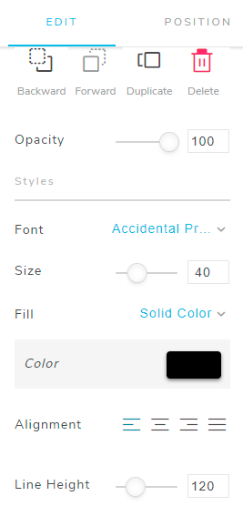
General settings for an object
This column appears if you select an object (text, image, etc.). In this palette you will find general settings for each selected object. You can place an object above another and clone or delete an object (the DEL key does not work).

Slide 9
Tool options
Text: This field appears only if you have selected a text object and there you write the text that will appear.
Effect: This field appears only if you have selected a fancy text object and you select the type of effect.
Font: This field appears only if you have selected a text object and of course you select the font. The fonts that appear do not support Greek characters, so whichever one you choose will not change the format of the Greek letters.

Slide 10
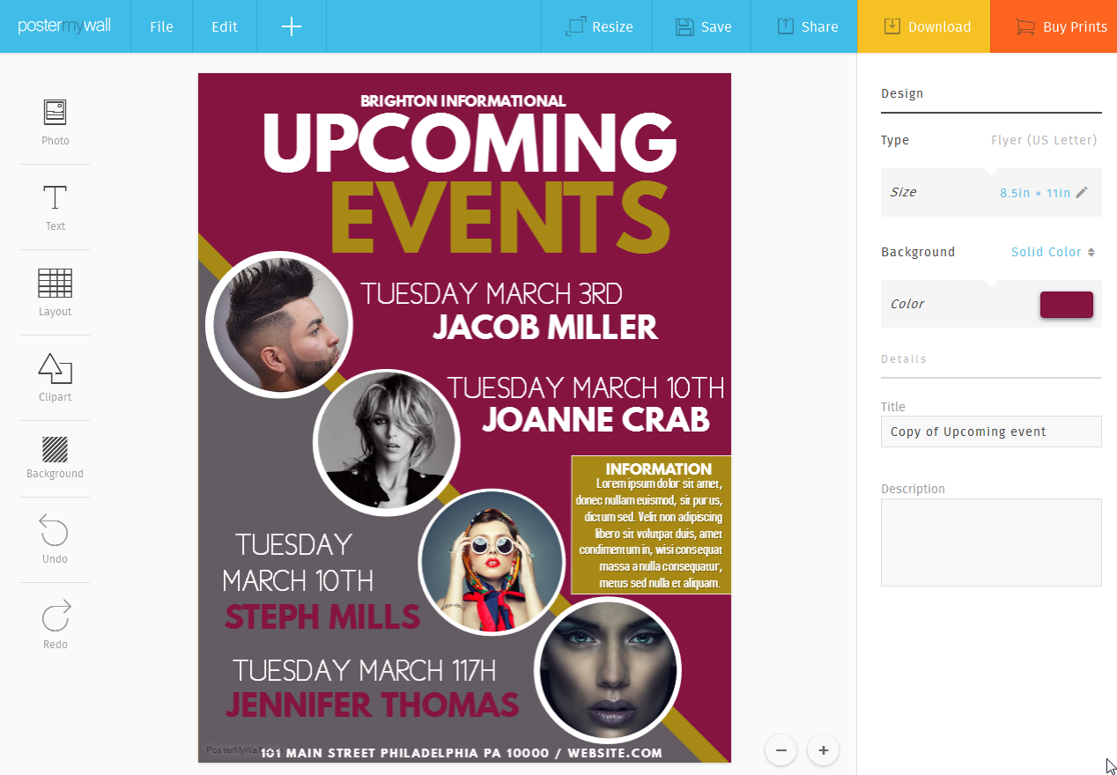
Other options
You select color, alignment and various other options for the text or various effects and editing options if you have selected an image object.

Slide 11
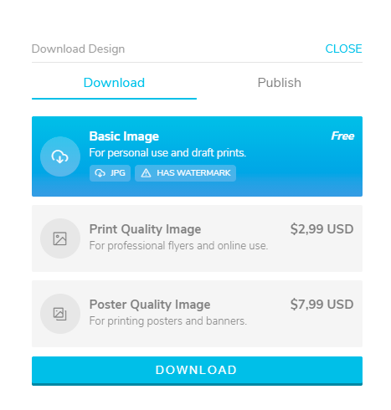
PosterMyWall Presentation
Step 4: Once you are done with your work, you have the options to save, share, download to your computer, and purchase. All options require registration with the service, except for downloading.
After selecting "Download", in the window that opens, click "Download" again and save the file to your PC.

Slide 12
THANK YOU

