Slide 1
PADLET

Slide 2

What is Padlet?
Padlet is a digital tool that allows users to create collaborative boards, where they can add various types of content, such as text, images, videos, links, documents, and more. These digital boards, known as "padlets," can be customized to the user's preferences and shared with others for collaboration, brainstorming, organizing ideas, gathering feedback or presenting information.

Slide 3
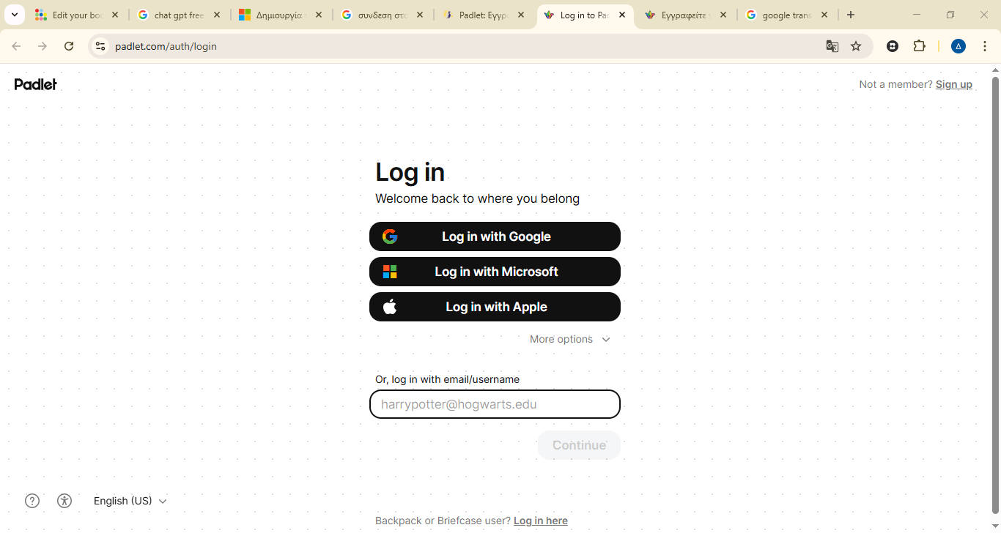
Registration and login
Make sure to first register on Padlet, https://padlet.com/auth/signup, if you haven't already.
Register for free using one of the registration methods available on Padlet. When registering, select use as a teacher.

Slide 4

Choose
After registering, choose the free plan which has a limit of 3 padlets per user and 20 MByte upload.
Free
For ever
Start

Slide 5
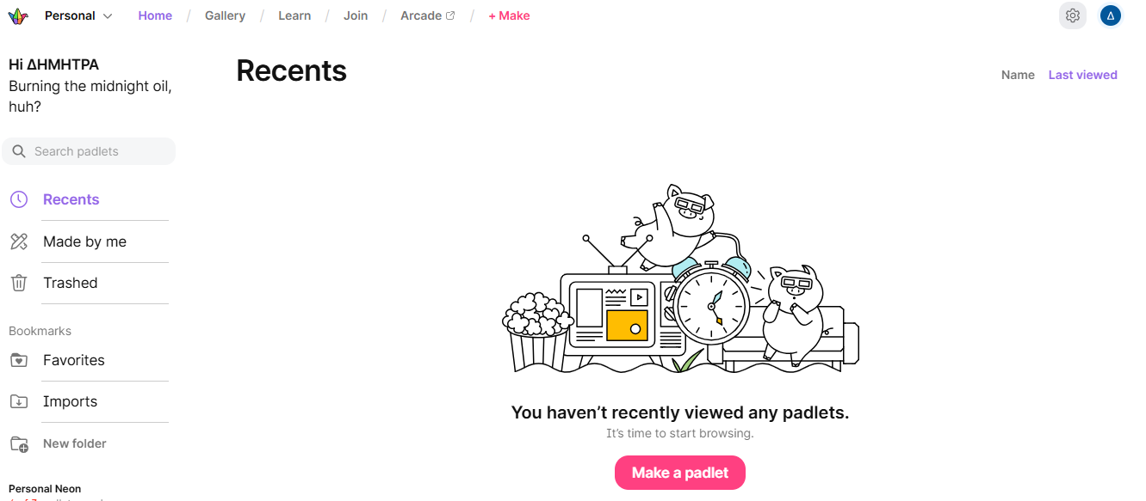
Make a padlet
You will then be taken to the application's dashboard.
Click the pink Make a padlet button.

Slide 6
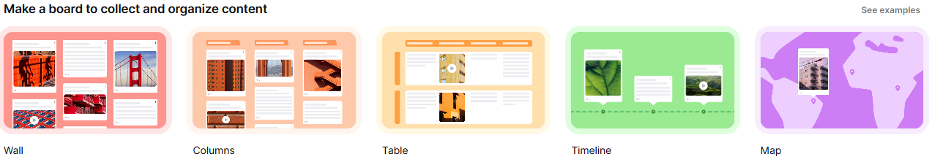
Make a padlet
The format determines the layout of posts in a padlet and you can choose between Wall, Stream, Timeline, Grid, Canvas and Map. For starters, choose Wall, but don't worry, you can change the format of a padlet later.

Slide 7
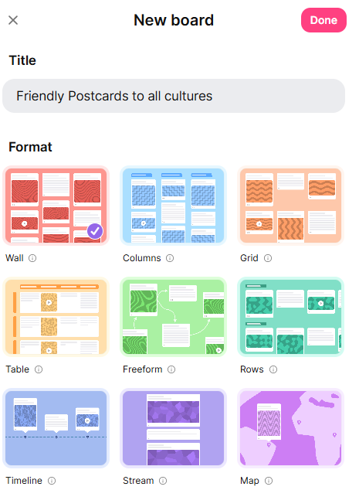
A new padlet
A new padlet will appear with a panel on the right where you can change the title (1), choose the format(2) and Done(3).
3
1
2

Slide 8

Make a post
At this point, you have a blank padlet in which you can create posts. To add a post, click the + button in the bottom right.

Slide 9
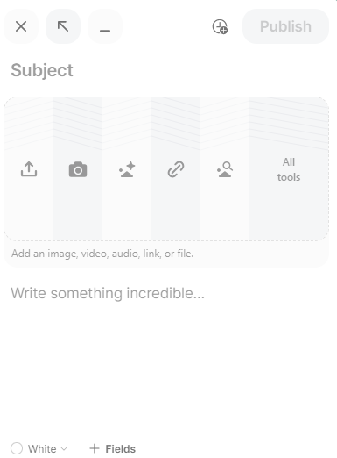

Make a post
Add a title, text, and/or attachment. Click the Publish button to publish.

Slide 10

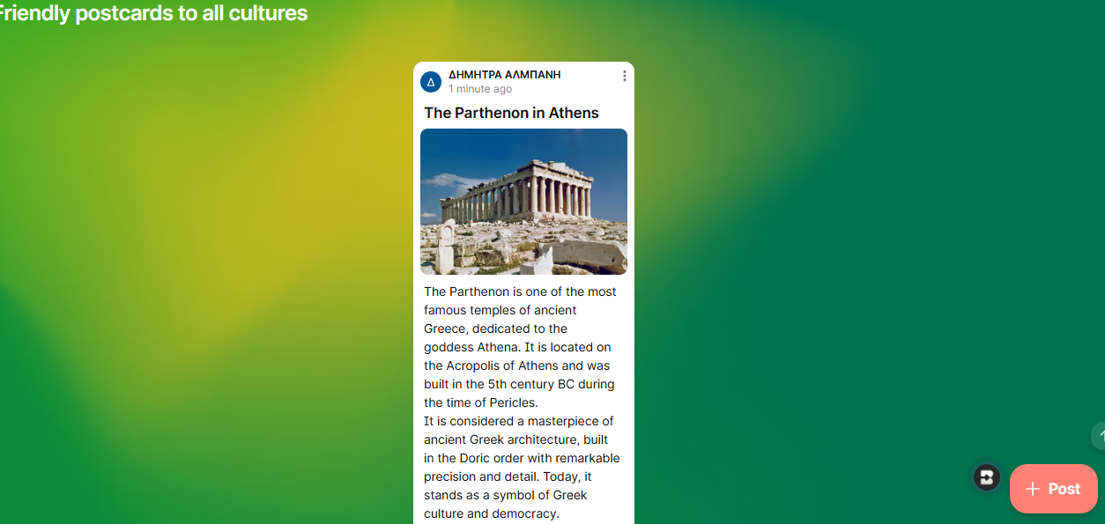
Add media
For a more impressive entry, you can also add media files to your post. Some of the attachment options include images, documents, links, videos, and drawings. You can even use your device's camera or microphone to record a video or audio file.

Slide 11
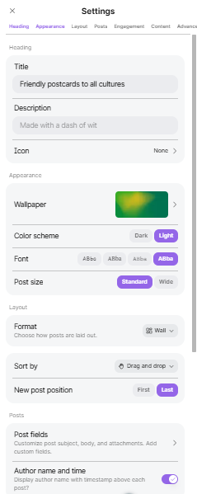
Padlet settings
Click the Settings gear icon to display the Settings menu. Here you can change your wallpaper, update your padlet icon and customize how your posts are added and displayed in the padlet.
To see all the many options you
have for configuring your padlet, click here.
https://padlet.help/l/el/article/8713enefe4-padlet-settings

Slide 12
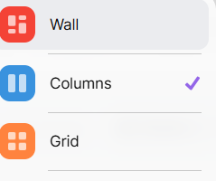
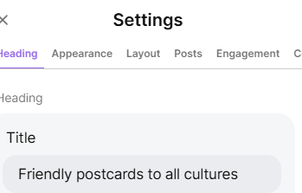
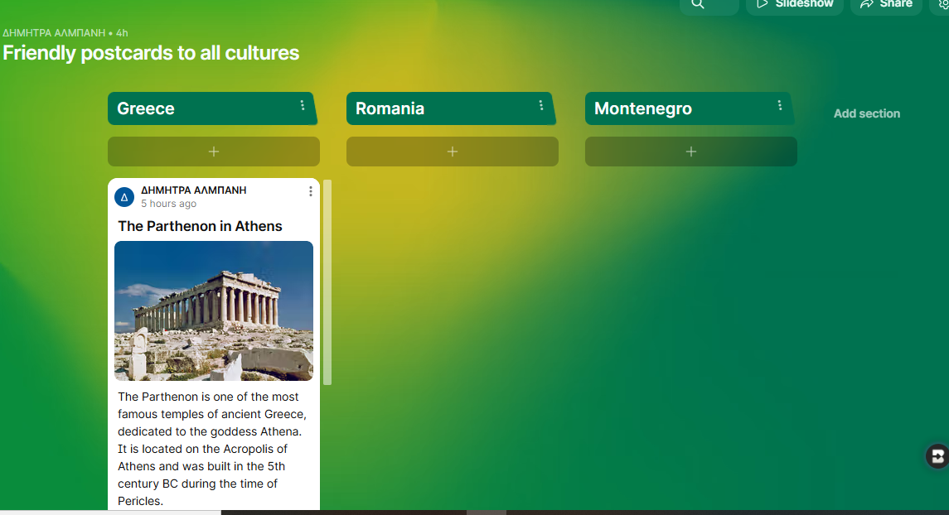
Add column
In the options that appear, select the “Columns” layout. This format organizes content into columns with titles.
Adding Columns: Once the wall is created, click “Add column” to name the first column (e.g. “Greece”) and repeat for as many columns as you need.

Slide 13

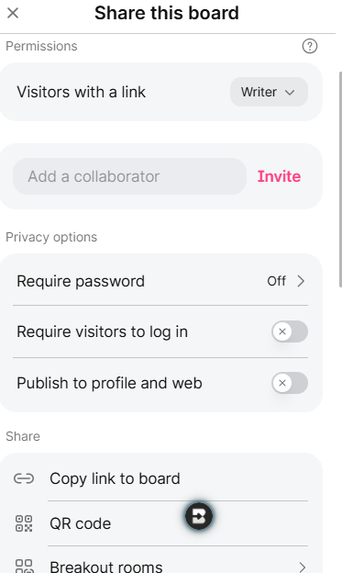
Share your padlet
Click the share icon in the top right corner of the padlet to choose guest permissions and link privacy settings.
Within the Share menu there are several options for sharing your work with others. The most common way is to copy a link.
https://padlet.com/dimitralmpani/friendly-postcards-to-all-cultures-ht7ygqem8wdtkxc

Slide 14
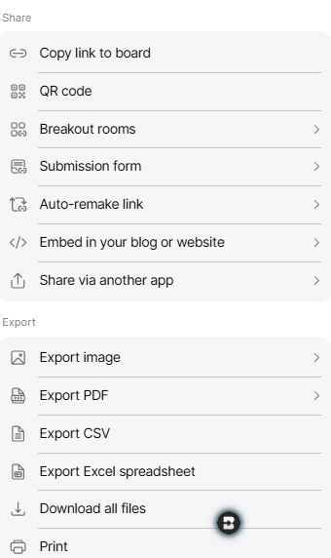
Padlet settings
You can show a padlet to the class as a presentation by clicking the Show Presentation button. You can also create a QR code, embed code for a website, or share via another app. You can also export to an image, pdf or spreadsheet.

Slide 15
THANK YOU

