Slide 1
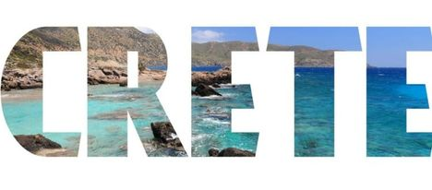
https://www.youtube.com/watch?v=9C9Uenda1gs

Slide 2
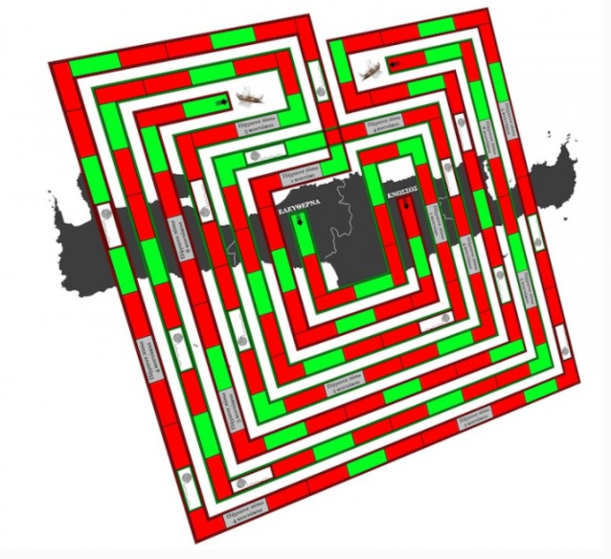

Slide 3
What does the thread of Ariadne mean?

Slide 4
Τhis expression is used in the meaning of a tool that can help you get out of a difficult situation, solve a complicated question, or deal with a problem.

Slide 5
LET’S PLAY THE GAME

Slide 6
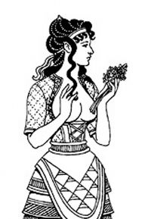
My name is Ariadne and I live in Crete . I am here to help you explore my island . If you want to accomplish this you must answer the following questions so as to unravel my thread .
First we open the white sails and travel to the island of Crete .

Slide 7
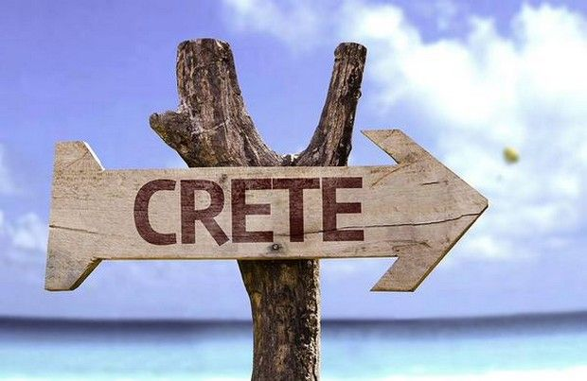
So , let’s go to ……

Slide 8
Where is Crete located ?
Find the place on the map .

Slide 9
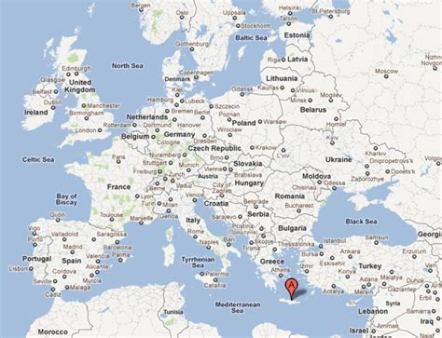

Slide 10
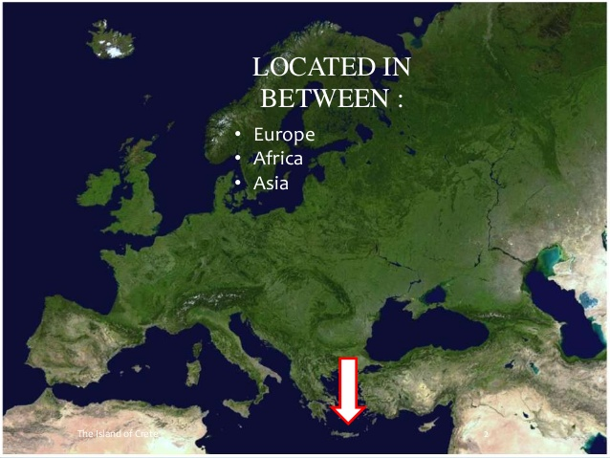

Slide 11
Crete is an island in the eastern Mediterranean, located between three continents: Europe, Africa and Asia.
It is located in the southern part of the Aegean Sea separating the Aegean from the Libyan Sea.
It is the fifth largest island in the Mediterranean and the largest of the Greek islands.

Slide 12
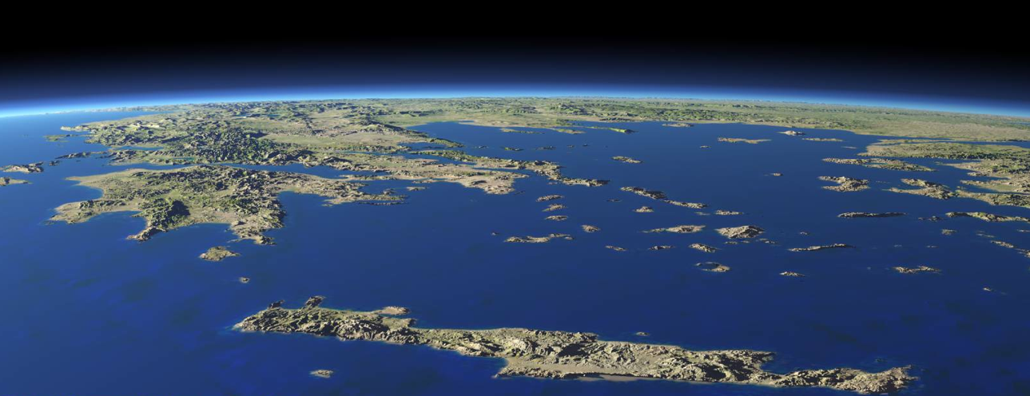

Slide 13
2 . Where did the name Crete come from ?

Slide 14
The name Crete comes from the name of a nymph , who came from the west to the island of Crete, together with the Kourites.
Kourites accompanied Rhea, who wanted to give birth to Zeus away from his father Cronus . They banged their brass cymbals to drown out the cries of baby Zeus.

Slide 15
3. How many prefectures are there in Crete?

Slide 17
Crete is divided into four prefectures . From west to east they are: Chania, Rethimnon, Iraklion and Lassithi.
Crete's population is approximately 650,000 people . Heraklion (150,000 people) is the capital of the island, Chania (70,000 people) is the second largest city , whereas Rethymnon (40,000 people) and Agios Nikolaos (10,000 people) are the next two bigger towns of the island.

Slide 18
Let me tell you a secret . My island is well known for its seas and beaches but it has a very contrasting landscape. The island goes from fertile coastal plains to rugged mountains and from busy metropolitan cities to very peaceful hillside villages.

Slide 19
4. Now discover the bigger mountains of the island !

Slide 20
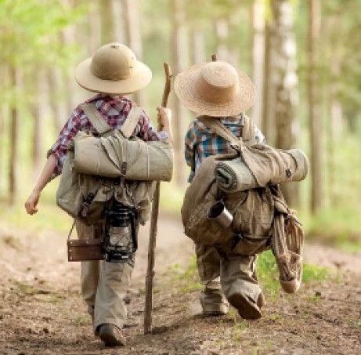
Crete is one of the most mountainous islands of Europe with high mountain ranges crossing the island from West to East.
In the middle of the island ,Mount Idi or Psiloritis, whose highest peak Timios Stavros (2456 m.), is the highest point in Crete. Ιn Western Crete, the White Mountains or "Lefka Ori” with the Pachnes (2453m) as its highest peak.
In eastern Crete there is the Dikti Mountain with the highest peak of 2148m.

Slide 21
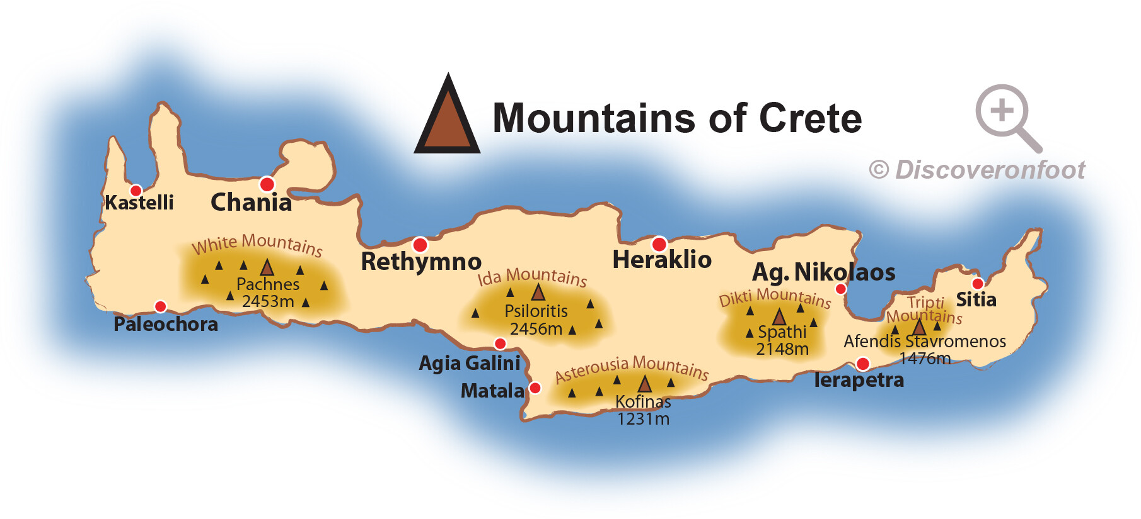
https://www.youtube.com/watch?v=Mb_fF5h3cOw

Slide 22
5. What about rivers and lakes ?

Slide 23
Because of its small width, Crete has few rivers, starting from the mountains of the island, in the central part, and ending either at the South Cretan or North Cretan Sea.
Most of them have water only during the winter months, while on summer they get dry . There is only one natural freshwater lake. It is Kournas lake .

Slide 24
I feel too hot ! Let’s go to the beach !! Take your camera and show me pictures of the beaches .

Slide 25
https://www.youtube.com/watch?v=Cm-D04RdIyA&t=78s

Slide 26
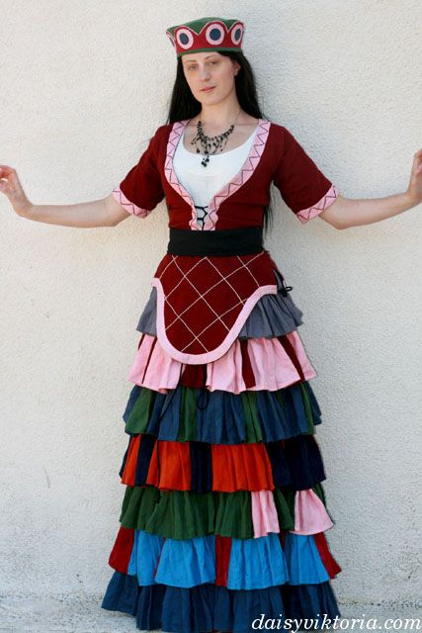
Mythology places the birth of music in Crete. The Kurites beat with rattles to cover the cry of little Zeus and try to protect him from Cronus , his father , who ate his children.
Your next mission is to find Cretan traditional musical instruments.

Slide 27
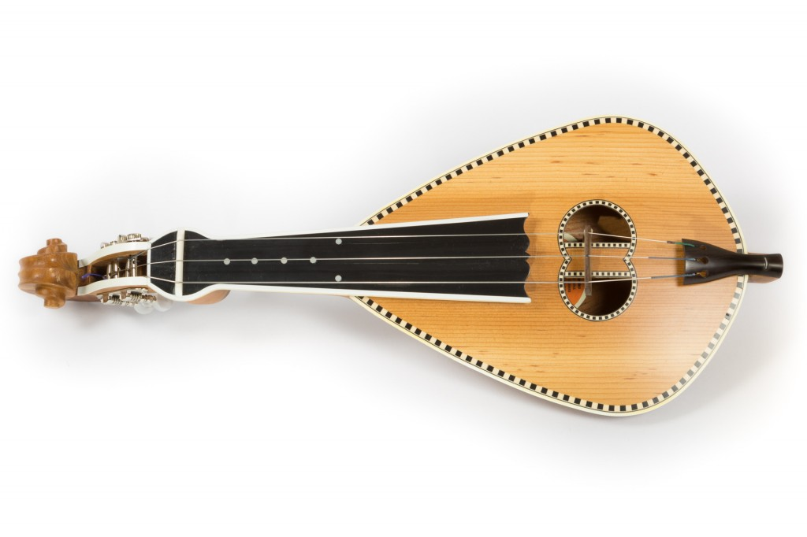
Cretan lyre is the king or queen of Cretan music . There is no party and dance in Crete without the lyre. It has the shape of a pear, three strings and is played with the bow. The lyre player rests the instrument on his thigh or between his legs when sitting or on his chest when playing upright.
https://www.youtube.com/watch?v=PEw9TiD3li8

Slide 28
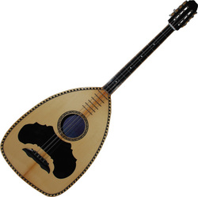
Lute
It accompanies the lyre or the violin, sometimes playing the basic sounds of the melody, and sometimes taking, for a short time, the melody in order for the lyre player or the violinist to rest.
https://www.youtube.com/watch?v=2dudaOQvIQ4

Slide 29
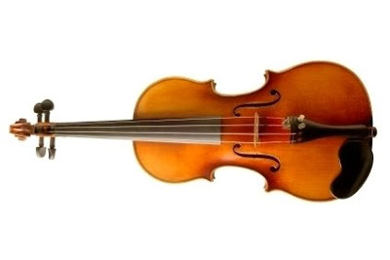
Violin
Ιn Crete it is played , along with the lyre .
https://www.youtube.com/watch?v=OL76udpdQjA

Slide 30
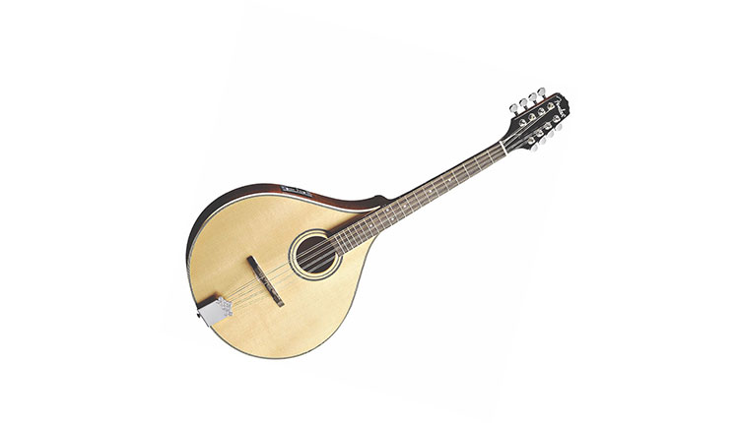
Mandolin
https://www.youtube.com/watch?v=kFQ1cZ_vTsc

Slide 31
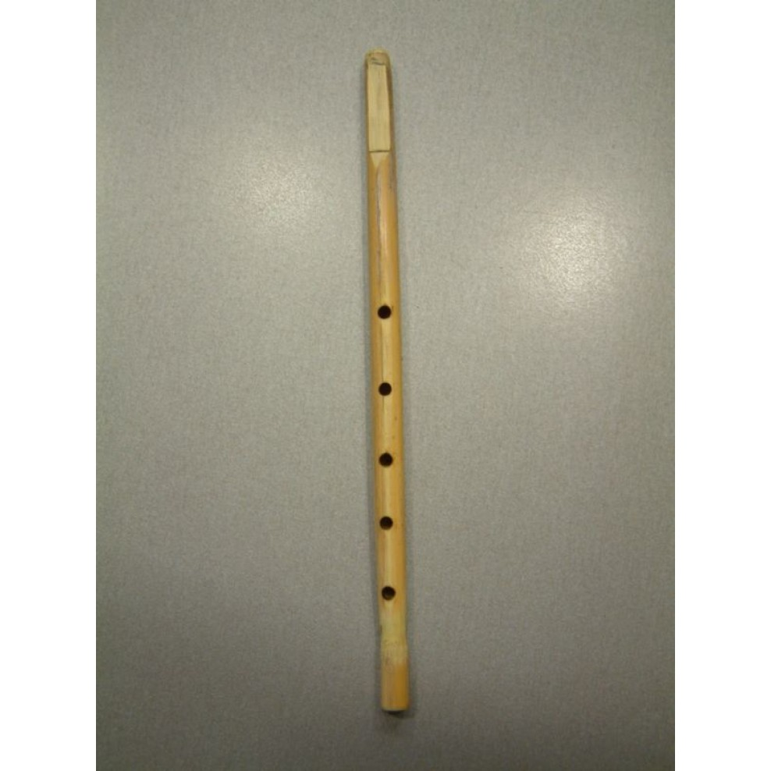
Madura
A type of clarinet .
It has 4-6 holes and it is made in various sizes.
https://www.youtube.com/watch?v=M1zYlysuABk

Slide 32
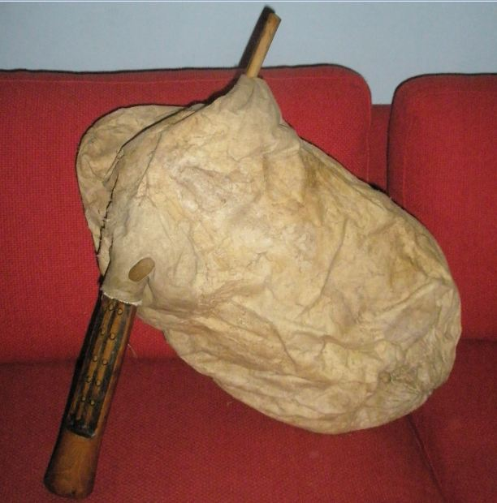
Ascomantura
It consists of a leather bag that serves as an air storage, the wooden or bone mouthpiece with a valve, through which the organist blows air, and the sound production device, which includes a vessel ending in a funnel and two tubes.
This instrument was very common in the past in Crete but unfortunately it tends to disappear today.
https://www.youtube.com/watch?v=BX1wh3ytek8

Slide 33
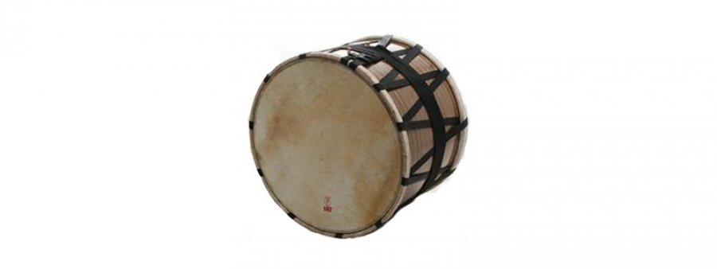
Τουμπί ή νταουλάκι
https://www.youtube.com/watch?v=XoENUsnHZLs

Slide 34
It is a small drum that is played with the hands or with two sticks, the drumsticks or the boxwood sticks hitting only one leather surface. It rhythmically accompanies at least one melodic instrument, which can be madura, ascomantura, lyre or violin.
It is played hanging from the left shoulder or from the neck or held under the armpit or on the left thigh or, also, hung from a small loop, in the left hand, just above the wrist.

Slide 35
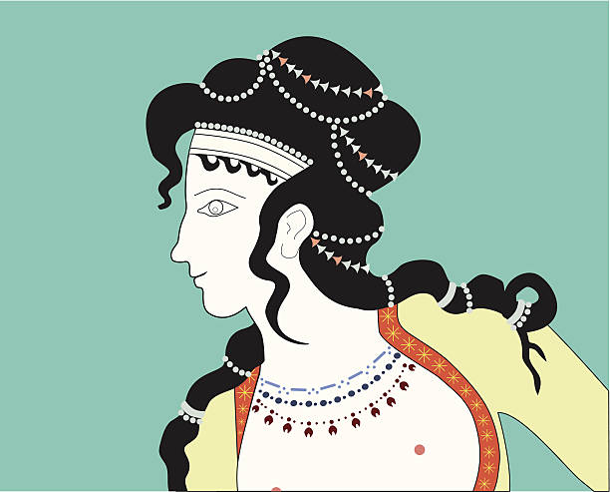
“A Cretan does not say in plain words what he feels, With mantinades he weeps or with laughter he peals!”
Υou have to search and find what mantinada is .

Slide 36
Mantinades are the most common form of folk song and are widespread across Crete. The Cretan mantinada is a 15-syllable rhyming couplet in Cretan dialect. Each mantinada is complete in itself in spite of its short length, like a limerick. There are however some mantinades used to answer others, in which case their meaning is complementary.
The mantinada is the unique way in which young and old in Crete can express their many and varied emotions: sorrow, joy, hope, desire, love, anger, revenge, nostalgia. Most have to do with love and romance, but there are also satiric, didactic, teasing couplets or verses on engagement, marriage, everyday life and of course death and losing loved ones.
Mantinades are told at festivals accompanied by the lyre. Most are not written down even in a notebook, and even fewer are published. Many are told and forgotten, but the best are learnt off by heart and passed on by word of mouth.

Slide 37
Time for cooking ! Let’s make candied mantinades !

Slide 38
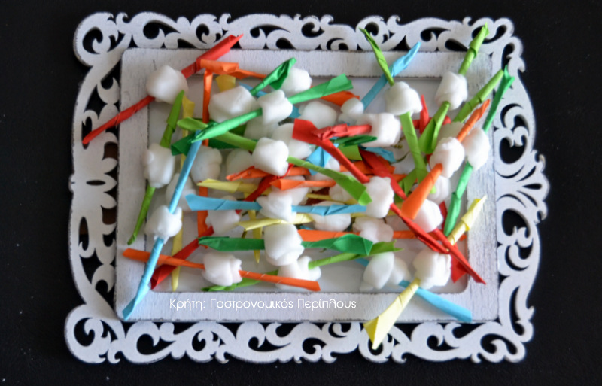

Slide 39
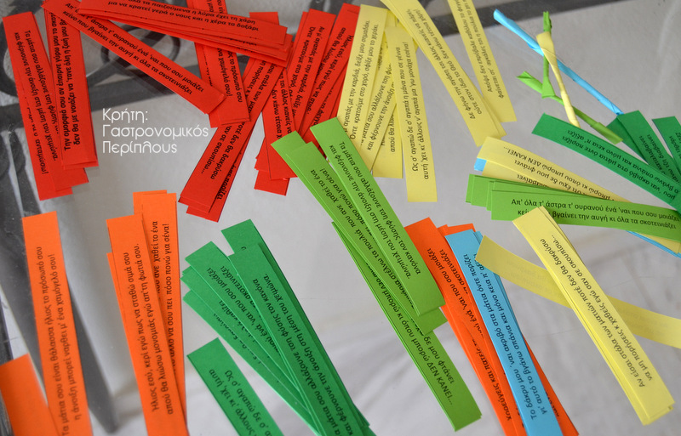

Slide 40
the recipe is:
1 small cup hot water
2 sheets of gelatin
2 vanilla powder
It takes about two packets of powdered sugar.
Implementation:
Dissolve the gelatin and vanilla in hot water. Put the sugar and knead until it becomes a pliable dough (a kind of sugar paste). We take small amounts of the sugar dough and shape strings . Then cut as much of the string as needed to wrap the paper with the mantinada that we have wrapped in a conical shape. Throughout the process, we have covered the dough with a damp cloth so that it does not dry out. After we mold all the dough into mantinades, we put them on a large surface to dry. From time to time we shake them to dry.

Slide 41
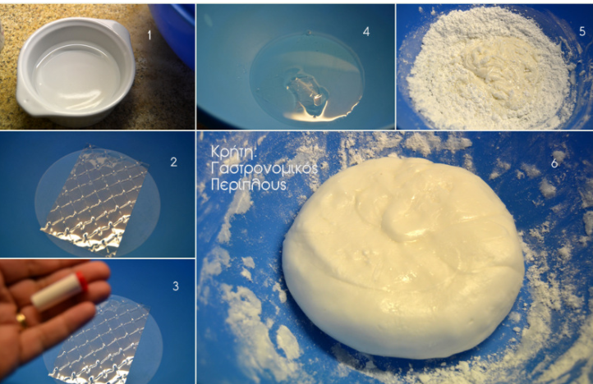

Slide 42
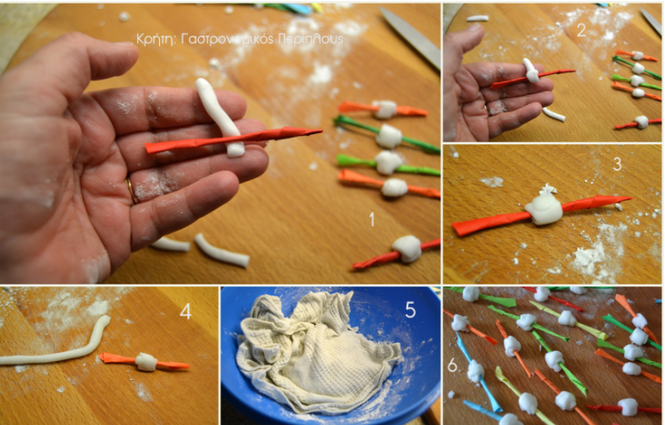

Slide 43
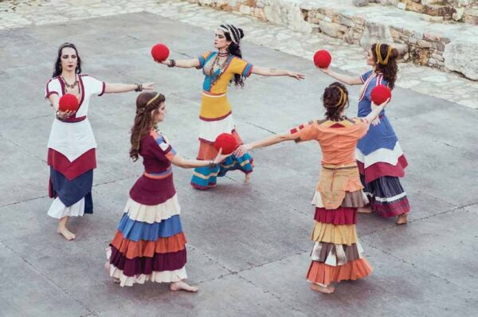
Time for dancing !
Do you know that Cretan dances have their roots in the Minoan times?
Tell me some Cretan dances .

Slide 44
Pentozali or Pentozalis
It is an enthusiastic and warlike dance, which took its name from the five basic steps. It is danced by men and women held by the shoulders, with arms outstretched in an open circle. Pentozali is, perhaps, the most famous, but also historical dance of Crete and represents the Cretan bravery.
https://www.youtube.com/watch?v=isxCFZsrcbs

Slide 45
Maleviziotis is one of the most popular dances in Crete.
It took its name from the province of Malevizi where it first appeared. It is even said that it came from the ancient war dance (a kind of pyrrhic dance) or from some other kind of war dance that represents scenes of the battle or the attempt to occupy the castle of Heraklion.
This dance is accompanied by music from a Cretan lyre, askomantura, violin, lute or mandolin.
It is a leap dance. It is one of the fastest and liveliest Cretan dances. For this reason, it is one of the most beloved. It is danced in a circle .
It includes 16 steps: 8 forward and 8 backward. The dancer who holds first, has the ability to detach from the circle so as to make spin jumps .
https://www.youtube.com/watch?v=MbXKJWuormA

Slide 46
Syrtos or Haniotis
It is the most popular dance in Crete. It is danced in a circle and consists of 12 steps. The movements are simple and uniform. Its primary form is located in the area of ​​Chania and is danced by men and women. It is also called sirtos because the dancer's feet crawl on the ground without losing contact with the land which the Cretans worshiped as a goddess.
https://www.youtube.com/watch?v=38AcD40WjDk&list=RD38AcD40WjDk&index=1

Slide 47
Sousta
Sousta is the dance of Crete that has taken many elements from the ancient pyrrhic. The special way it is danced proves it. The dance is danced by men and women, alternately holding the palms together forming a semicircle at the beginning by dancing, then they separate and stand facing each other forming two groups, men and women. Throughout the dance, a story develops between the couple, the man with calls and hugs, with twists and turns invites the woman, approaches her erotically.
The woman in turn with creases and approaches with turns and distances resists the love call.
https://www.youtube.com/watch?v=2wDPjmfbctE

Slide 48
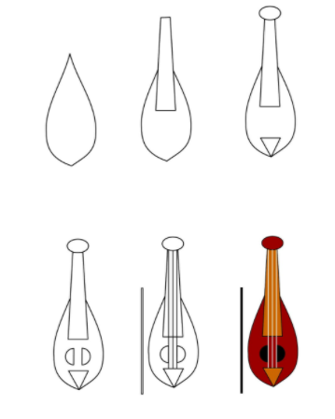

Slide 49
Now join the pieces of the puzzle to make the island of Crete .
https://www.jigsawplanet.com/?rc=play&pid=1672efb50830

Slide 50
Let’s play ! Open the link and find the pairs .
https://learningapps.org/watch?v=pxj3kog1n17&fbclid=IwAR2dFPEBS5FEfOOh5OV4u8ZzuTVgn0vfm_HQrspjw0hwm7dbeuvo6s_jMOQ

Slide 51
CROSSWORD
https://learningapps.org/view19903436

Slide 52
LET’S PLAY THE GAME !!
https://learningapps.org/view19902211

Slide 53
PUZZLE
https://www.jigsawplanet.com/?rc=play&pid=370f282cebd7

Slide 54
How well do you know Crete?
https://learningapps.org/display?v=p85tajaij21

