Slide 2
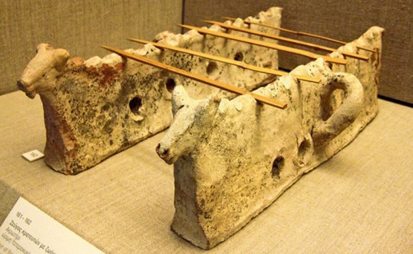
Αt the Archaeological Museum of Heraklion, in a display case there is the Cretan version of the grill, on which the Minoans baked their own skewers
This is one of the most characteristic delicacies of Greek gastronomy. Although in the same or similar form it exists in many countries of the world, the souvlaki has been identified with the cuisine of our country, not only in the consciousness of our own, but also abroad. Its roots go back to antiquity. The first mention is found in the Iliad where we meet Achilles cooking pieces of meat on the embers.
The souvlaki was known as "obelisk" (skewer = spit). It appears, among others, in the works of Aristophanes, Xenophon, Aristotle.
Characteristic is the reference of the ancient Greek biologist and gourmet Athenian in his work “Deipnosofistes", where Igisippos in his "Opsartytiko" (cooking guide he wrote), mentions a dish called "kandavlos", which contained pieces of meat , pie and dill and served with broth.

Slide 3
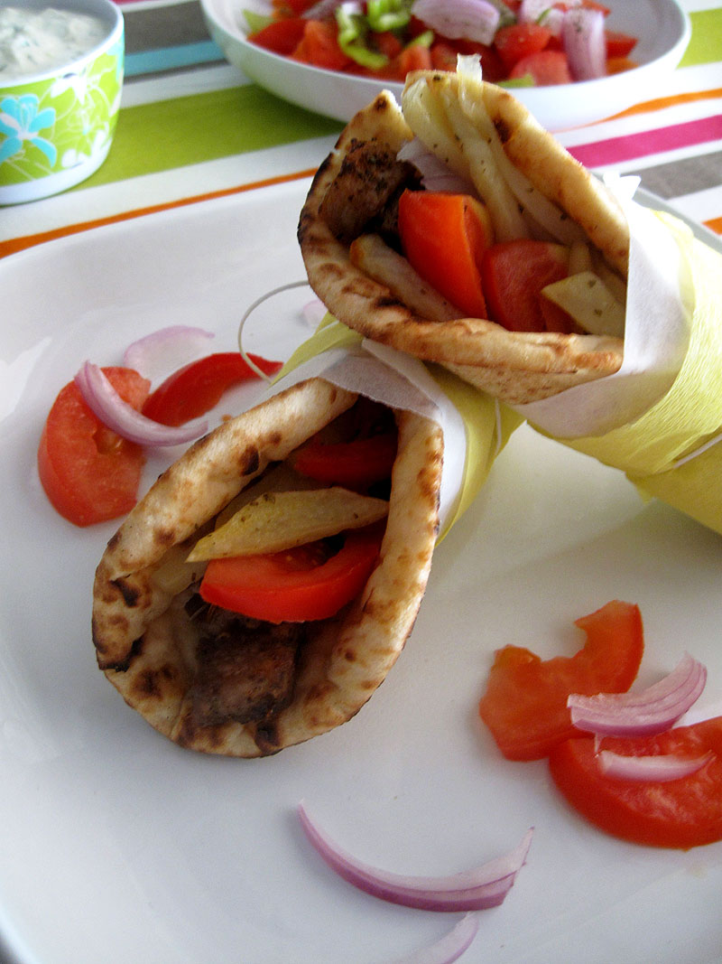
A balanced diet can include souvlaki as if combined properly with chicken straw, vegetables and yogurt or tzatziki it is a complete meal and a smart choice for your cheat meal.

Slide 4
souvlaki
INSTRUCTIONS
Add olive oil, lemon juice, white wine vinegar, minced garlic, dried oregano, salt and pepper to a small mixing bowl or measuring cup; mix until well incorporated.
Place chunks of chicken/pork in a bowl and pour marinade over them. Mix to coat really well, cover and place in the refrigerator to marinate for a couple of hours, or better yet, overnight.
Place skewers to soak in cold water for about 30 minutes before you start building your souvlaki.
Preheat outdoor grill (or grill pan) to medium-high heat.
Remove chicken/pork from the marinade and skewer onto bamboo sticks. Discard unused marinade.
Grill the souvlaki, turning them a few times, until chicken is cooked through, is nicely browned and has nice grill marks and is no longer pink in the center, about 10-12 minutes total.
INGREDIENTS
2 lb skinless chicken breasts or pork, cut into bite size chunks
1/4 cup extra virgin olive oil
2 tbsp lemon juice
2 tbsp white wine vinegar
3 cloves garlic, minced
1 tbsp dried oregano
1 tsp sea salt
1 tsp freshly ground black pepper

Slide 5
tzatziki
Ingredients
300 g strained yogurt
1 cucumber
1/3 clove(s) of garlic
3 tablespoon(s) vinegar, of white wine
1/4 bunch dill, finely chopped (optional)
2 tablespoon(s) olive oil
1 pinch salt
pepper
Peel the cucumber and grate with a cheese grater, using the large blades.
Put in a bowl. Add a pinch of salt and 1 tablespoon of white wine vinegar.
Set aside to release its liquid.
In the meantime, combine the yogurt, 1/3 of a garlic clove (minced), 2 tablespoons white wine vinegar and 3 tablespoons of olive oil.
Mix until it is combined and creamy.
Squeeze the cucumber with your hands to release any remaining liquid. Discard the liquid and add the cucumber to the yogurt mixture.
Stir into mixture. Add pepper and adjust salt according to taste.
Add some finely chopped dill and your sauce is ready.
Refrigerate until needed.

Slide 6
Pita bread
Ingredients
160 ml milk , at room temperature
80 ml water, at room temperature
1 teaspoon(s) granulated sugar
2 tablespoon(s) olive oil
2 teaspoon(s) yeast
320 g hard flour
salt
pepper
Combine the sugar, yeast, olive oil, water and milk in a bowl. Set the bowl aside for 5 minutes, until the mixture starts to froth.
In another bowl, combine the flour, the salt and give it a mix to combine.
Add the oil to the yeast mixture and stir to combine.
Add the yeast mixture to the flour mixture in batches. Make sure each batch is incorporated before adding the next.
Transfer mixture to a lightly floured working surface. Knead for 4-5 minutes until the dough becomes smooth.
Brush a bowl with some oil and add the dough.
Cover with a towel and let it rest for about 40 minutes, until it rises and doubles in size.
Place a pan over medium heat.
Press on the dough to remove the air and cut into 6 equal sized pieces.
Place pieces of dough on a lightly oiled working surface. Use a rolling pin to roll out each piece of dough to a circle 20 cm in diameter.
Cook the pita bread for 1-2 minutes on each side in the pan, until they puff up slightly.

Slide 7
To serve the souvlaki you will need sliced tomatoes, onions and parsley. You can serve it in two ways with pie open or with wrapped. Bon appétit !!!

