Slide 1
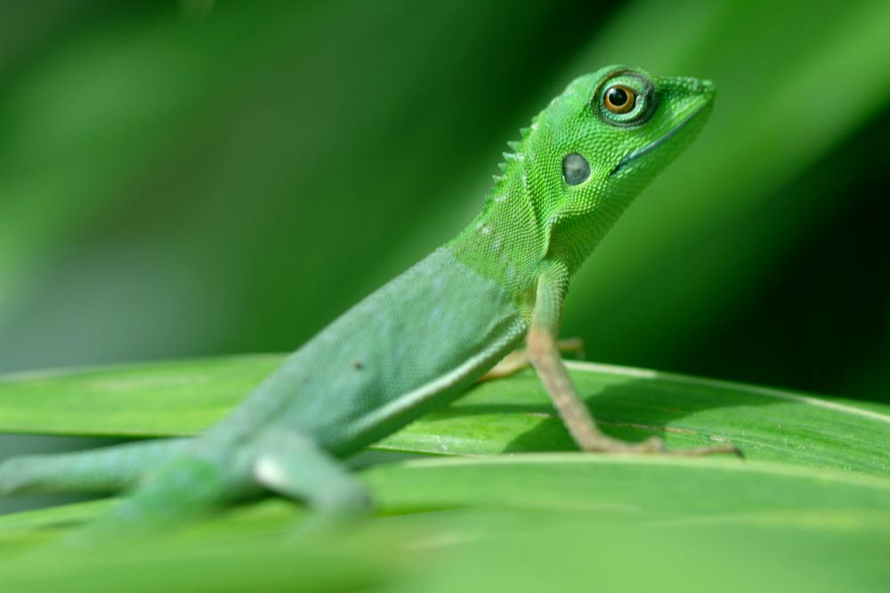
LIZARDS

Slide 2
According to Wikipedia we found out that lizards are reptiles.
With over 6.000 species in all continents, except Antarctica.
Their size range from a few centimeters long to three meters long, as Komodo dragon!

Slide 3
Humans have always been afraid of lizards and snakes !!
But snakes and lizards are very important for maintaining the balance of the natural environment, as they feed on harmful insects and rodents.

Slide 4
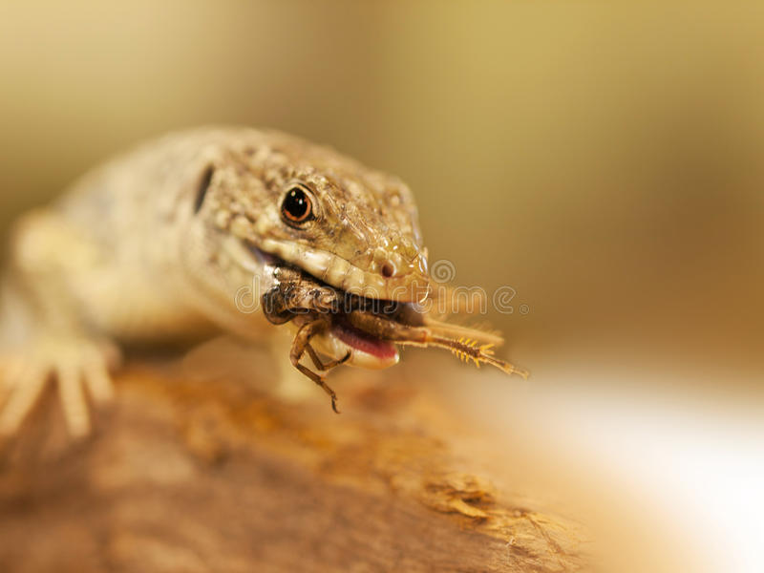
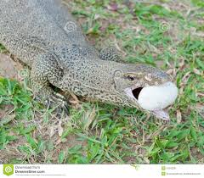
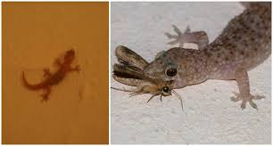
Most lizards have four legs and can run. Others are legless and have long snake like bodies.
They eat insects and mice, except Komodo dragon that eats mammals…

Slide 5
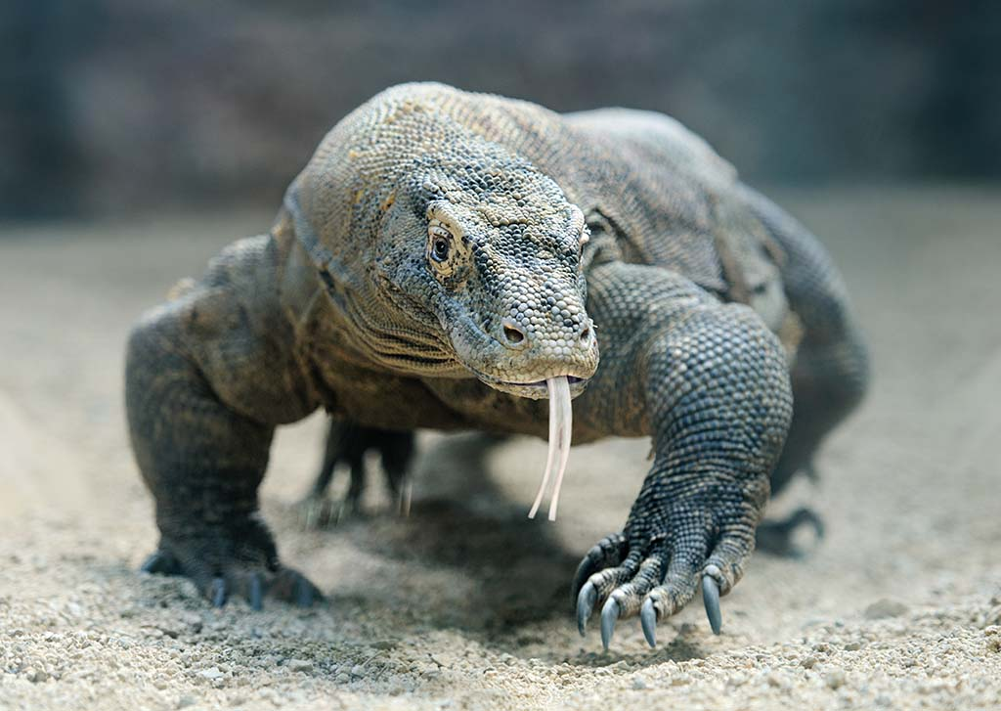
Here’s a Komodo dragon lizard!

Slide 6
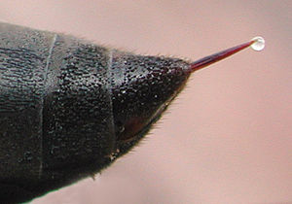
Lizards use a variety of adaptation, such as:
Venom

Slide 7
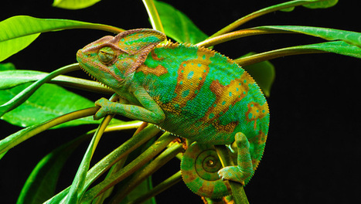
Camouflage

Slide 8
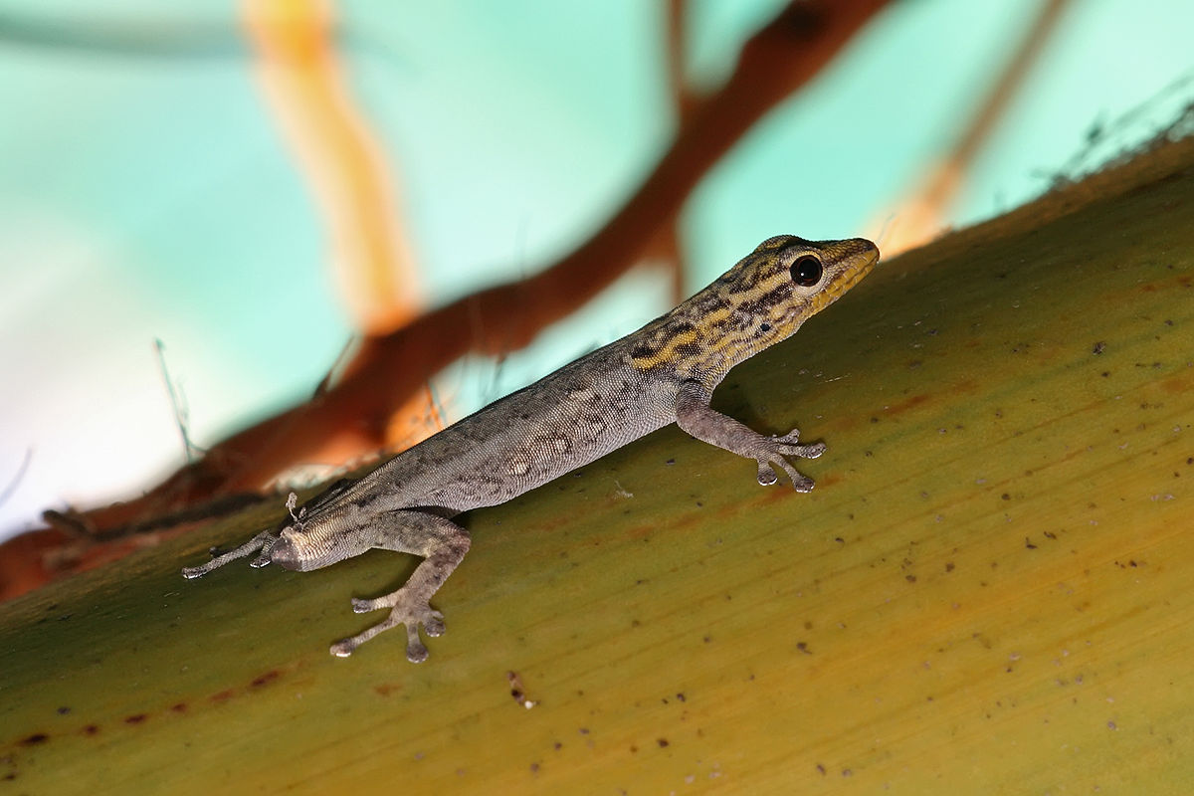
Ability to sacrifice and regrow their tails

Slide 9
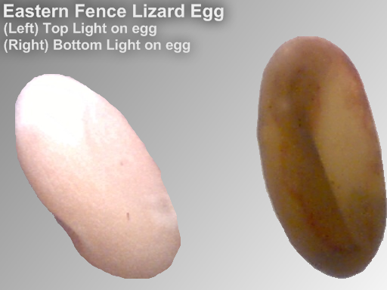
Lizards lay eggs.
After mating, the female deposits the eggs in a protective structure like a nest or simply on the ground.
The eggs range from one or few large to dozens of small eggs.

Slide 10
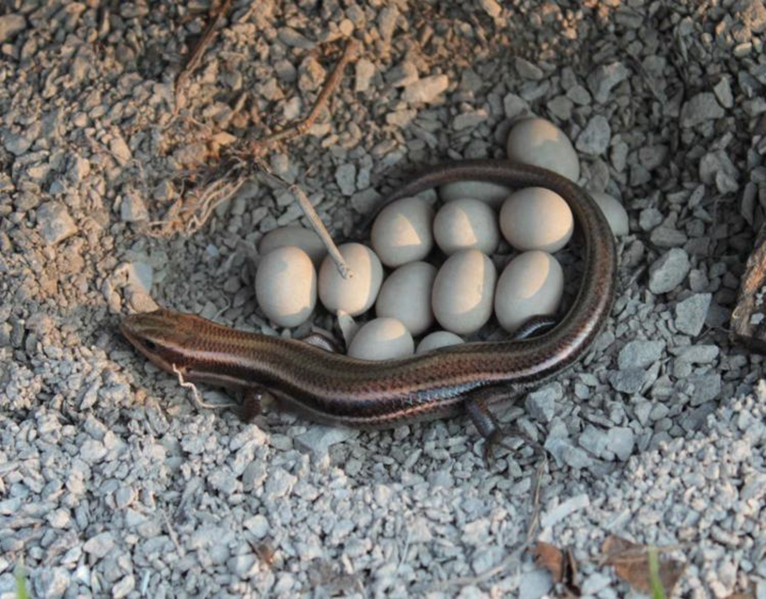
Inside the egg embryo use nutrients from the yolk.
The female usually abandons the eggs after laying them.
Protection of the eggs is observed in some species.

Slide 11
The temperature of the eggs can determine the sex
Low temperature produce females and higher temperature produce more males
However, lizards have both female and male chromosomes

Slide 12
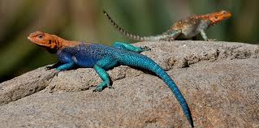
The majority of lizard species are active during the day, though some are active at night
They have limited ability to regulate their body temperature

Slide 13
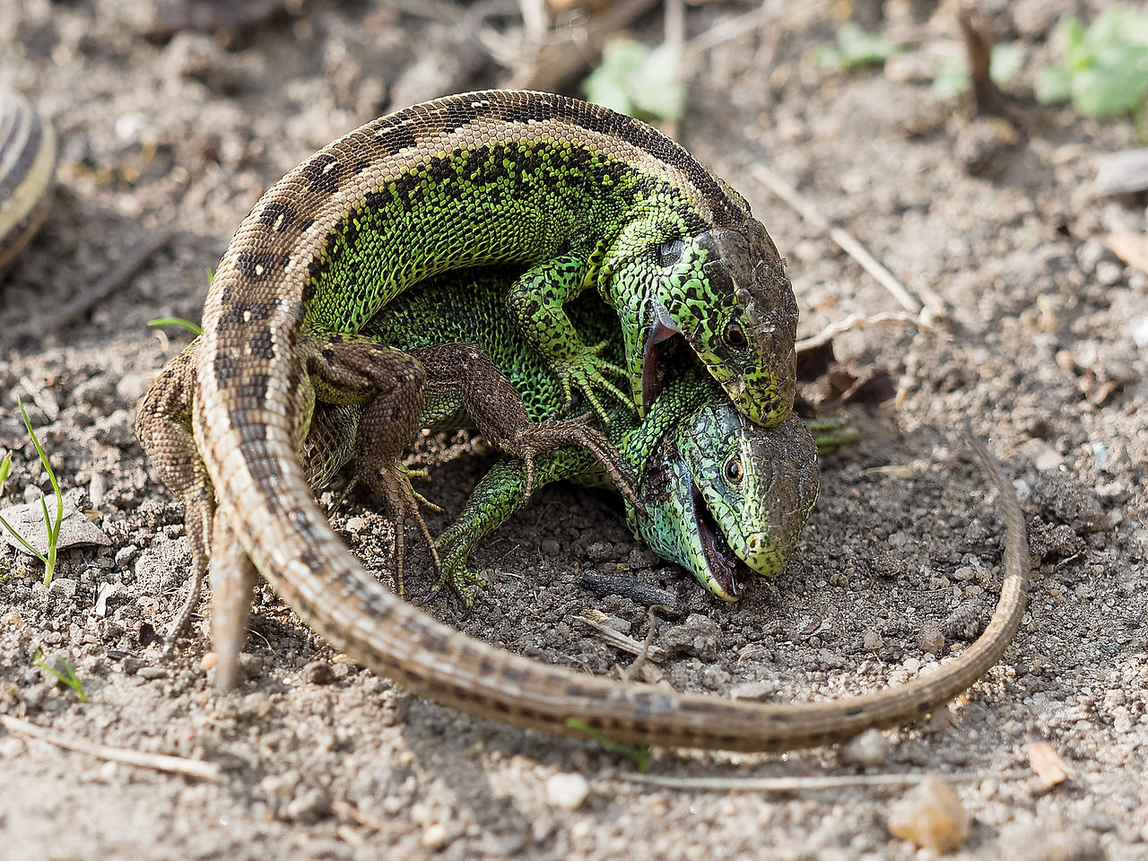
Most social interactions among lizards are between breeding individuals
However males establish and maintaim territories
Fighting male sand lizards

Slide 14
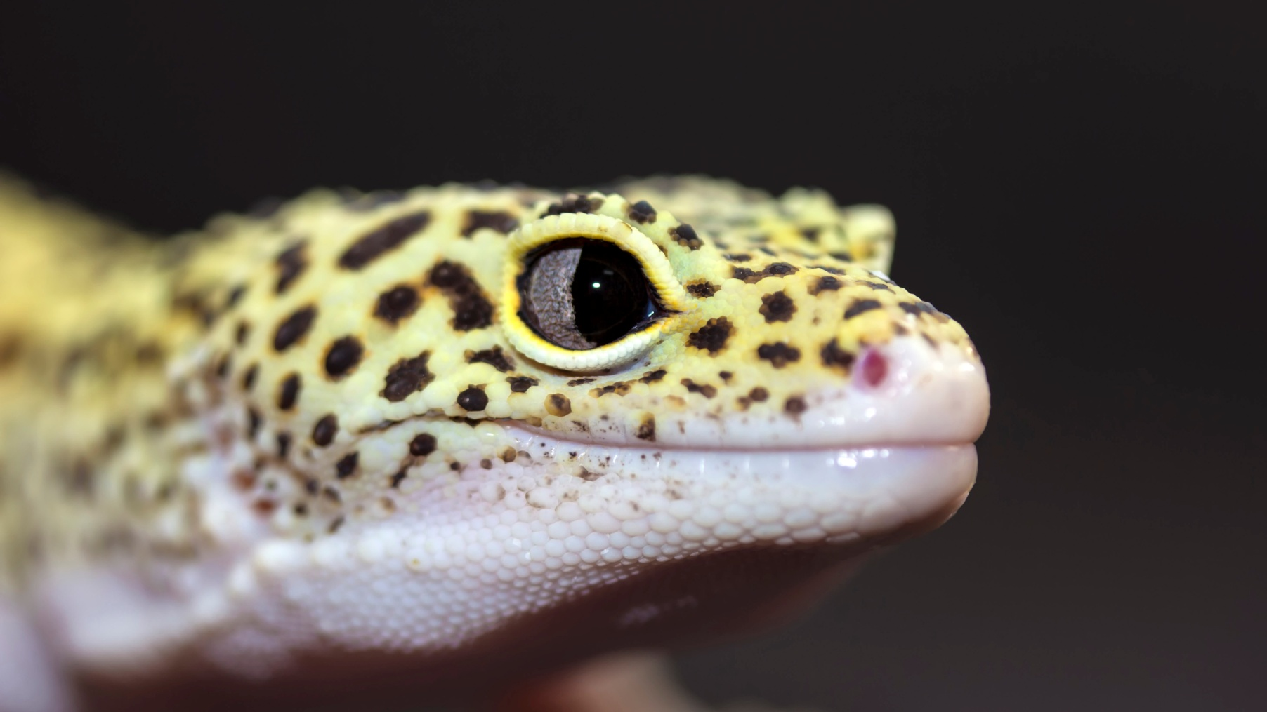

Slide 15
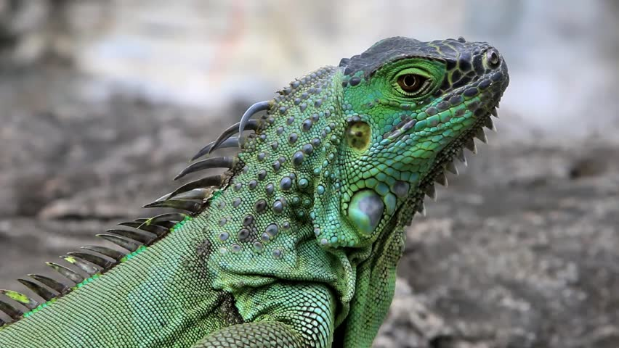

Slide 16
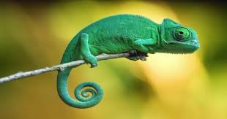

Slide 17
CRETAN LIZARDS

Slide 18
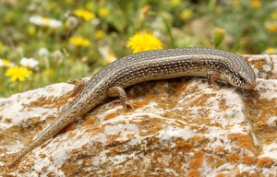
LIAKONI

Slide 19
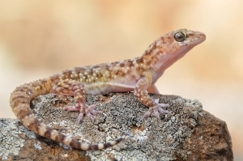
SIAMIMIDI

Slide 20
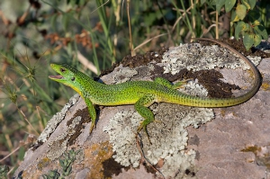
KOLISAVRA

Slide 21
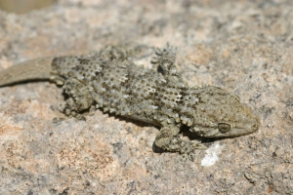
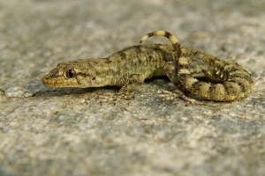
Tarentola mauritanica
Mediodactylus kotschyi

Slide 22
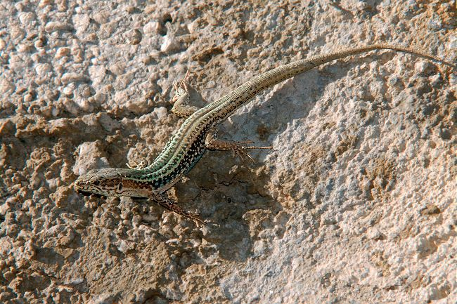
CRETAN LIZARD
The lizard of Crete (Dr. Podarcis cretensis) is the only endemic species on the island.

Slide 23
It s a 7cm short lizard that lives mainly in rocky areas with phrygana, where it finds refuge between the rocks. When there are not many rocks, it hides in the phrygana. Females lay 1-5 eggs in mid-summer.
The lizard is active all day long, most in the morning and in the afternoon. It feeds on a variety of small arthropods and snails. Its main enemies are snakes, hawks, some small mammals, but mostly humans, who constantly interfere with their favorite places

Slide 24
THANK YOU !!!

