Slide 1
Learning about European Union
The European Union is a group of 27 European countries. These countries joined forces
for making the lives of the people who live in them better.
They agreed to work together and help each other.
The idea of ​​the European Union has begun after the two great wars fought in Europe.The countries of Europe have realized that it is better to work together rather than fighting each other. Initially, only 6 European countries started cooperating:
Belgium Germany France Italy Luxembourg Netherlands. Soon other European countries took part and thus the European Union was created.

Slide 2
Soon other European countries took part and thus the European Union was created. Today, the European Union has 27 countries.These countries are:
Austria, Belgium, Bulgaria, Croatia, Cyprus, Czech republic, Denmark, Estonia, Finland, France, Germany, Greece, Hungary, Ireland, Italy, Latvia, Lithuania, Luxembourg, Malta, Netherlands, Poland, Portugal, Romania.
June 2016, England decided to no longer be a member of the European Union. Thus, from 31 January 2020, the United Kingdom is no longer a member of the European Union.

Slide 3
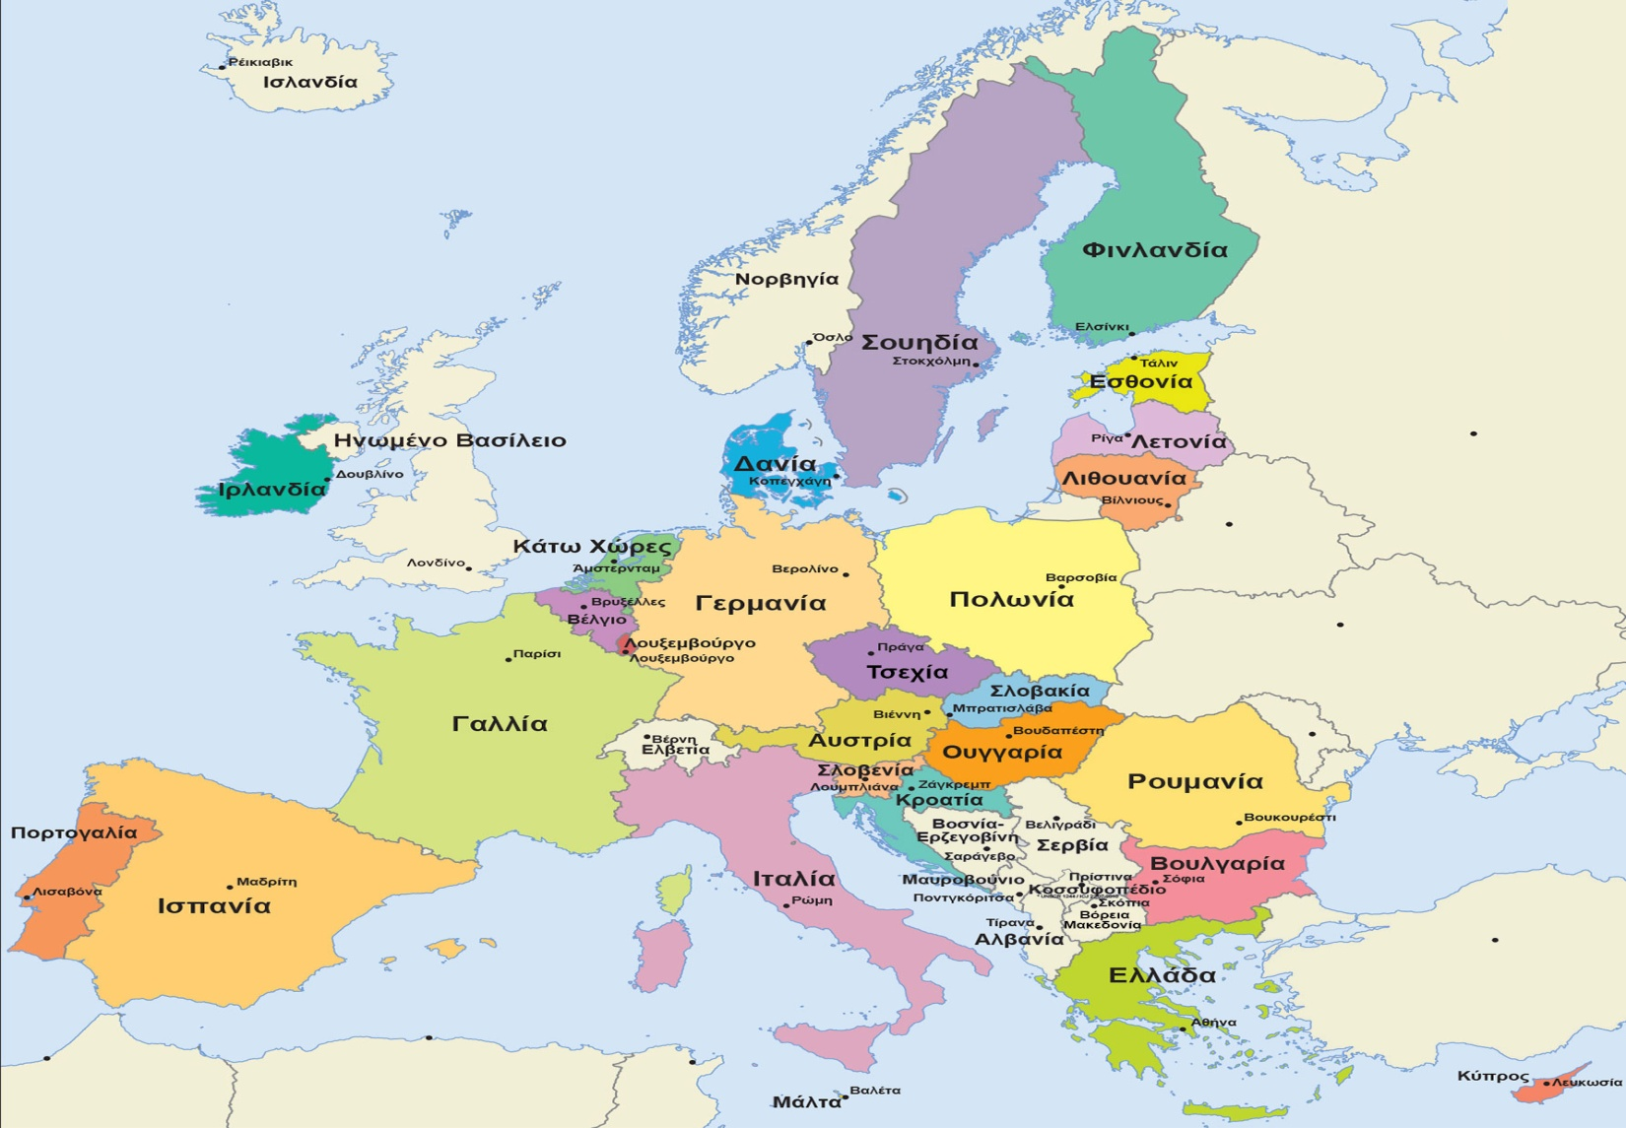
Map of the European union

Slide 4
Objectives and values ​​of the European Union
All countries that are members of the European Union cooperate with purpose:
to have peace in Europe
to live well its inhabitants
to have justice for all and there are no people on the sidelines
the languages ​​and cultures of all people to be respected
the economy in Europe is doing well and countries to use the same currency
to buy and sell things and services to each other more easily. The countries of the European Union have some important common values. For example, they care about the equality of all people and respect for their rights.

Slide 5
Peace and freedom in Europe
Since the creation of the European Union,there were no more wars between the countries constituting the European Union.Thanks to the European Union, all countries in Europe are cooperating peacefully.
In 2012 the European Union won a major award, "the Nobel Peace Prize".This award was given to the European Union because he managed to keep the peace inEurope.
The European Union has helped the people to move freely from one country to another.They can live, study or work in any country of the European Union they want.For example, a person from France can choose to go to Italy and work there.Or a student from Belgium can study at a university of Greece.
In every country of the European Unionthe inhabitants speak their own language.The European Union protects the rights of the people to communicate in their mother tongue.That is why the European Union provides all the important information in the languages ​​that people speak in their country

Slide 6
United in diversity
The European Union uses the expression "united in diversity“ to show its values. This expression means that: people living in the European Union they may have different cultures or languages but support each other and work together peacefully.
It's not a problem the existence of different languages ​​or cultures.The opposite. People who have different cultures they can learn more from each other and work well together.

Slide 7
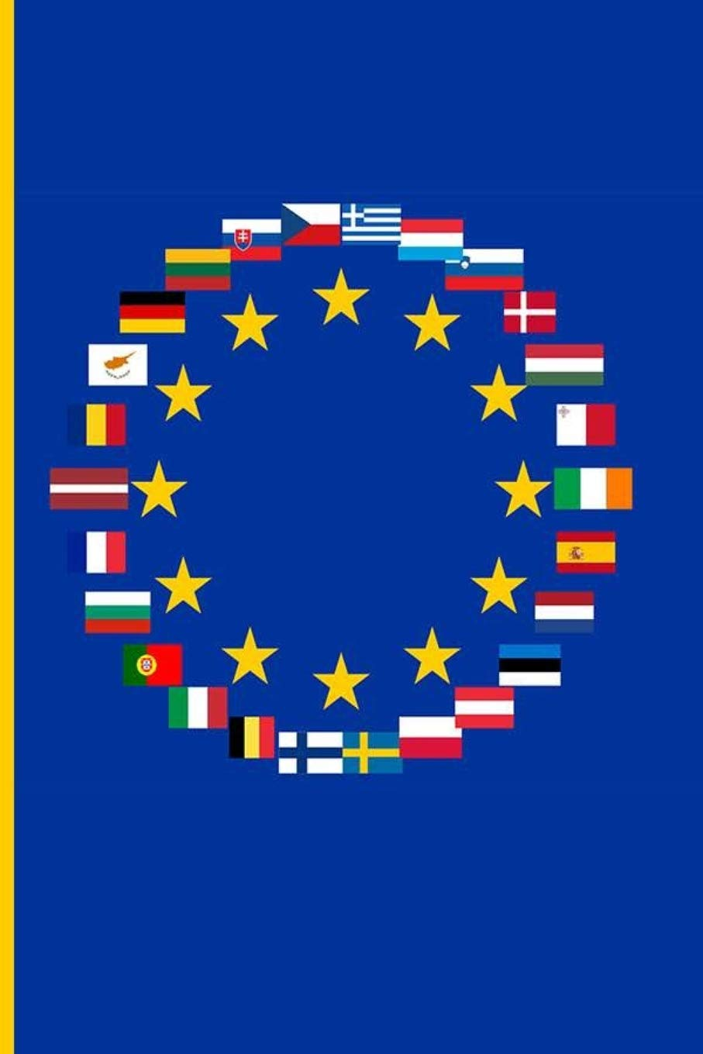

Flag of E.U.

Slide 8
The flag of the European Union is blue and has a circle of gold stars.It is a symbol that shows that the countries of the European Union are united and help each other. The flag has 12 yellow stars in a circle with a blue background, which symbolizes the ideals of unity, solidarity and harmony between the peoples of Europe. The number of stars has nothing to do with the number of Member States. The circle is a symbol of unityThe EU flag symbolizes both the European Union and the unity and identity of Europe in general.

Slide 9
"Erasmus" One word - Many meanings! Really, do you know what Erasmus is?
As we all know, everything has its own beginning, so this successful training program started somewhere. So let's get to know it and learn more ..
The program owes its name to the Dutch philosopher Erasmus, who lived and worked in many parts of Europe with the main goal of acquiring and expanding his knowledge. The Erasmus program is a student exchange program of the European Union created in 1987.
Erasmus + is the new program that combines all the current programs of the European Union for education, training youth and sport, which started in January 2014. Each year the program gives Europeans the opportunity to study, train, gain experience and volunteer abroad. Since 2014, over 2 million people have had the opportunity to participate in the program

Slide 10
"The world is like a book, and those who do not travel are like reading only the first page" (St. Augustine).
Erasmus is a big chance! Travel is a life experience that you carry with you forever! Our participation in the Erasmus program gave us the opportunity to travel to other cities in other countries and meet new people.
This fantastic experience not only gave us knowledge, but filled us as human beings in general! We return to our country with a suitcase full of memories, memories and confidence. Everything we have experienced will surely accompany us forever and we will remember it with love and a lot of nostalgia!

Slide 11
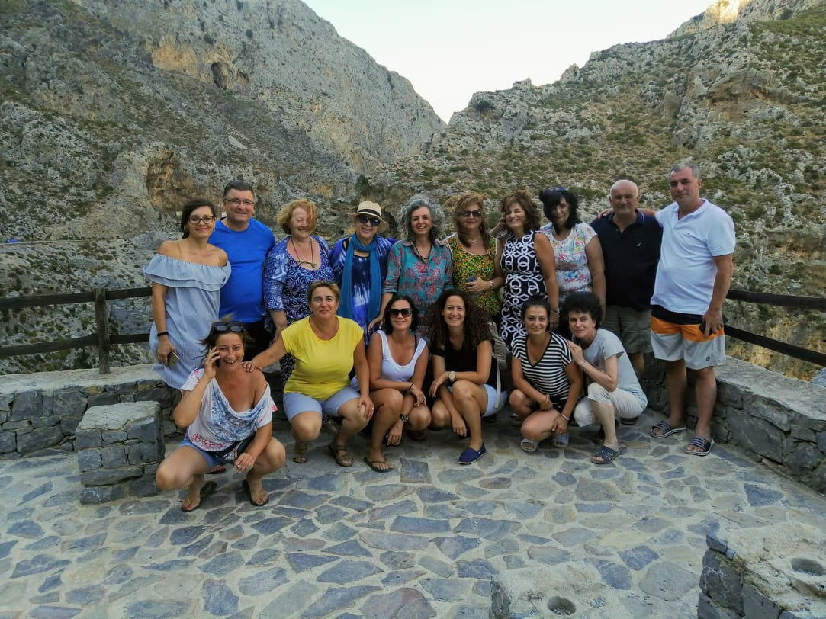
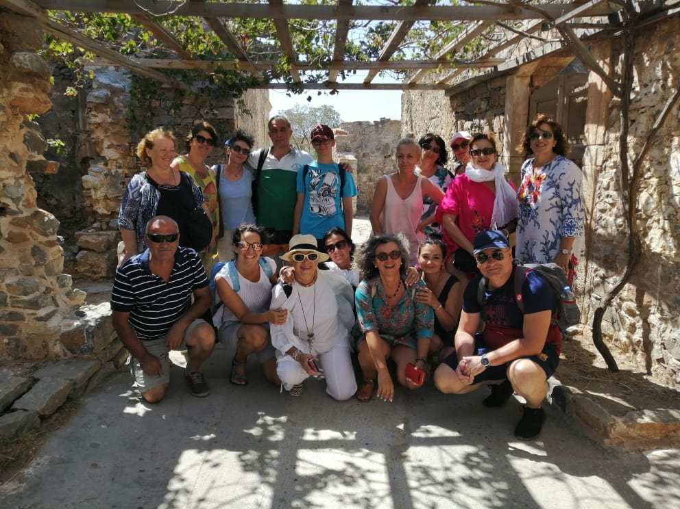
Beautiful Erasmus+ memories

Slide 12
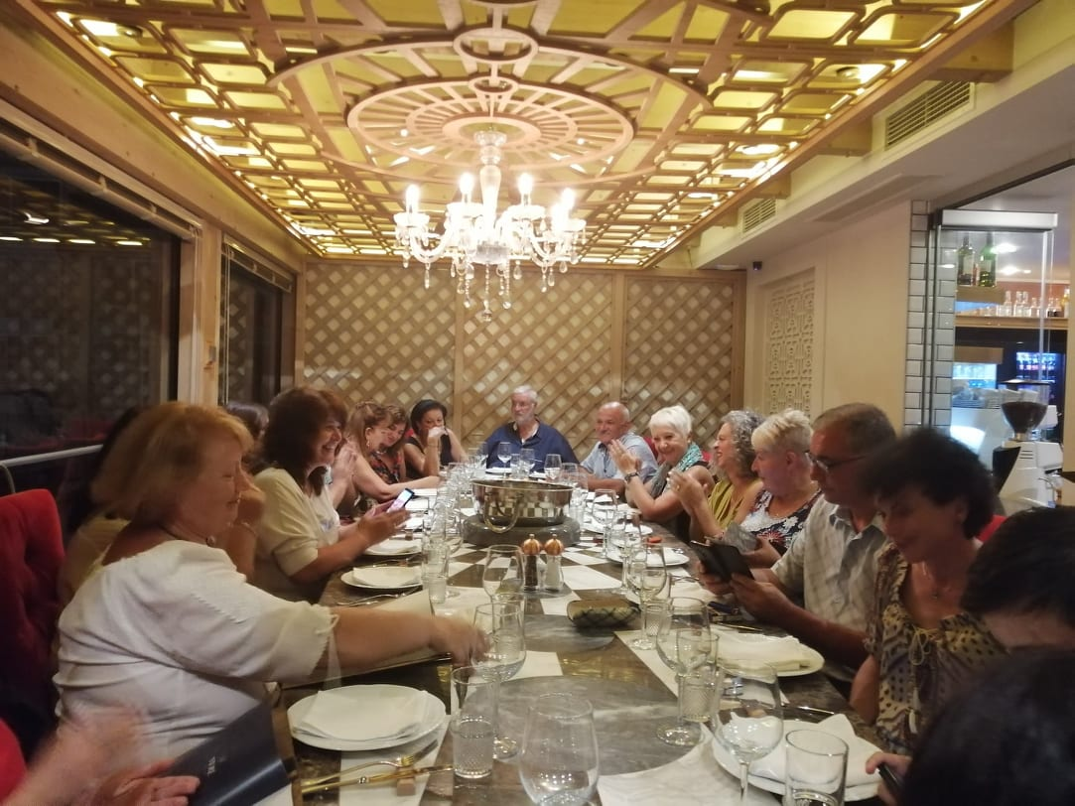
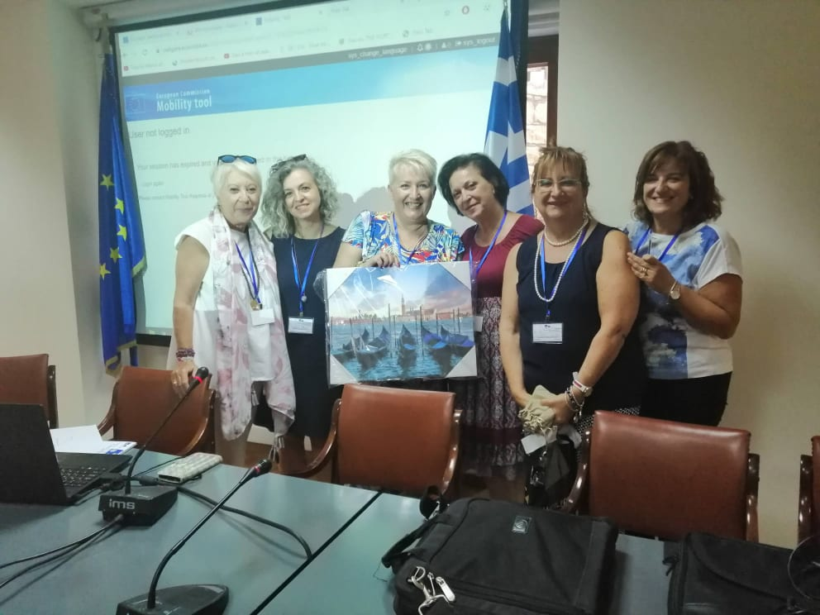

Slide 13
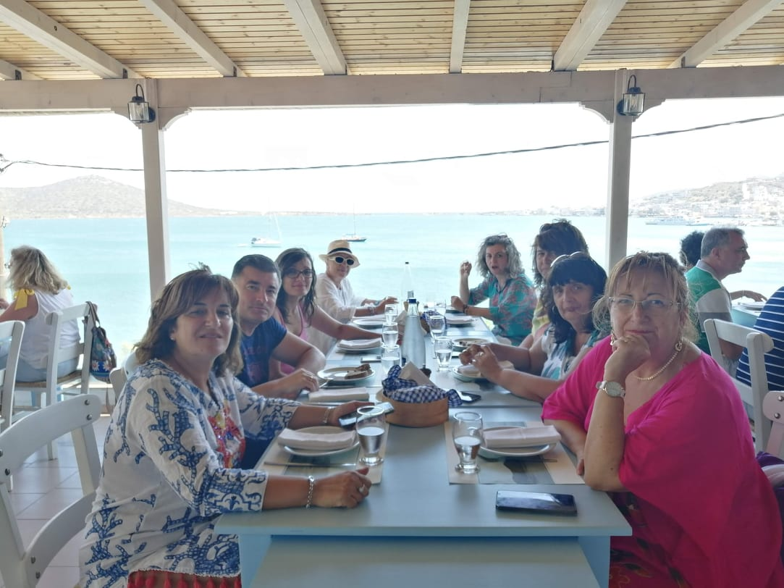

Slide 14
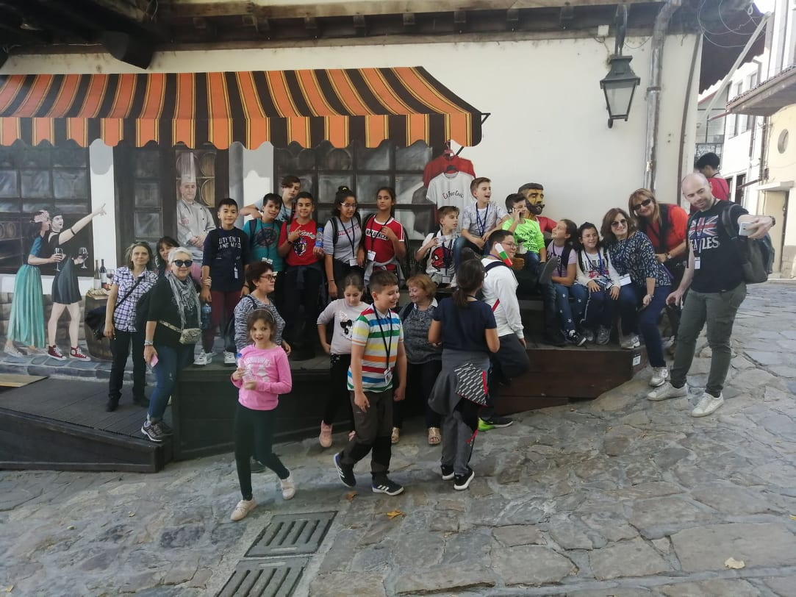
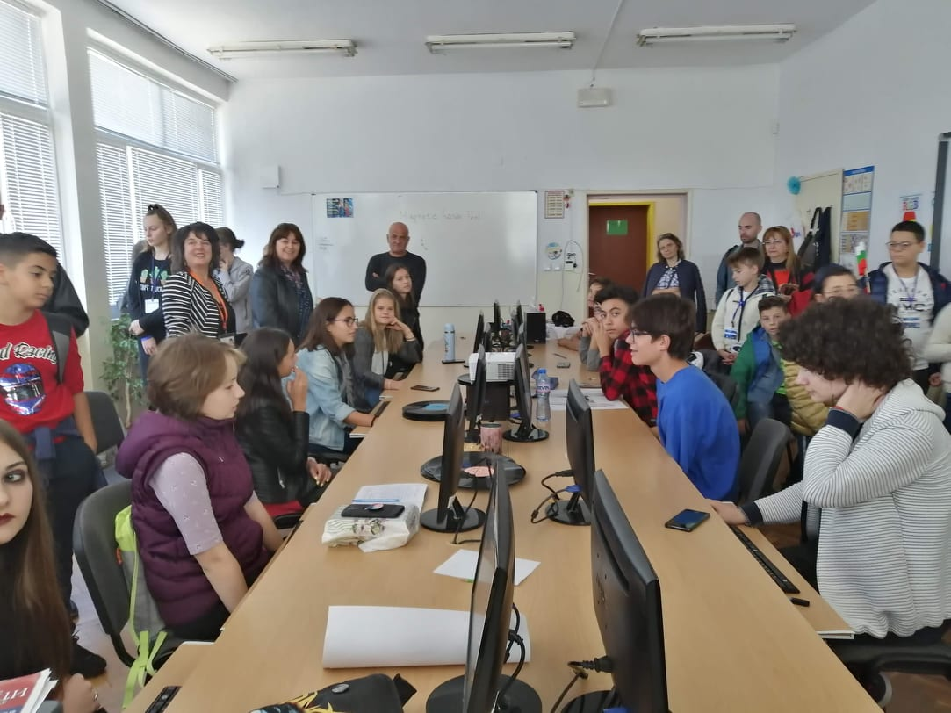

Slide 15
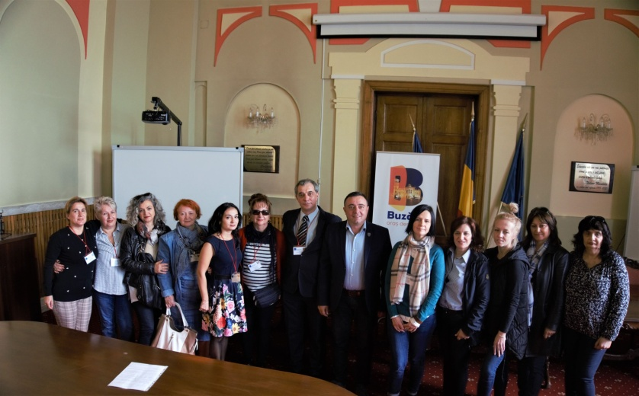

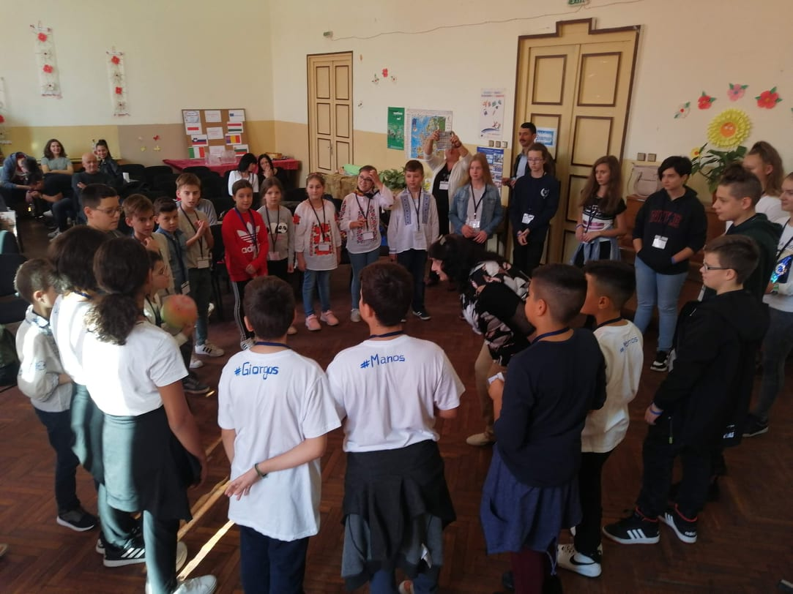
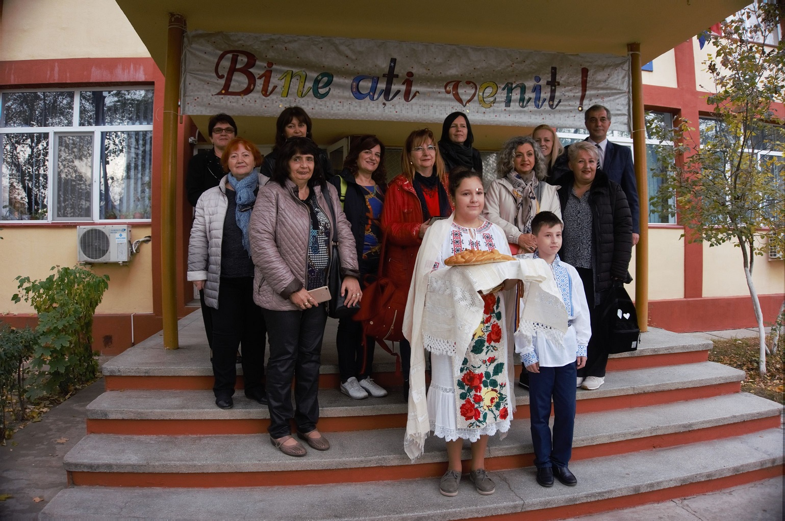

Slide 16
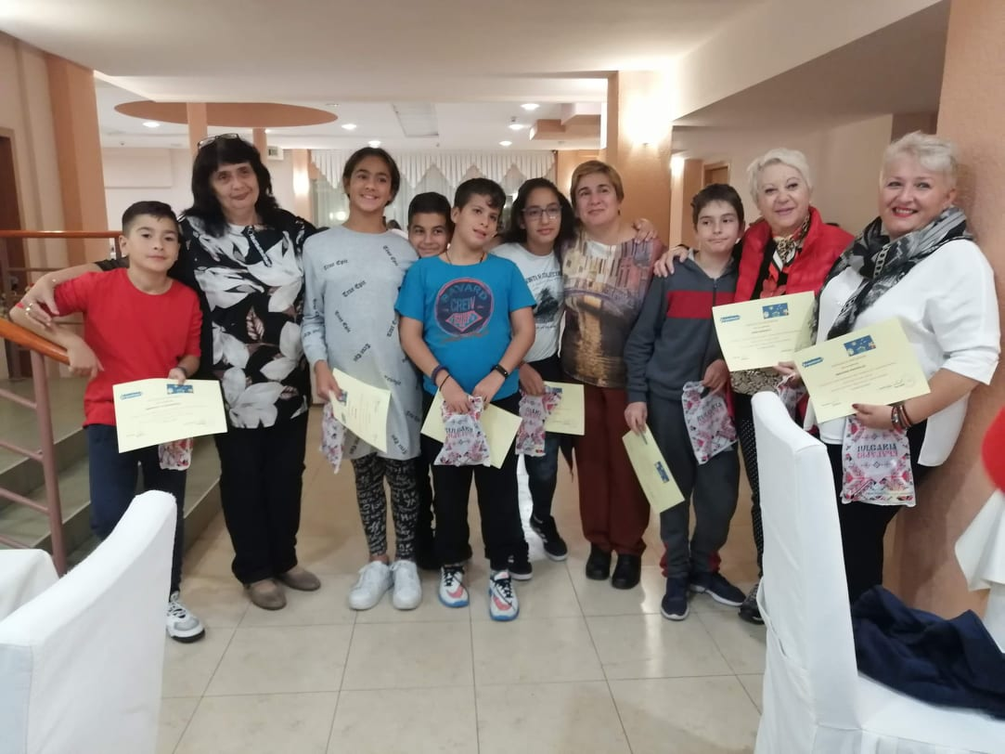
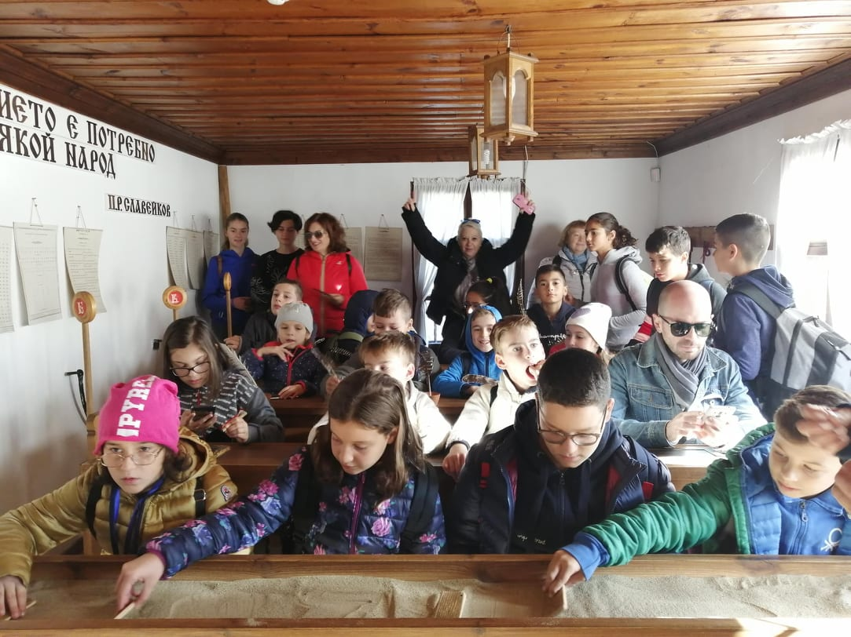

Slide 17
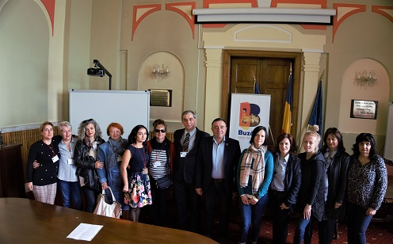
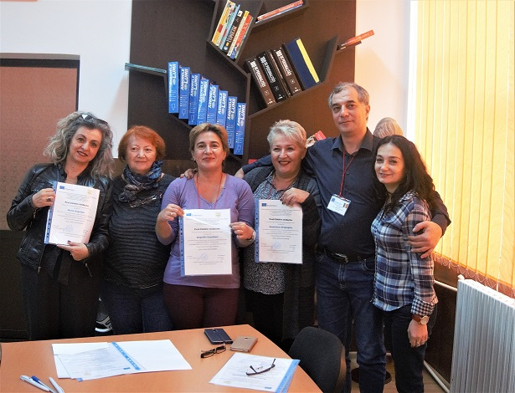

Slide 18
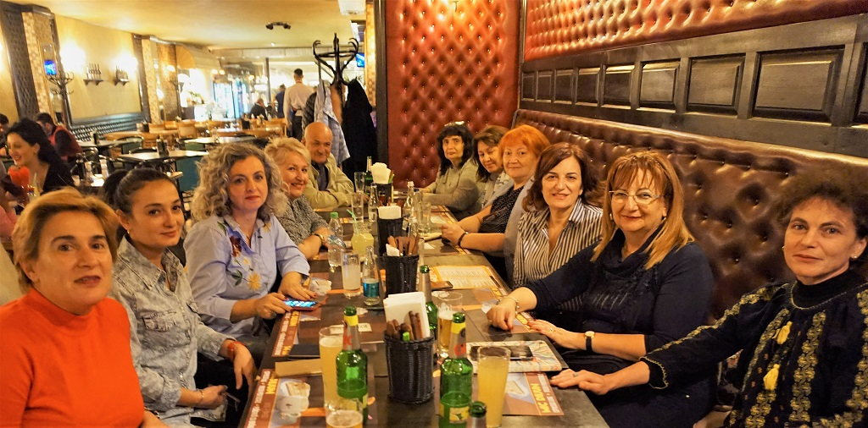
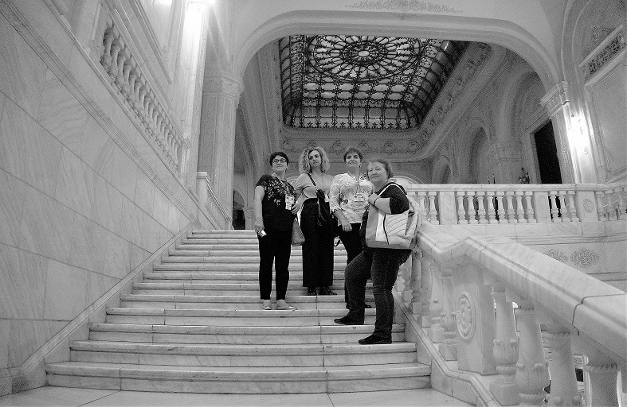

Slide 19
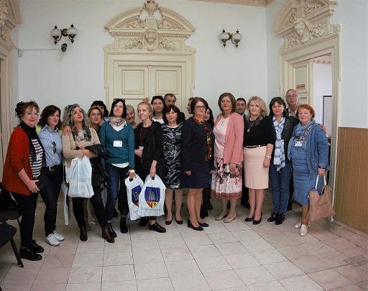
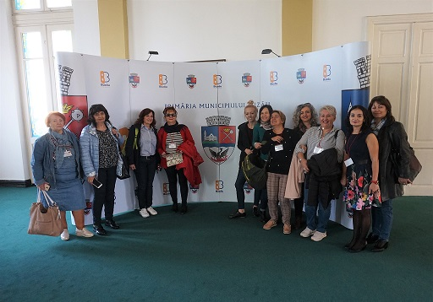

Slide 20
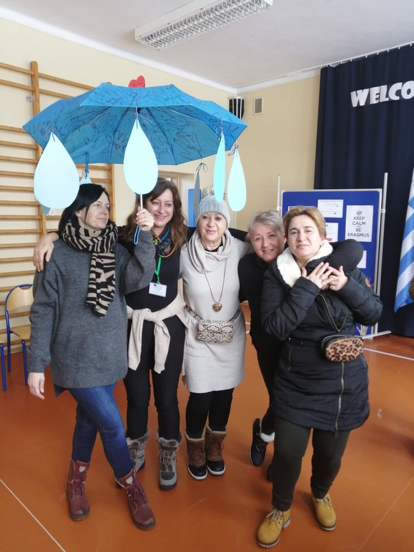
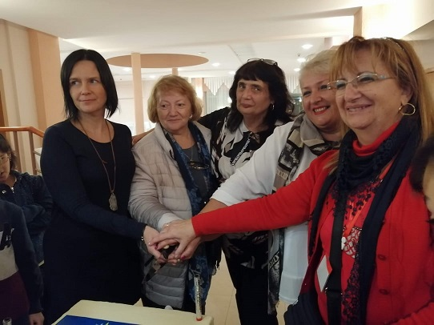

Slide 21
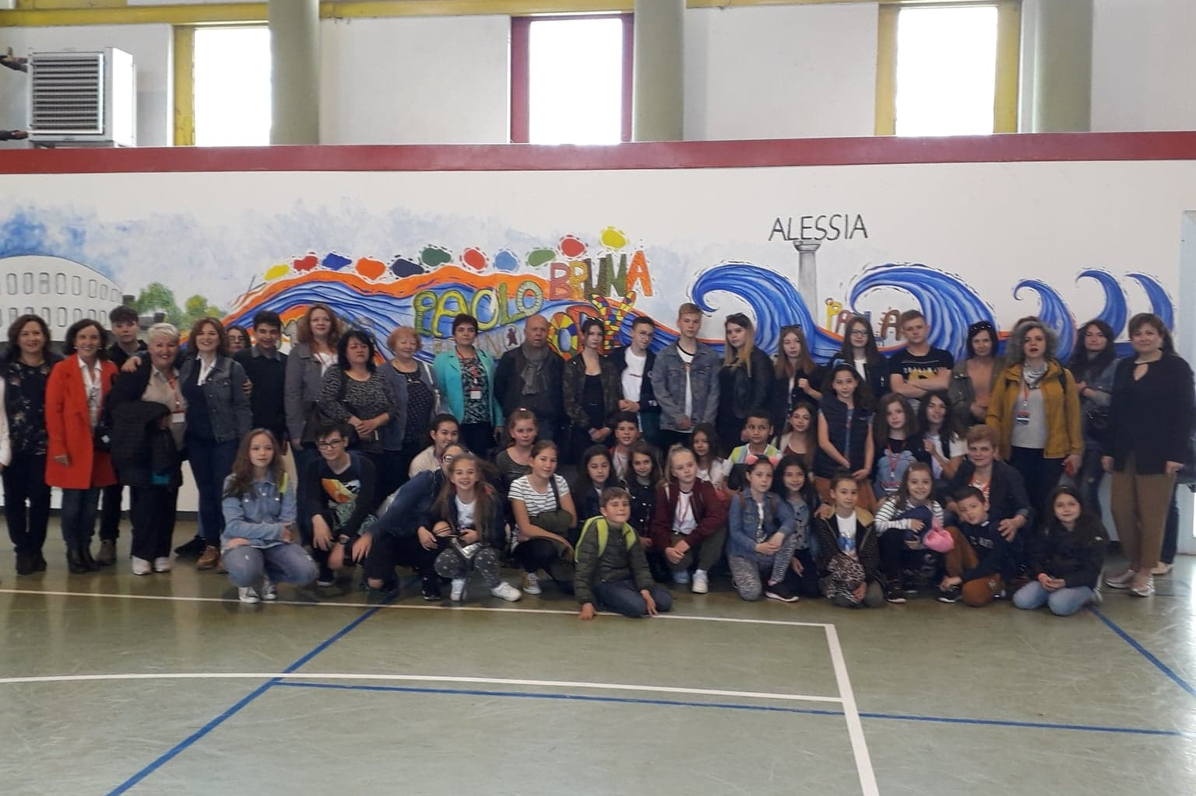

Slide 22
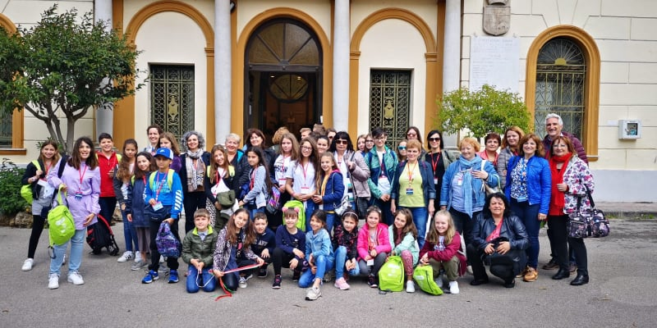

Slide 23


HOPE WE WILL SOON MEET AGAIN

