Slide 1
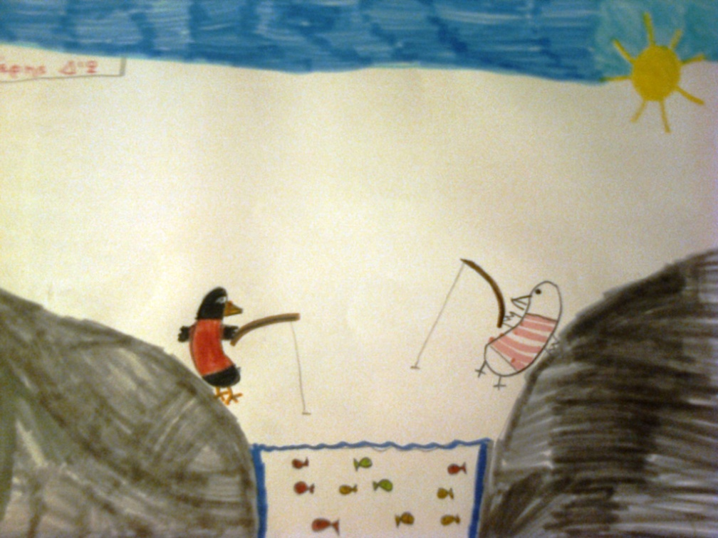
23rd Primary School of Thessaloniki, Greece eTwinning Celebrating Diversity
“Reading a book”
The Blackbird and the Seagull
May 9th

Slide 2
Reading a book about diversity
ACTIONS
To talk about diversity in our class, we took the occasion by reading all together in class a very nice French book, Kitty Crawther’s, "Mon ami Jim", which in its Greek edition is entitled "The black mockingbird and the white seagull” («Ο μαύρος κότσυφας και ο άσπρος γλάρος»).

Slide 3
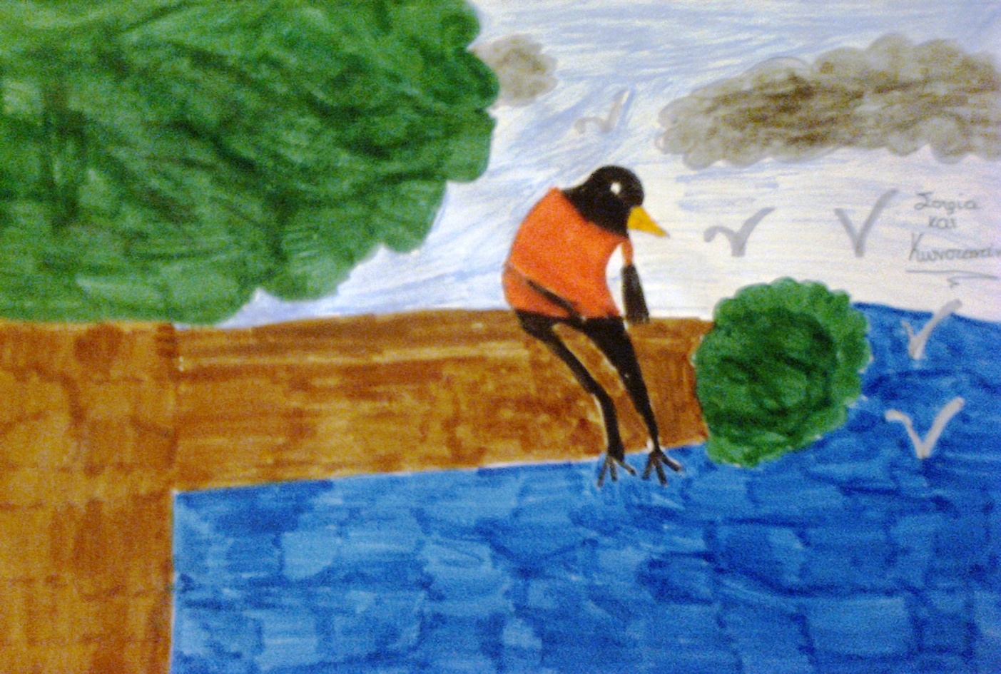
PROTAGONISTS James: a blackbird that leaves the forest and travels to the sea, where he meets the seagulls. Jimmy: a lone seagull who loves sea and fish, which makes the blackbird his friend and conflicts with the other seagulls for his sake. Seagulls: they are inhospitable, they judge James only by its color, they don’t even speak to him, they isolate Jimmy when he makes James his friend. But when they know him better, they do not hesitate to change their minds and accept him as their own. Albert: a little seagull who watched the two friends, transferred to the other gulls what they did and helped them understand that James was a remarkable bird which they had to make their friend.

Slide 4
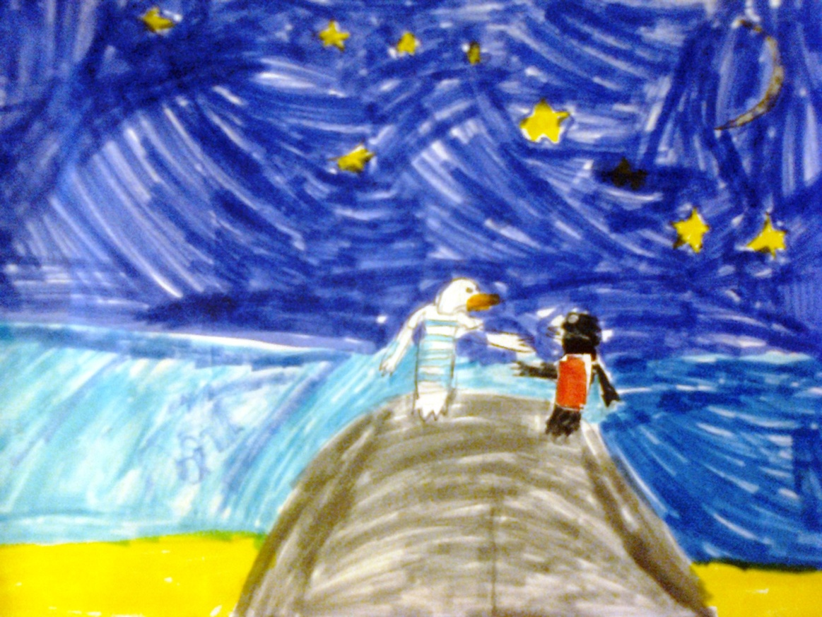
SUMMARY A blackbird, James, decided one day to visit the sea. When he saw it, he liked it very much. There he met a seagull, Jimmy, and they became friends. Jimmy called him to the village of seagulls. They had to travel for a whole day to reach it. James was very happy that he found such a nice new friend.

Slide 5
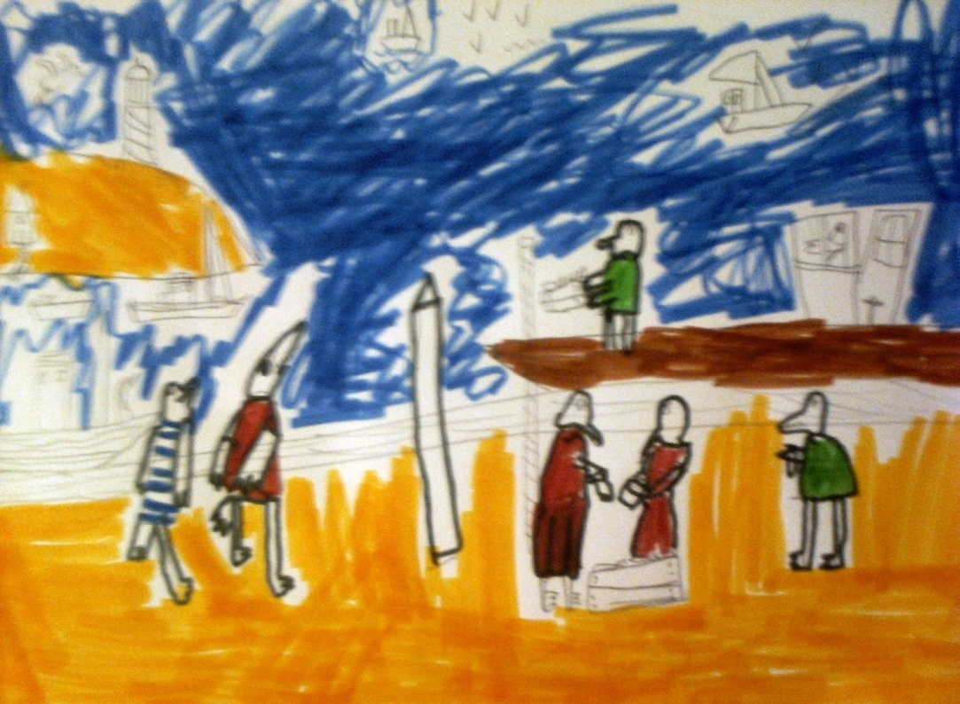
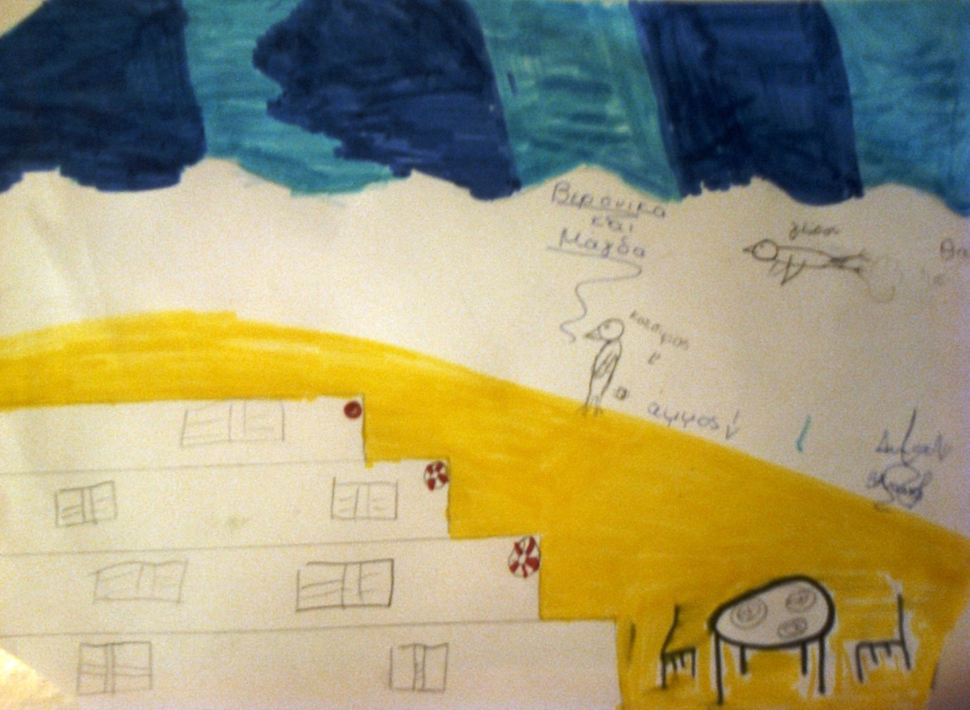
But in Seagull Village the gulls were not friendly towards him. His black color made them dislike him and did not speak to him.

Slide 6
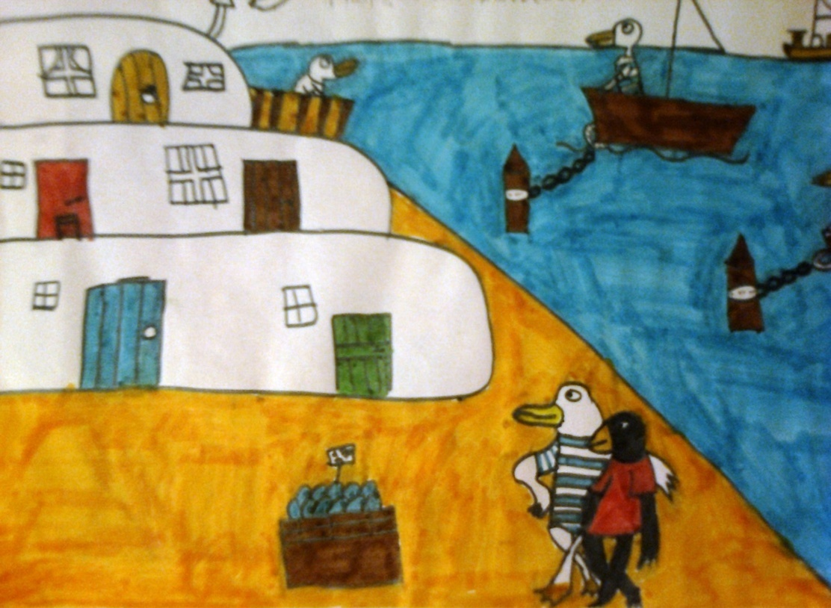
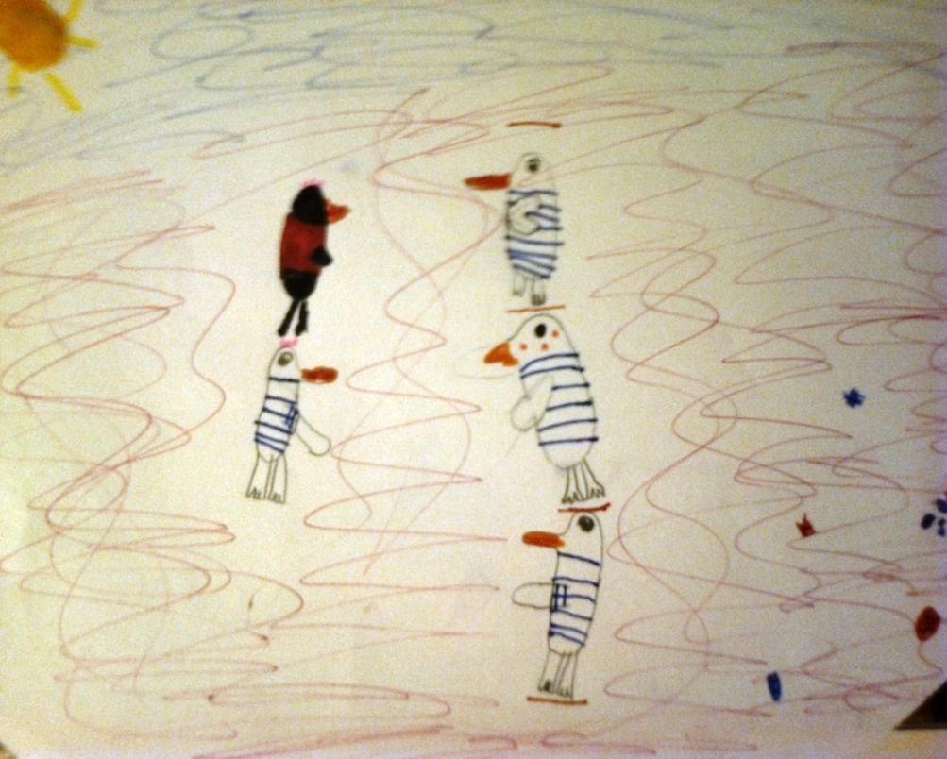

Slide 7
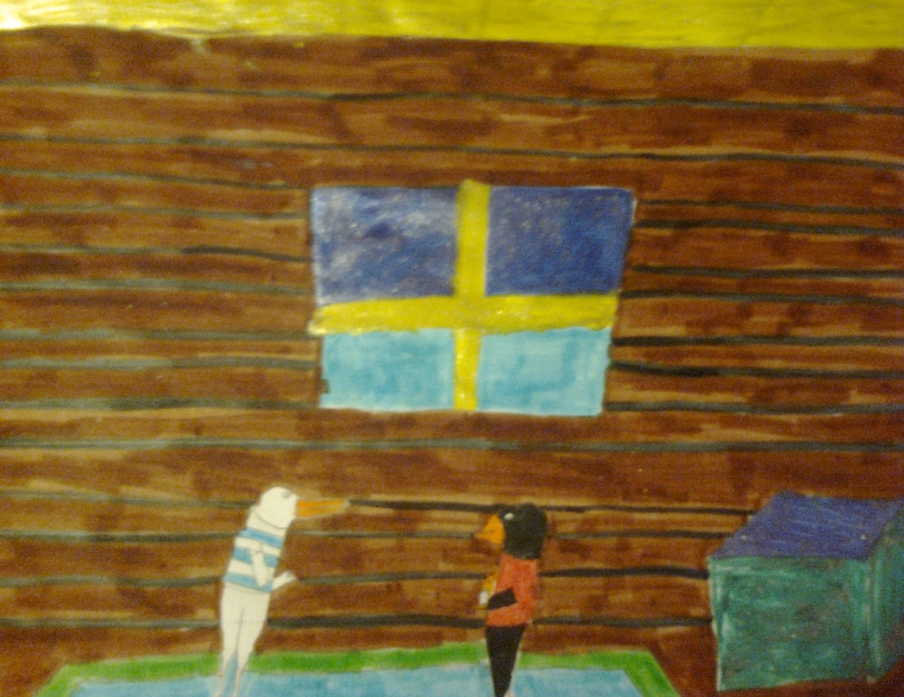
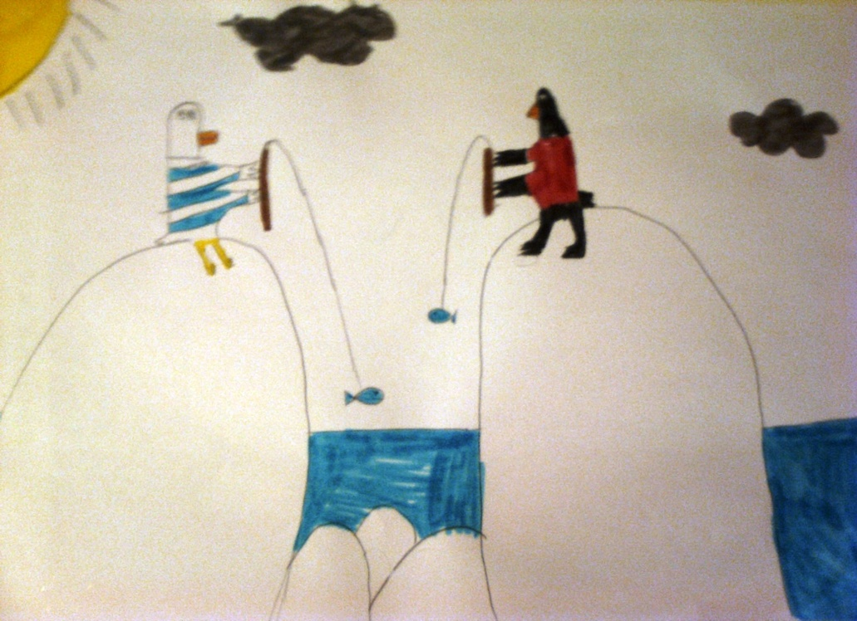
Jimmy was angry with them and took his new friend to his house, which was outside the village. There they spent their days by catching fish, walking in the forest and flying.

Slide 8
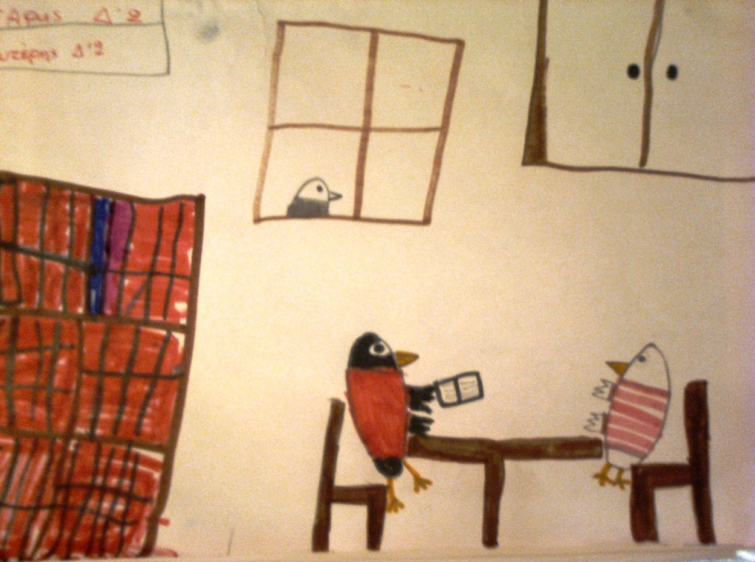
One day James found a trunk with books at home, that Jimmy used them as kindling for the fireplace, because he could not read. James, who knew how to read, was reading stories to his friend every night. Jimmy was excited. With him was excited and a little seagull, Albert, who was watching them.

Slide 9
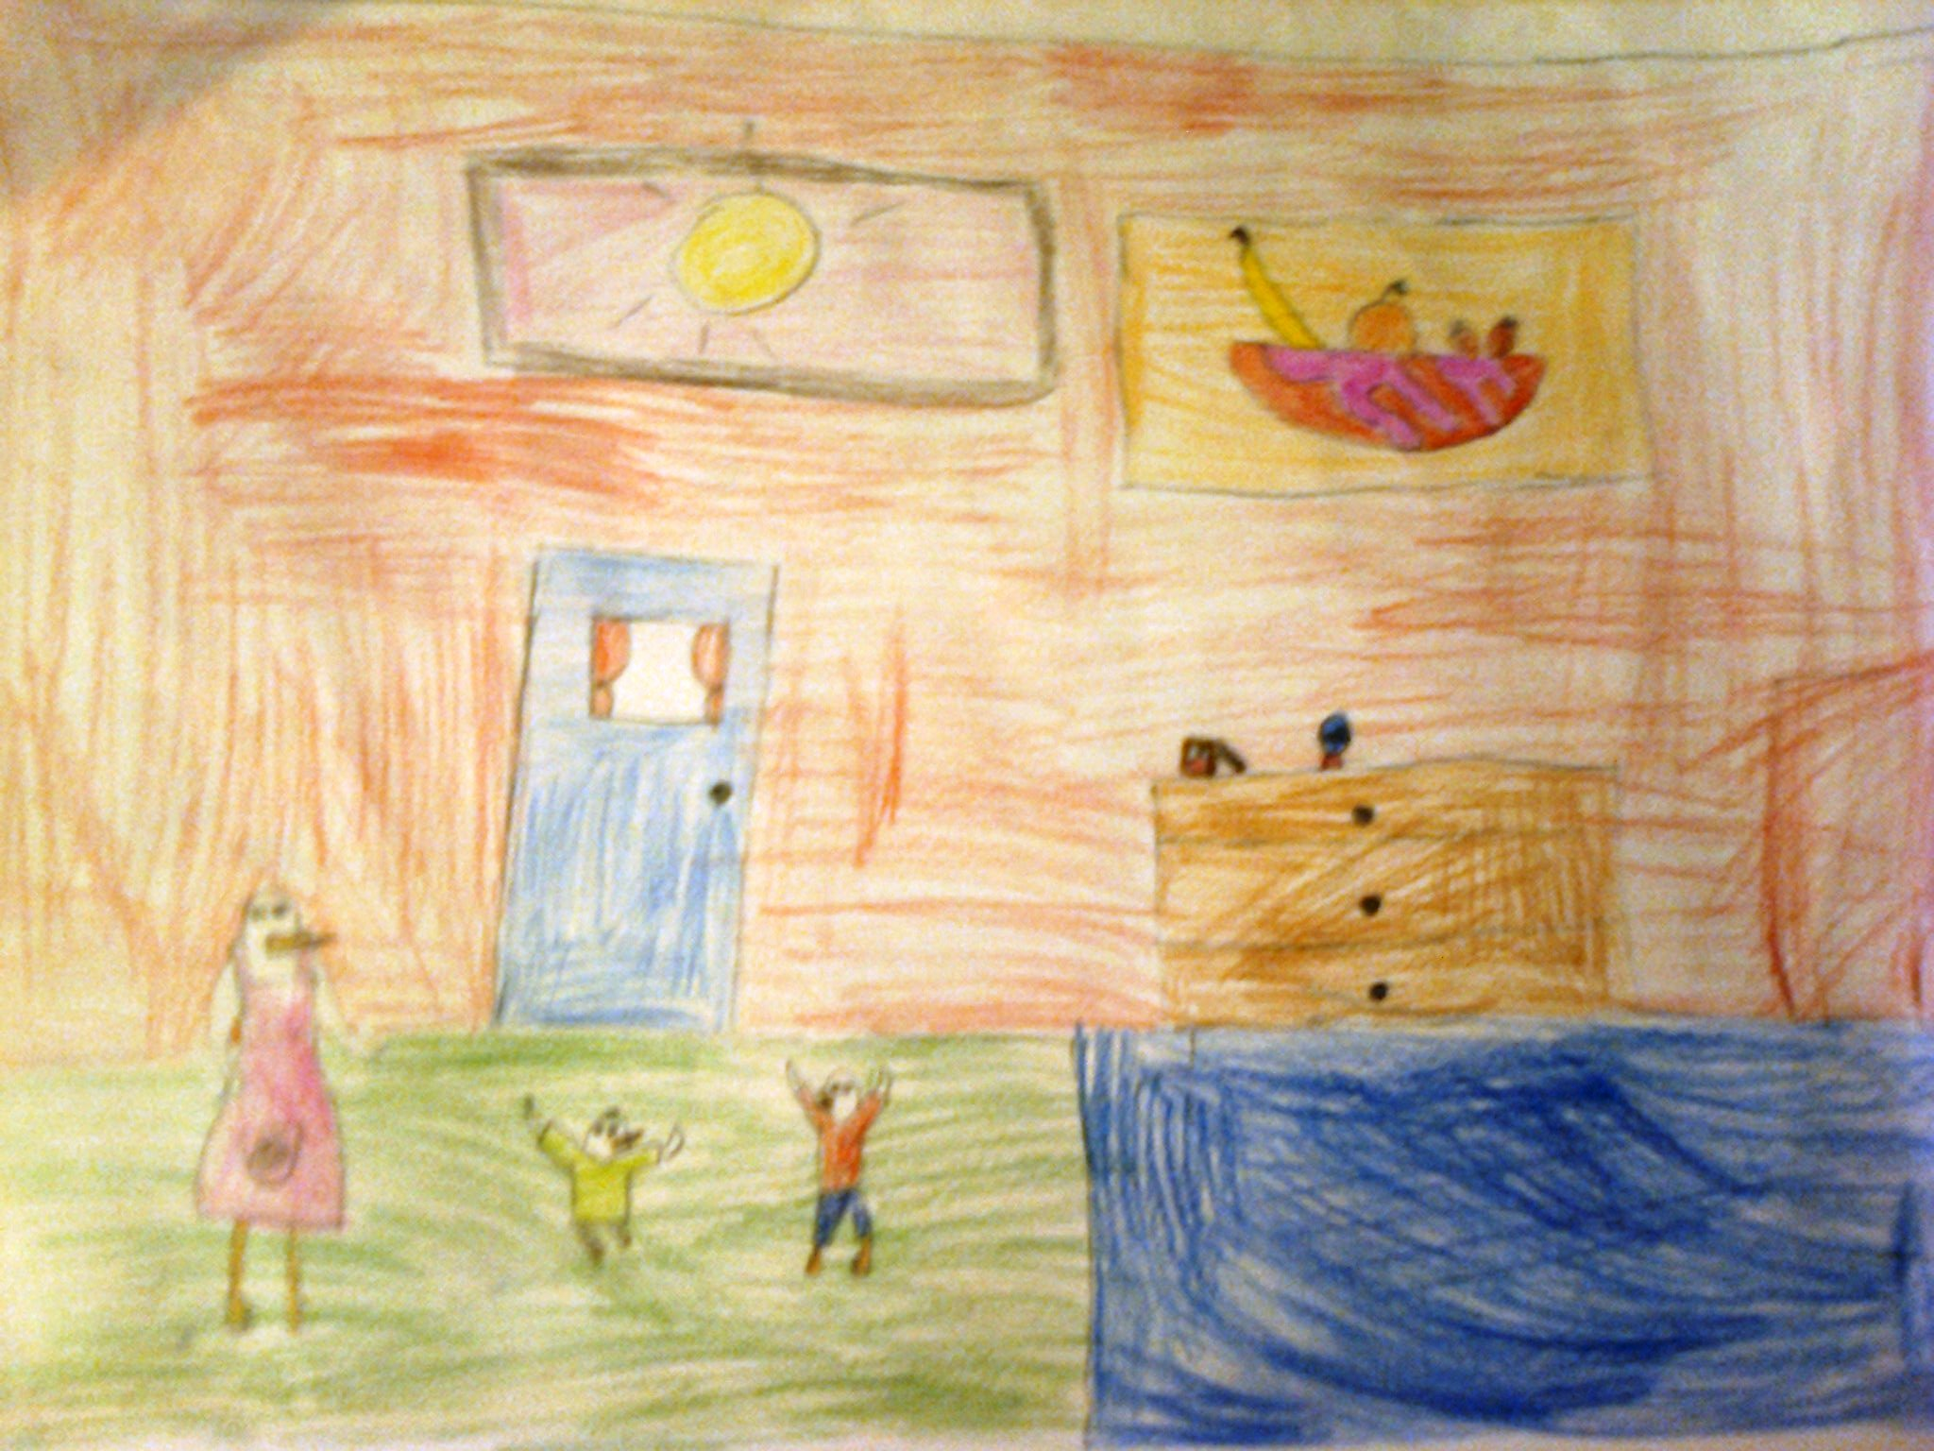
He told his mom about the books, and she wanted to visit the two friends. During her visit, she thrilled with the books of James. She went back next day with her friends.

Slide 10
So slowly all the seagulls knew James and liked him. They all gathered every night outside Jim’s house and heard James reading the books. Eventually, James decided to live with seagulls, he became a teacher and taught little seagulls how to read.

Slide 11
DISCUSSION In the story of James and Jim we saw that the seagulls did not want to hang out, not even to speak with the blackbird, just because they differ in the color of their wings, he was black and they were white. This is exactly what we humans do. Whoever differs from us in skin color, language, dressing, religion, ideas, behavior and so much more, we see him with suspicion, and may dislike him, even treat him badly. And this without even talk to him, without having tried to meet him. This is wrong, it’s unfair. And the seagulls understood this when they knew James.

Slide 12
This is what we should try to avoid. All people are the same, we are equal, and we can live together peacefully and cooperate. We have nothing to divide. We should not dislike each other, οr putting some people in margin, this way we make enemies within our societies. This leads to wars between nations or civil wars, in social conflicts and hatreds , and even acts of terrorism, such as the recent in Paris and Brussels.

Slide 13
This must stop. Our participation in eTwinning certainly helps in this, since we know children from different countries and talk to them, work with them, as young European citizens. Let us all live together in peace, let us build a better world!

Slide 14
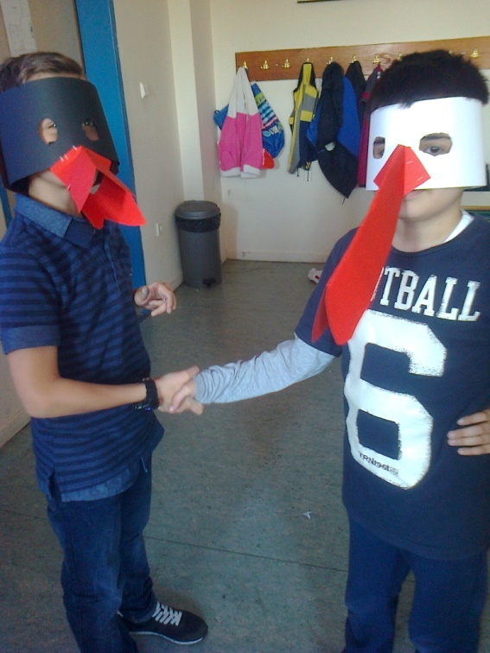
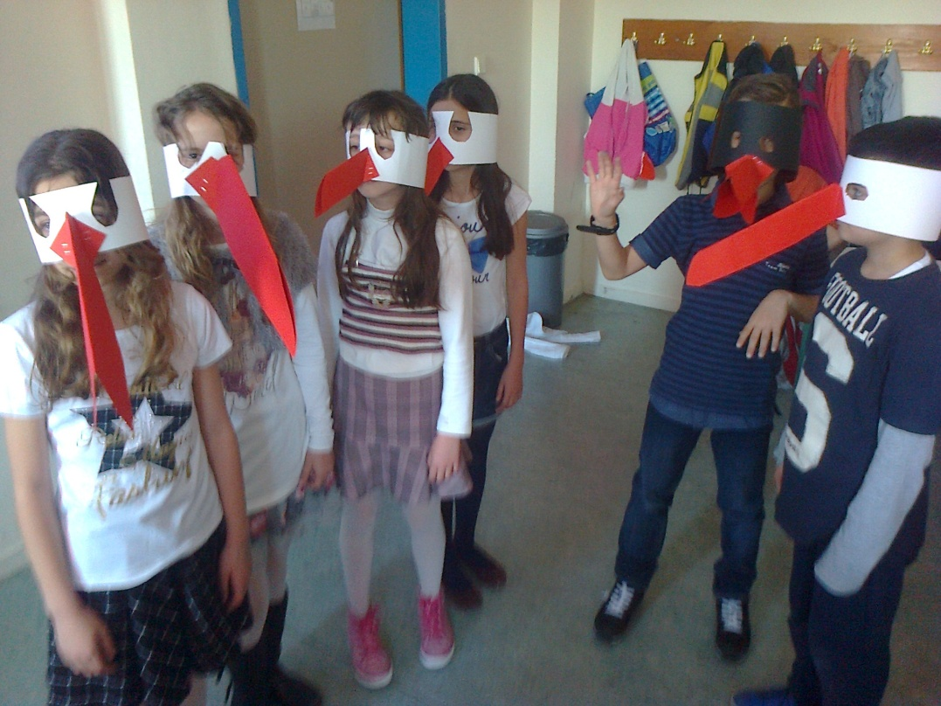
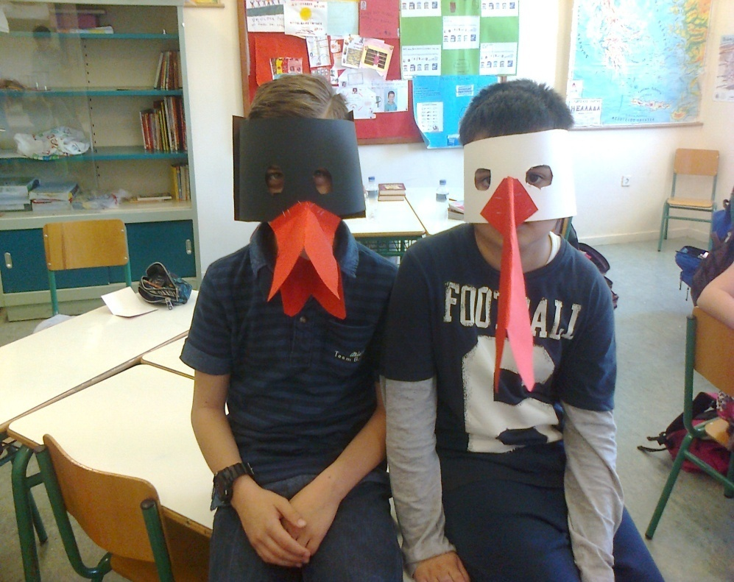
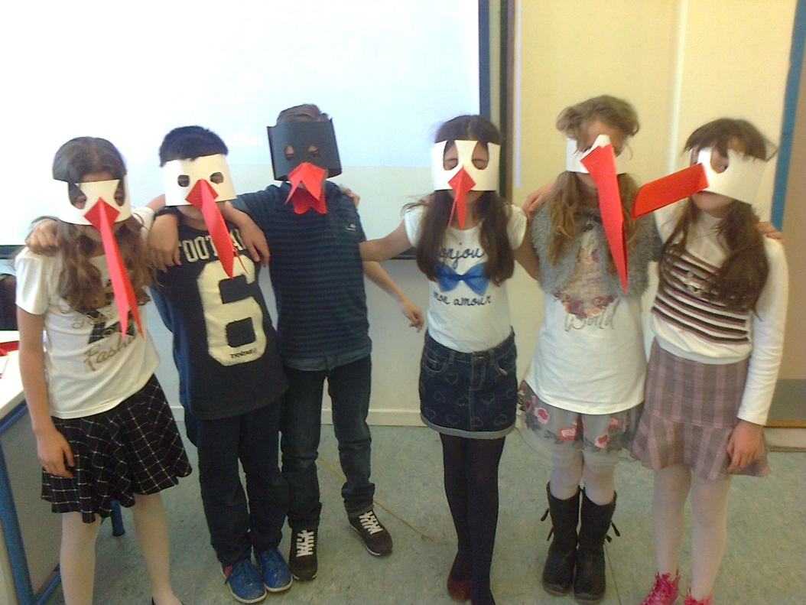
Us playing the story of James and Jim.

