Slide 1
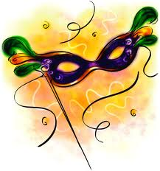
23rd primary school of thessaloniki – greece
CARNIVAL
IN GREECE

Slide 2
Carnival or Apokries in Greek, is a feast of fun celebrated all over the country with masquerade and parties.
The name APOKRIES means “abstention from meat”, because after that starts the period of Lent that goes on till Easter.
The characteristic of Carnival is disguising and wearing masks. The masks remind the clay masks worn by actors in ancient Greek theatre. The costumes and disguises offered-and still do- anonymity and freedom of expression.
Apokries is celebrated all over Greece, with feasts and songs that can’t always be described as decent!

Slide 3
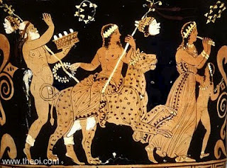
The Greek Carnival has its roots in ancient Greece. It is connected with the worship of Dionysus, God of wine and fun. It was meant to worship him as well as to help the earth put forth shoots-hence the various leaping dances and the various kinds of disguise in order to please harmful spirits.

Slide 4
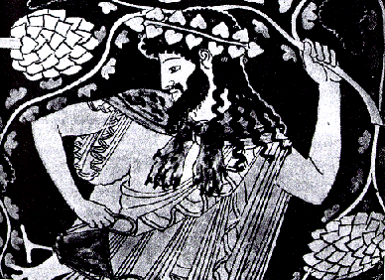
In ancient Greece, the festival in honour of Dionysus took place in early Spring, as Dionysus symbolised life’s rebirth after Winter. Today, carnival is held in the same period but not on a fixed date, as it depends on the moveable feast of Easter. It is celebrated 40 days before Easter, so this ceremony has been incorporated into the Christian religion.

Slide 5
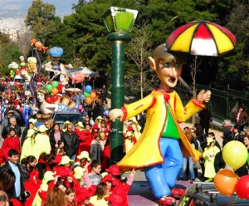
Carnival Parades
Today, there are many different carnival parades and festivities going on all over Greece. Hundreds of groups take part in those parades, and anyone who wishes to participate can just join a group. Celebrations stop on Clean Monday, when kitchen utensils are cleaned of animal products, because the Lent period starts.

Slide 6
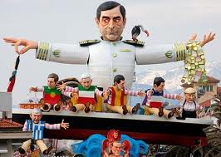
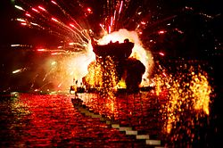
CARNIVAL IN PATRA
The biggest festival take place in the city of Patra for the past 180 years, and the regular attendance of young people in the great parade is approximately 40,000. That’s why this festival is considered to be one of the greatest in Europe and is a meeting point for all carnival enthusiasts around Greece.
Just like in Rio de Janeiro, people in Patra spend the whole year preparing for the coming Carnival celebrations.
There is a big float parade and thousands of masqueraders fill the main streets of the town. The floats have themes taken from current political and social circumstances.

Slide 7
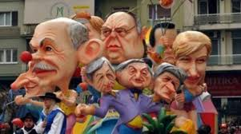
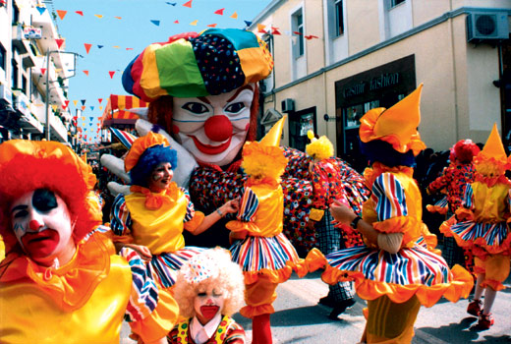
CARNIVAL IN XANTHI
Xanthi’s Carnival is the biggest festival of Northern Greece, and has been taking place yearly since 1926. Approximately 20,000 visitors go there every year to get a taste of fun, imagination, creativity and music.

Slide 8
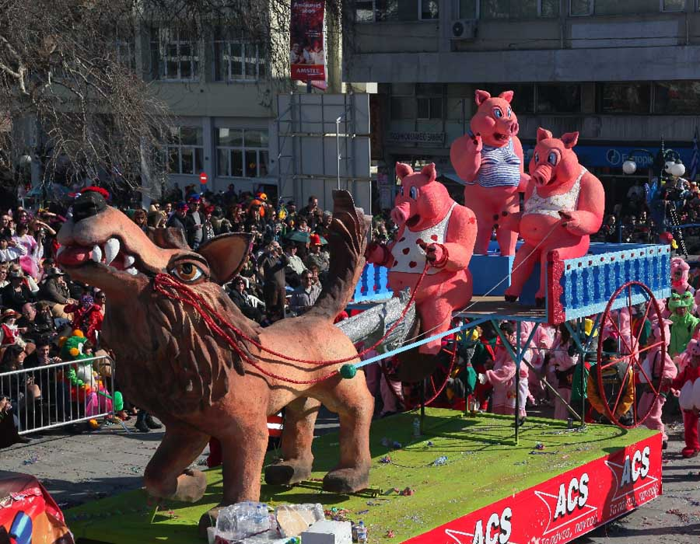
mkkiugfdx

Slide 9
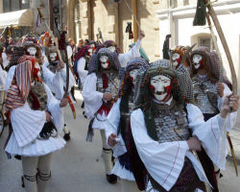
CARNIVAL IN NAOUSA
In Naoussa, every year people celebrate the custom of “Yenitsari” and “Bules”. Yenitsari are men dressed in traditional Greek costumes and Bules are also men dressed-up as women. They all wear masks and sing and dance in the city’s roads.

Slide 10
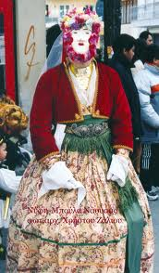
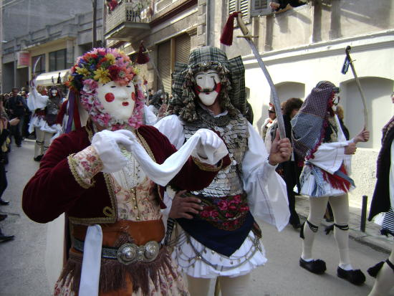
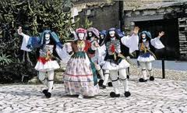

Slide 11
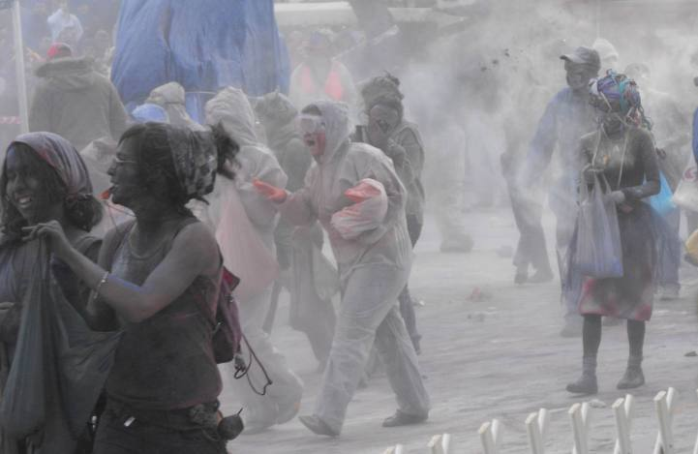
CARNIVAL IN GALAXIDI
The carnival in Galaxidi is famous for the custom of “ flour war” , a strange but funny carnival custom. On Clean Monday they throw flour and ashes at each other, so they turn white and in a minute they’re all covered in black!

Slide 12
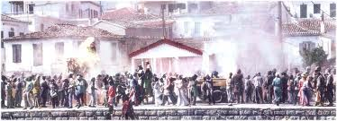
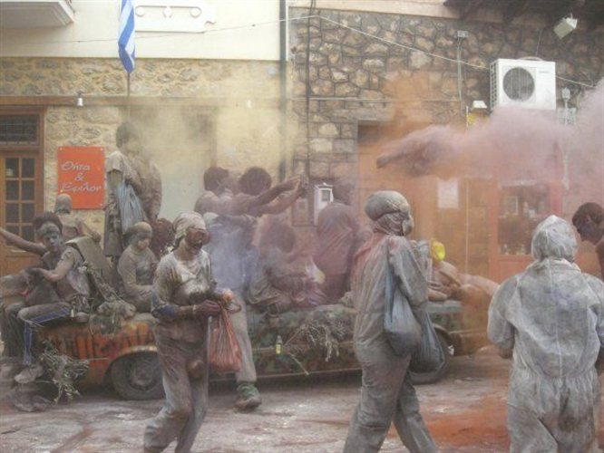

Slide 13
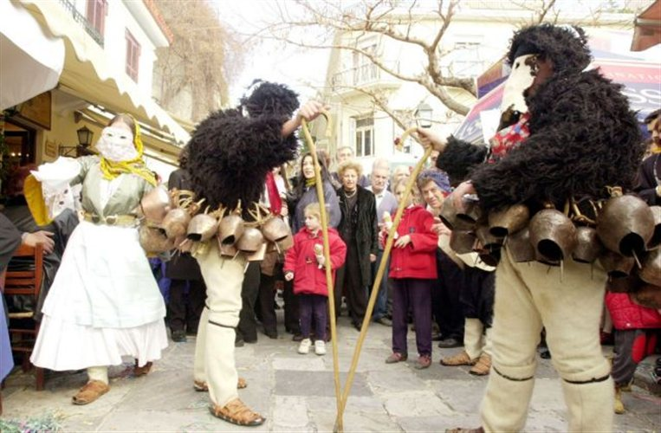
CARNIVAL IN SKYROS
There is the custom of yeri (men dressed as old men), korela (a man dressed as a young lady) and koudounati (bell carriers). They go around the streets, say funny stories, dance and drink.

Slide 14
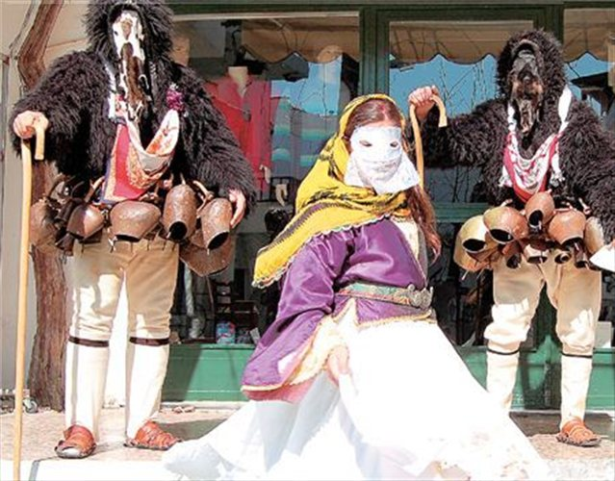
Men are dressed up as old men and a young lady and they go around the streets of Skyros. They say funny stories and their bells make lound noise. At the end of the day they all dance and drink at the central square

Slide 15
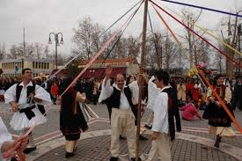
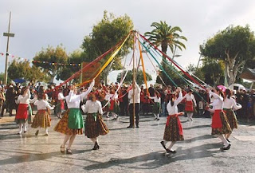
GAITANAKI
Gaitanaki is a traditional Carnival dance. One of the dancers holds a pole from which 12 ribbons start . The dancers hold the colorful ribbons and dance around the pole. The dance symbolizes the circle of life.

Slide 16
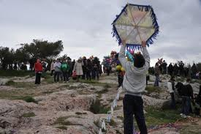
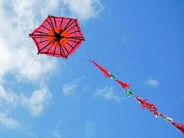
FLYING A KITE ON CLEAN MONDAY
Families usually have a picnic with meat-free foods and sweets and they fly colourful kites. They usually compete to each other on whose kite is going to fly higher.

Slide 17
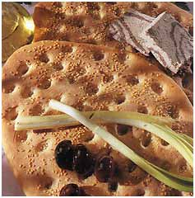
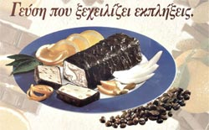
TYPICAL CLEAN MONDAY FOOD ( LAGANA, HALVAS, PASTELI)

Slide 18
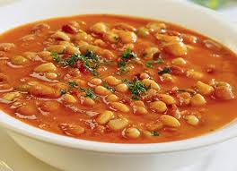
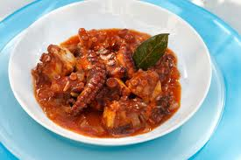
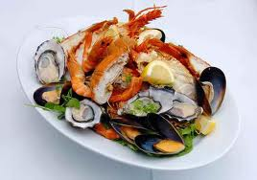
BEANS, OCTAPUS, DOLMATHAKIA, SEA FOOD

