Slide 1
Mr Bean’s diary - part 3
Pylos Messinia
December 2016

Slide 2
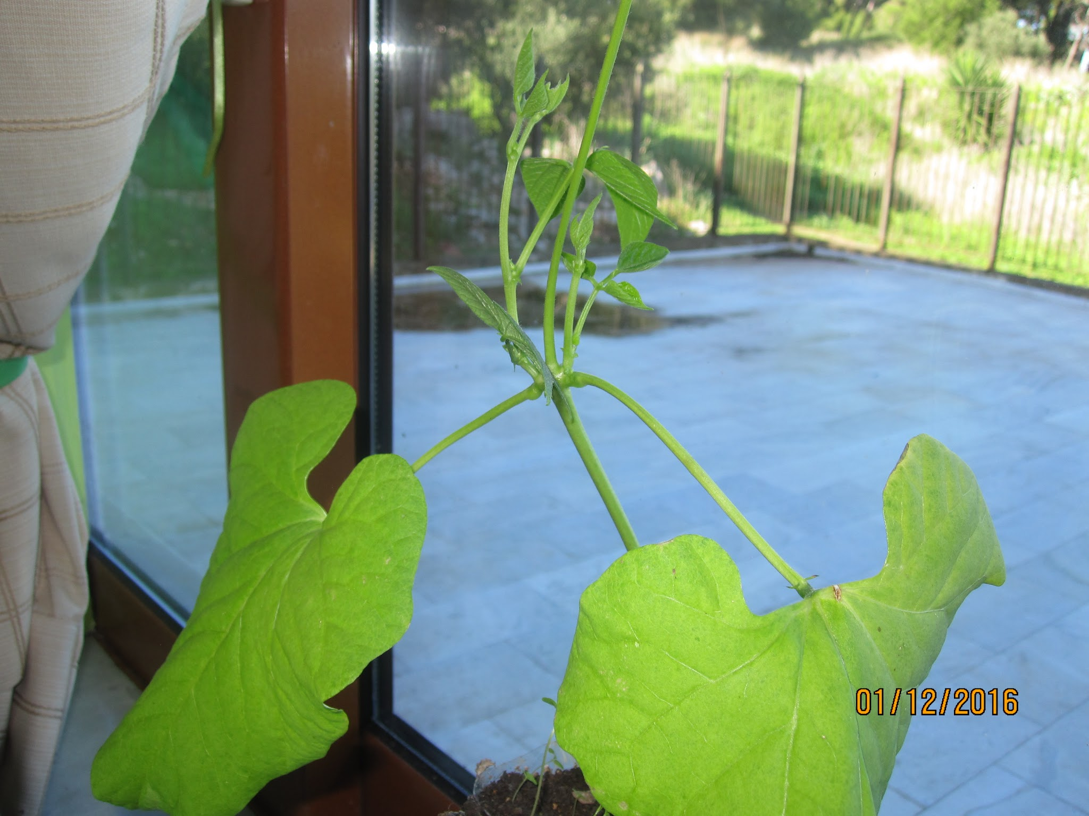
Giant bean is growing
More leaves...

Slide 3
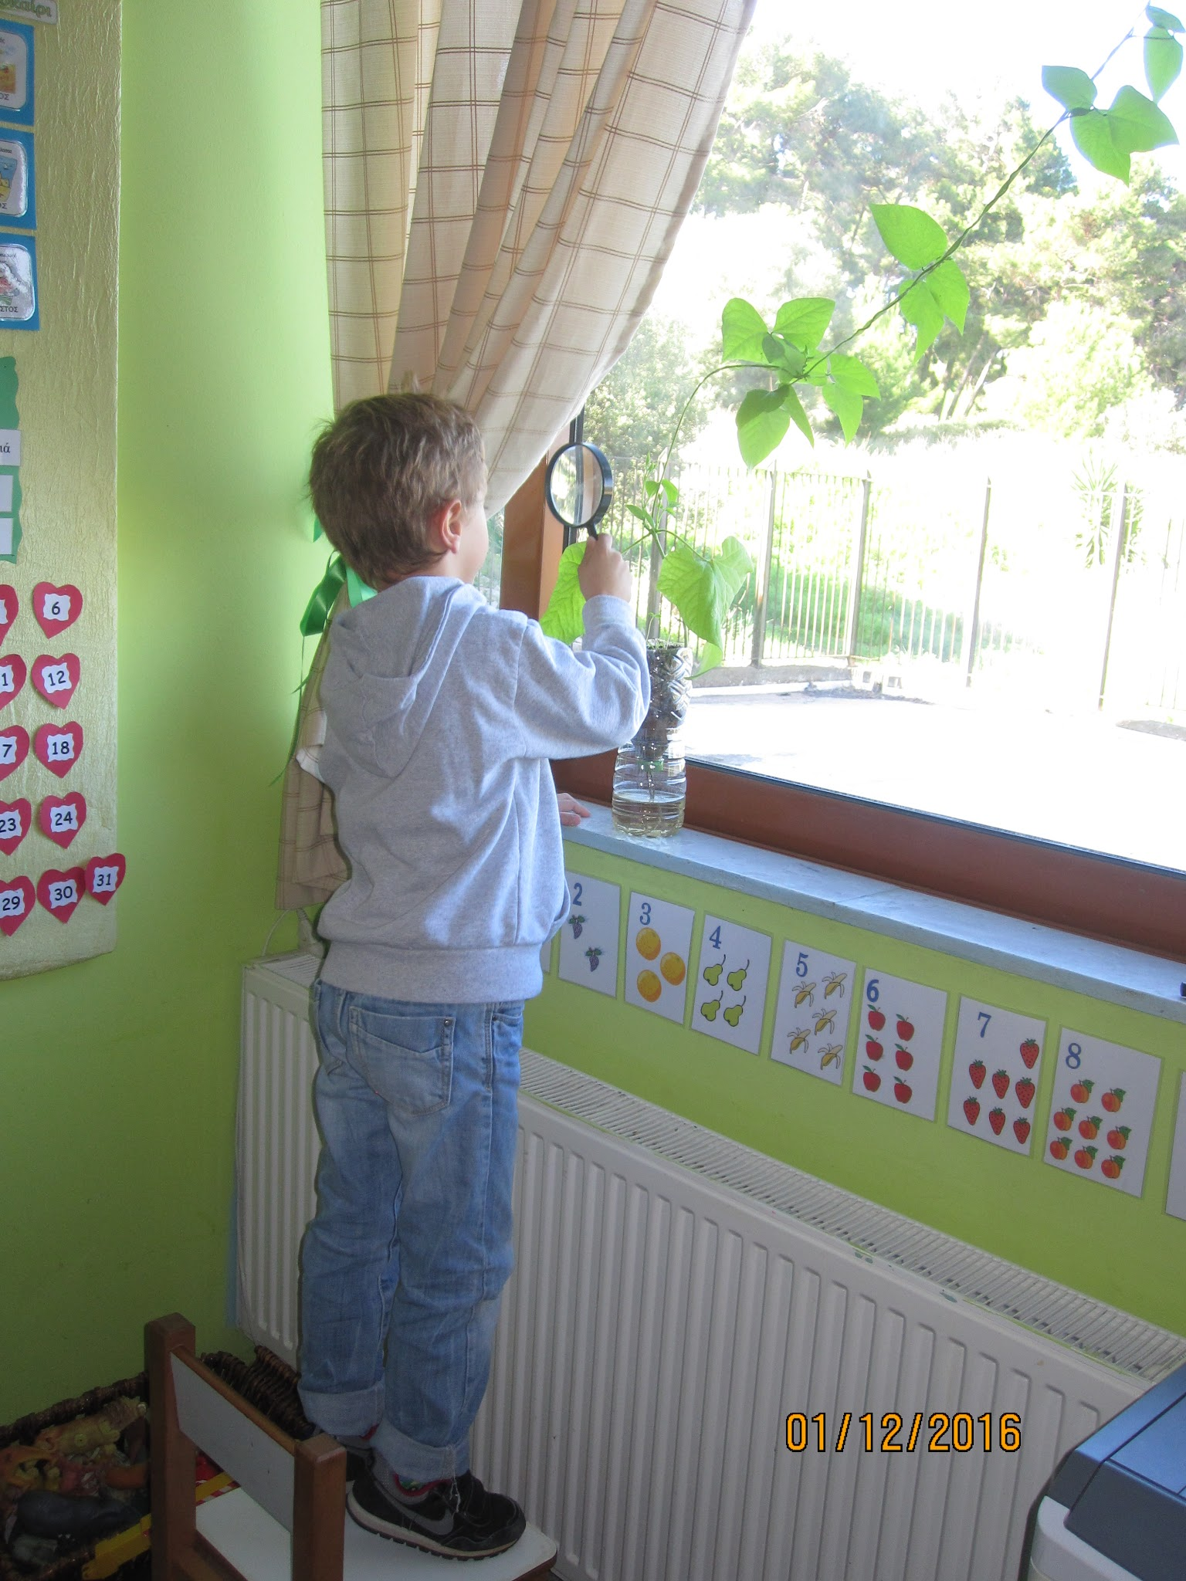
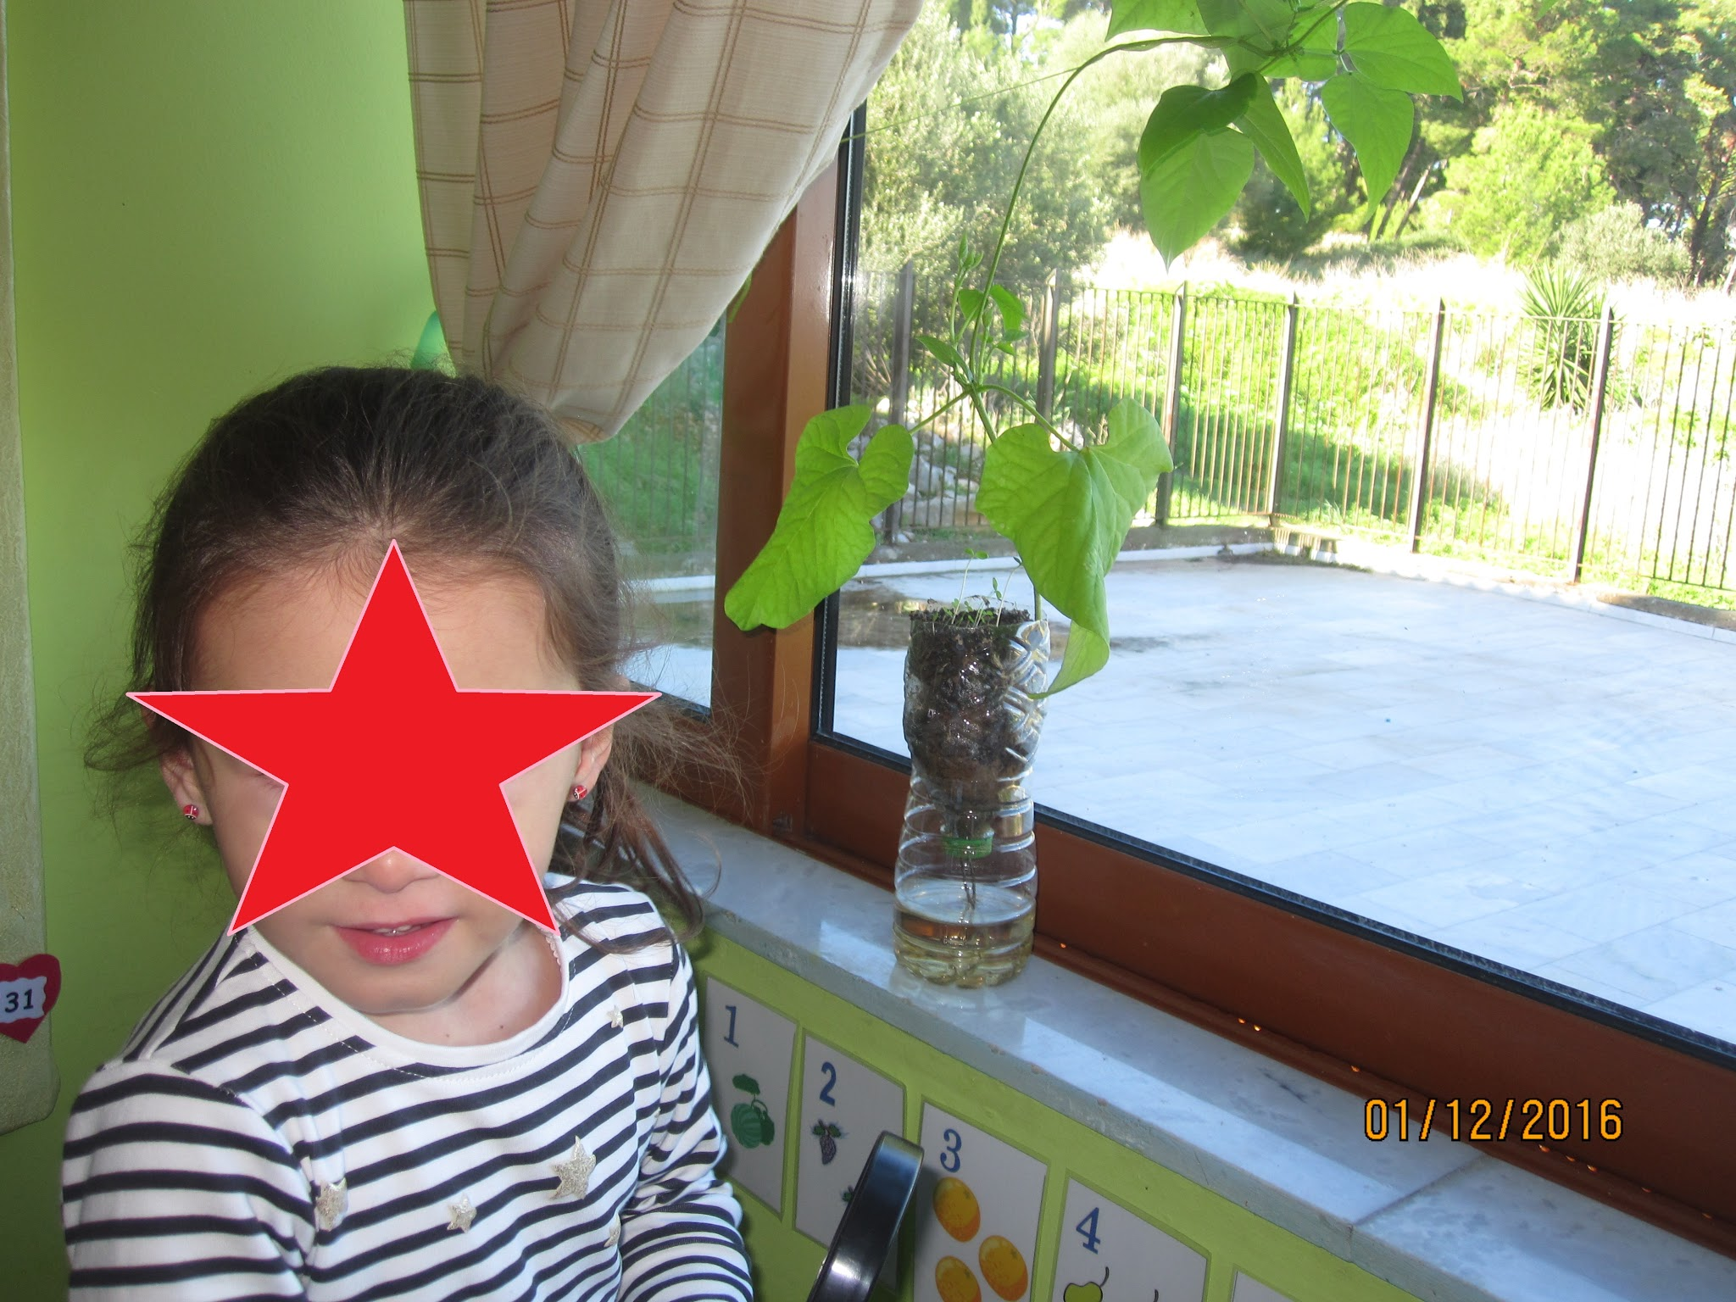

Slide 4
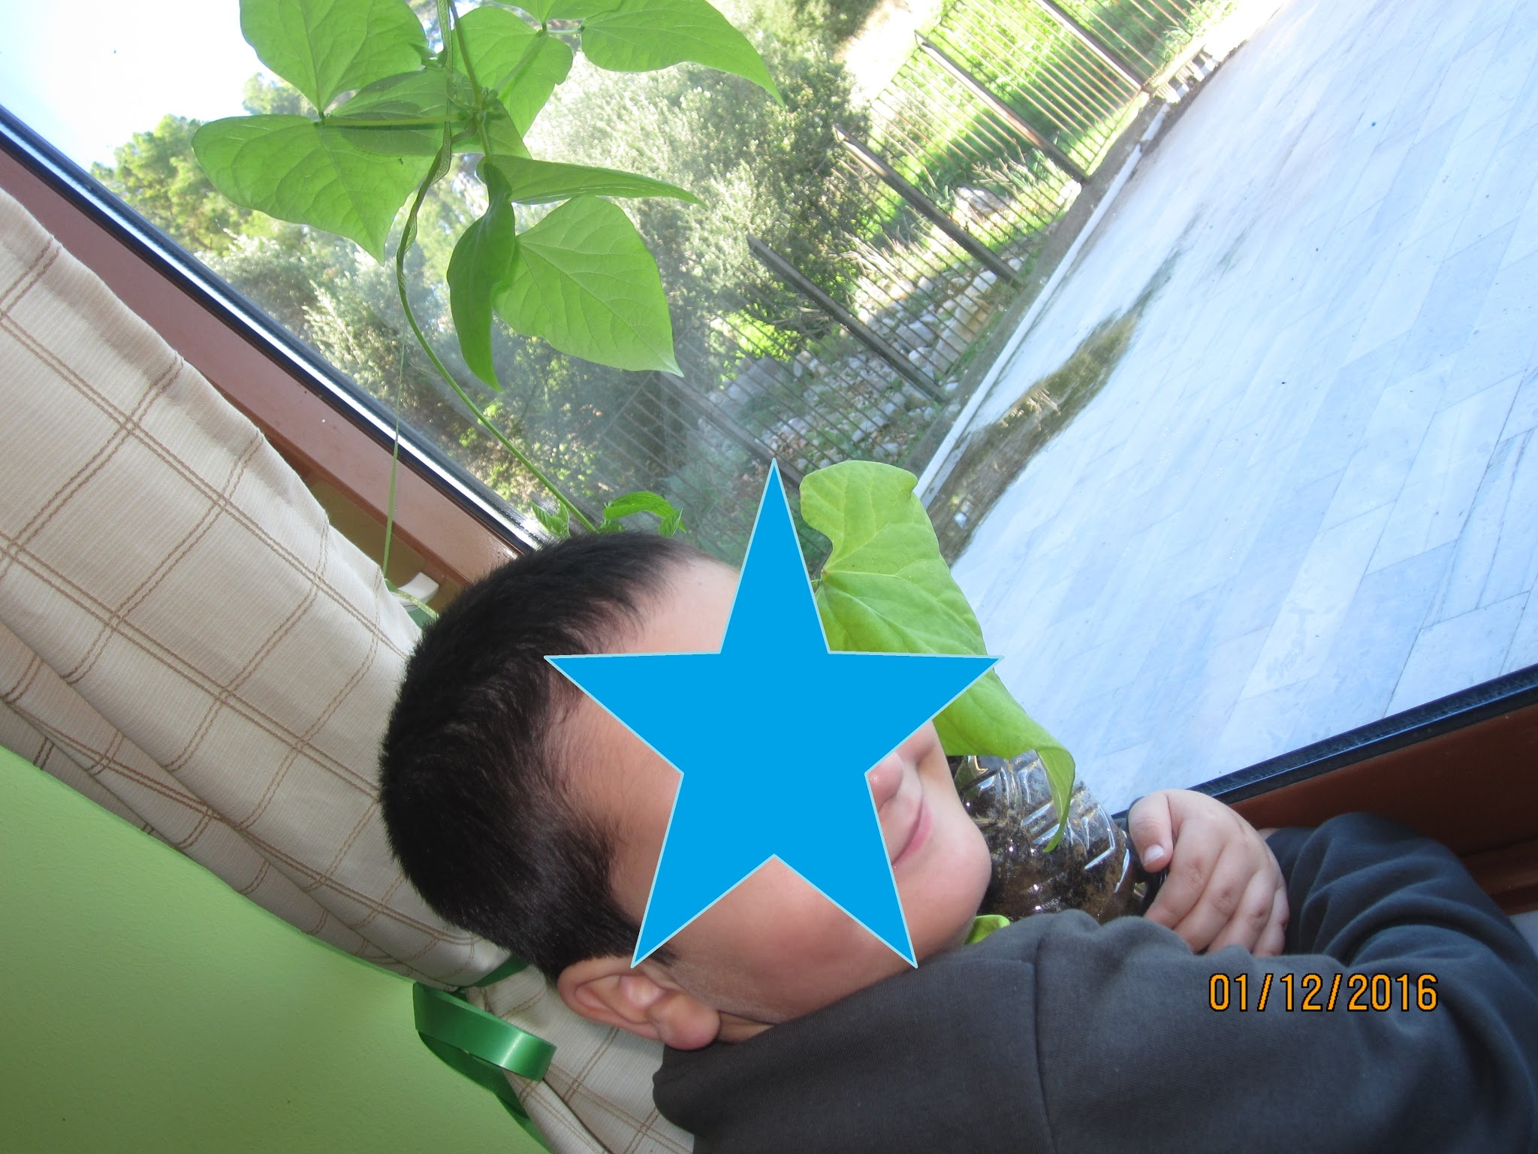
We love our beans!

Slide 5
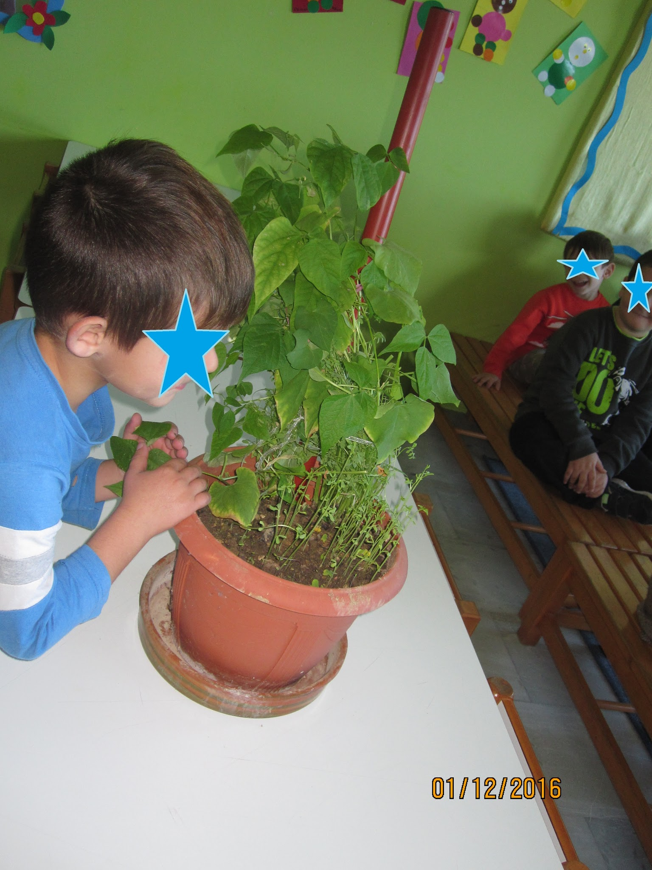

Slide 6
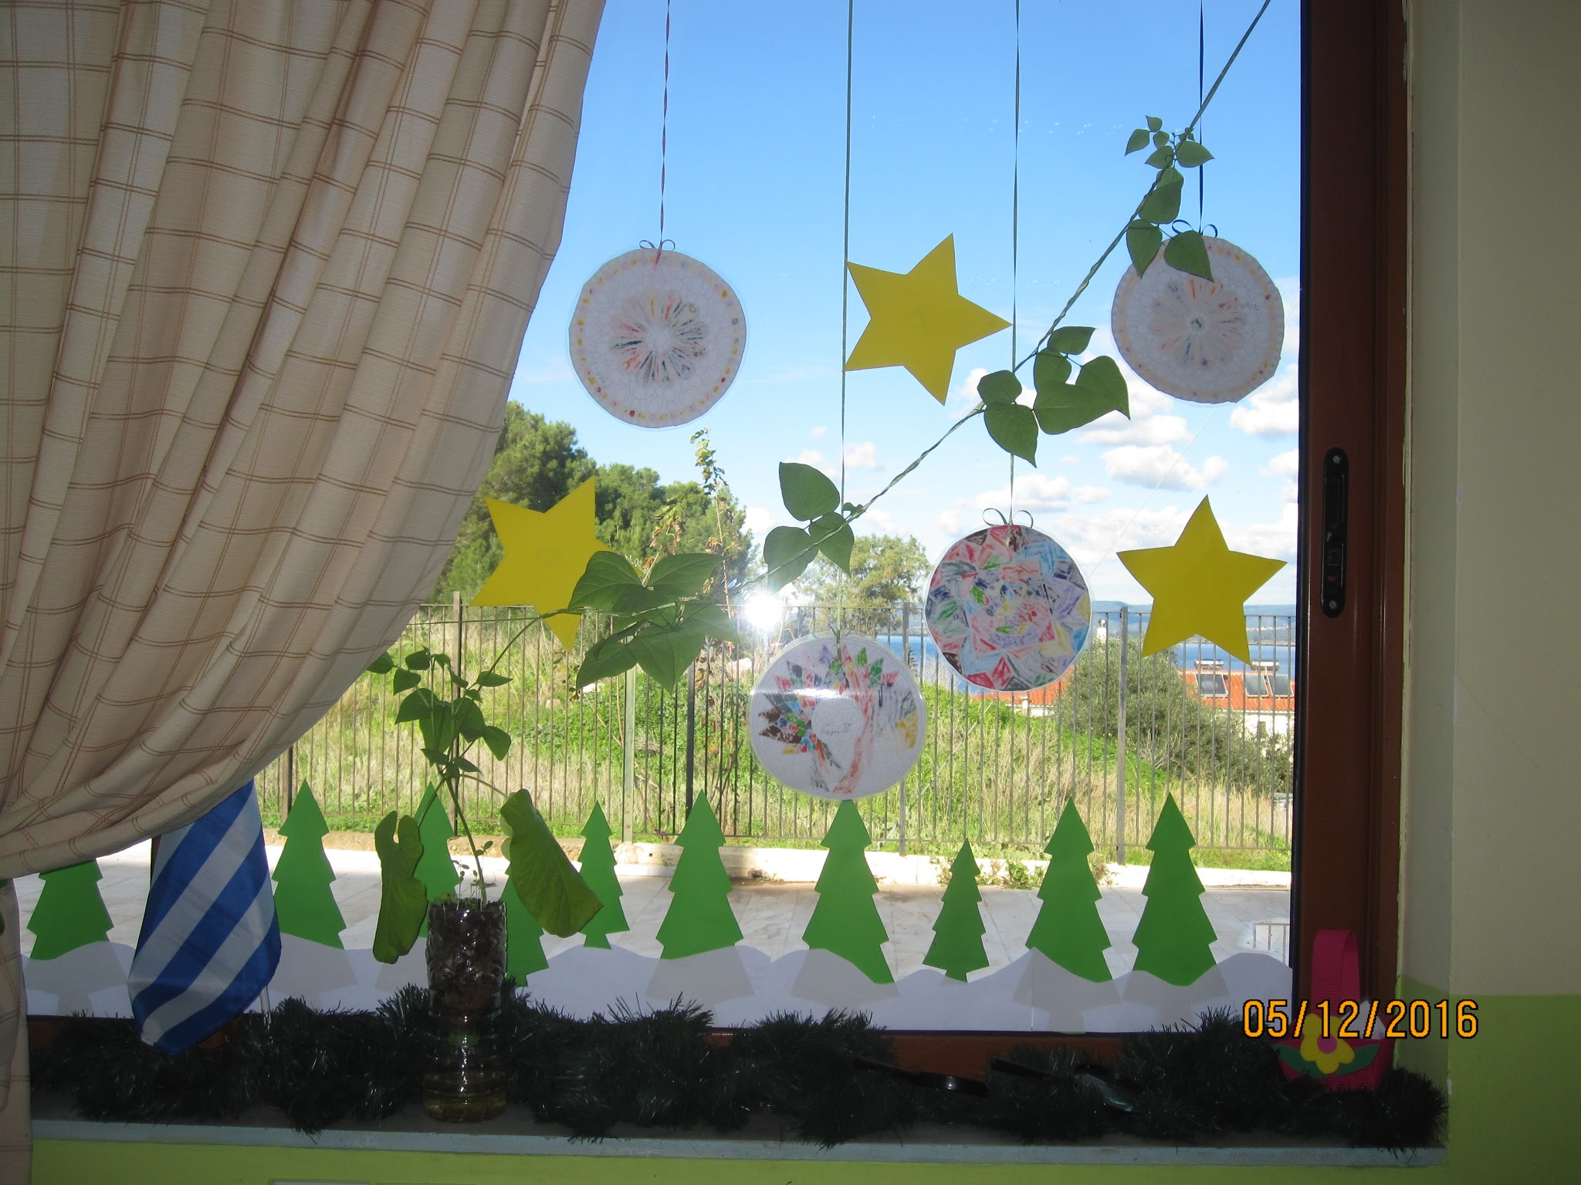
Giant bean decorated for Christmas

Slide 7
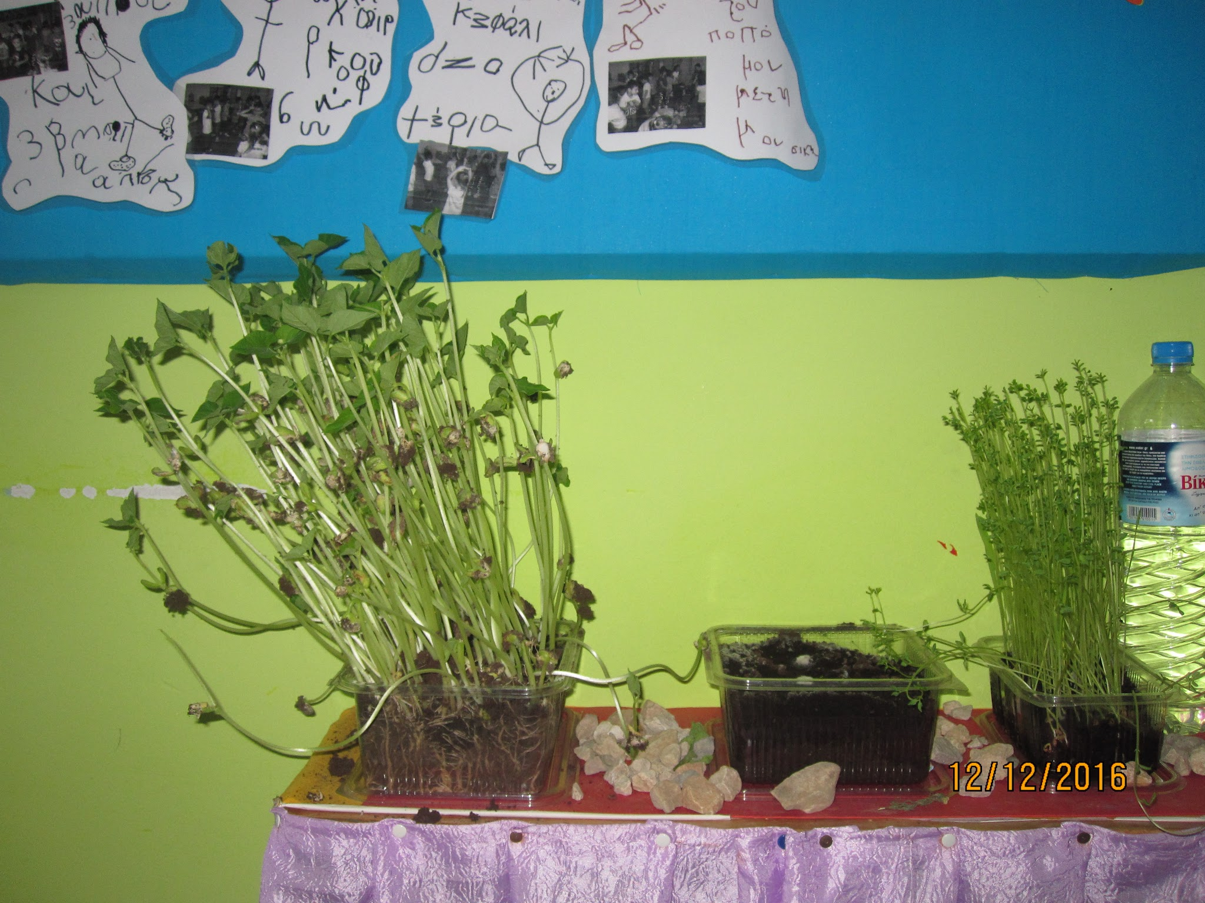

Slide 8
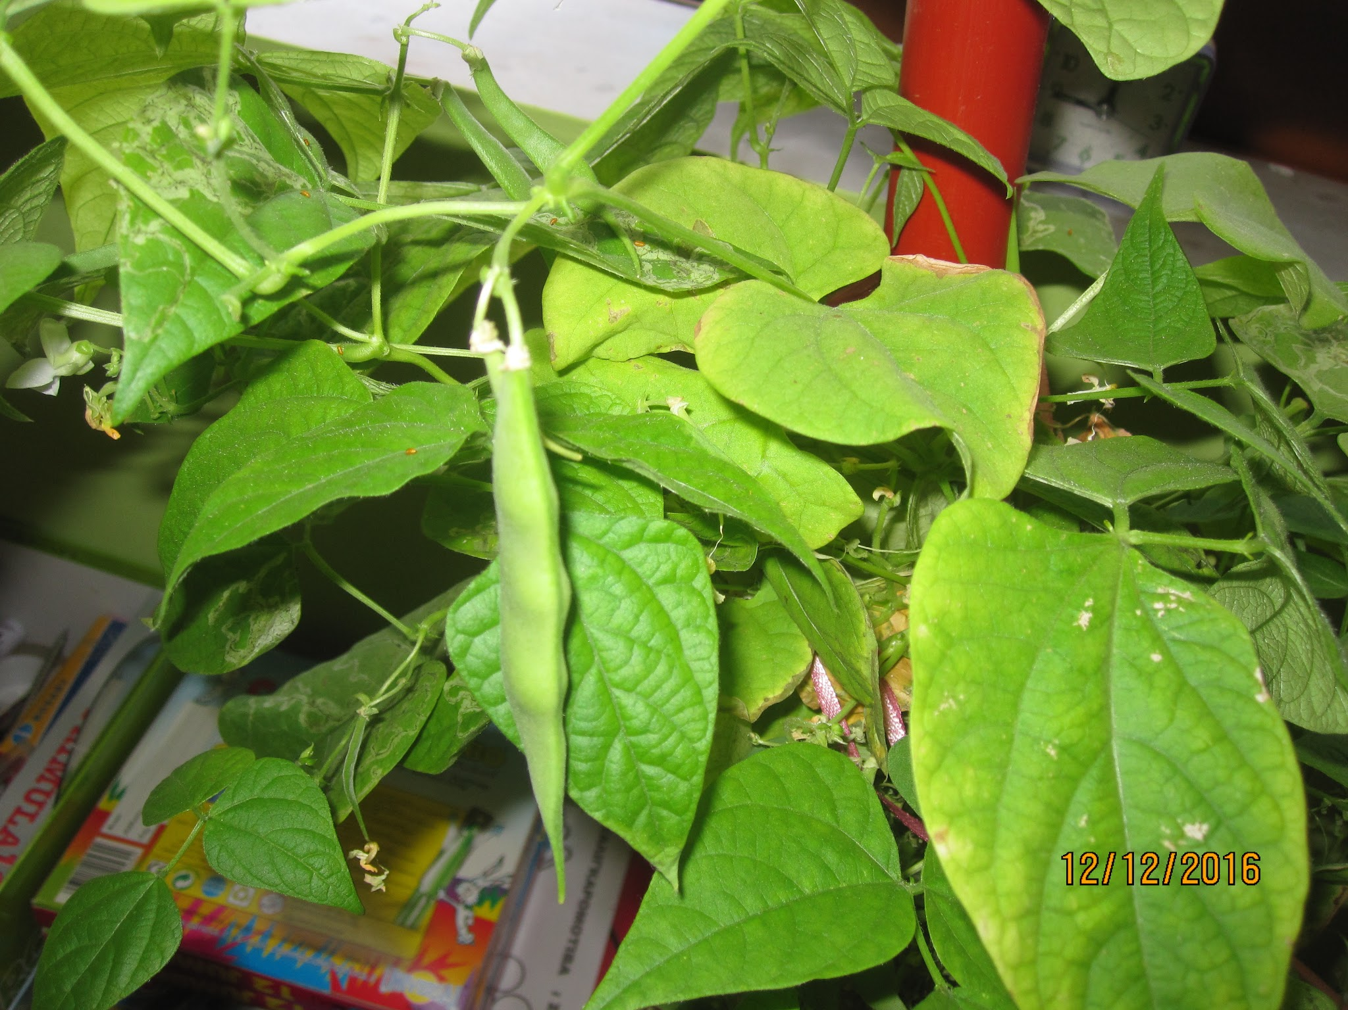
Our beans are growing byt we think that something is going wrong…
Is it a disease?

Slide 9
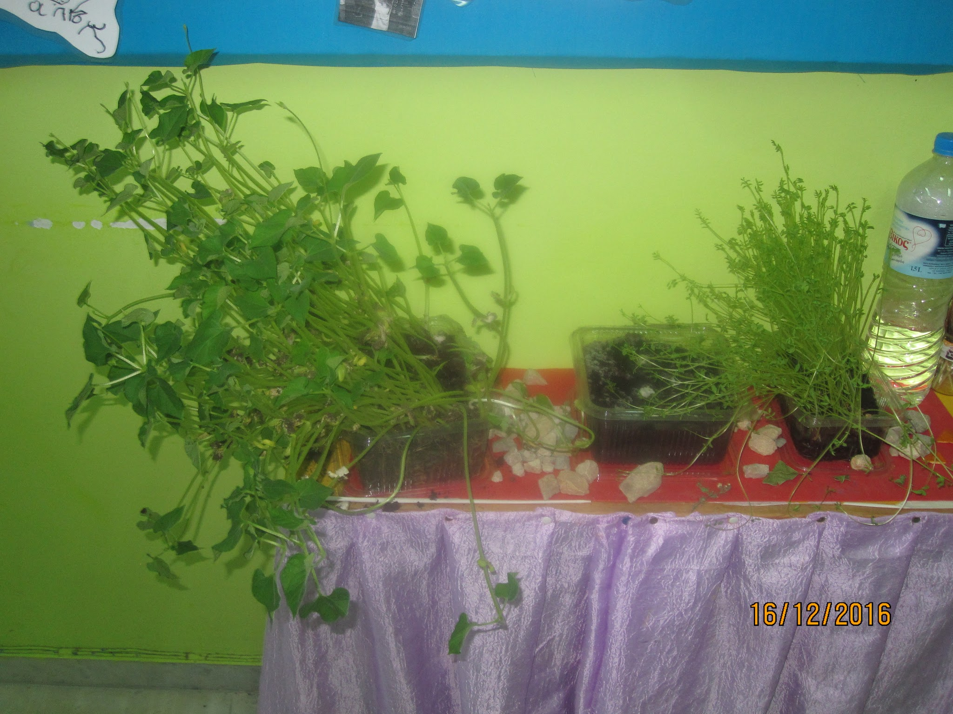
1.They look like beans and lentils forest…
2.They are trying to find light that’s why they turned left.
3.The other on the centre rotted, … too much water...

Slide 10
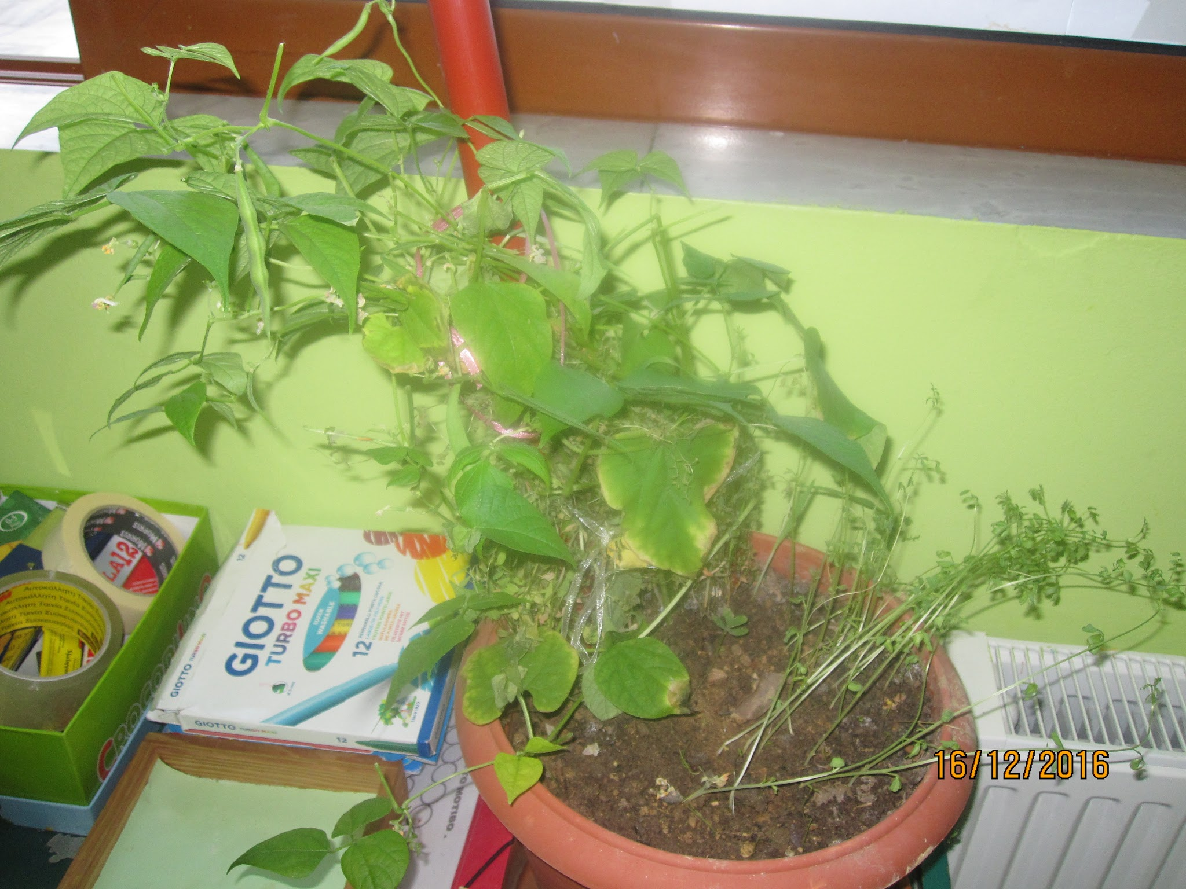
Beans & lentils, leaves, flowers, beans, & disease...

Slide 11
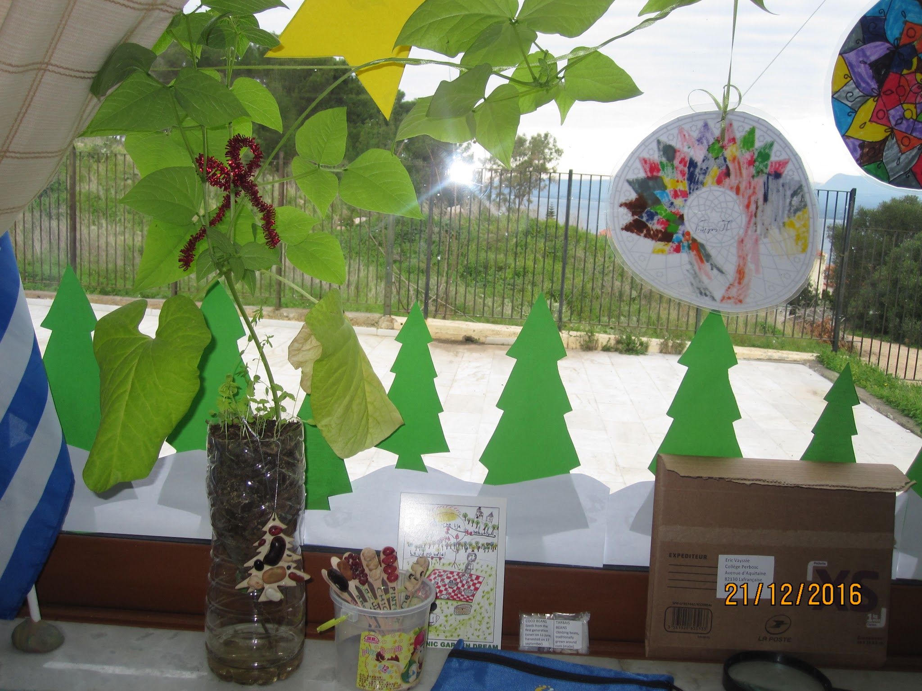
Giant beans were decorated with the ornaments received from France!!!

Slide 12
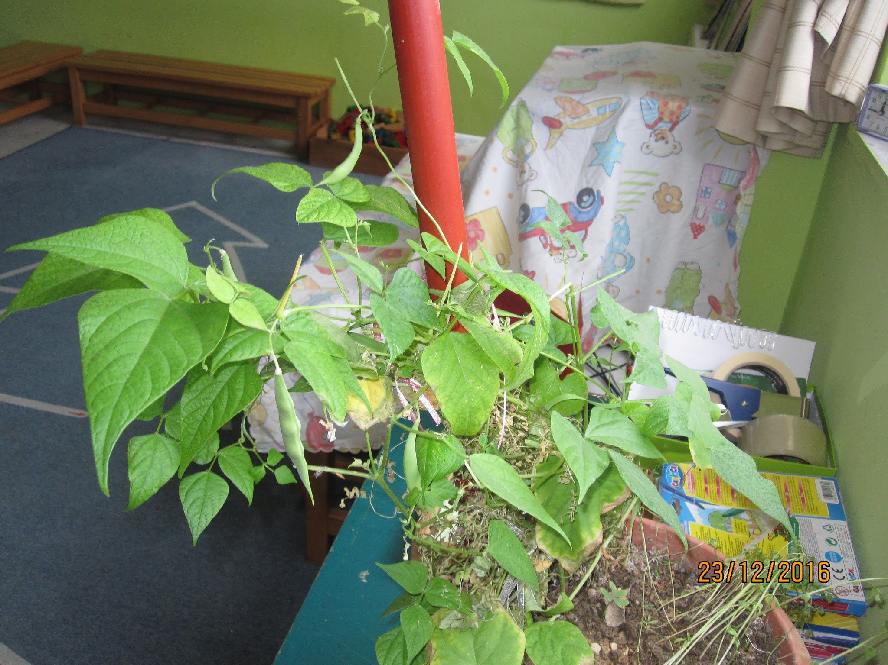

Slide 13
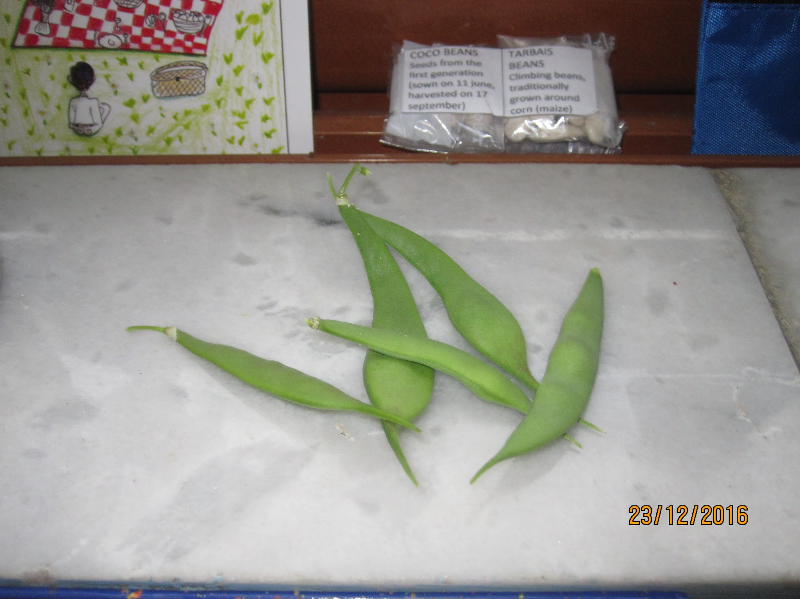
Harvest time before Christmas holidays.
Five little beans…
Merry Christmas!!!

Slide 14
Merry Christmas
&
Happy New Year
We will see you next year…
Kids took beans and lentils at their homes for holidays to take care of them.

