Slide 1
Stem for a cleaner world
1st kindergarten trilofos
E twinning project 2025-26

Slide 2
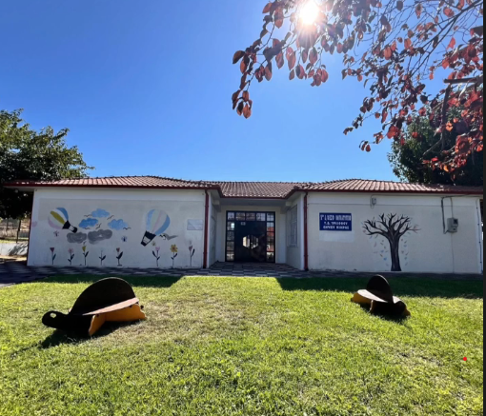
OUR KINDERGARTEN
https://padlet.com/evaasvesta9/to-get-to-know-each-other-s88tx03xdi89zdpb

Slide 3
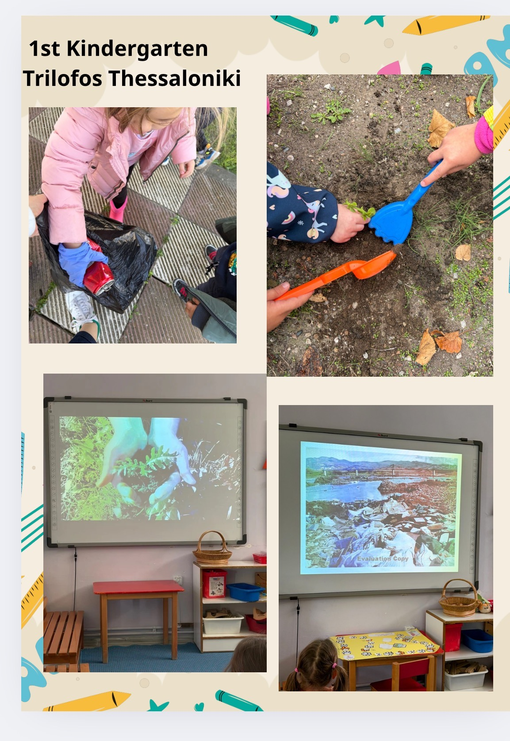
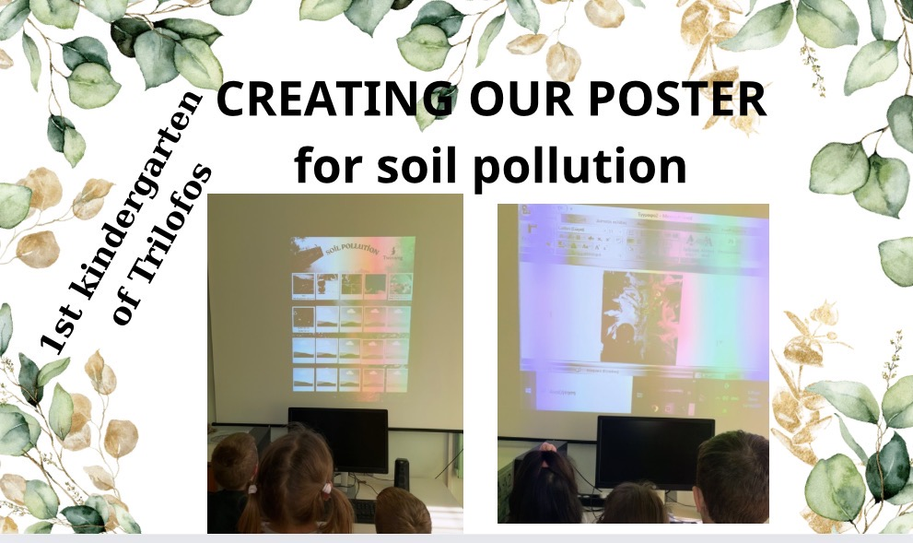
SOIL POLLUTION

Slide 4
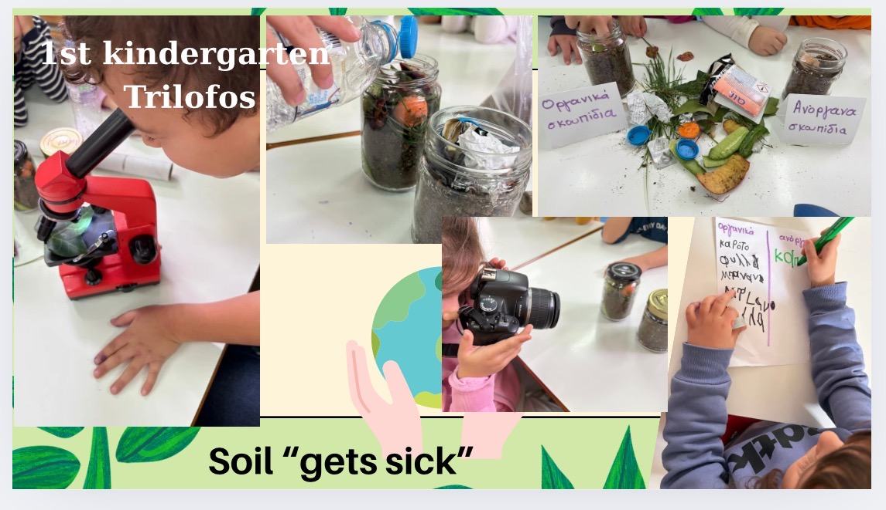
STEM FOR SOIL POLLUTION

Slide 5
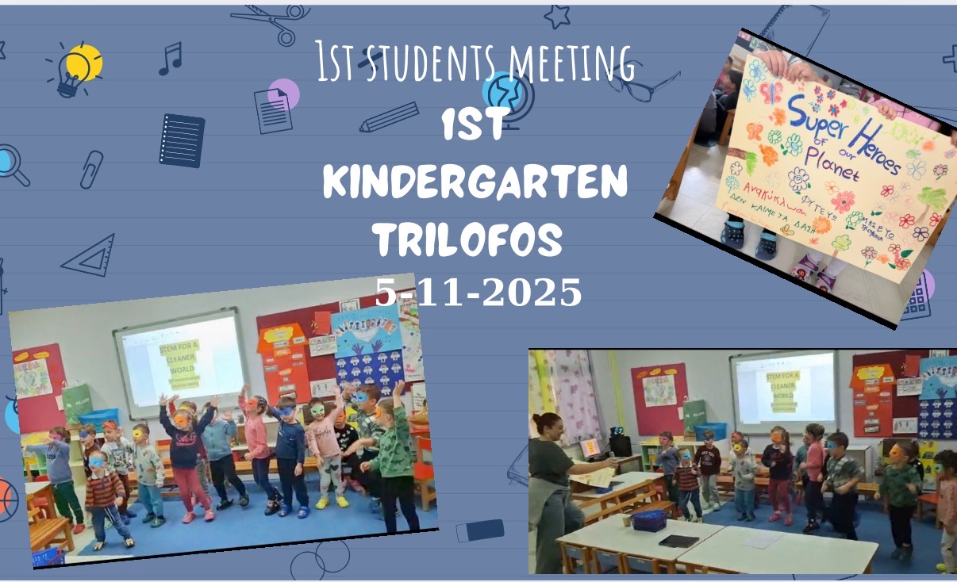
1ST STUDENT’S MEETING

Slide 6
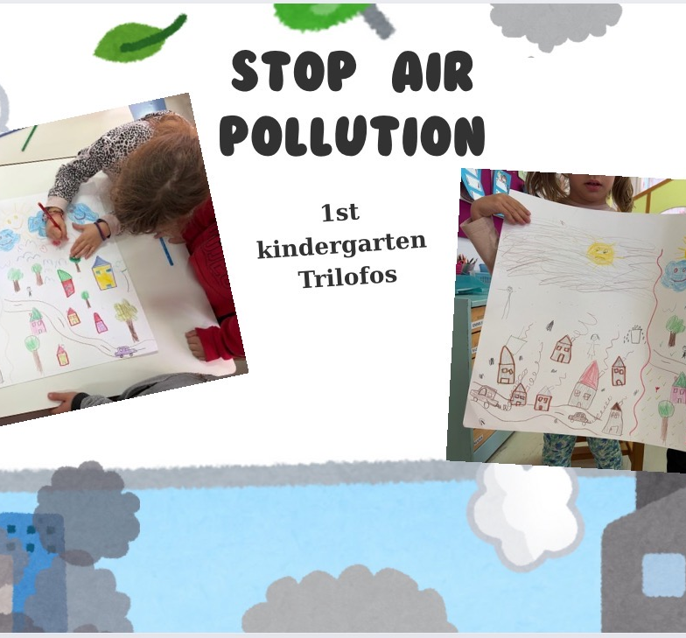
Our air pollution poster

Slide 7
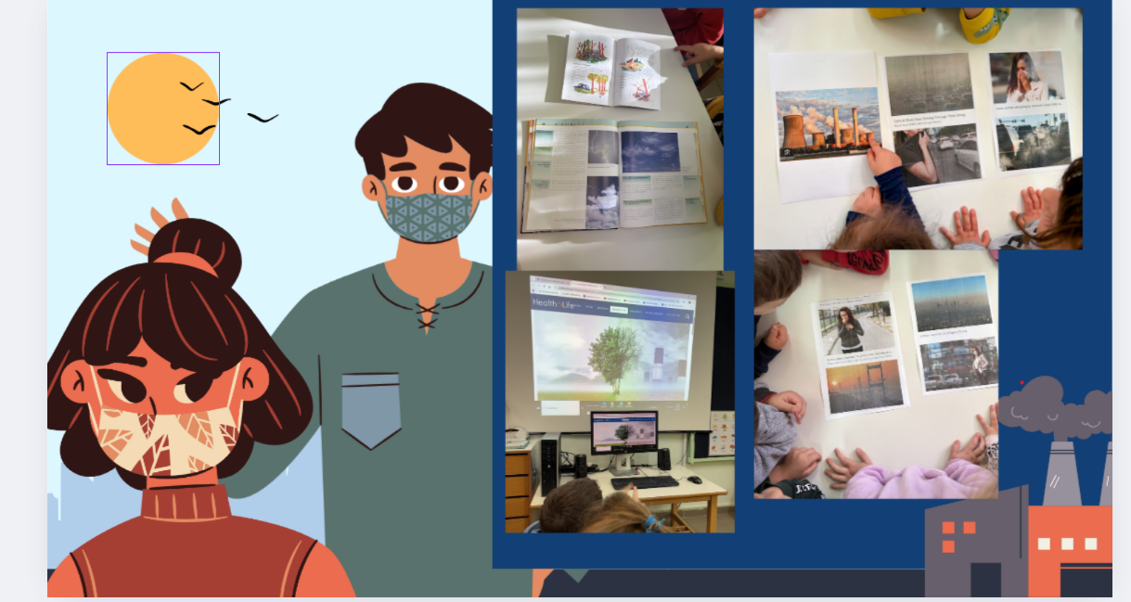
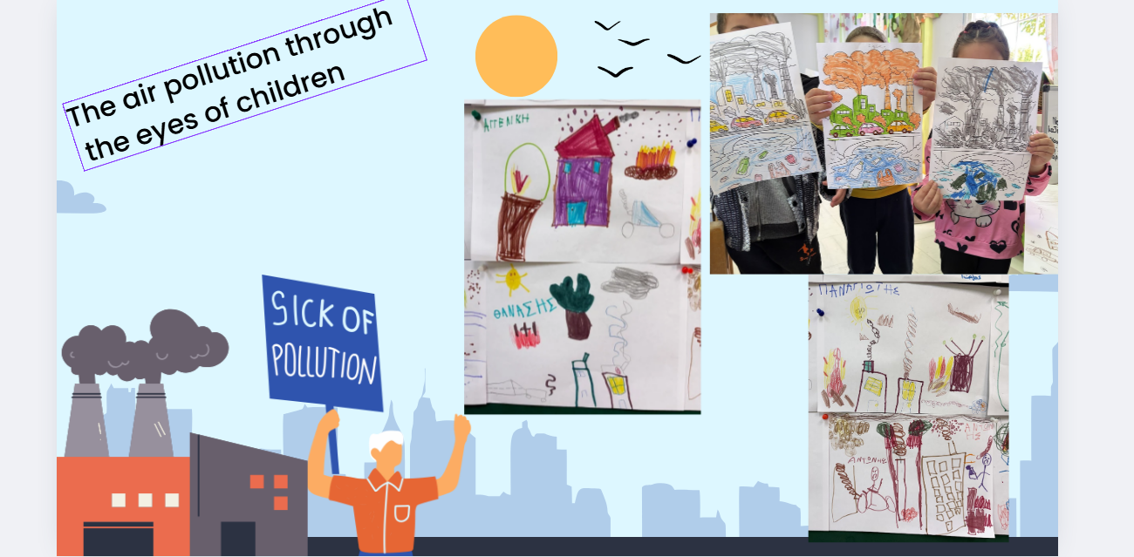
Learning about air pollution
https://www.canva.com/design/DAG5KQHowcs/vsUCo-GrW-oJdwJuv4UNsg/edit?ui=eyJBIjp7fX0

Slide 8
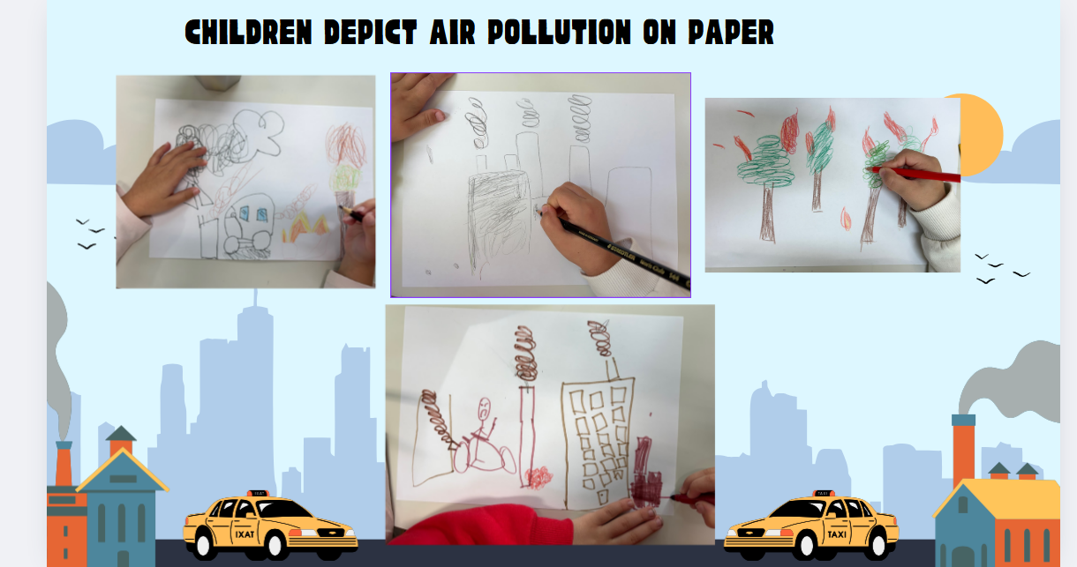
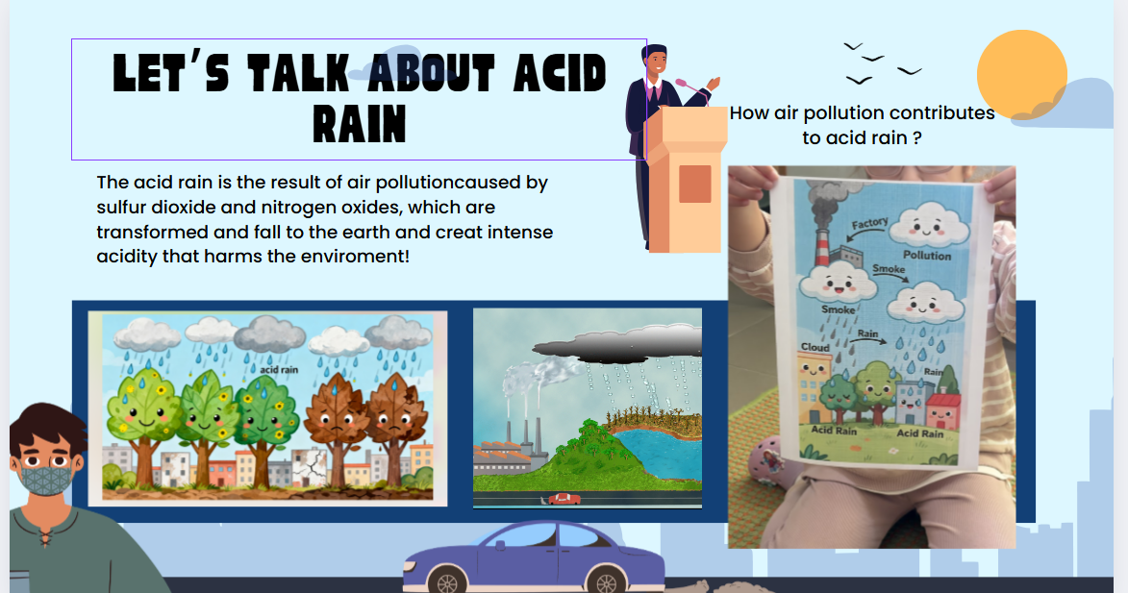

Slide 9
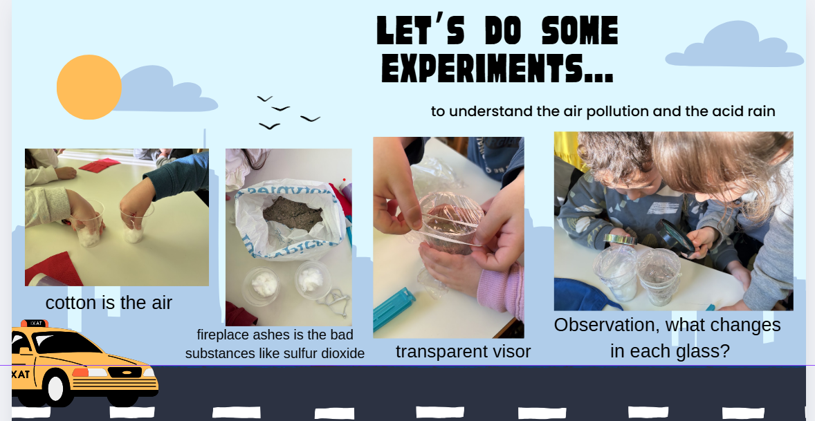
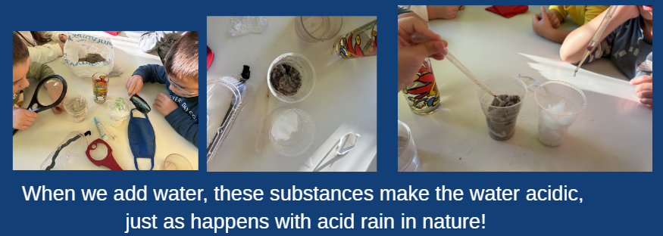
experiments

Slide 10
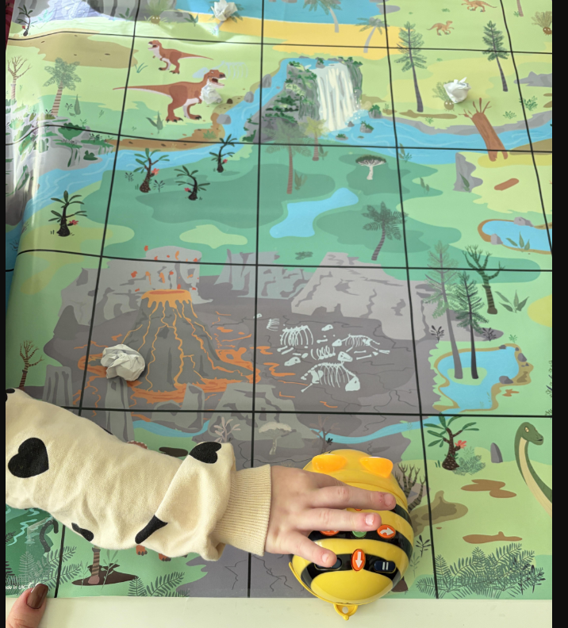
EU Codeweek 2025
In this STEM activity, preschool children use the BeeBot robot to help clean up a forest depicted on a large poster. The poster shows a forest scene with scattered pieces of "litter" that represent trash left by people.

Slide 11
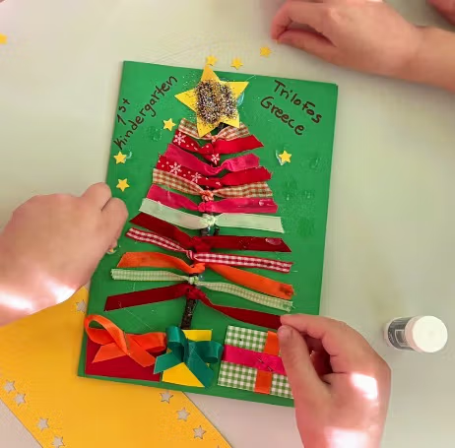
Greeting Cards for Christmas and New Year
https://padlet.com/ekonstantinidou8/greeting-cards-for-christmas-and-new-year-b31vy0m4q9iond90

