Slide 1
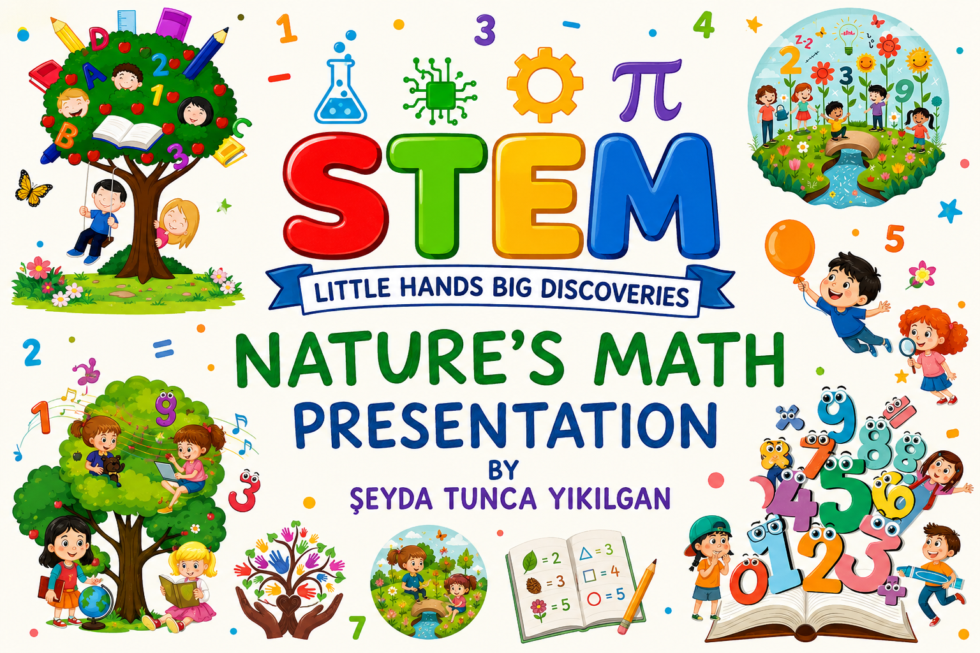

Slide 2
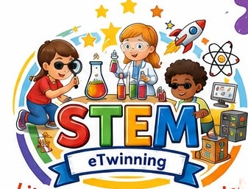
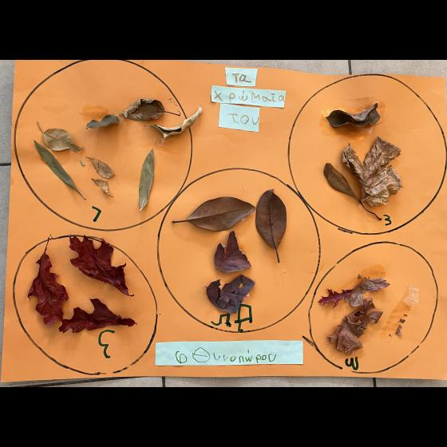
CHRISTINA TSOUMELEKA-GREECE
Children explored grouping and sorting natural materials.
1

Slide 3
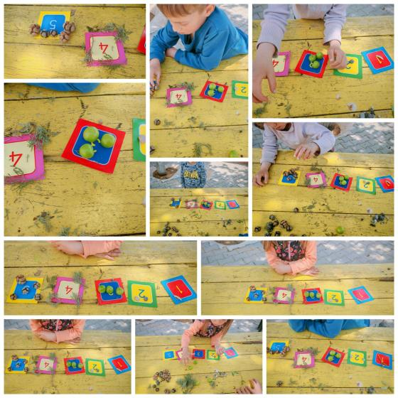
DERYA PARLAK ULUPINAR-TÜRKİYE
Students matched quantities using natural objects.
2

Slide 4
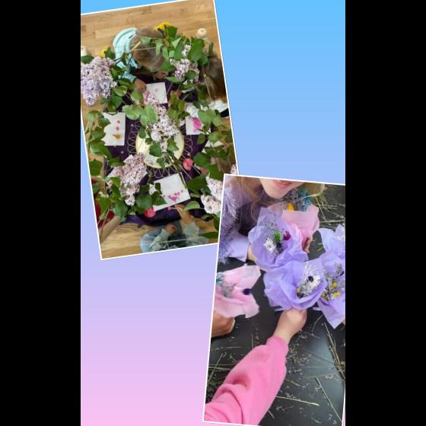
ELENA GHINEA 2-ROMANIA
Learners created mathematical compositions inspired by nature.
3

Slide 5
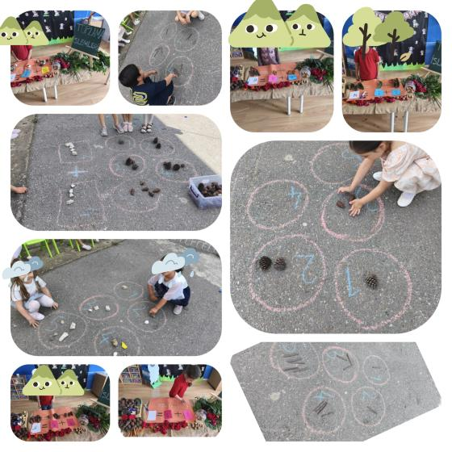
EMİNE DÜZGÜN BAYRAKDAR-TÜRKİYE
Children discovered numbers using pinecones and circles.
4

Slide 6
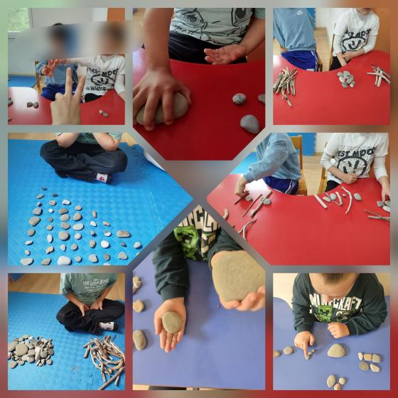
MERVE ŞAHİN 1-TÜRKİYE
Students compared sizes with stones and sticks.
5

Slide 7
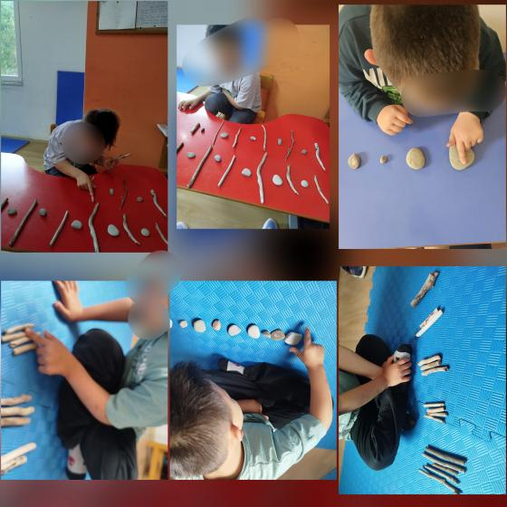
MERVE ŞAHİN 2-TÜRKİYE
Children explored sequencing through natural materials.
6

Slide 8
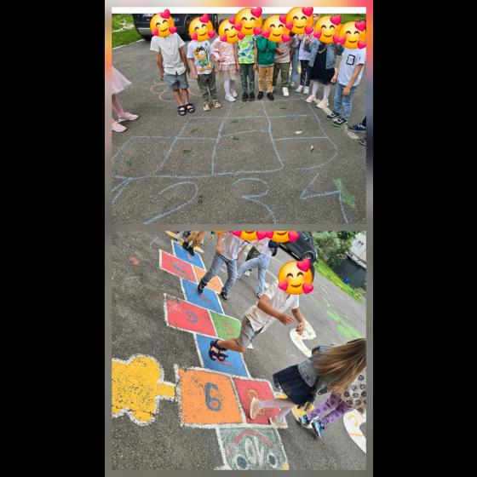
MIHAELA VINTILA-ROMANIA
Learners practiced counting through outdoor games.
7

Slide 9
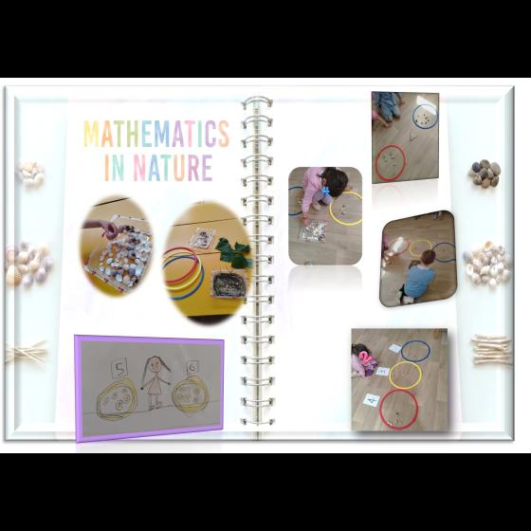
OMBRETTA PIERANTONI-ITALY
Students classified pinecones and natural objects.
8

Slide 10
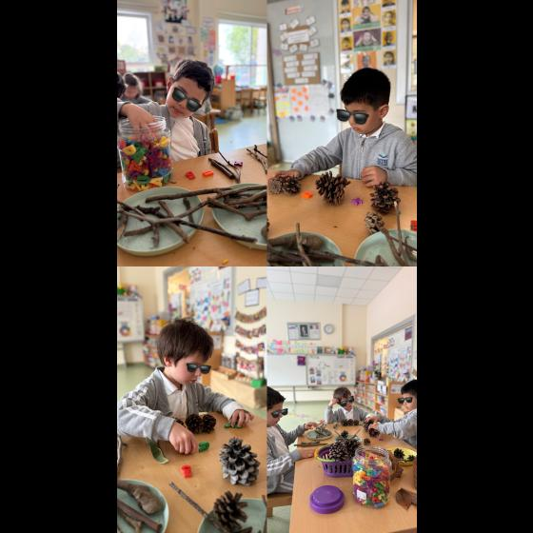
SELİN KEŞMER-TÜRKİYE
Children connected counting with nature exploration.
9

Slide 11
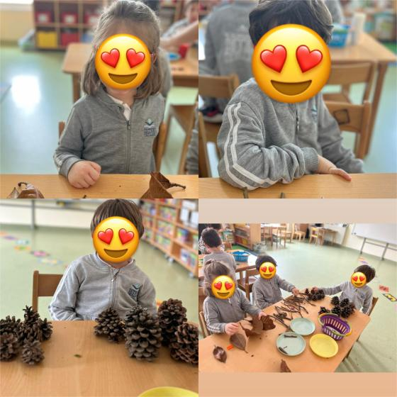
ŞEYDA TUNCA YIKILGAN-TÜRKİYE
Students explored patterns and grouping in nature.
10

Slide 12
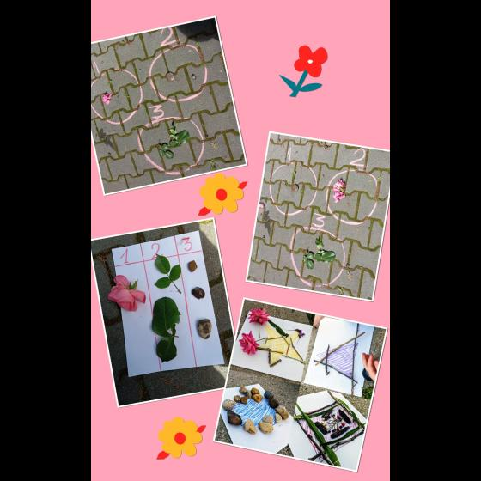
SİLVİA CHRISTINA MOLDOVEANU-ROMANIA
Children discovered mathematical relationships playfully.
11

Slide 13
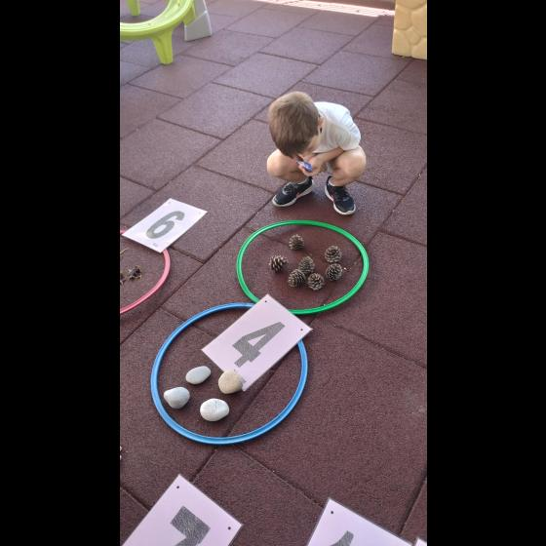
ΒΑΡΒΑΡΑ ΒΑΣΙΛΕΙΟΥ-GREECE
Learners strengthened observation and creativity skills.
12

Slide 14
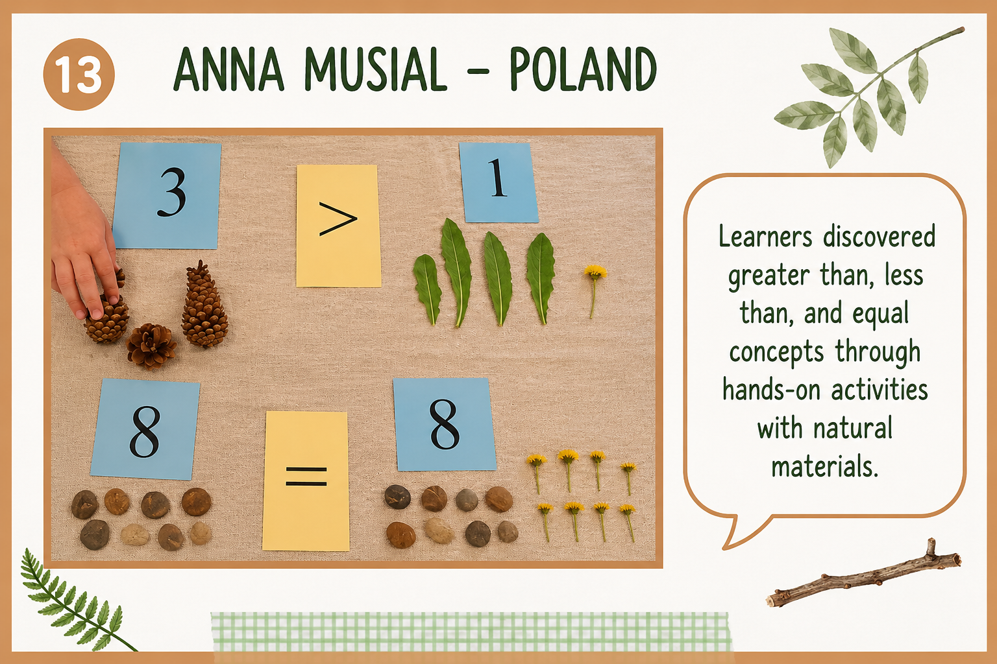

Slide 15
THANK YOU!
Learning Mathematics Through Nature Was So Much Fun!
Little Hands, Big Discoveries 🌿✨

