Slide 1
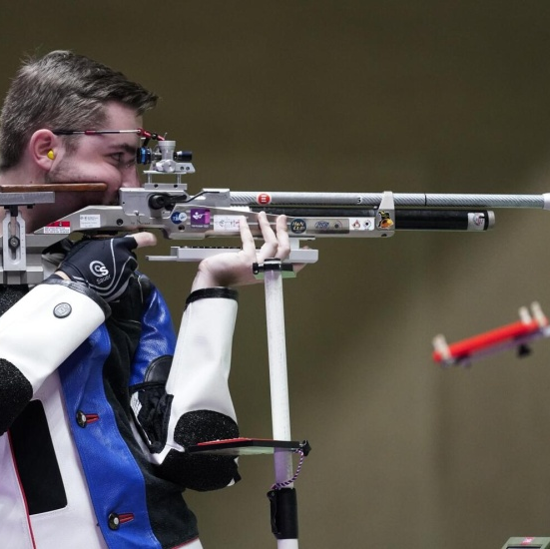
SHOOTING
shooting is a sport not so common in the world but it is quite famous in the olympic games

Slide 2
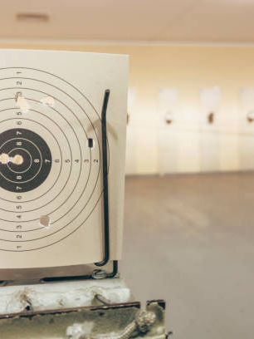
shooting is not as easy as it seems, you shoot from a distance of 10 meters, a specific number of shots and targets ,with the sole aim of hitting the center of the target

Slide 3
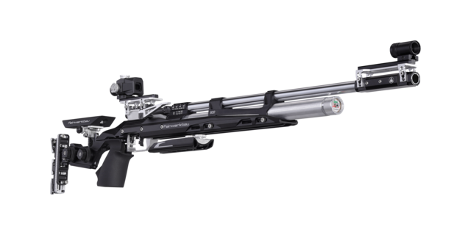
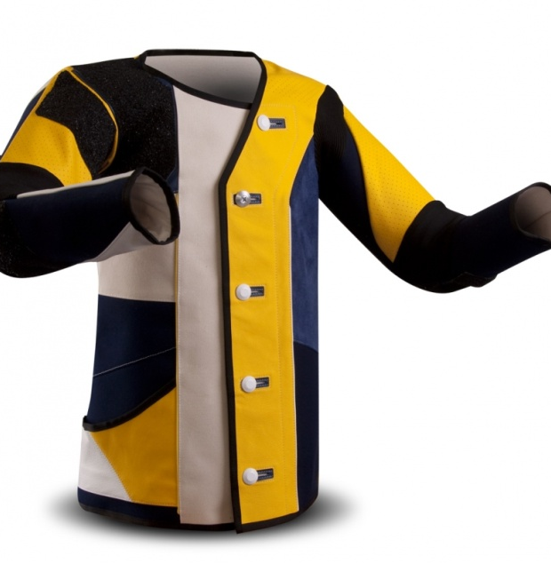
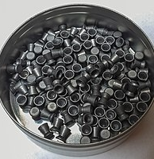
special equipment
If you shoot amateur you don't need equipment as most of the time the shooting range provides it. However, if you do shooting and want to take it one level further,to participate in Pan-hellenic and Olympic competitions, then you will need equipment. More specifically, you will need a weapon, a special uniform and whatever else is required.

Slide 4
Τhis sport is also my hobby, it was something I wanted to do a long time ago. and I was given the opportunity to start it, I decided to present it to you so that you can see the sport from another side and see that it is completely different from what you thought until now, as I told you before it is special and I want to win trophies in this the sport.

Slide 5
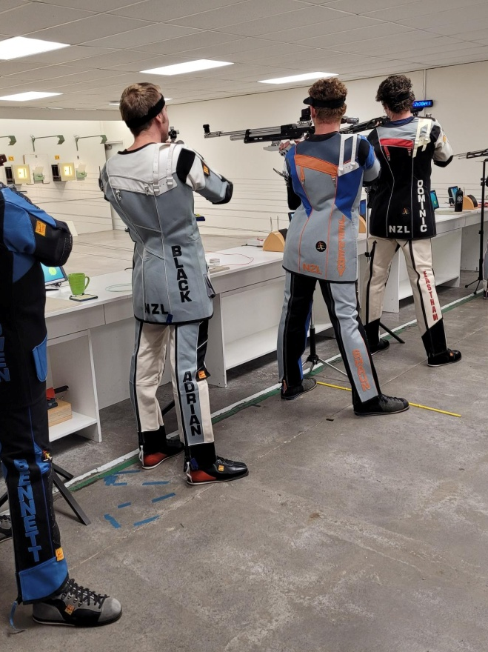
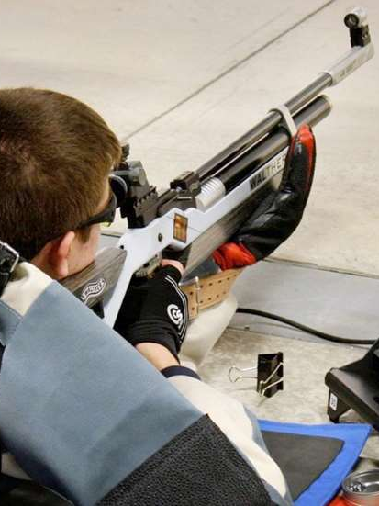
I still don't know if I'm good or not but I'm trying, usually I don't face problems other than concentration and sometimes stability.
I started shooting in April 2023 and in a month or so I will complete a year. There are three stages, sitting, standing, and in uniform. I am in the second stage, I train once or twice a week and many times I take part in local competitions.

Slide 6
THE END
ΠΑΠΑΧΡΙΣΤΟΥΔΗΣ
ΠΑΝΑΓΙΩΤΗΣ
ΕΤΟΣ:2024
ΤΜΗΜΑ:Β6
ΗΜΕΡ.:8/3/2024

