Slide 1
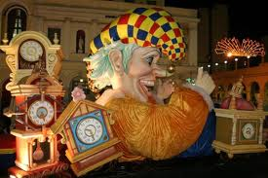
PATRAS CARNIVAL
Patras ,(a Greek city and port in the Peloponnese , Greece) hosts every year its famous Carnival which constitutes the most important celebration of the area, but also one of the biggest in our country.

Slide 2
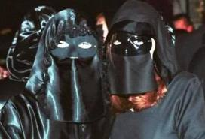
The opening ceremony of the Carnival, constitutes the beginning of the festivities and at the same time an invitation to the people of Patras to actively participate in them.
Some of the events that take place during the period of celebrations are: ‘BOURBOULIA’

Slide 3
(Bourboulia are dancing the balls which were first held in Patras around 1872. In these balls, men are dressed in suits and women wear dominoes and cover their faces in black masks so that they remain anonymous. Men invite them to dance without knowing their identity! Bourboulia is one of the most popular celebrations during Carnival time, with many fans.) ,
‘ THE BABY RALLY’,
‘ THE WALKING NIGHT PARADE’ and the final huge PARADE OF THE FLOATS AND THE CREWS of all the participating groups .

Slide 4
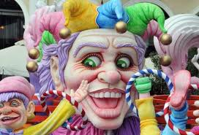
The Carnival of Patras dates back to 1829 , when the first dancing balls with people dressed up took place in the houses of wealthy Patrians. Since then, the Carnival in Patras has evolved to what it is today: an attraction for many visitors and an unforgettable experience of fun and joy for all , natives and guests.

Slide 5
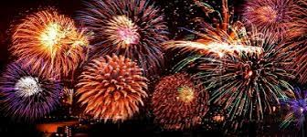
THE FIRE WORKS OVER THE PORT TURN NIGHT INTO DAY!

Slide 6
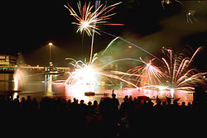
During the last week of the Carnival the most leading moments of the whole carnival period take place: the PARADES. The first parade is on Saturday at night and the last one on Sunday at noon. More than 30.000 people participate in them. This year 163 groups will parade , a lot more than last year.
The parade is watched by more than 300.000 people, while Patras, the capital of Achaia, is the centre of joy!!

