Slide 1
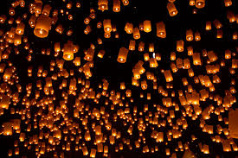
Yee Peng Sky Lantern Festival & Loi Krathong in Chiang Mai
Yee Peng Sky Lantern Festival & Loi Krathong in Chiang Mai

Slide 2
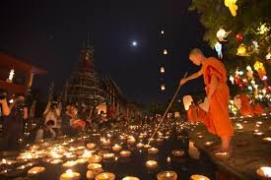
Yi Peng (local name) is part of the festival of lights in Northern Thailand to show respect to Buddha. It's date usually coincides with Loi Krathong which all of Thailand celebrates using floating lights on water. In Northern Thailand Yi Peng, which is celebrated alongside Loi Krathong, is different in that lights are placed into sky lanterns which float up into the air.

Slide 3
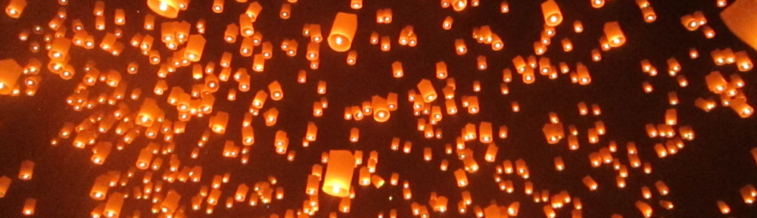
Loi Krathong still happens in Chiang Mai but the actual Loi Krathong floating lanterns on water event happens the day/night after Yi Peng.
Alongside the floating light ceremonies there are also parades, fireworks, displays of colorful lanterns and cultural highlights involving the Lanna. As Chiang Mai was the former capital of the Lanna Kingdom it holds the largest Yi Peng Festival.

Slide 4
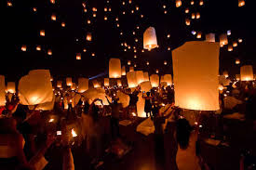
Did you know?
Yi Peng translated from Lanna is "Yi" meaning "2nd" and "Peng" meaning "month".
Yi Peng is held on the full moon of the 2nd month of the Lanna calendar. Though the exact dates change yearly it's usually held in mid to late November.

Slide 5
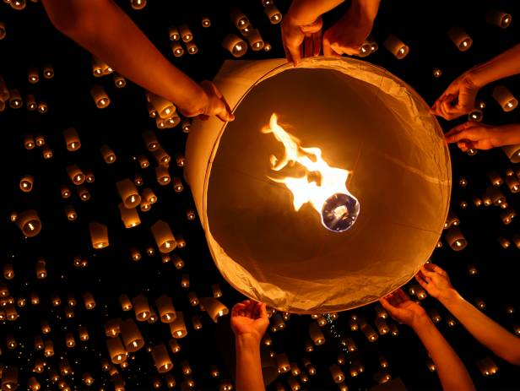
Sky Lanterns (Khom loi / Khom Loy / Khom Fai) when released are said to end a person’s bad luck or misfortune. Especially if it disappears from view before the fire goes out.

Slide 6
There's a little confusion over where and when to actually see the spectacular lantern release during Yi Peng in Chiang Mai. Here's a simple break down.
The biggest lantern release is held behind Mae Jo University in Chiang Mai known as the Lanna Dhutanka grounds.
There is a second release of lanterns for paying tourists only about a week after the official ceremony.
Lanterns are released all over Chiang Mai city throughout the weekend festival (even in the days leading up to it)

Slide 7
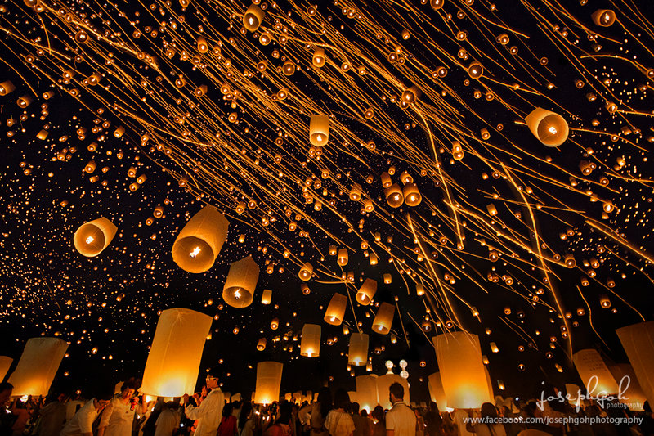
Thank you for ΥΟUR PATIENCE yριΑΝΝΑ ΝΤΑΛΙΠΗ

