Slide 1
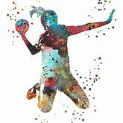
Learning to play handball in nature
An outdoor project based on experiential learning
Created by:
Basiouri Alexandra
Beinas Apostolis
Gkalmpeni Evangelia

Slide 2
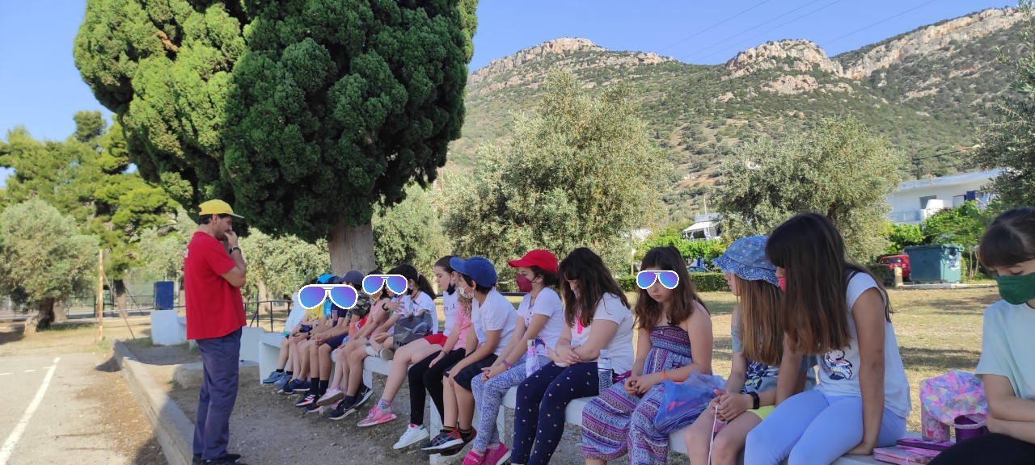
Activities Index
Study material (video & specific pages from the Physical Education students’ book)
Information exchange-> all students share the same amount of information at the end
Design & creation of an improvised handball court & equipment based on material from nature
Practice of rules & movements
Final game

Slide 3

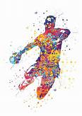
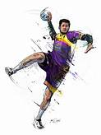
Brainstorming
Duration of Activity: 15 min
Materials: video
Aims: - To activate possible background knowledge about handball
- To give them the necessary information to proceed to next stages
Implementation: T shows videos and gives students books with information about the history of handball (how it started, first matches, technique details)

Slide 4
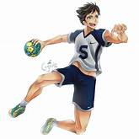
Presentation
Duration of Activity: 20 min
Materials: Physical Education student’s book
Aims: - To have Ss retrieve specific information
- To collaborate & be able to exchange information
Implementation: Ss work in groups of 3 & are given pieces of information about the sport
Group A: Handball history
Group B: Handball court & basic handball rules
Group C: Motor skills & technique details

Slide 5
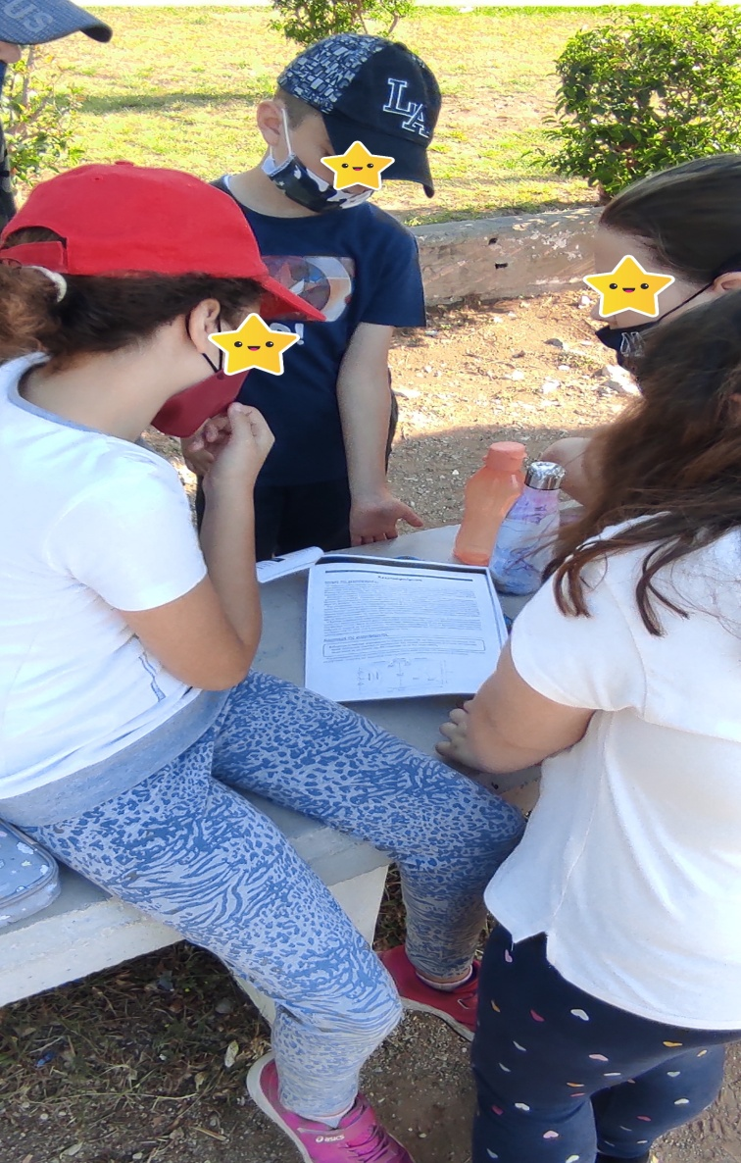
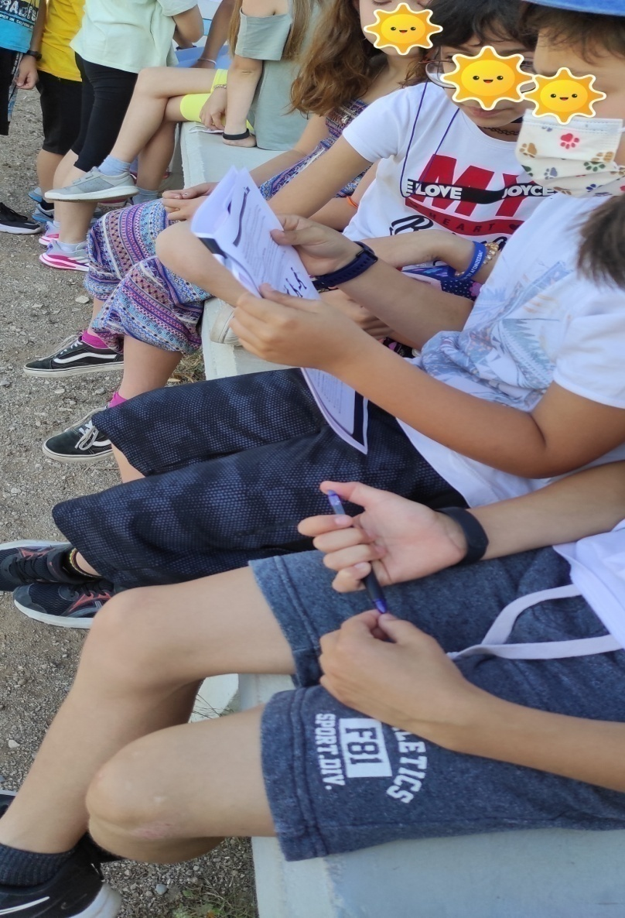
Getting the first information

Slide 6
Practice Construction of a handball court
Duration of Activity: 20 min
Materials: branches, pebbles, sea stones & oranges
Aims: - To engage Ss in a problem solving activity & have them use the information they got in a real life context
To collaborate
To develop their creativity
Implementation: Ss use materials from nature to draw lines & make the boundaries of a handball court and the two basic court fixtures. Then, Ss cut oranges from the trees of the area & they use them as handballs.
Curriculum Relation: P.E., Maths (Geometry), Art, Environmental Studies

Slide 7
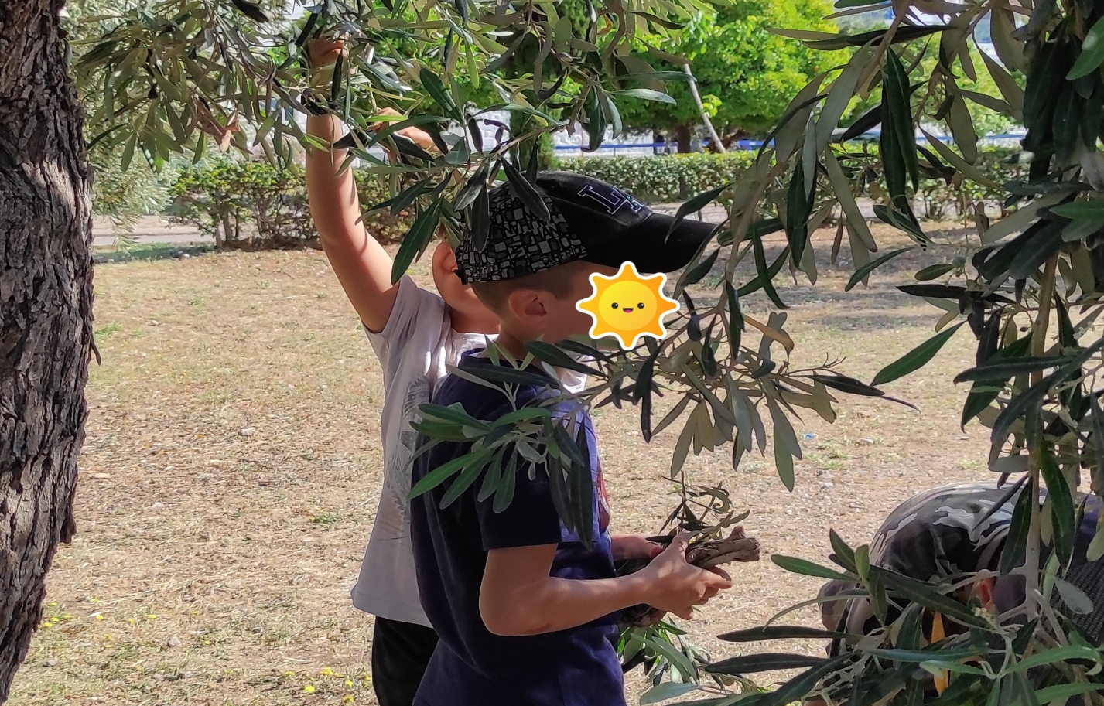
Students while collecting olive tree branches

Slide 8
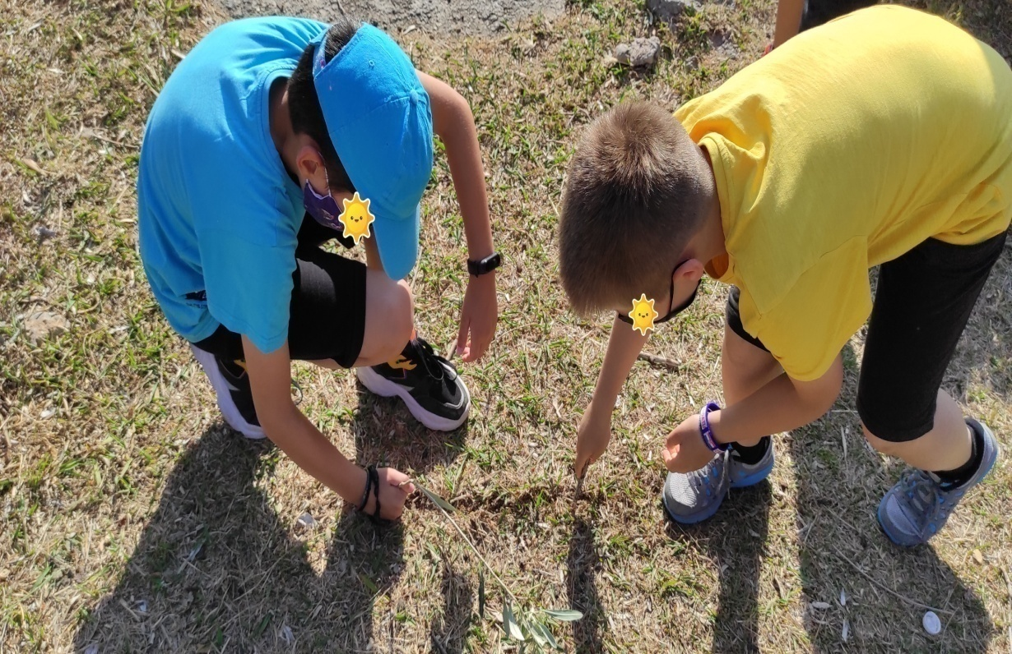
Students while tracing the handball court

Slide 9
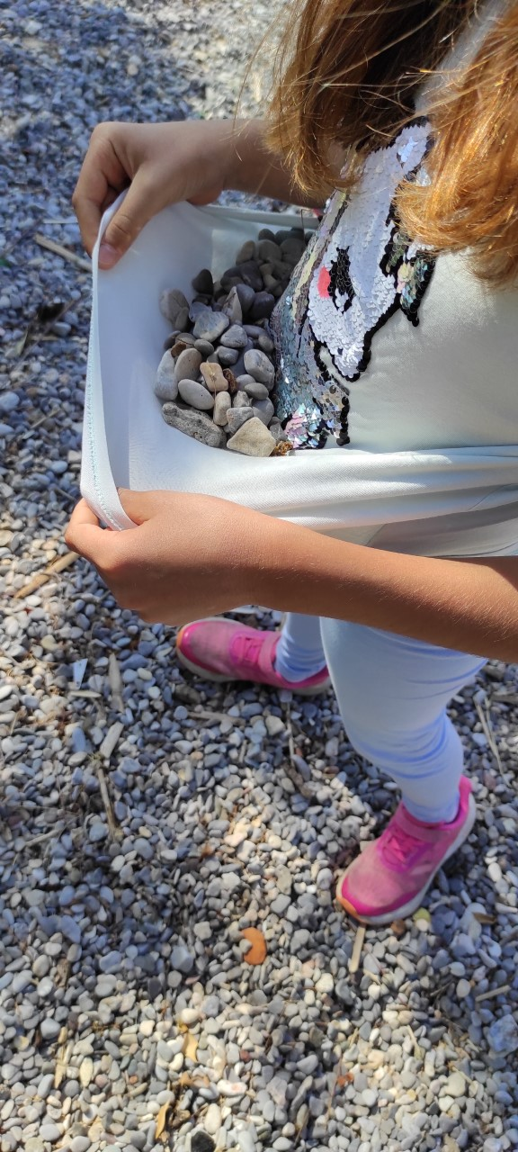
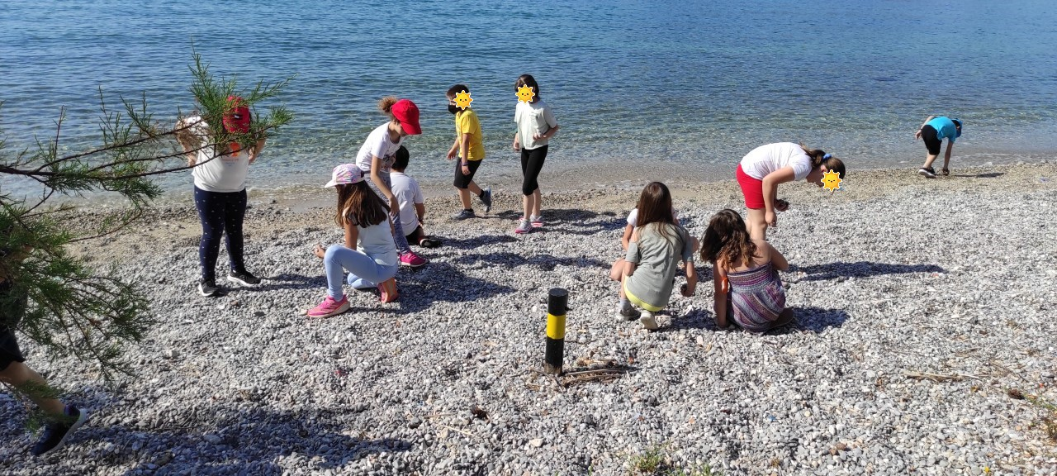
Collecting material to make the court

Slide 10
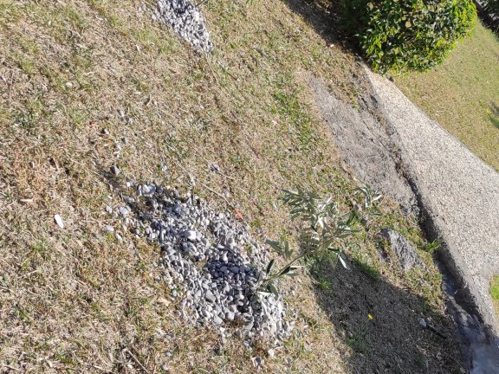
Making the goal post

Slide 11
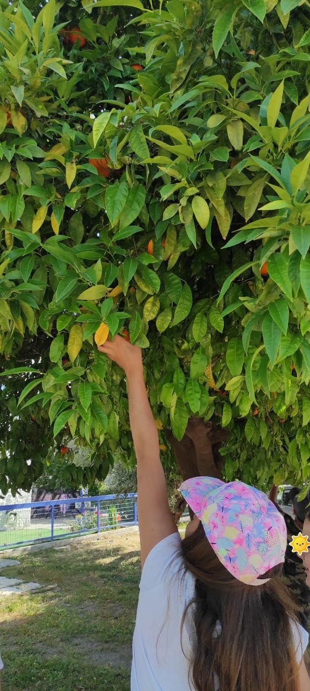
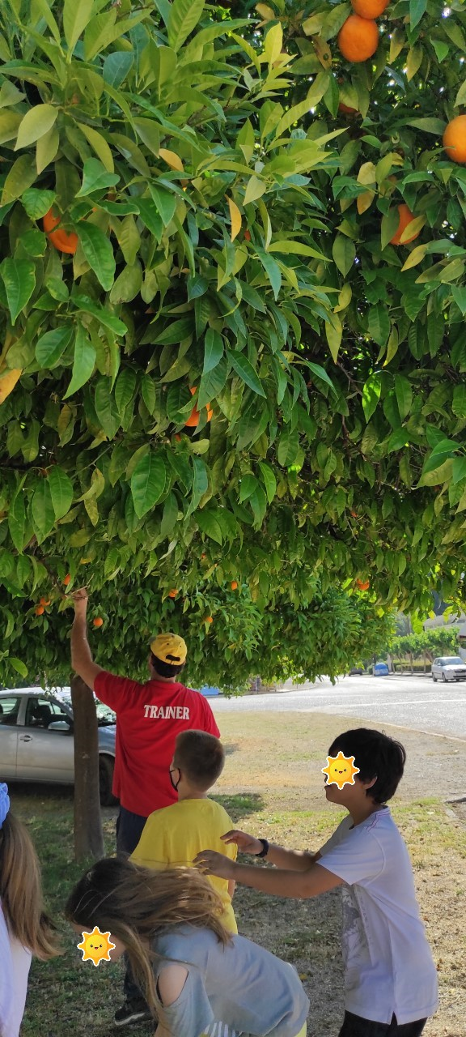
Collecting oranges for balls

Slide 12
Practical Exercise
Duration of Activity: 45 min
Materials: oranges
Aims: - To practice the rules they have learnt
To develop hand & leg coordination
To raise good sportsmanship
Implementation: Activity A - > execution of 3 steps (rule) and ball tossing
Activity B-> passes among Ss & right movement in the court (outdoor beach area).
Activities C-> The final game play. The Ss are asked to play with the improvised balls without exceeding the limits of the goalposts

Slide 13
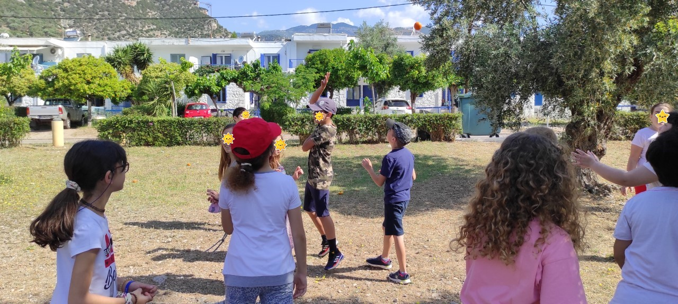
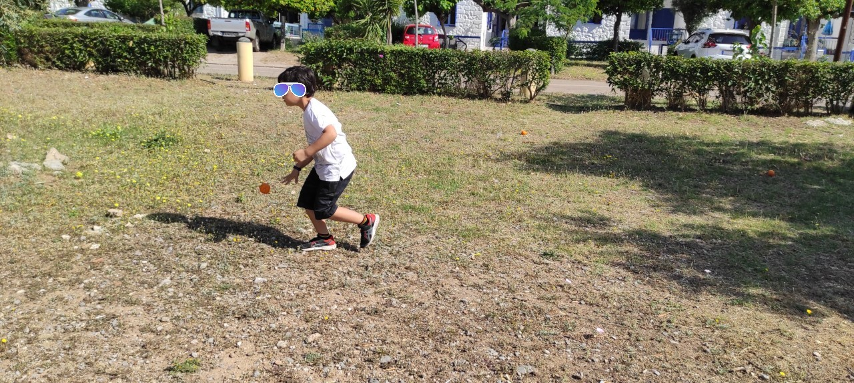
3 Steps & Movements

Slide 14
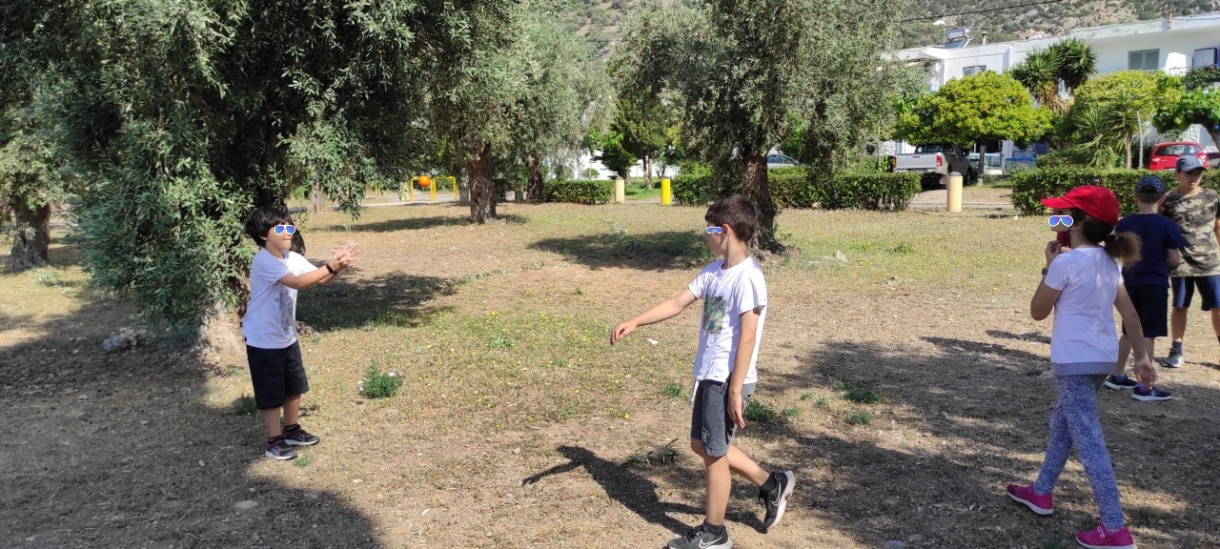
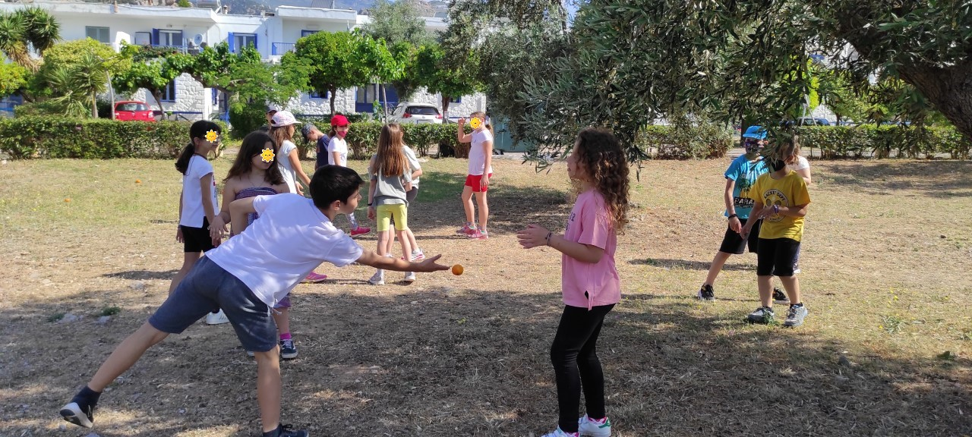
Ball tossing & Movements

Slide 15
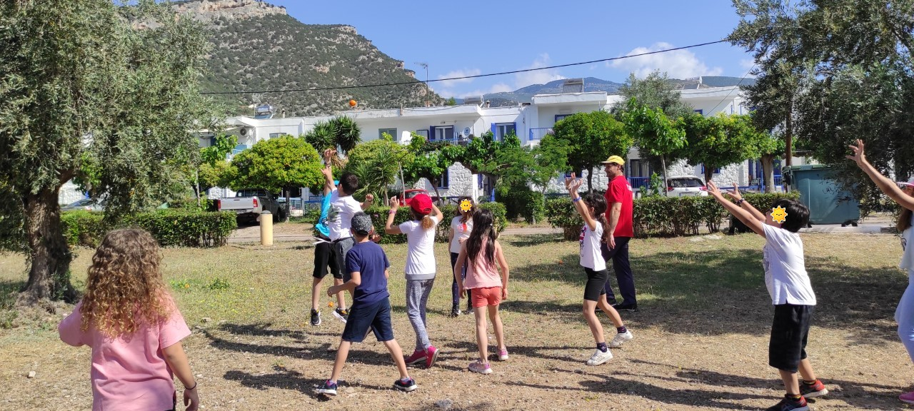
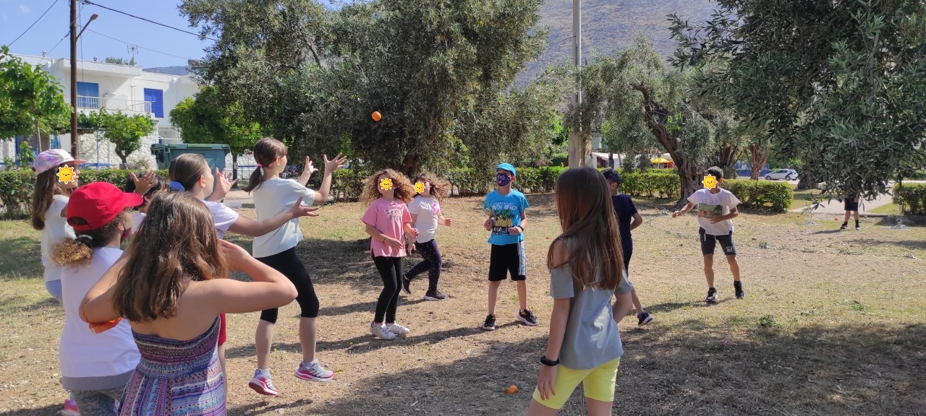
Final Game

Slide 16

vă mulțumesc!!! Diolch yn fawr iawn!!! Ευχαριστούμε !!!

