Slide 1

Christmas card

Slide 2

The Christmas tree of the card is made by the hands of the children.
The Christmas balls are also decorated by the children.

Slide 3
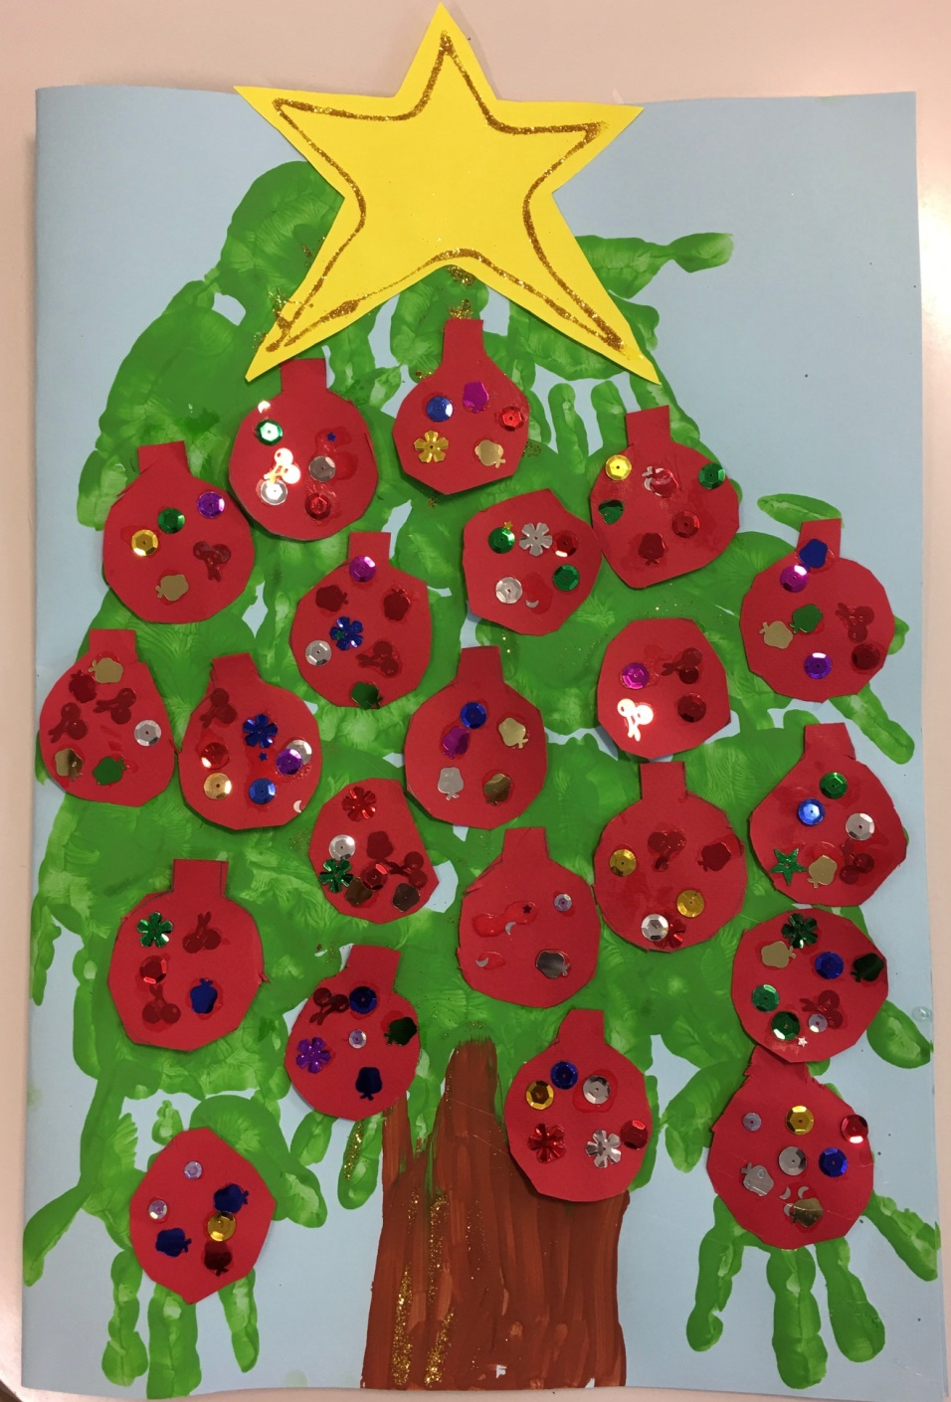

Slide 4
