Slide 1
VOLCANO

Slide 2
A volcano allows hot lava and smoke to leave from a magma chamber below the surface of the Earth.
Volcanoes are generally found at different places on Earth. For example, in the oceans, Volcanoes can also form where there is stretching and thinning of the crust. For example the Hawaii was created from magma 3,000 km deep in the Earth.
Erupting volcanoes have many dangers not only near the eruption. One such danger is that volcanic ash can be a threat to aircraft. Also, large eruptions can affect temperature and cool the Earth's atmosphere

Slide 3
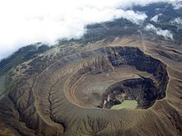
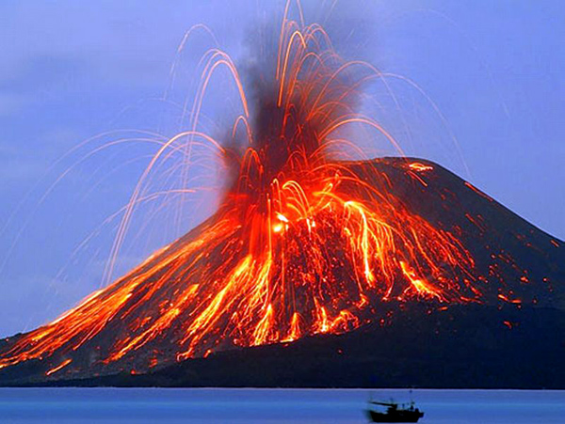

Slide 4
Volcanic features
The most people think that volcanoes are like tall mountains; however, this describes just one of the many types of volcano. The features of volcanoes are much more complicated and their structure and behavior depends on a number of factors. Some volcanoes have peaks formed by lava while others are flat.

Slide 5
As of 2013, the following are considered Earth's most active volcanoes:
Kīlauea, the famous Hawaiian volcano since 1983, and has the longest-observed lava lake
Mount Etna and nearby Stromboli two Mediterranean volcanoes in "almost continuous eruption since ancient times.

Slide 6
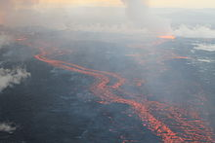
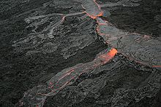
1)Lava flows at Holuhraun, Iceland, September 2014
2)Pāhoehoe lava flow on Hawaii. The picture a main lava channel

Slide 7
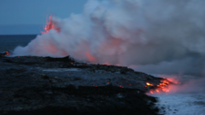
Active volcanoes.
Scientists usually consider a volcano to be active if it is erupting or likely to erupt
Kīlauea lava entering the
sea.

Slide 8
Thank you for attention
Dionysia Kalantzi B1

