Slide 1
Volcanic Eruption
By Karanasiou Katerina B1
07/02/2017

Slide 2
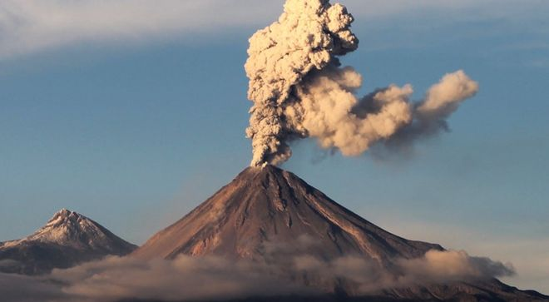
Volcano…
Volcano is open passageway from the interior of the Earth that allows blast rock and gases from the interior to the cortex surface in the form of lava. This activity creates mountains

Slide 3
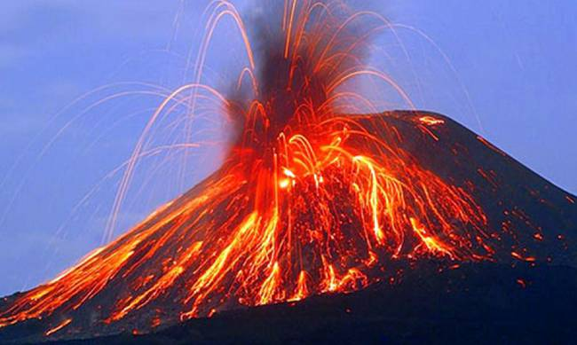
Volcanic eruption…
The volcanic eruption ,as we know, makes many disasters and is the reason of many people’s death. These events are very sad for all of us…

Slide 4
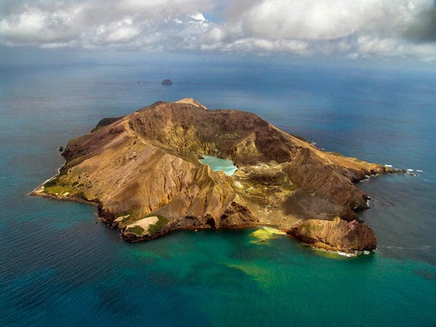
Τypes of volcanoes…
volcanic vent
central vent,
summit crater
Edifice
magma chamber
Flanks
flank eruptions
parasitic cones
fumaroles

Slide 5
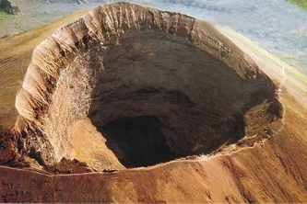
Some of the volcanoes
VEsuvius
An image…
On August 24 of the year 2016, a tectonic earthquake destroyed many villages in central Italy. On August 24 of the year 79 AD, the volcano Vesuvius near Pompeii begins to explode. Over the next 25 hours destroyed all the city. These were two different etiology earthquakes and physiognomy, but coincidentally were in the same day. In Central Italy lament over 200 victims. Pompeii victims were thousands.

Slide 6
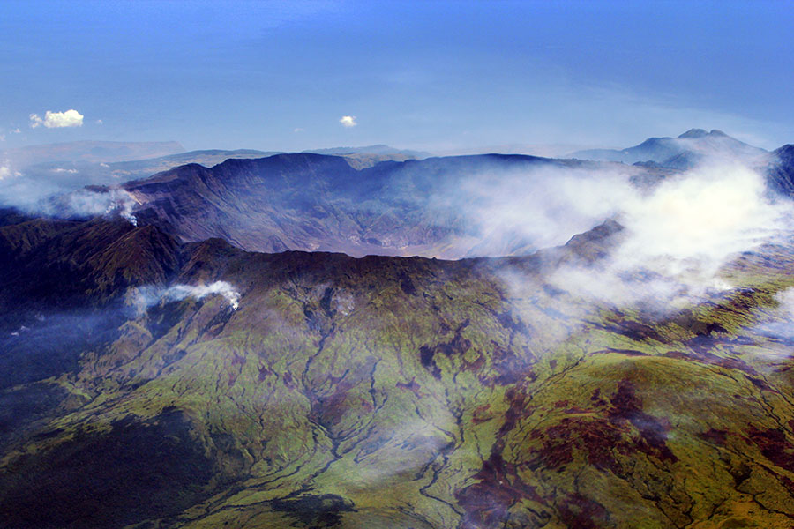
Tabora
The term Tabora is an active volcano with a height of 2.722 meters. As a large magma chamber inside the mountain filled over several decades, the volcanic activity escalated until the big explosion of April 1815

Slide 7
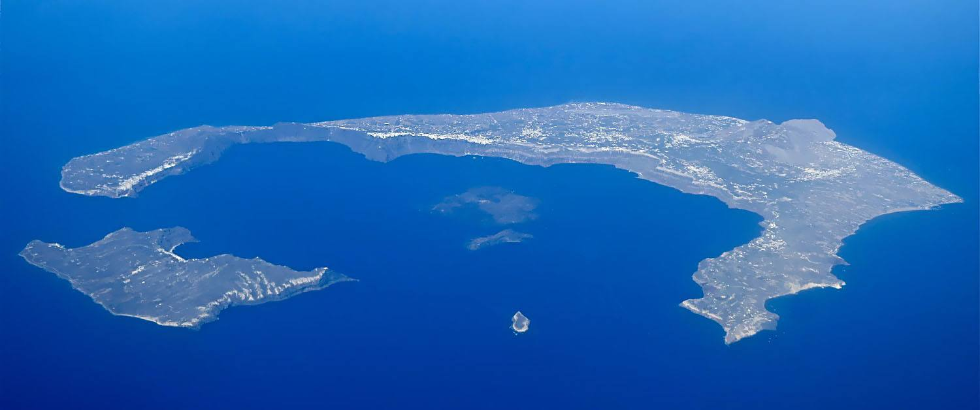
Santorini’s volcano…
The greatest explosion occurred during the Minoan Bronze Age 3,600 years ago. The entire center of the circular island sank into the sea during the tremendous volcanic eruption. The explosion caused a tidal wave that literally wiped out the advanced civilization of Minoan Crete, 70 miles south of Santorini.

Slide 8
Thanks for your attention…
Karanasiou Katerina B1

