Slide 1
BRIGHT AND DARK SIDE OF CHRISTMAS!
By Karanasiou Katerina B1
15/12/2016

Slide 2
Christmas customs…
General customs in "Christmas Holiday" from a combination of religious and folk traditions that are celebrated mainly by Christians of Europe and America but also by other non-Christian peoples (Chinese, Japanese, etc.). In Greece combined international traditions like Santa Claus and the reception of the new year with Greek traditions such as New Year pomegranate and stories of goblins. Each country has its particular customs of Christmas.
Notes:
Karanasiou Katerina B1 15/12/2016

Slide 3
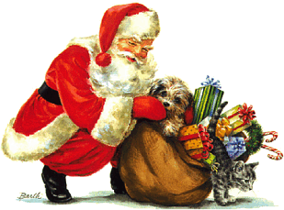
SANTA CLAUS…
Santa Claus, also known as Saint Nicholas, Saint Nick, Kris Kringle, Father Christmas, or simply Santa, is a legendary figure of Western culture who is said to bring gifts to the homes of well-behaved ("good" )children on Christmas Eve (24th December) and the early morning hours of Christmas Day (25th December).
Every year all children all over the world are waiting for Santa Claus to come…
Notes:
Karanasiou Katerina B1 15/12/2016

Slide 4
Decoration…
Decoration in counties like America…
Decoration in Greece…
Notes:
Karanasiou Katerina B1 15/12/2016

Slide 5
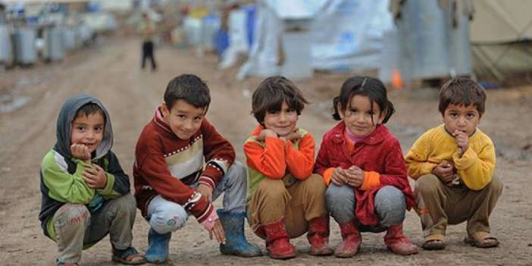
All children are happy…right?
Some children are not as happy as us…We are offered presents every year by the ones we love…Unfortunately families in wars, separate, get killed and wish they had a better life…Children that are in a difficult economical state don’t get offered any presents this time of year…
Notes:
Karanasiou Katerina B1 15/12/2016

Slide 6
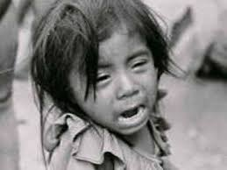
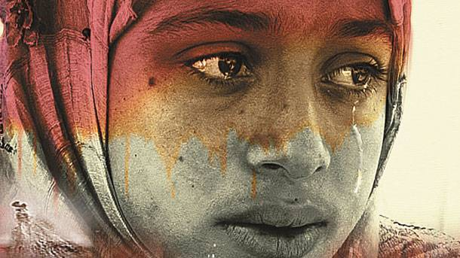
Photos…
Notes:
Karanasiou Katerina B1 15/12/2016

Slide 7
Other disadvantages of Christmas…
Spending an extreme amount of money
Some people are in bad situations in hospitals
food consumption
…and more…
We have to help each other…
Notes:
Karanasiou Katerina B1 15/12/2016

Slide 8
Thanks for your attention…
Karanasiou Katerina B1
15/12/2016

