Slide 1
Unicorns!!!
Some wonderful creatures…

Slide 2
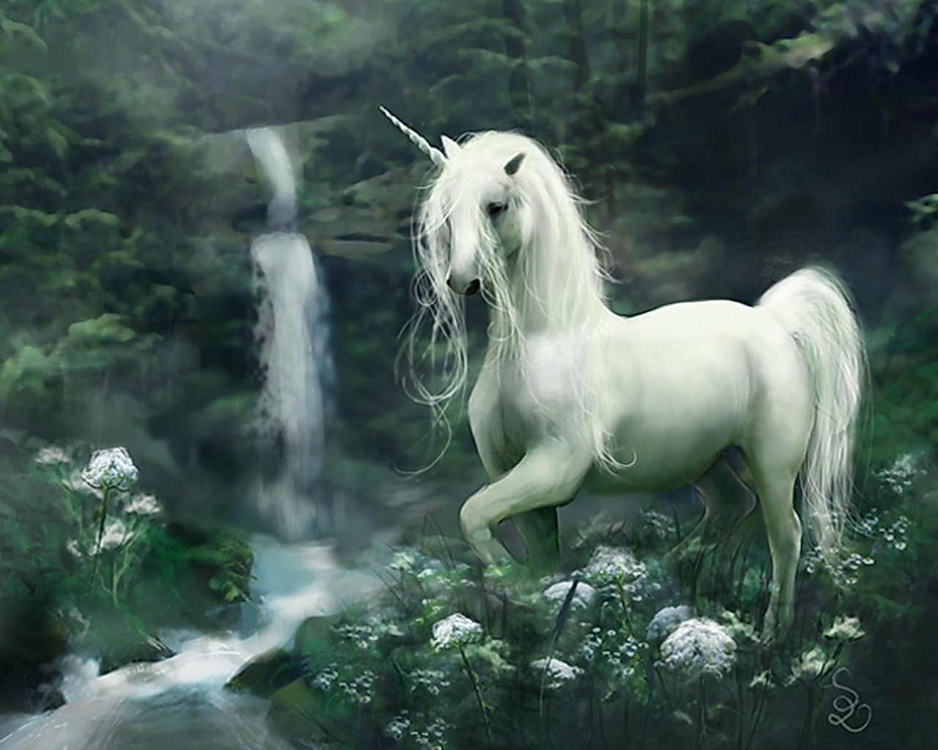
Unicorns!!!

Slide 3
UNICORNS!!!
Unicorns were legendary creatures that had the form of a horse and a horn on their head.
They were wild animals , impossible to be caught.
Also , it is said that unicorns had been seen in many forms.
Their enemy was the lion.

Slide 4
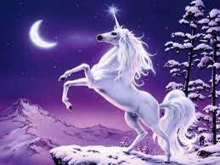
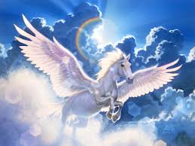
It is not the same thing…
Unicorn!
Pegasus!

Slide 5
. . .
It is believed that unicorns΄s horn had magical abilities.
On the opposite side , pegasus had very big and strong wings.

Slide 6
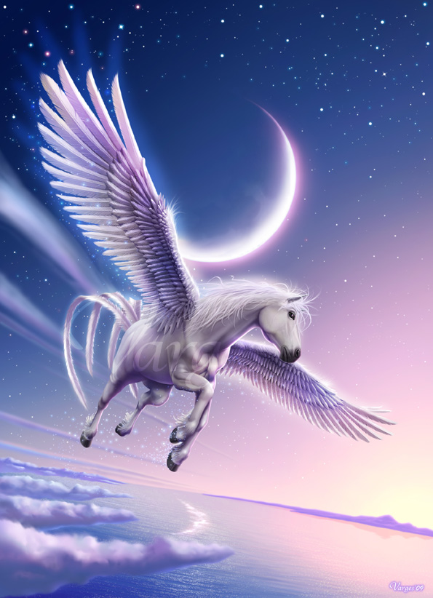
PEGASUS!!!

Slide 7
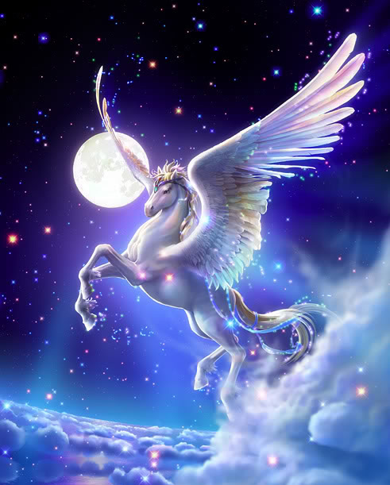

Slide 8
By: eftichia zachou
THE END!

