Slide 1
BABIS
AND
VAGELIS
PARADISE CITY

Slide 2
Babis and Vagelis went to London for summer holidays.
There they met a tourist guide named Alice.When they get to the hotel
they saw a strange monster.

Slide 3
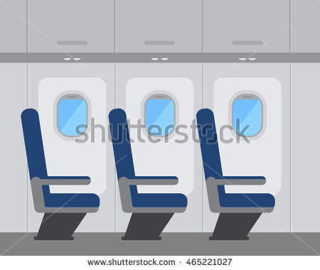
We have arrived to London!
I’m so excited about going to London.
Me too ! I want to see the Big Ben.

Slide 4
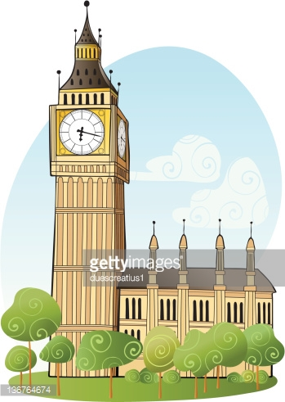
I will be your tourist guide on this trip . My name is Alice.
My name is Vagelis.
Now we will take the bus to go to the hotel.
And my name is Babis

Slide 5
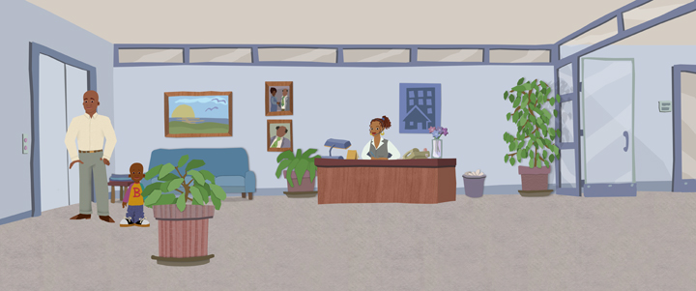
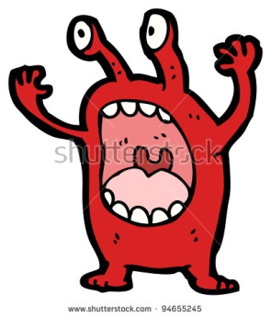
Do you believe in aliens?
Now,yes!
Can you see a red shadow over there?
What is that?
What a great hotel!
And expensive hotel as well!
It is the best hotel in the city!
It might be a light.
I will destroy London!hahahaha

Slide 6
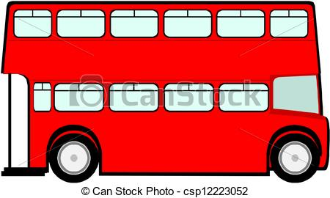
I can not believe that an alien will destroy this Paradise city
or destroy the Buckingham Palace
I think that the alien will go to the Green Park to burn it .
We must follow him.
I can see the red shadow again
We must do something!

Slide 7
We will catch you alien!
Let’s split!
I will put my bomb in the clock of big ben!
OK!

Slide 8
I will call the police and the NASA to jail you red vicious alien.
YES! YES! YES!
YES! YES! YES!
Now we have you
Oh , noooooo
My name is SAUSAGE!
YES! YES! YES!

Slide 9
YES! YES! YES!
YES! YES! YES!
YOUPI !! YOUPI !!
You will stay at the best hotel in the city.
‘’THE PARADICE CITY HOTEL’’
You have saved London so we must give you the best award.

Slide 10
THANK YOU FOR WATCHING
DIRECTED BY :KONSTADINOS
EVELINA
MANOLIS

