Slide 1
LOOK FOR US, LOOK FOR US, YOU DON’T FIND US
5 FINGERS

Slide 2
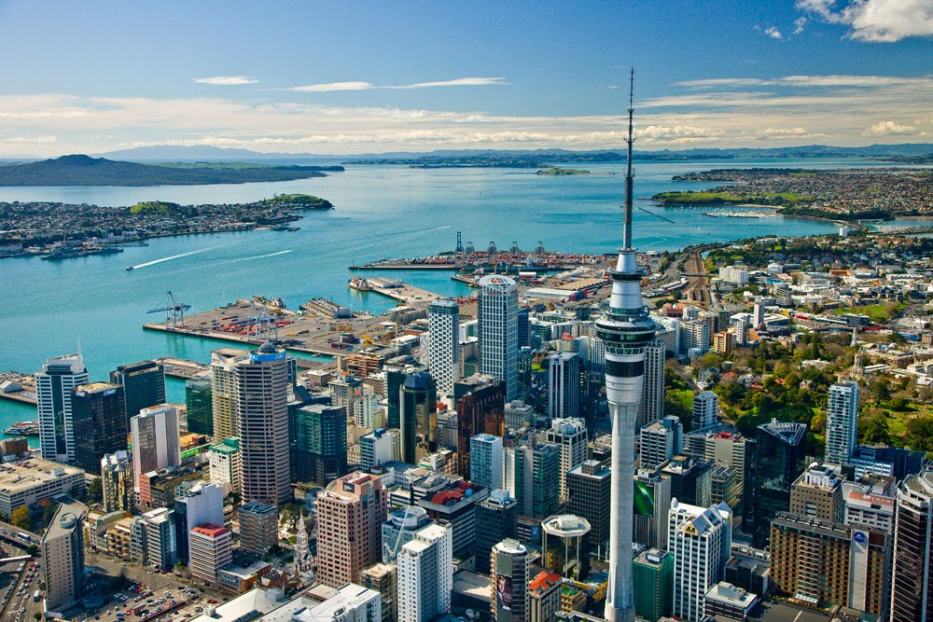
Once upon a time in the beautiful city of Oxford there lived 2 families. But they didn’t get well with each other. One sunny morning Jim and John were playing baseball. Suddenly, Jim threw the ball to Amie and Nick’s house.

Slide 3
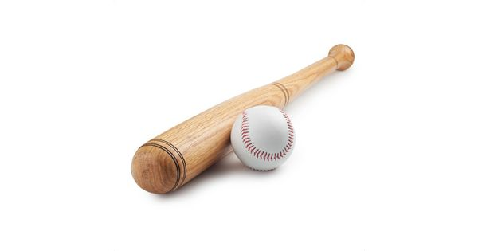
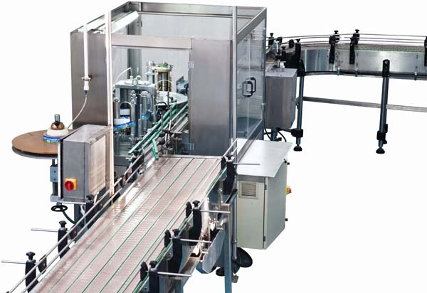
John: Jim, go and take the ball from the other house.
Jim: No, I don’t want to.
John: Ok then! Let’s go together.
After a few minutes.
John knocked on the door.
Amy :Hi ! What do you want?
Jim : Sorry ! We want to take our ball!
Nick : OK ! Let’s go to take it ,Jim!
Few minutes later…
Amy : What are they doing all this time?
John: Let’s go upstairs and see.

Slide 4
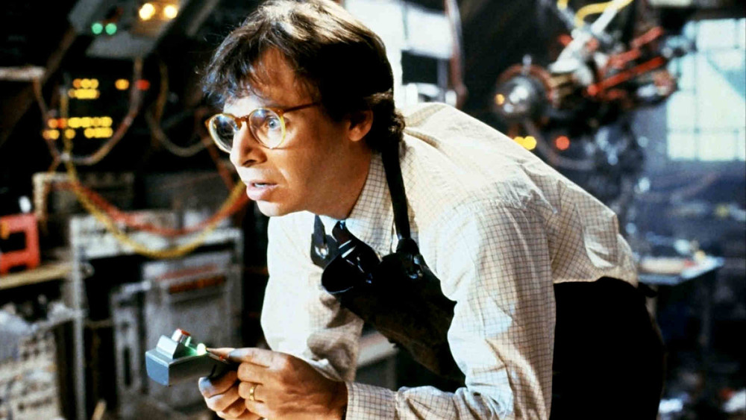
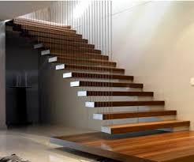
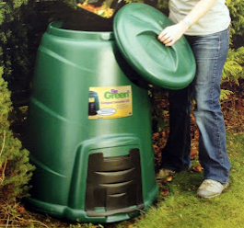
After a few minutes…
Amy : What’s happened ?
Jim:Where are we ? We are shrunk!
Nick :Help! Help!
Suddenly the kids saw an enormous machine.
John : What’s this noise ?
Nick : That’s my dad . He is coming up the stairs .
Amy : This room is so dirty !
All the kids look at Amie and laugh .
Dad mopped the floor . The children were inside the rubbish bin !

Slide 5
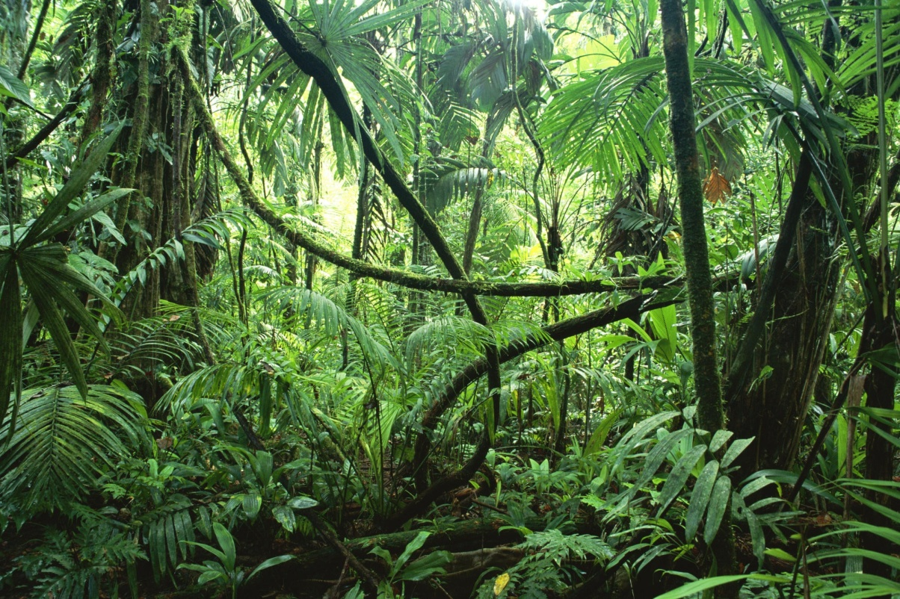
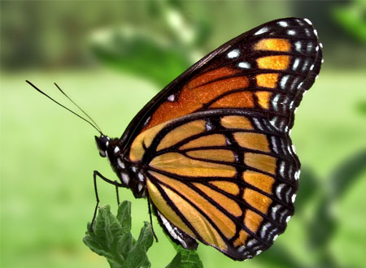
Amy : Where are we ?
Nick : Oh no ! We are in the back yard .
Unfortunately, a butterfly was flying over them . Ιt grabbed them, carried them and
dropped them on the grass .

Slide 6
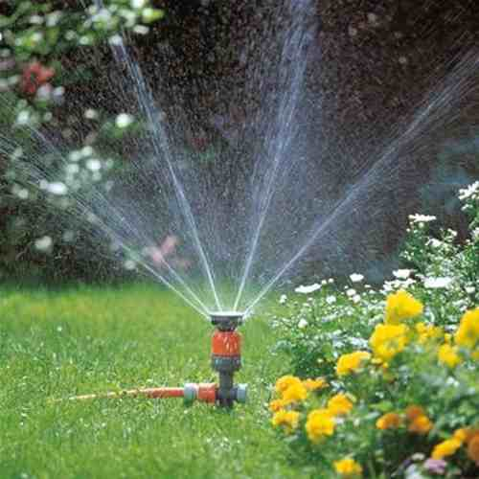
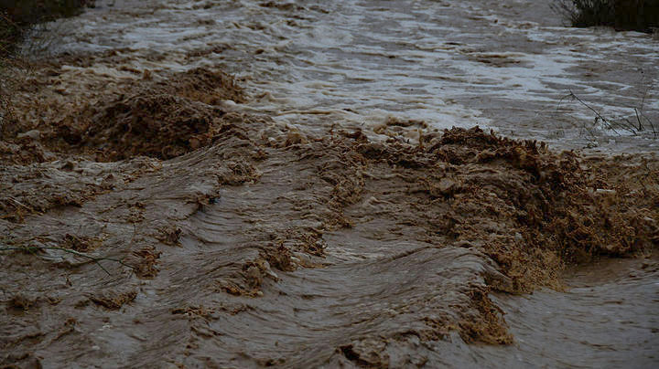
For their bad luck it was that time that the sprinkler started to water the grass .
Jim : Oh, my God ! It is started to rain .
Amy : Aaaaaaaaaa!
Nick : My sister !!!!
Amie slipped and fell into the mud . John went straight to save her . But he couldn’t . He searched everywhere and
he found her . Finally, he saved her and got her out of the mud .
Αmy : Thank you very much !
Nick : You are alive !!!!!

Slide 7
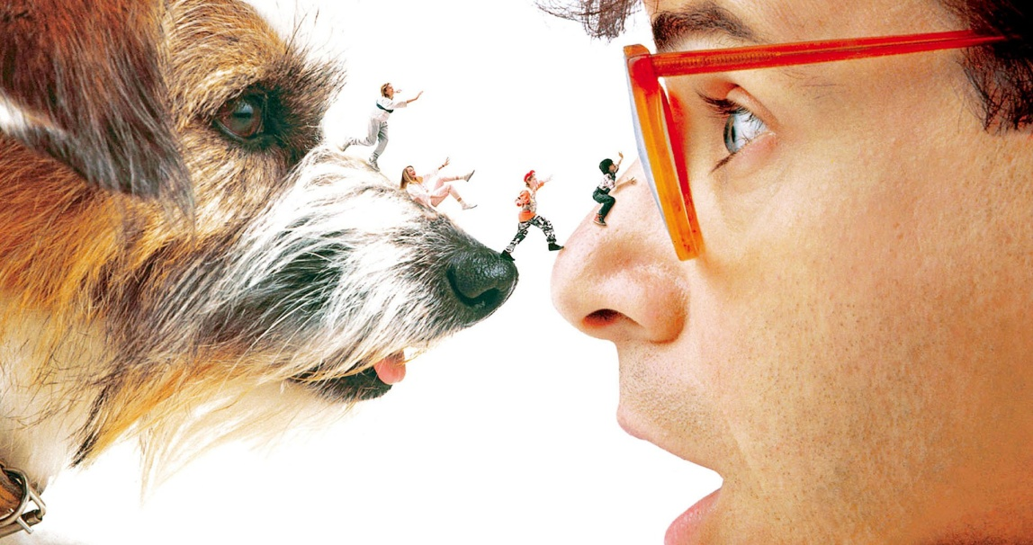
When they finally arrived home, they were exhausted . They went upstairs and started to fix the machine . In the end they managed to return to their normal size and lived happily ever after !

Slide 8
THANKS FOR WATCHING!!!

Slide 9
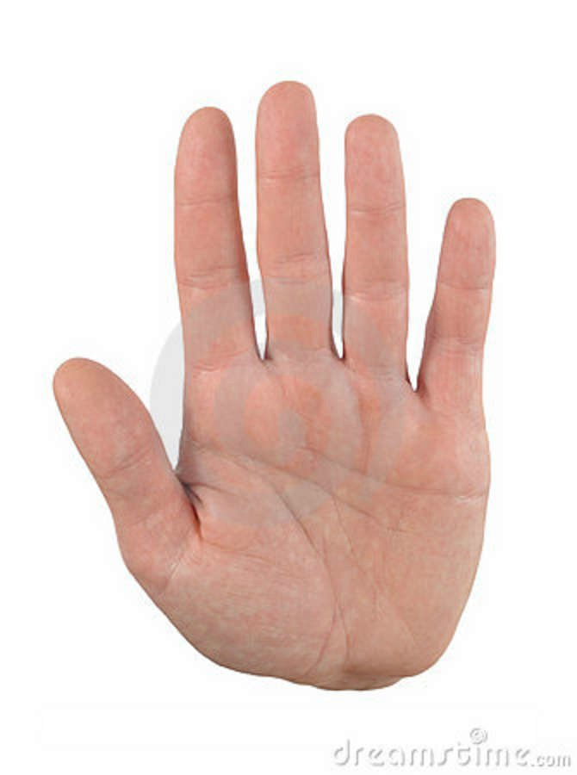
5 FINGERS
ANASTASIA SPANOU
SOPHIA KATERI
GEORGIA ANASTASIADOU
NEFELI AGAPAKI
MARIA PILIANIDOU

