Slide 1
Miss Wasteful and her little daughter
Zoe Petridou & Marilena Flevaraki
Comic books

Slide 2
Miss Hart ,or else miss Wasteful, is a woman about 35 years old, who has a little daughter. Her daughter is called Tiffany and is about 6 years old. Tiffany is environmentally friendly, but her mother the opposite. We will show you different days from their life. So read the comic and answer to this question. Who is doing the right thing?

Slide 3
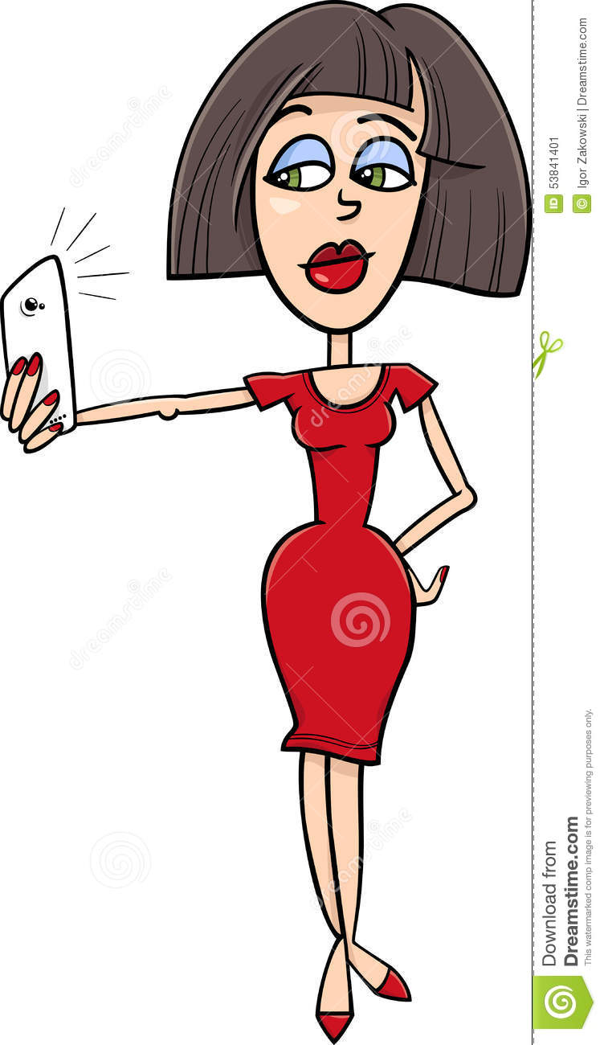
Hi,my name is Jane Hart!
And I am Tiffany , her little daughter!

Slide 4
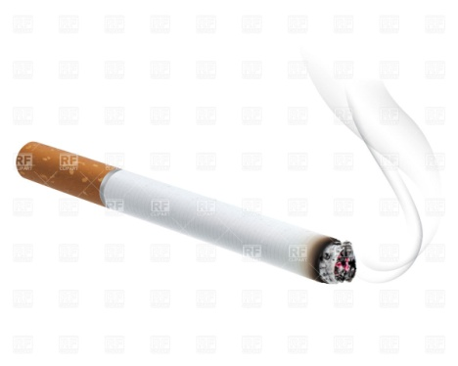
The cigarette
Monday 24th June
6 pm

Slide 5
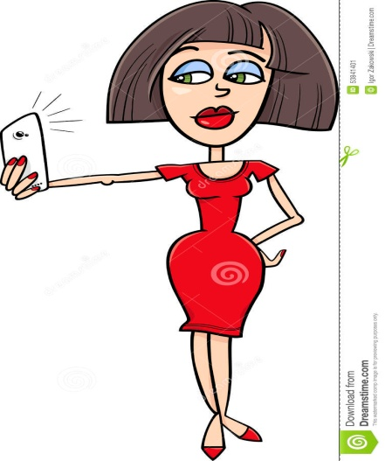
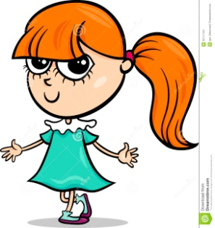
Honey, what are you doing?
Mum, why did you throw your cigarette to the pavement?
I am picking up the cigarette and I will throw it to the bin.
Tiffany, don’t touch it or else I will be very angry!
Let’s go!
But…

Slide 6
The hose
Tuesday 25th June
6 pm

Slide 7
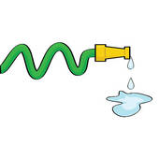
I think I will clean up the balconies.
Not of course.I will do it with the hose.
Shall I bring you the mop?
Mum, do you know how many litres more we waste with the hose?
Darling, we have got money!
w
What a stupid idea to mop the balcony!

Slide 8
The factory
Wednesday 26th June
6 pm

Slide 9
Mum, why don’t you put filters in the chimneys?
Why should we do that?
Oh, Tiff that’s a big lie, they just want to close our factory.
Close your mouth, you don’t know anything about business!
So we can reduce air pollution!
But mum…

Slide 10
THE END
Who’s doing the right thing?

