Slide 1
Acronym
1. IS RECYCLING FRENDLY FOR OUR EARTH?
2.THE FOREST.
3.WE MUST RECYCLE DAY.
4.WE CAN THROW RUBBISH BINS.
5. RE-USE REDUCE
6.WE THE LIGHTS.
7. WE RECYCLE PLASTIC,GLASS AND
8.WE STOP THE POLLUTION OF EARTH.
9. WE ‘D RATHER HAVE A SHOWER WITHOUT LEAVING THE RUNNING WHILE SHAMROOING.
10.WE SPEND A LOT OF IN ONE YEAR.
11.THE PROBLEM WITH THE RUBBISH IS A BIG

Slide 2
E
N
V
I
R
O
N
M
E
N
T
A
L
L
Y
N
A
T
U
R
E
E
V
E
R
Y
L
I
T
T
E
R
R
E
C
Y
C
L
E
T
U
R
N
O
F
F
C
A
N
S
M
A
N
A
G
E
W
A
T
E
R
E
N
E
R
G
Y
T
H
R
E
A
T

Slide 3
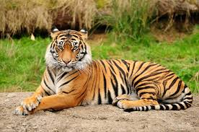
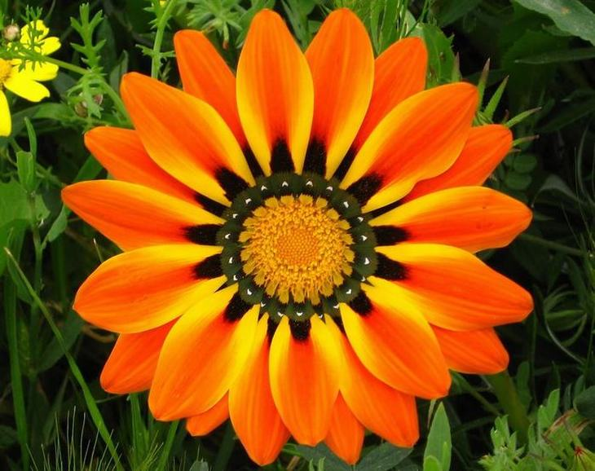
S.O.S. SAVE OUR EARTH
DON’T THROW RUBBISH
DON’T POLLUTE THE AIR!
PROTECT THE ANIMALS
PROTECT THE PLANTS
REDUCE,REUSE,RECYCLE
YES!!!!!!

Slide 4
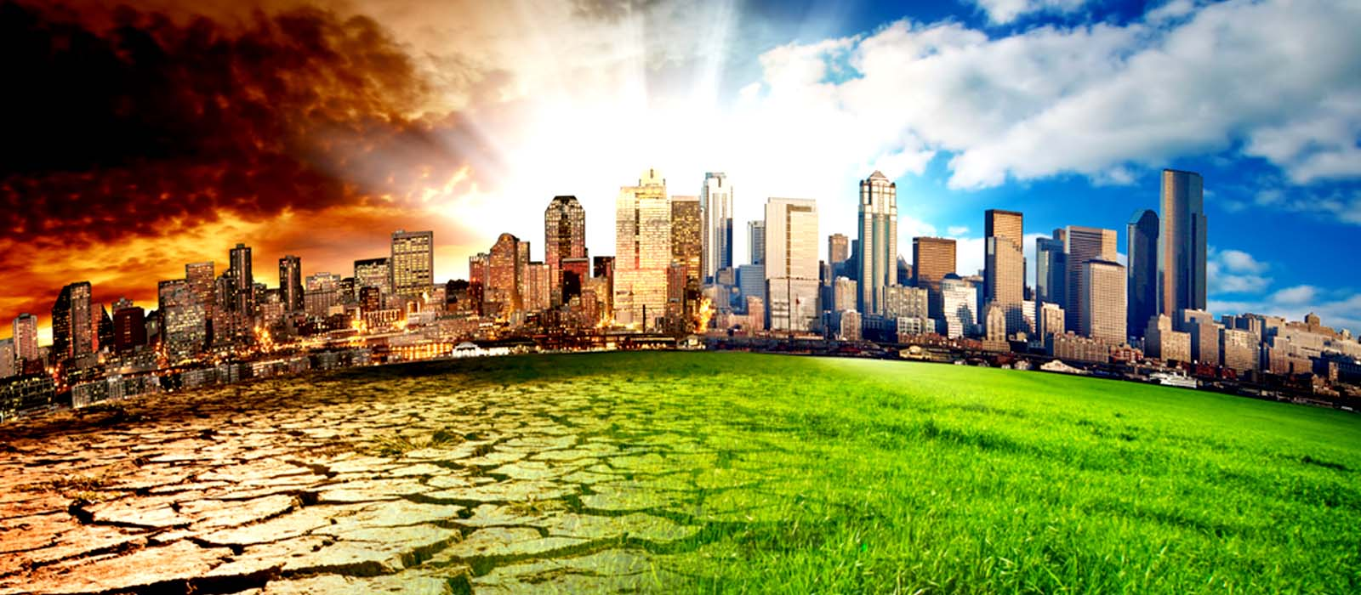
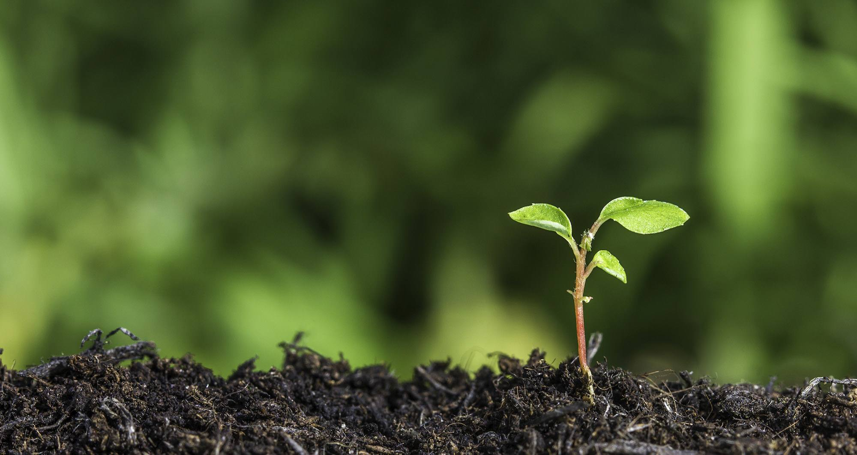
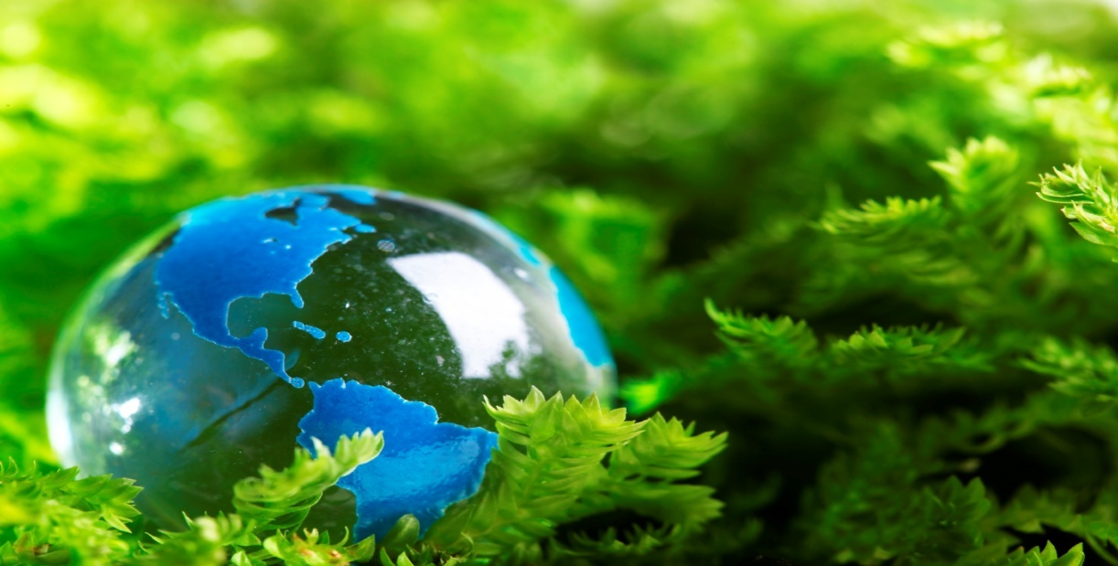
ΑΝΑΣΤΑΣΙΑ ΣΠΑΝΟΥ ΜΑΡΙΑ ΠΗΛΙΑΝΙΔΟΥ Ε2 3/5/2017

